Slide 1
Solvency Ratios

Slide 2
Ratio Analysis
Solvency Ratios
Solvency ratios measure the ability of a company to survive over a long period of time.
Debt to total assets and times interest earned are two ratios that provide information about debt-paying ability.
SO 5 Identify and compute ratios used in analyzing a firm’s liquidity, profitability, and solvency.

Slide 3
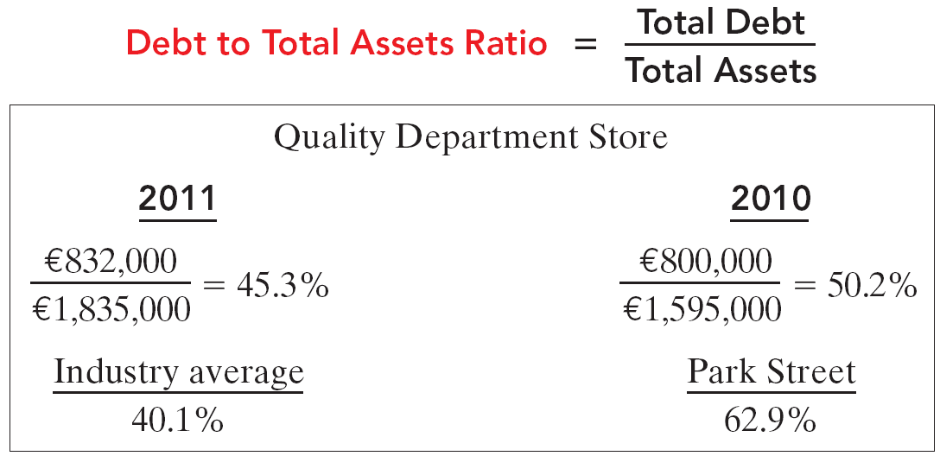
Solvency Ratios
Ratio Analysis
Measures the percentage of the total assets that creditors provide.
SO 5 Identify and compute ratios used in analyzing a firm’s liquidity, profitability, and solvency.

Slide 4
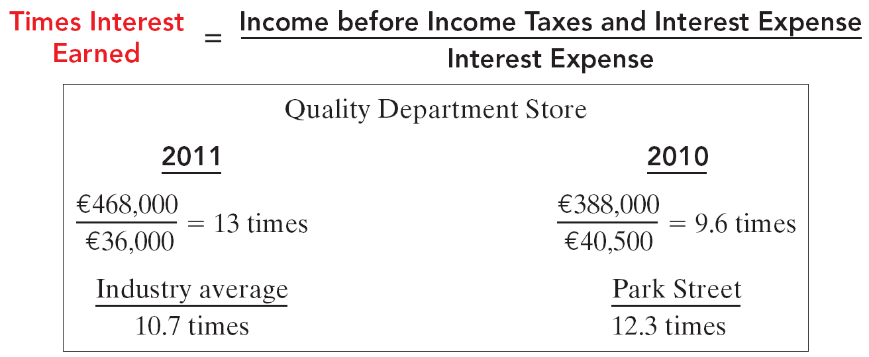
Solvency Ratios
Ratio Analysis
Provides an indication of the company’s ability to meet interest payments as they come due.
SO 5 Identify and compute ratios used in analyzing a firm’s liquidity, profitability, and solvency.

Slide 5
Solvency Ratios
Ratio Analysis
Illustration 14-27
Summary of solvency ratios
SO 5 Identify and compute ratios used in analyzing a firm’s liquidity, profitability, and solvency.

