Slide 1



WILEY
IFRS EDITION
Prepared by
Coby Harmon
University of California, Santa Barbara
Westmont College

Slide 2
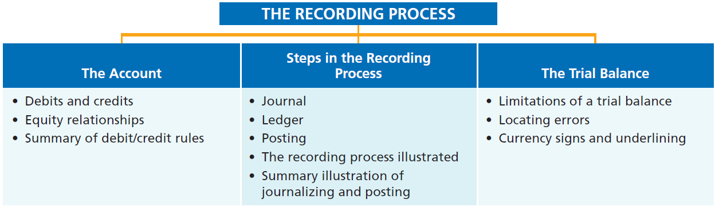
PREVIEW OF CHAPTER 2
Financial Accounting
IFRS 3rd Edition
Weygandt ● Kimmel ● Kieso

Slide 3
CHAPTER
2
The Recording Process
LEARNING OBJECTIVES
After studying this chapter, you should be able to:
Explain what an account is and how it helps in the recording process.
Define debits and credits and explain their use in recording business transactions.
Identify the basic steps in the recording process.
Explain what a journal is and how it helps in the recording process.
Explain what a ledger is and how it helps in the recording process.
Explain what posting is and how it helps in the recording process.
Prepare a trial balance and explain its purposes.

Slide 4
The Account
Learning Objective 1 Explain what an account is and how it helps in the recording process.
Record of increases and decreases in a specific asset, liability, stockholders’ equity, revenue, or expense item.
Debit = “Left”
Credit = “Right”
An account can be illustrated in a T-account form.
LO 1

Slide 5
Debits and Credits
Learning Objective 2 Define debits and credits and explain their use in recording business transactions.
DEBIT AND CREDIT PROCEDURES
Double-entry system
  Each transaction must affect two or more
  accounts to keep the basic accounting
  equation in balance.
  Recording done by debiting at least one account and crediting at least one other account.
  DEBITS must equal CREDITS.
LO 2

Slide 6
Debits and Credits
If the sum of Debit entries are greater than the sum of Credit entries, the account will have a debit balance.
Transaction #1
$10,000
$3,000
Transaction #2
Transaction #3
8,000
Balance
$15,000
LO 2

Slide 7
Debits and Credits
If the sum of Credit entries are greater than the sum of Debit entries, the account will have a credit balance.
Transaction #1
$10,000
$3,000
Transaction #2
8,000
Transaction #3
Balance
$1,000
LO 2

Slide 8
Debits and Credits
Assets - Debits should exceed credits.
Liabilities – Credits should exceed debits.
Normal balance is on the increase side.
LO 2

Slide 9
Debits and Credits
Issuance of share capital and revenues increase equity (credit).
Dividends and expenses decrease equity (debit).
LO 2

Slide 10

Debits and Credits
The purpose of earning revenues is to benefit the shareholders.
The effect of debits and credits on revenue accounts is the same as their effect on equity.
Expenses have the opposite effect: expenses decrease equity.
LO 2

Slide 11
Debits and Credits
Normal Balance Debit
Normal Balance Credit
LO 2

Slide 12
Summary of Debit/Credit Rules
Statement of Financial Position
Income Statement
Asset
Liability
+
-
=
Equity
Revenue
Expense
Debit
Credit
LO 2

Slide 13
Summary of Debit/Credit Rules
Question
Debits:
  increase both assets and liabilities.
  decrease both assets and liabilities.
  increase assets and decrease liabilities.
  decrease assets and increase liabilities.
LO 2

Slide 14
Summary of Debit/Credit Rules
Question
Accounts that normally have debit balances are:
  assets, expenses, and revenues.
  assets, expenses, and equity.
  assets, liabilities, and dividends.
  assets, dividends, and expenses.
LO 2

Slide 15
INVESTOR INSIGHT
Keeping Score
The Brothers Elephants (TWN) baseball team probably has these major revenue and expense accounts:
Revenues Expenses
Admissions (ticket sales) Players’ salaries
Concessions Administrative salaries
Television and radio Travel
Advertising Stadium maintenance
Do you think that the Manchester United (GBR) football (soccer) club would be likely to have the same major revenue and expense accounts as Brother Elephants?
LO 2

Slide 16
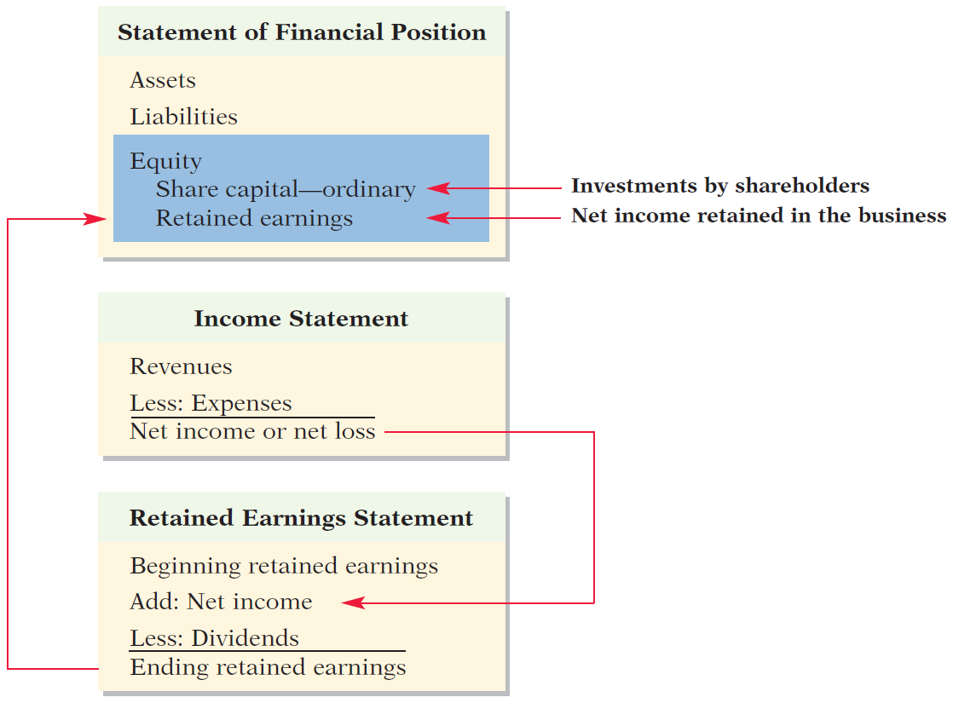
Equity Relationships
Illustration 2-11
Equity relationships
LO 2

Slide 17
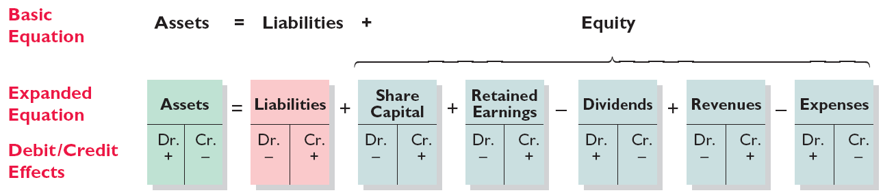
Summary of Debit/Credit Rules
Relationship among the assets, liabilities, and equity of a business:
Illustration 2-12
Summary of debit/credit rules
The equation must be in balance after every transaction. Total Debits must equal total Credits.
LO 2

Slide 18
>
DO IT!
Kate Browne, president of Hair It Is Company SA, has just rented space in a shopping mall in which she will open and operate a beauty salon. A friend has advised Kate to set up a double-entry set of accounting records in which to record all of her business transactions.
Identify the balance sheet accounts that Hair It Is Company will likely use to record the transactions needed to establish and open the business. Also, indicate whether the normal balance of each account is a debit or a credit.
Assets
Liabilities
Equity
Cash (debit)
Supplies (debit)
Equipment (debit)
Notes Payable (credit)
Accounts Payable (credit)
Share Capital—Ordinary
(credit)
LO 2

Slide 19
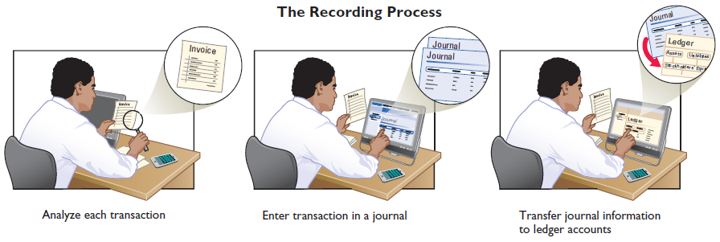
The Account
Learning Objective 3 Identify the basic steps in the recording process.
Business documents, such as a sales receipt, a check, or a bill, provide evidence of the transaction.
Analyze each transaction
Enter transaction in a journal
Transfer journal information to ledger accounts
Illustration 2-13
The recording process
LO 3

Slide 20
Steps in the Recording Process
Learning Objective 4 Explain what a journal is and how it helps in the recording process.
The Journal
Book of original entry.
Transactions recorded in chronological
order.
Contributions to the recording process:
  Discloses the complete effects of a transaction.
  Provides a chronological record of transactions.
  Helps to prevent or locate errors because the debit and credit amounts can be easily compared.
LO 4

Slide 21
The Journal
JOURNALIZING - Entering transaction data in the journal.
Illustration: On September 1, shareholders invested €15,000 cash in the corporation in exchange for ordinary shares, and Softbyte purchased computer equipment for €7,000 cash.
Illustration 2-14
GENERAL JOURNAL
Sept. 1
Cash
15,000
  Share Capital—Ordinary
15,000
Equipment
7,000
  Cash
7,000
LO 4

Slide 22
The Journal
SIMPLE AND COMPOUND ENTRIES
Illustration: On July 1, Tsai Company purchases a delivery truck costing NT$420,000. It pays NT$240,000 cash now and agrees to pay the remaining NT$180,000 on account.
Illustration 2-15
Compound journal entry
GENERAL JOURNAL
July 1
Equipment
420,000
  Cash
240,000
  Accounts Payable
180,000
LO 4

Slide 23
>
DO IT!
As president and sole shareholder, Kate Browne engaged in the following activities in establishing her salon, Hair It Is Company SA.
Opened a bank account in the name of Hair It Is Company SA and deposited €20,000 of her own money in this account in exchange for ordinary shares.
Purchased equipment on account (to be paid in 30 days) for a total cost of €4,800.
Interviewed three applicants for the position of beautician.
Prepare the entries to record the transactions.
LO 4

Slide 24
>
DO IT!
Prepare the entries to record the transactions.
Opened a bank account and deposited €20,000.
Purchased equipment on account (to be paid in 30 days) for a total cost of €4,800.
Interviewed three applicants for the position of beautician.
Cash 20,000
Share Capital—Ordinary 20,000
Equipment 4,800
Accounts Payable 4,800
No entry
LO 4

Slide 25
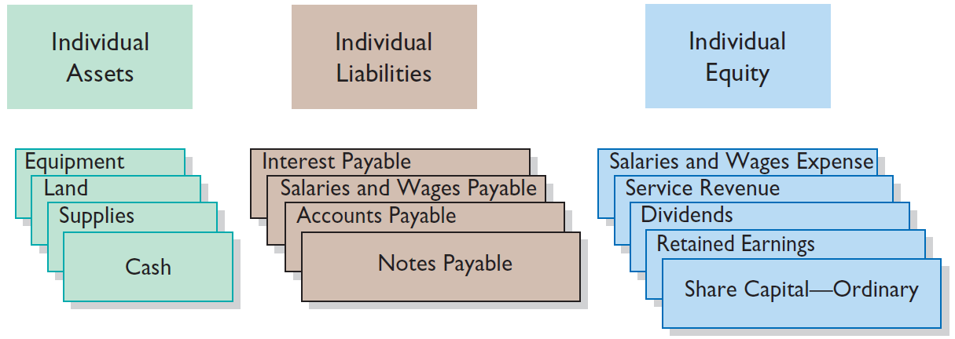
Steps in the Recording Process
Learning Objective 5 Explain what a ledger is and how it helps in the recording process.
The Ledger
General Ledger contains all the asset, liability, and equity accounts.
Illustration 2-16
The general ledger
LO 5

Slide 26
ACCOUNTING ACROSS THE ORGANIZATION
Wal-Mart Stores, Inc. (USA)
What Would Sam Do?
In his autobiography, Sam Walton described the double-entry accounting system he used when Wal-Mart Stores, Inc. (USA) was just getting started: “We kept a little pigeonhole on the wall for the cash receipts and paperwork of each [Wal-Mart] store. I had a blue binder ledger book for each store. When we added a store, we added a pigeonhole. We did this at least up to twenty stores. Then once a month, the bookkeeper and I would enter the merchandise, enter the sales, enter the cash, and balance it.” Today, the company operates more than 7,000 stores worldwide under various names. That’s a lot of “pigeonholes.”
Source: Sam Walton, Made in America (New York: Doubleday, 1992), p. 53.
LO 5

Slide 27
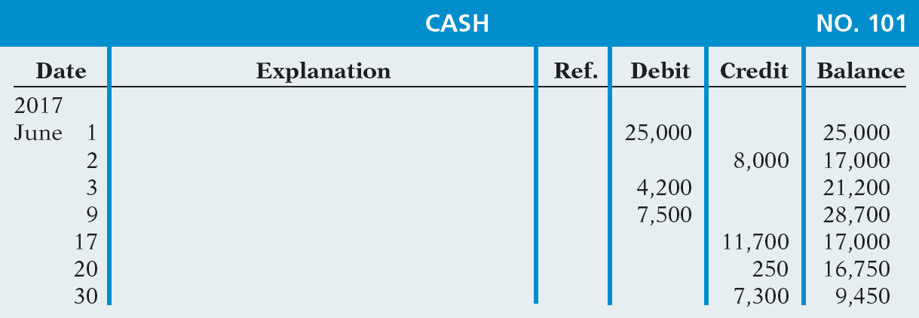
The Ledger
STANDARD FORM OF ACCOUNT
Illustration 2-17
Three-column form of account
LO 5

Slide 28
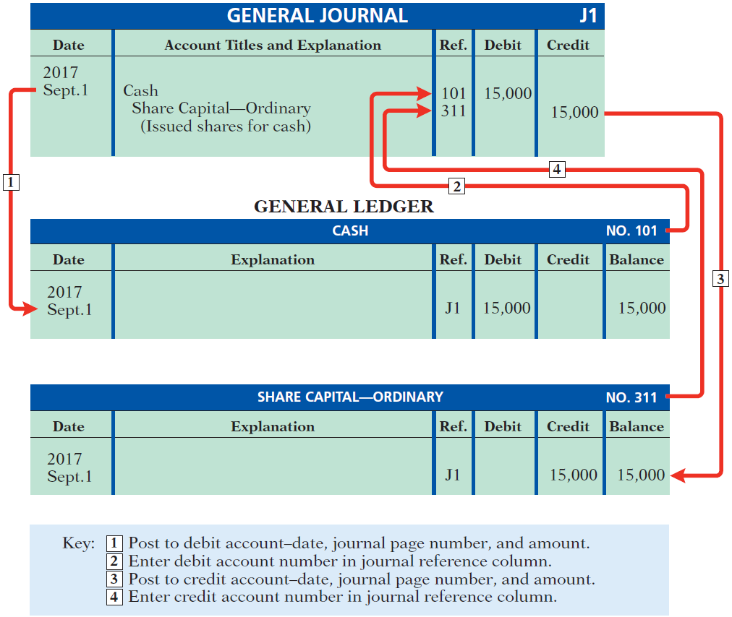
Posting
Learning Objective 6 Explain what posting is and how it helps in the recording process.
Transferring journal entries to the ledger accounts.
Illustration 2-18
Posting a journal entry
LO 6

Slide 29
Posting
Question
Posting:
  normally occurs before journalizing.
  transfers ledger transaction data to the journal.
  is an optional step in the recording process.
  transfers journal entries to ledger accounts.
LO 6

Slide 30
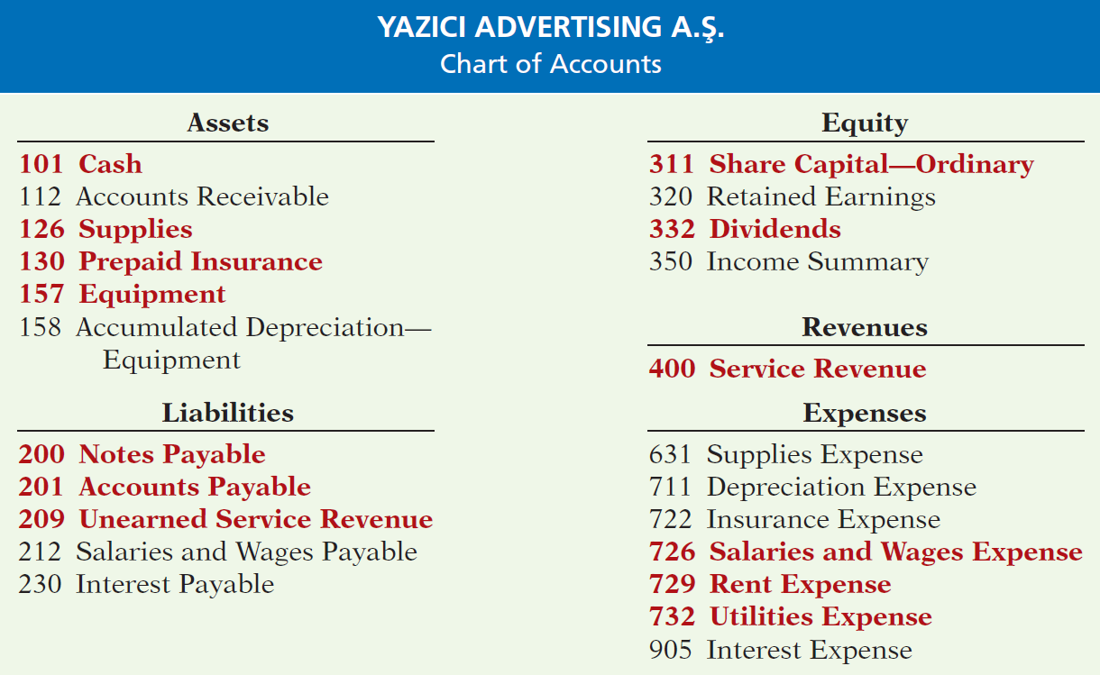
Illustration 2-19
Chart of accounts for Yazici Advertising A.S¸ .
LO 6

Slide 31
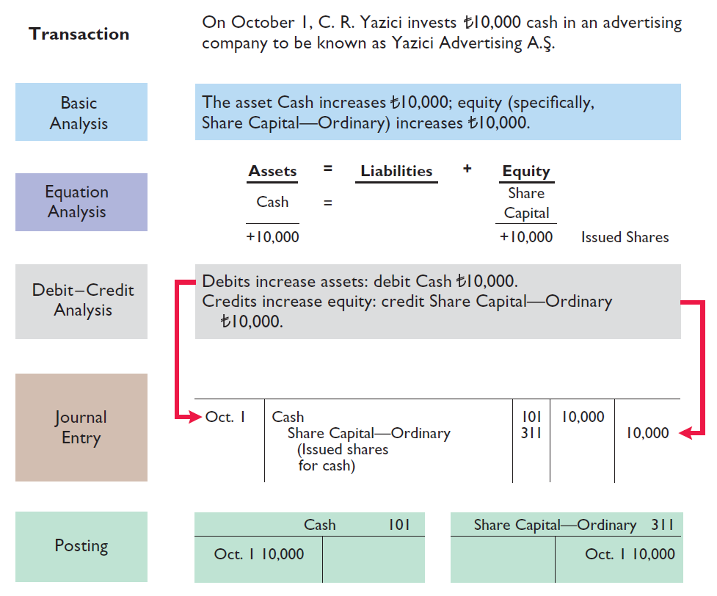
The Recording Process Illustrated
Follow these steps:
1. Determine what type of account is involved.
2. Determine what items increased or decreased and by how much.
3. Translate the increases and decreases into debits and credits.
Illustration 2-20
Investment of cash by shareholders
LO 6

Slide 32
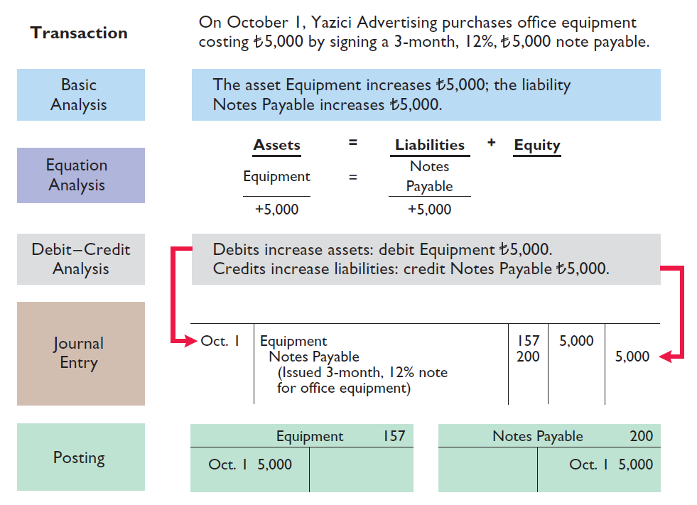
Illustration 2-21
Purchase of office equipment
LO 6

Slide 33
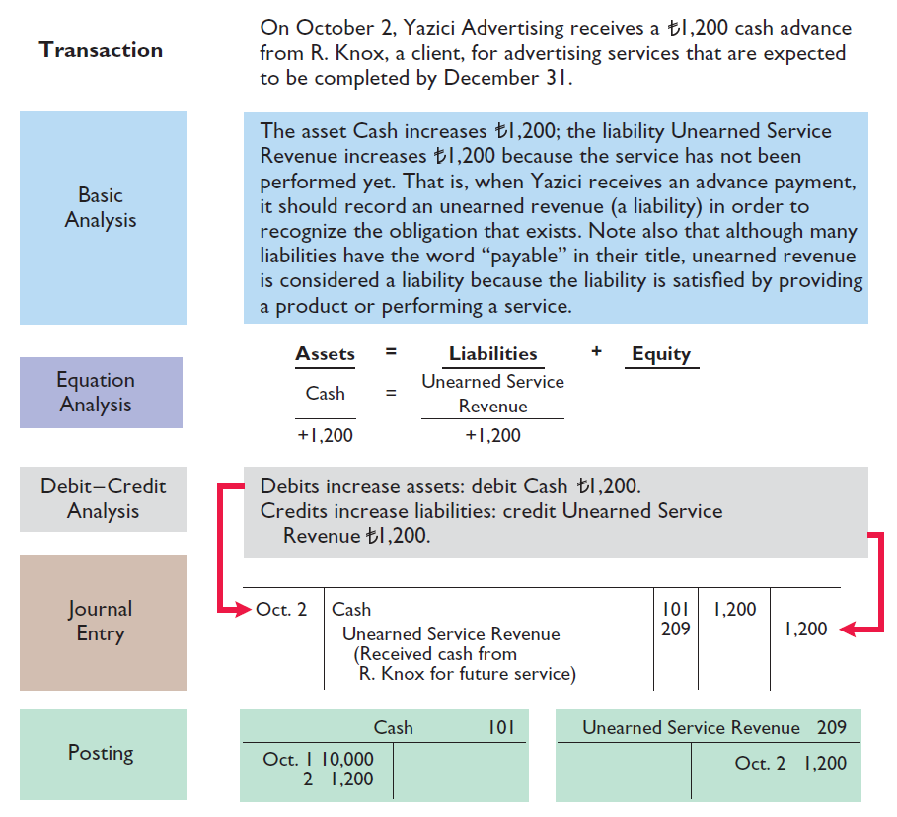
Illustration 2-22
Receipt of cash for future service
LO 6

Slide 34
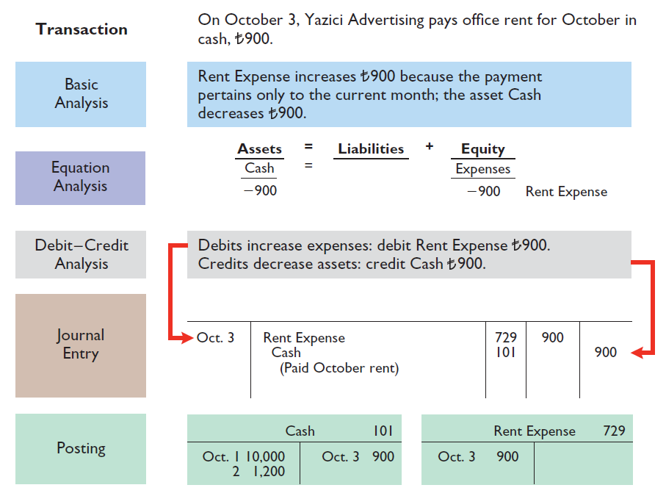
Illustration 2-23
Payment of monthly rent
LO 6

Slide 35
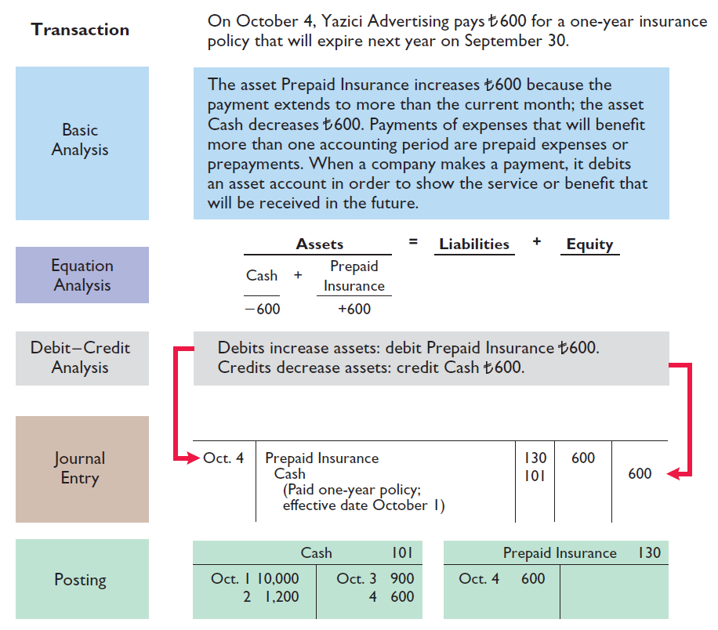
Illustration 2-24
Payment for insurance
LO 6

Slide 36
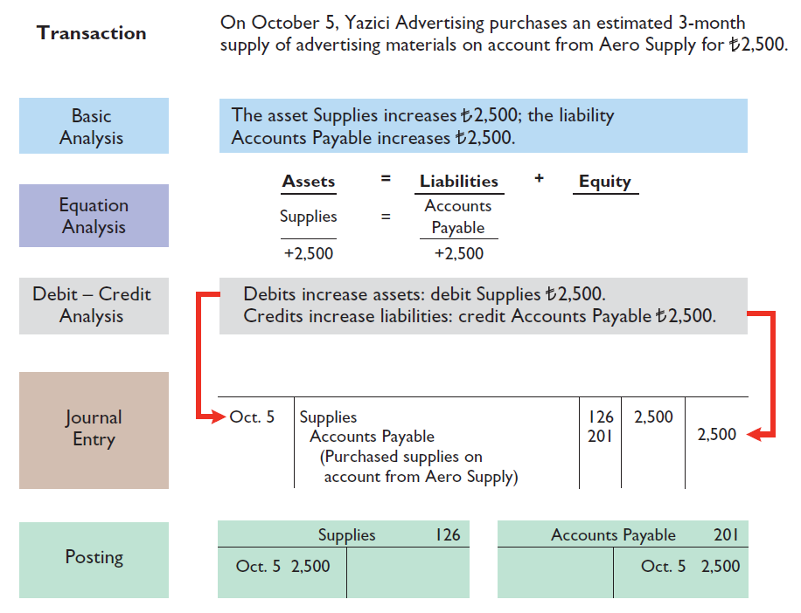
Illustration 2-25
Purchase of supplies on credit
LO 6

Slide 37
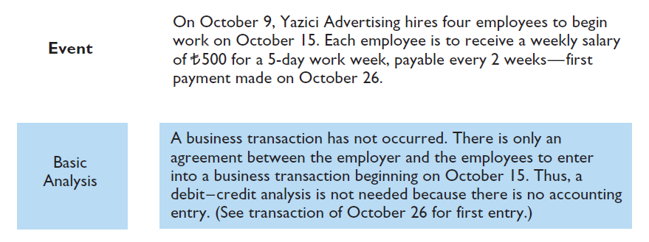
The Recording Process Illustrated
Illustration 2-26
Hiring of employees
LO 6

Slide 38
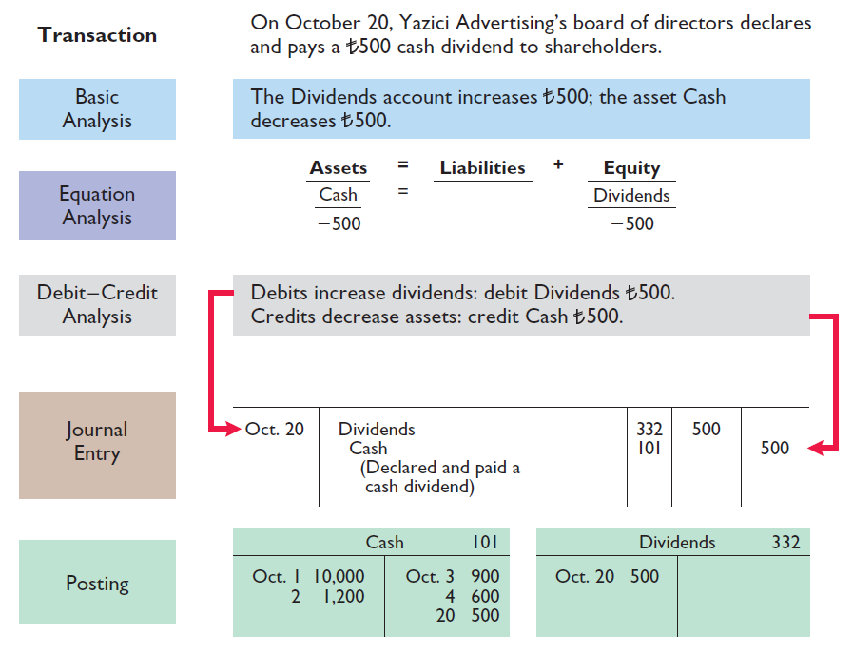
Illustration 2-27
Declaration and payment of dividend
LO 6

Slide 39
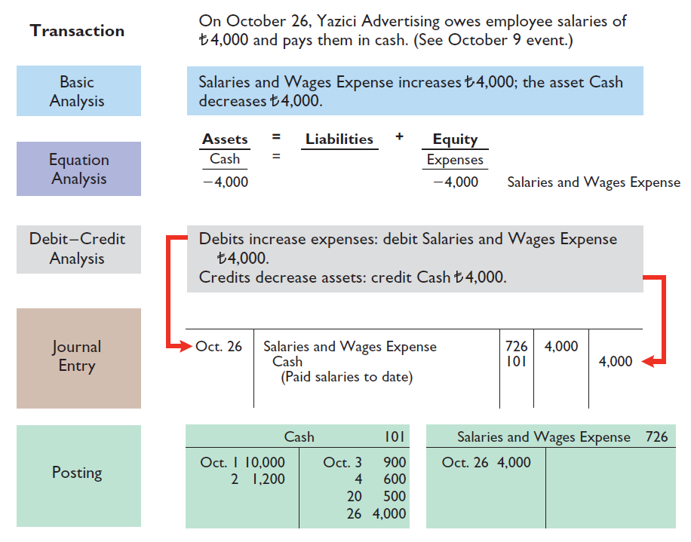
Illustration 2-28
Payment of salaries
LO 6

Slide 40
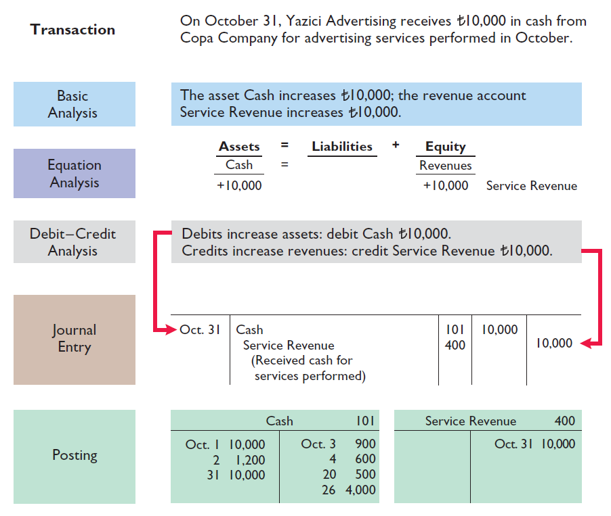
Illustration 2-29
Receipt of cash for services performed
LO 6

Slide 41
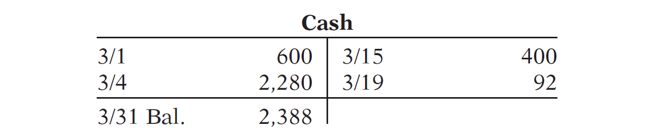
>
DO IT!
Como Company SpA recorded the following transactions in a general journal during the month of March. Post these entries to the Cash account.
Mar. 4 Cash 2,280
Service Revenue 2,280
15 Salaries and Wages Expense 400
Cash 400
19 Utilities Expense 92
Cash 92
LO 6

Slide 42
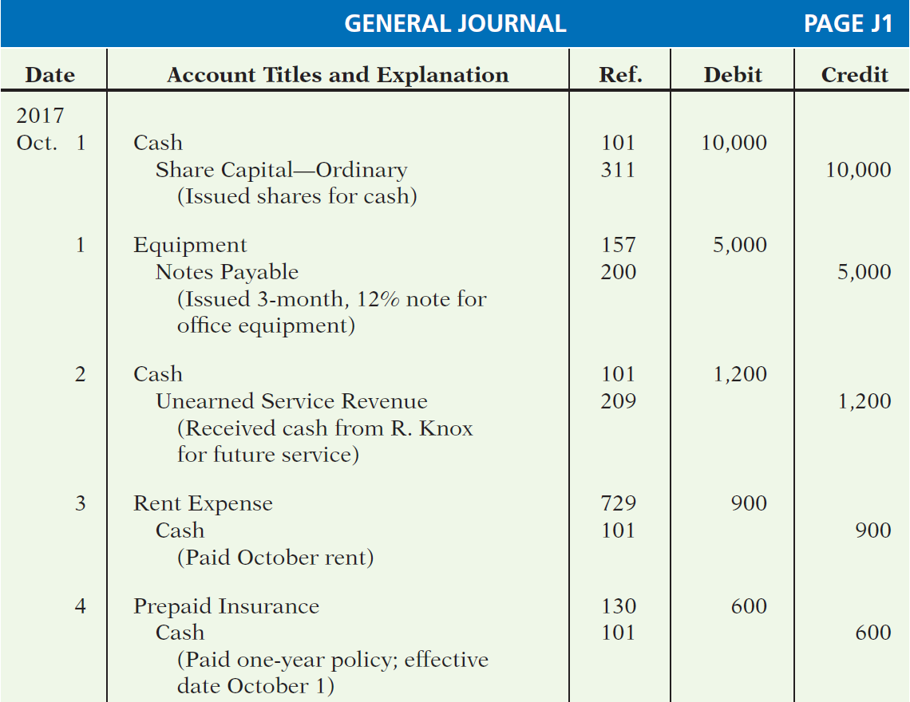
Illustration 2-30
General journal entries
LO 6

Slide 43
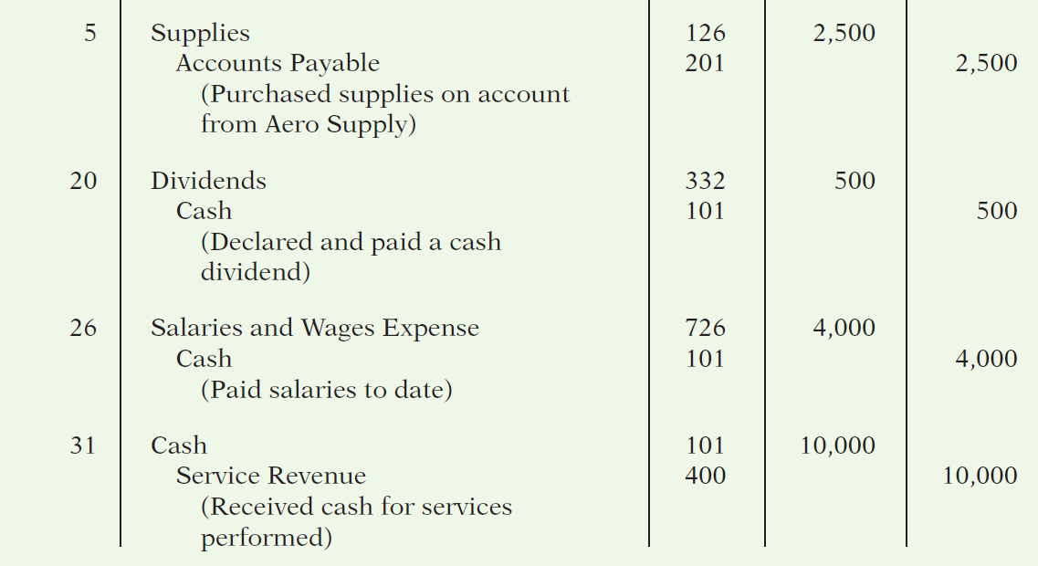
Illustration 2-30
General journal entries
LO 6

Slide 44
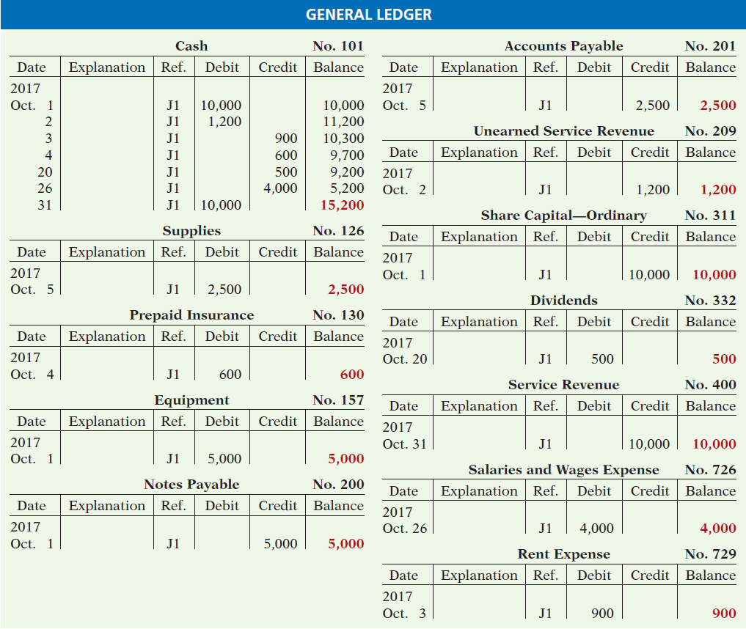
Illustration 2-31
General ledger
LO 6

Slide 45
The Trial Balance
Learning Objective 7 Prepare a trial balance and explain its purposes.
A trial balance
  is a list of accounts and their balances
  at a given time.
  proves the mathematical equality of debits and credits after posting.
  The steps for preparing a trial balance are:
  List the account titles and their balances.
  Total the debit and credit columns.
  Prove the equality of the two columns.
LO 7

Slide 46
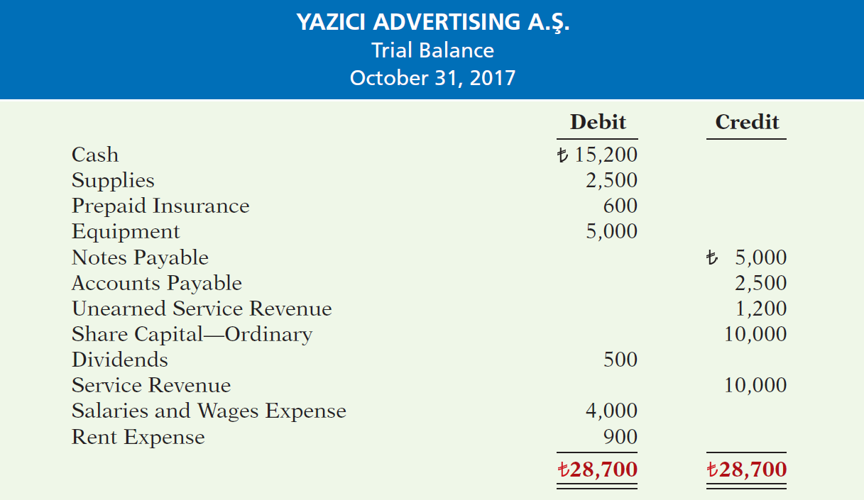
Trial Balance
Illustration 2-32
A trial balance
LO 7

Slide 47
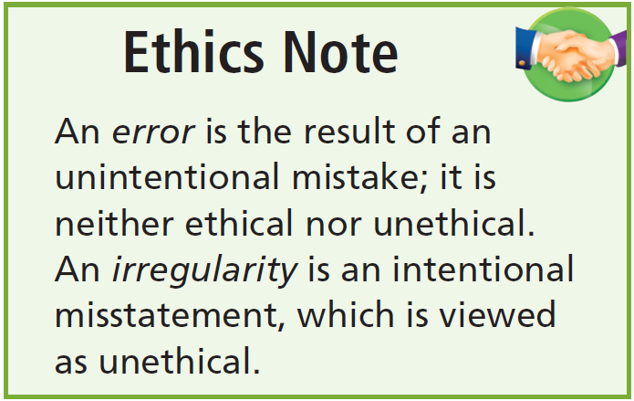
Limitations of a Trial Balance
Trial balance may balance even when:
  A transaction is not journalized.
  A correct journal entry is not posted.
  A journal entry is posted twice.
  Incorrect accounts are used in journalizing or posting.
  Offsetting errors are made in recording the amount of a transaction.
LO 7

Slide 48
Currency Signs and Underlining
Currency Signs
Do not appear in journals or ledgers.
Typically used only in the trial balance and the financial statements.
Shown only for the first item in the column and for the total of that column.
Underlining
A single line is placed under the column of figures to be added or subtracted.
Totals are double-underlined.
LO 7

Slide 49
INVESTOR INSIGHT
Why Accuracy Matters
Recently, the German Finance minister, Wolfgang Schauble, said that “statistical and communication problems” were to blame for a €55.5 billion error in the accounts of nationalized property lender Hypo Real Estate Holding (DEU). Mr. Schauble referred to the error as “an annoying mistake.” This seems to be a considerable understatement considering that the error represented 2.6% of the German gross domestic product. Since the bank had been previously taken over by the German government, the error had resulted in an overstatement of the federal debt of €55.5 billion.)
How could this error have occurred?
LO 7

Slide 50
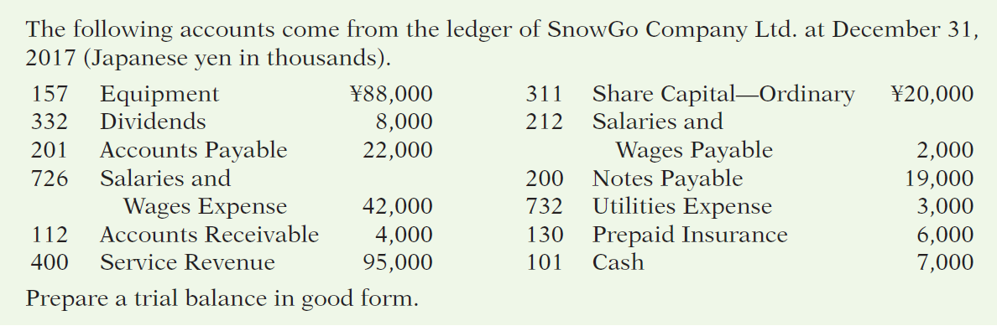
>
DO IT!
LO 7

Slide 51
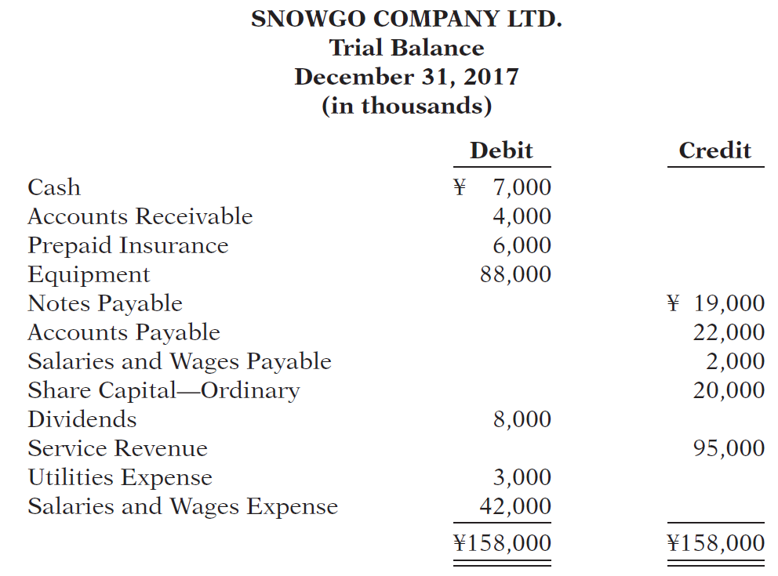
LO 7

Slide 52
A Look at U.S. GAAP
Learning Objective 8
Compare the procedures for the accounting process under IFRS and U.S. GAAP.
Key Points
Both the IASB and FASB go beyond the basic
definitions provided in this textbook for the key
elements of financial statements, that is, assets, liabilities, equity, revenues, and expenses.
In deciding whether the United States should adopt IFRS, some of the issues the U.S. Securities and Exchange Commission (SEC) said should be considered are:
  Whether IFRS is sufficiently developed and consistent in application.
  Whether the IASB is sufficiently independent.
  Whether IFRS is established for the benefit of investors.
  The issues involved in educating investors about IFRS.
  The impact of a switch to IFRS on U.S. laws and regulations.
  The impact on companies including changes to their accounting systems, contractual arrangements, corporate governance, and litigation.
  The issues involved in educating accountants, so they can prepare statements under IFRS.
LO 8

Slide 53
A Look at U.S. GAAP
  Similarities
  A trial balance under GAAP follows the same format as shown in the textbook.
  As shown in the textbook, currency signs are typically used only in the trial balance and the financial statements. The same practice is followed under GAAP, using the U.S. dollar.
  Differences
  In the United States, equity is often referred to as either shareholders’ equity or stockholders’ equity, and Share Capital—Ordinary is referred to as Common Stock. The statement of financial position is often called the balance sheet in the United States.
  Rules for accounting for specific events sometimes differ across countries. For example, IFRS companies rely less on historical cost and more on fair value than U.S. companies. Despite the differences, the double-entry accounting system is the basis of accounting systems worldwide.
LO 8

Slide 54
A Look at U.S. GAAP
Looking to the Future
  The basic recording process shown in this textbook is followed by companies across the globe. It is unlikely to change in the future. The definitional structure of assets, liabilities, equity, revenues, and expenses may change over time as the IASB and FASB evaluate their overall conceptual framework for establishing accounting standards.
LO 8

Slide 55
A Look at U.S. GAAP
A Look at IFRS
IFRS Self-Test Questions
Which statement is correct regarding GAAP?
  GAAP reverses the rules of debits and credits, that is, debits are on the right and credits are on the left.
  GAAP uses the same process for recording transactions as IFRS.
  The chart of accounts under GAAP is different because revenues follow assets.
  None of the above statements are correct.
LO 8

Slide 56
A Look at U.S. GAAP
A Look at IFRS
IFRS Self-Test Questions
A trial balance:
  is the same under GAAP and IFRS.
  proves that transactions are recorded correctly.
  proves that all transactions have been recorded.
  will not balance if a correct journal entry is posted twice.
LO 8

Slide 57
A Look at U.S. GAAP
A Look at IFRS
IFRS Self-Test Questions
One difference between GAAP and IFRS is that:
  IFRS uses accrual-accounting concepts, and GAAP uses primarily the cash basis of accounting.
  GAAP uses a different posting process than IFRS.
  IFRS uses more fair value measurements than GAAP.
  the limitations of a trial balance are different between GAAP and IFRS.
LO 8

Slide 58
Copyright
“Copyright © 2016 John Wiley & Sons, Inc. All rights reserved. Reproduction or translation of this work beyond that permitted in Section 117 of the 1976 United States Copyright Act without the express written permission of the copyright owner is unlawful. Request for further information should be addressed to the Permissions Department, John Wiley & Sons, Inc. The purchaser may make back-up copies for his/her own use only and not for distribution or resale. The Publisher assumes no responsibility for errors, omissions, or damages, caused by the use of these programs or from the use of the information contained herein.”

