Slide 1
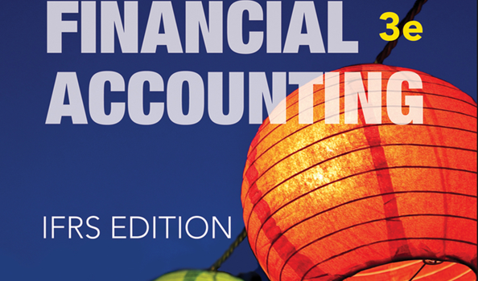
WILEY
IFRS EDITION
Prepared by
Coby Harmon
University of California, Santa Barbara
Westmont College

Slide 2
PREVIEW OF CHAPTER 5
Financial Accounting
IFRS 3rd Edition
Weygandt ● Kimmel ● Kieso

Slide 3
CHAPTER
5
Accounting for Merchandising Operations
LEARNING OBJECTIVES
After studying this chapter, you should be able to:
Identify the differences between service and merchandising companies.
Explain the recording of purchases under a perpetual inventory system.
Explain the recording of sales revenues under a perpetual inventory system.
Explain the steps in the accounting cycle for a merchandising company.
Prepare an income statement for a merchandiser.

Slide 4
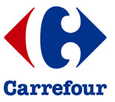
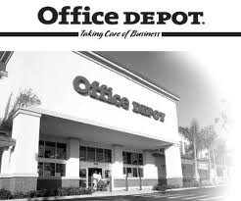
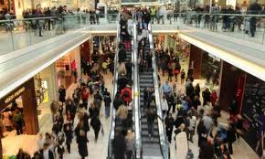
Merchandising Operations
Learning Objective 1
Identify the differences between service and merchandising companies.
Merchandising Companies
Buy and Sell Goods
Retailer
Wholesaler
Consumer
The primary source of revenues is referred to as sales revenue or sales.
LO 1

Slide 5
Merchandising Operations
Income Measurement
Sales
Revenue
Not used in a Service business.
Less
Illustration 5-1
Income measurement process for a merchandising company
Cost of
Goods Sold
Equals
Gross
Profit
Less
Operating
Expenses
Net
Income
(Loss)
Cost of goods sold is the total cost of merchandise sold during the period.
Equals
LO 1

Slide 6
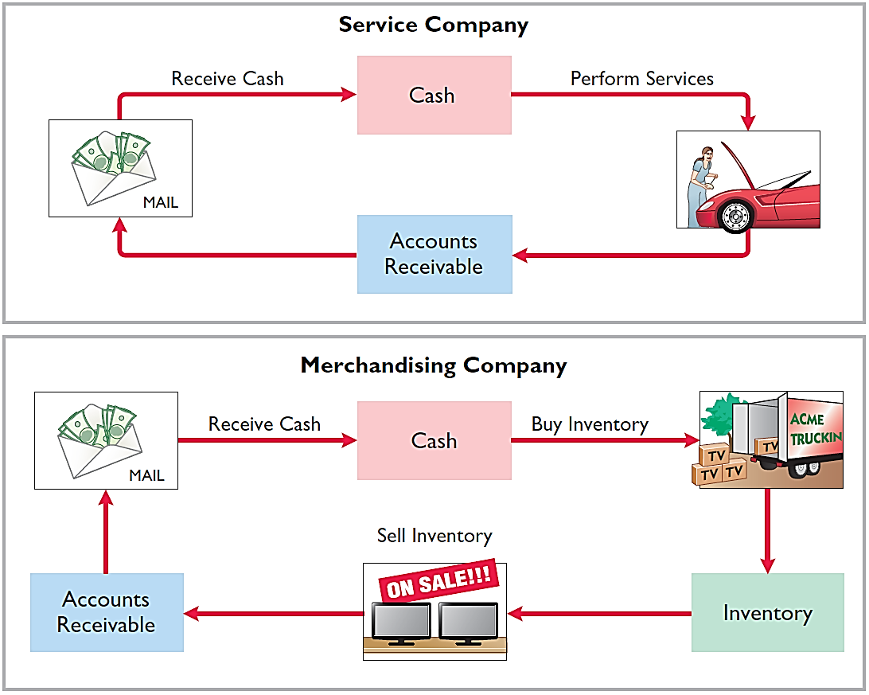
Operating Cycles
The operating cycle of a merchandising company ordinarily is longer than that of a service company.
Illustration 5-2
Illustration 5-3
LO 1

Slide 7
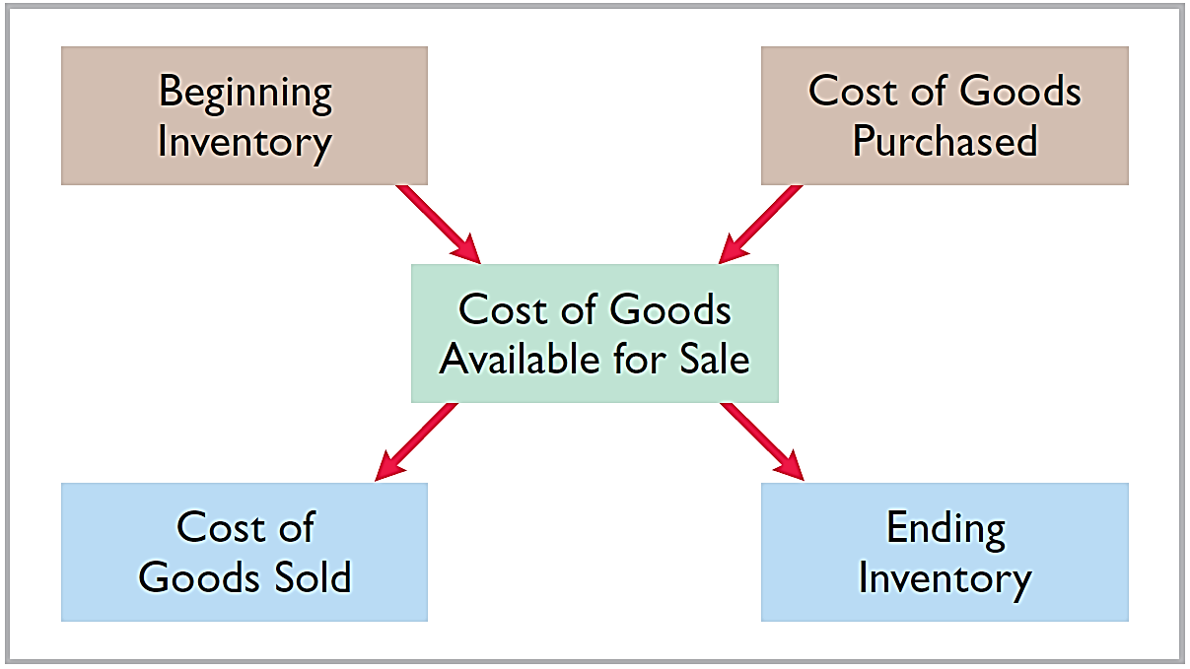
Flow of Costs
Illustration 5-4
Companies use either a perpetual inventory system or a periodic inventory system to account for inventory.
LO 1

Slide 8
Flow of Costs
PERPETUAL SYSTEM
Maintain detailed records of the cost of each inventory purchase and sale.
Records continuously show inventory that should be on hand for every item.
Company determines cost of goods sold each time a sale occurs.
LO 1

Slide 9
Flow of Costs
PERIODIC SYSTEM
Do not keep detailed records of the goods on hand.
Cost of goods sold determined by count at the end of the accounting period.
Calculation of Cost of Goods Sold:
Beginning inventory € 100,000
Add: Purchases, net 800,000
Goods available for sale 900,000
Less: Ending inventory 125,000
Cost of goods sold € 775,000
LO 1

Slide 10
Flow of Costs
ADVANTAGES OF THE PERPETUAL SYSTEM
Traditionally used for merchandise with high unit values.
Shows the quantity and cost of the inventory that should be on hand at any time.
Provides better control over inventories than a periodic system.
LO 1

Slide 11
INVESTOR INSIGHT
Snowboard Company Improves Its Share Appeal
Investors are often eager to invest in a company that has a hot new product. However, when a fast-growing snowboard-maker issued ordinary shares to the public for the first time, some investors expressed reluctance to invest in it because of a number of accounting control problems. To reduce investor concerns, the company implemented a perpetual inventory system to improve its control over inventory. In addition, the company stated that it would perform a physical inventory count every quarter until it felt that its perpetual inventory system was reliable.
LO 1

Slide 12
>
DO IT!
Indicate whether the following statements are true or false.
The primary source of revenue for a merchandising company results from performing services for customers.
The operating cycle of a service company is usually shorter than that of a merchandising company.
Sales revenue less cost of goods sold equals gross profit.
Ending inventory plus the cost of goods purchased equals cost of goods available for sale.
False
True
True
False
LO 1

Slide 13
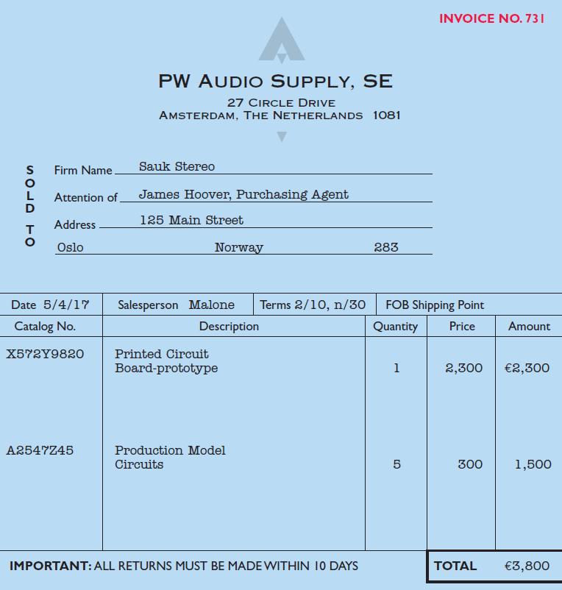
Recording Purchases of Merchandise
Learning Objective 2
Explain the recording of purchases under a perpetual inventory system.
Made using cash or credit (on account).
Normally record when goods are received from the seller.
Purchase invoice should support each credit purchase.
Illustration 5-6
Sales invoice used as purchase
invoice by Sauk Stereo

Slide 14
Recording Purchases of Merchandise
Illustration: Sauk Stereo (the buyer) uses as a purchase invoice the sales invoice prepared by PW Audio Supply, Inc. (the seller). Prepare the journal entry for Sauk Stereo for the invoice from PW Audio Supply.
Illustration 5-6
May 4
Inventory 3,800
Accounts Payable 3,800
LO 2

Slide 15
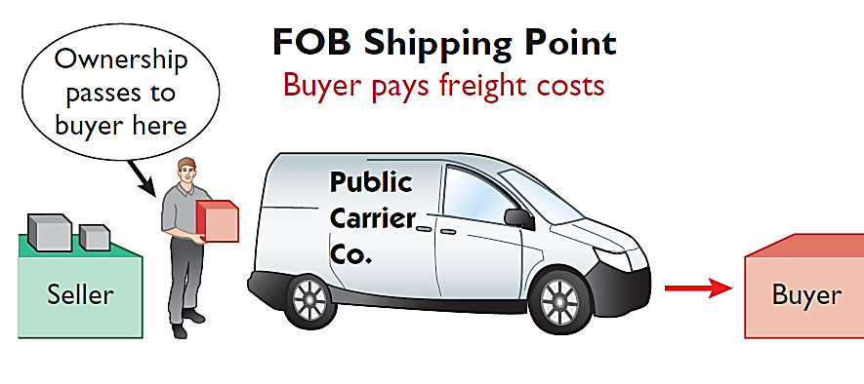
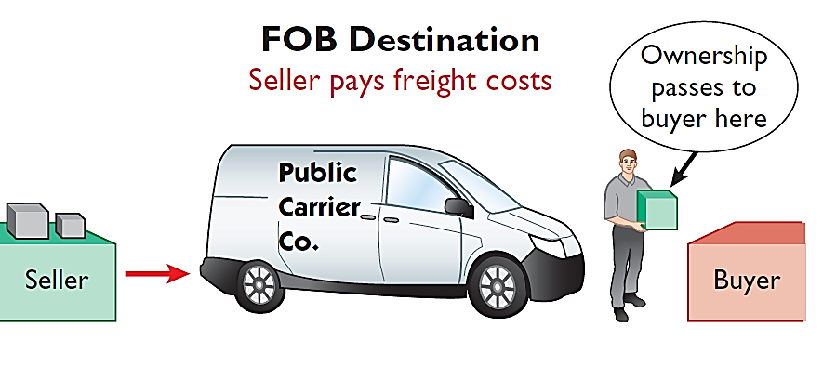
Freight Costs
Ownership of the goods passes to the buyer when the public carrier accepts the goods from the seller.
Ownership of the goods remains with the seller until the goods reach the buyer.
Illustration 5-7 Shipping terms
Freight costs incurred by the seller are an operating expense.
LO 2

Slide 16
Freight Costs
Illustration: Assume upon delivery of the goods on May 6, Sauk Stereo pays Public Freight Company €150 for freight charges, the entry on Sauk Stereo’s books is:
May 6
Inventory 150
Cash 150
Assume the freight terms on the invoice in Illustration 5-6 had required PW Audio Supply to pay the freight charges, the entry by PW Audio Supply would have been:
May 4
Freight-Out (Delivery Expense) 150
Cash 150
LO 2

Slide 17
Purchase Returns and Allowances
Purchaser may be dissatisfied because goods are damaged or defective, of inferior quality, or do not meet specifications.
Purchase Return
Purchase Allowance
Return goods for credit if the sale was made on credit, or for a cash refund if the purchase was for cash.
May choose to keep the merchandise if the seller will grant a reduction from the purchase price.
LO 2

Slide 18
Purchase Returns and Allowances
Illustration: Assume Sauk Stereo returned goods costing €300 to PW Audio Supply on May 8.
May 8
Accounts Payable 300
Inventory 300
LO 2

Slide 19
Purchase Returns and Allowances
Question
In a perpetual inventory system, a return of defective merchandise by a purchaser is recorded by crediting:
Purchases
Purchase Returns
Purchase Allowance
Inventory
LO 2

Slide 20
Purchase Discounts
Credit terms may permit buyer to claim a cash discount for prompt payment.
Advantages:
Purchaser saves money.
Seller shortens the operating cycle by converting the accounts receivable into cash earlier.
Example: Credit terms may read 2/10, n/30.
LO 2

Slide 21
Purchase Discounts
2/10, n/30
1/10 EOM
n/10 EOM
2% discount if paid within 10 days, otherwise net amount due within 30 days.
1% discount if paid within first 10 days of next month.
Net amount due within the first 10 days of the next month.
LO 2

Slide 22
Purchase Discounts
Illustration: Assume Sauk Stereo pays the balance due of €3,500 (gross invoice price of €3,800 less purchase returns and allowances of €300) on May 14, the last day of the discount period. Prepare the journal entry Sauk Stereo makes on May 14 to record the payment.
May 14
Accounts Payable 3,500
Inventory 70
Cash 3,430
(Discount = €3,500 x 2% = €70)
LO 2

Slide 23
Purchase Discounts
Illustration: If Sauk Stereo failed to take the discount, and instead made full payment of €3,500 on June 3, the journal entry would be:
June 3
Accounts Payable 3,500
Cash 3,500
LO 2

Slide 24
Purchase Discounts
Should discounts be taken when offered?
Discount of 2% on €3,500 €70.00
€3,500 invested at 10% for 20 days 19.18
Savings by taking the discount €50.82
Example: 2% for 20 days = Annual rate of 36.5%
€3,500 x 36.5% x 20 ÷ 365 = €70
LO 2

Slide 25
Summary of Purchasing Transactions
4th - Purchase
3,800
300
8th - Return
6th - Freight-in
150
70
14th - Discount
Balance
3,580
LO 2

Slide 26
>
DO IT!
On September 5, Zhu Company buys merchandise on account from Gao Company. The selling price of the goods is ¥15,000, and the cost to Gao Company was ¥8,000. On September 8, Zhu returns defective goods with a selling price of ¥2,000. Record the transactions on the books of Zhu Company.
Sept. 5
Inventory 15,000
Accounts Payable 15,000
Accounts Payable 2,000
Inventory 2,000
Sept. 8
LO 2

