Slide 2


Slide 3
Chapter 14
Financial Statement Analysis
Financial Accounting, IFRS Edition
Weygandt Kimmel Kieso

Slide 4
Study Objectives
Discuss the need for comparative analysis.
Identify the tools of financial statement analysis.
Explain and apply horizontal analysis.
Describe and apply vertical analysis.
Identify and compute ratios used in analyzing a firm’s liquidity, profitability, and solvency.
Understand the concept of earning power, and how discontinued operations are presented.
Understand the concept of quality of earnings.

Slide 5
Financial Statement Analysis
Basics of Financial Statement Analysis
Horizontal and Vertical Analysis
Ratio Analysis
Earning Power and Irregular Items
Quality of Earnings
Need for comparative analysis
Tools of analysis
Statement of financial position
Income statement
Retained earnings statement
Liquidity
Profitability
Solvency
Summary
Discontinued operations
Changes in accounting principle
Comprehensive income
Alternative accounting methods
Pro forma income
Improper recognition

Slide 6
Basics of Financial Statement Analysis
Analyzing financial statements involves:
Characteristics
Comparison
Bases
Tools of
Analysis
Liquidity
Profitability
Solvency
Intracompany
Industry averages
Intercompany
Horizontal
Vertical
Ratio
SO 1 Discuss the need for comparative analysis.
SO 2 Identify the tools of financial statement analysis.

Slide 7
Horizontal Analysis
Horizontal analysis, also called trend analysis
  Technique for evaluating a series of financial statement data over a period of time.
  Purpose is to determine the increase or decrease that has taken place.
  Commonly applied to the statement of financial position, income statement, and statement of retained earnings.
SO 3 Explain and apply horizontal analysis.

Slide 8
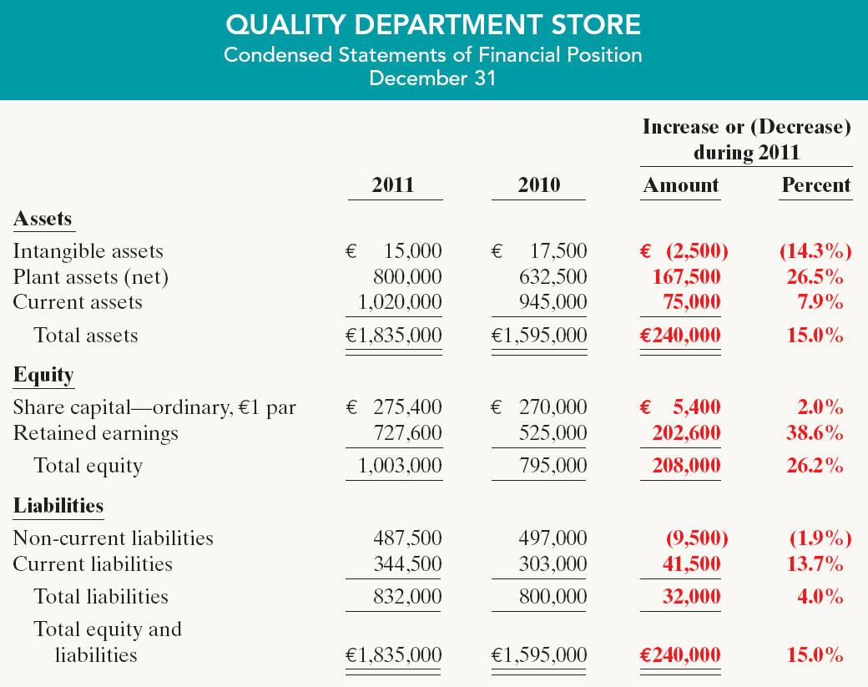
Horizontal Analysis
Statement of Financial Position
These changes suggest that the company expanded its asset base during 2011 and financed this expansion primarily by retaining income rather than assuming additional long-term debt.
Illustration 14-5
SO 3 Explain and apply horizontal analysis.

Slide 9
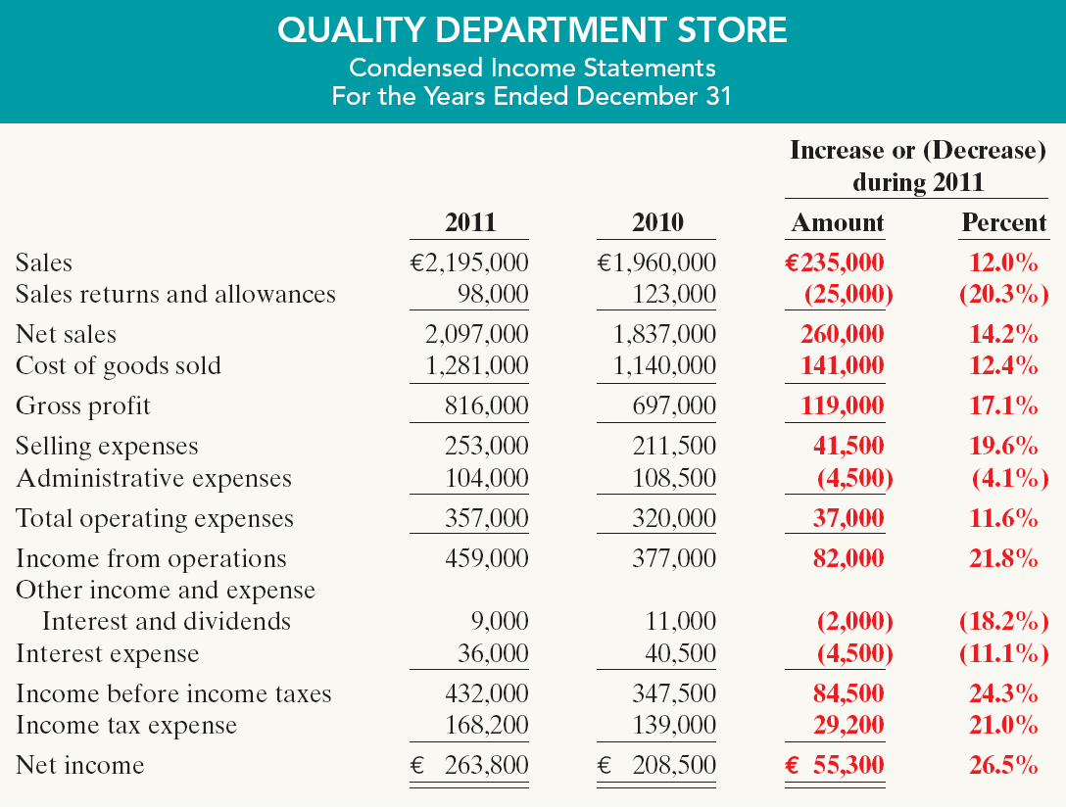
Horizontal Analysis
Income Statement
Overall, gross profit and net income were up substantially. Gross profit increased
17.1%, and net income, 26.5%. Quality’s profit trend appears favorable.
Illustration 14-6
SO 3 Explain and apply horizontal analysis.

Slide 10
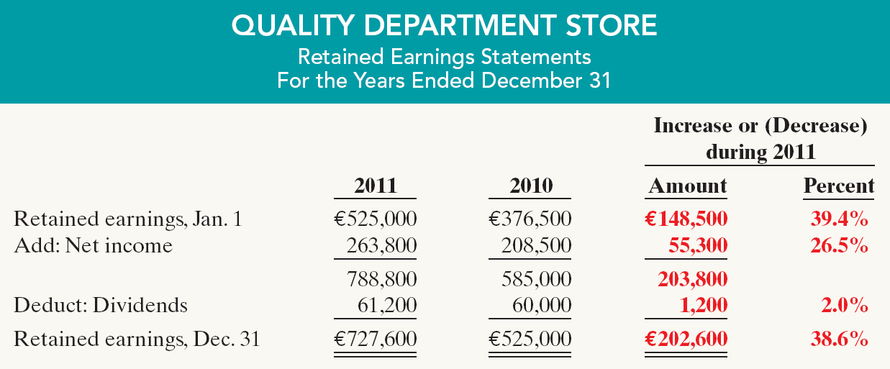
Horizontal Analysis
Retained Earnings Statement
Illustration 14-7
We saw in the horizontal analysis of the statement of financial position that ending retained earnings increased 38.6%. As indicated earlier, the company retained a significant portion of net income to finance additional plant facilities.
SO 3 Explain and apply horizontal analysis.

Slide 11

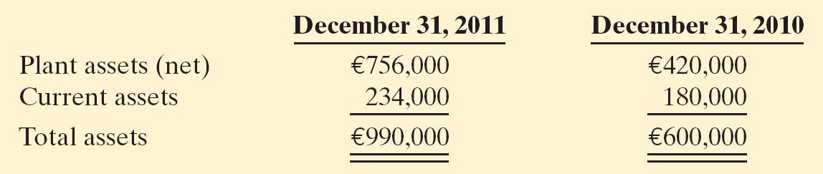
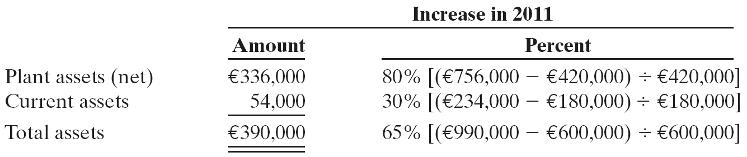
Horizontal Analysis
Illustration: Summary financial information for Rosepatch Company is as follows.
Compute the amount and percentage changes in 2011 using horizontal analysis, assuming 2010 is the base year.
Solution
SO 4 Describe and apply horizontal analysis.

Slide 12
Vertical Analysis
Vertical analysis, also called common-size analysis
  Expresses each financial statement item as a percent of a base amount.
  For example, selling expenses could be expressed as 16% of net sales.
  Commonly applied to the statement of financial position and the income statement.
SO 4 Describe and apply vertical analysis.

Slide 13
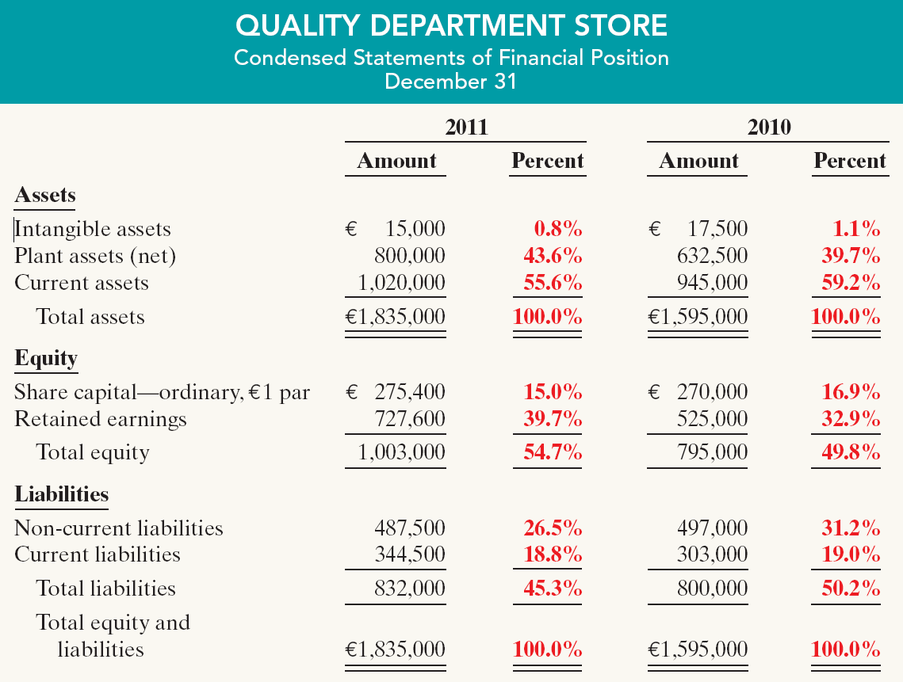
Vertical Analysis
Statement of Financial Position
These results reinforce the earlier observations that Quality is choosing to finance its growth through retention of earnings rather than through issuing additional debt.
Illustration 14-8
SO 4 Describe and apply vertical analysis.

Slide 14
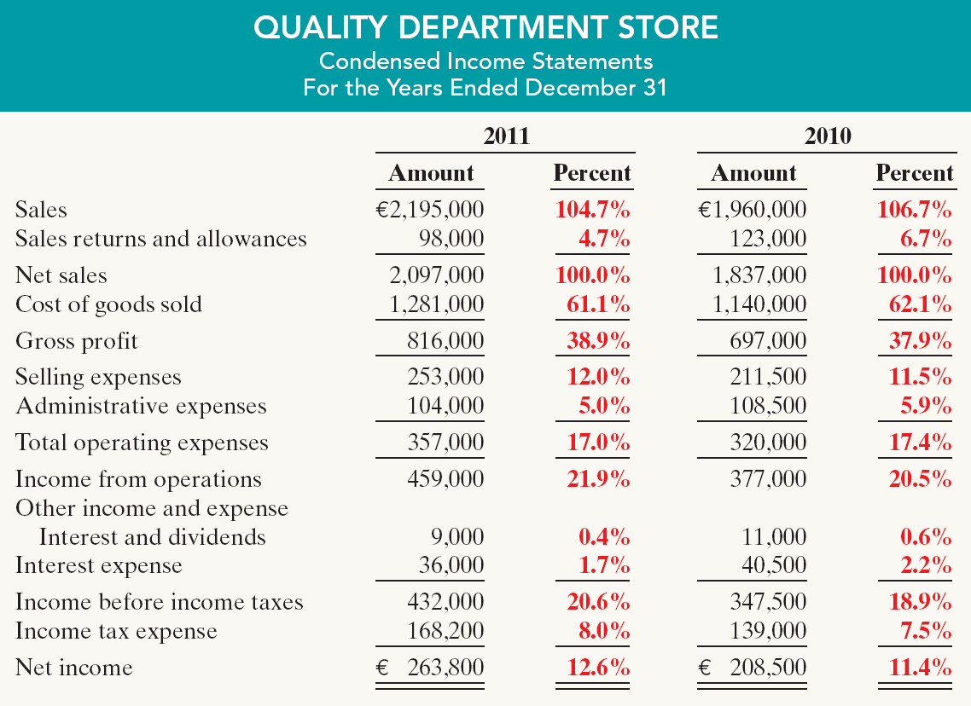
Vertical Analysis
Income Statement
Quality appears
to be a profitable enterprise that is becoming even more successful.
Illustration 14-9
SO 4 Describe and apply vertical analysis.

Slide 15
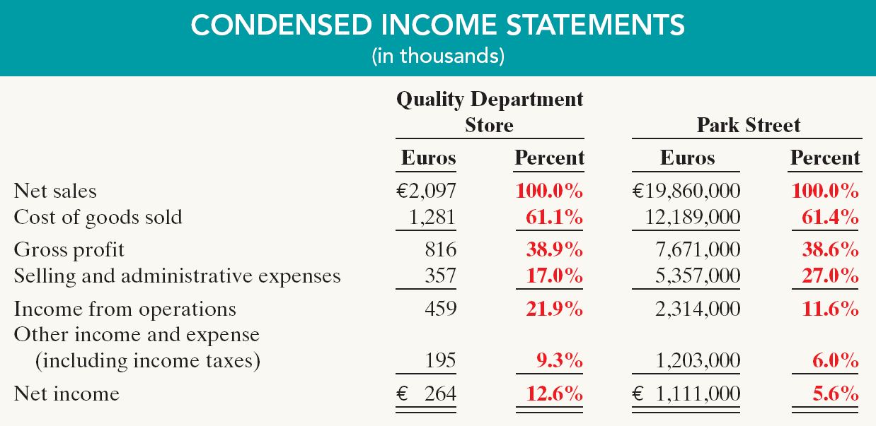
Vertical Analysis
Enables a comparison of companies of different sizes.
Illustration 14-10
Intercompany income statement comparison
Park Street earned net income more than 4,208 times larger than Quality’s, Park Street’s net income as a percent of each sales euro (5.6%) is only 44% of Quality’s (12.6%).
SO 4 Describe and apply vertical analysis.

