Slide 1
Pertemuan 1
Plant Assets,
Natural Resources, and
Intangible Assets

Slide 2
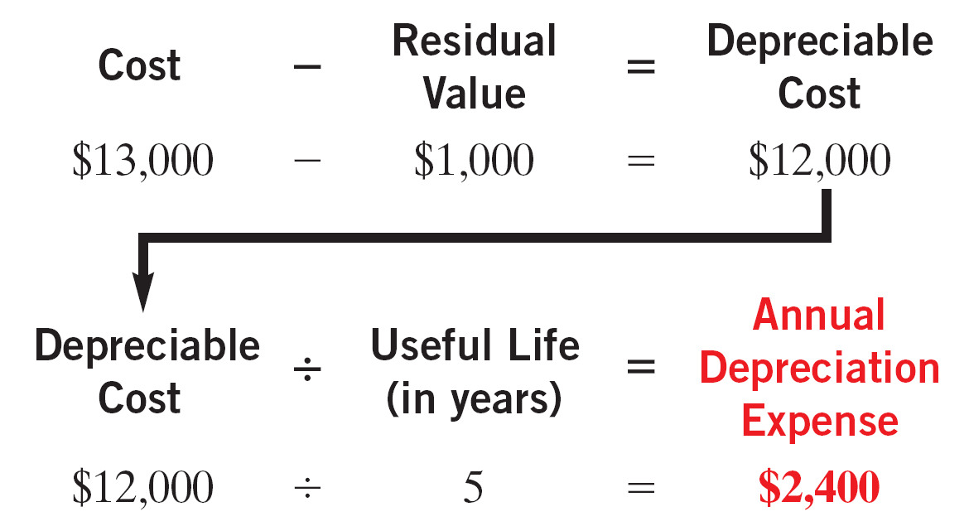
Depreciation
Straight-Line
Expense is same amount for each year.
Depreciable cost - cost of the asset less its residual value.
Illustration 9-8
SO 3 Compute periodic depreciation using different methods.

Slide 3
Depreciation
Illustration: (Straight-Line Method)
Illustration 9-9
2011
$ 12,000
20%
$ 2,400
$ 2,400
$ 10,600
2012
12,000
20
2,400
4,800
8,200
2013
12,000
20
2,400
7,200
5,800
2014
12,000
20
2,400
9,600
3,400
2015
12,000
20
2,400
12,000
1,000
2011 Journal Entry
Depreciation expense 2,400
Accumulated depreciation 2,400
SO 3 Compute periodic depreciation using different methods.

Slide 4
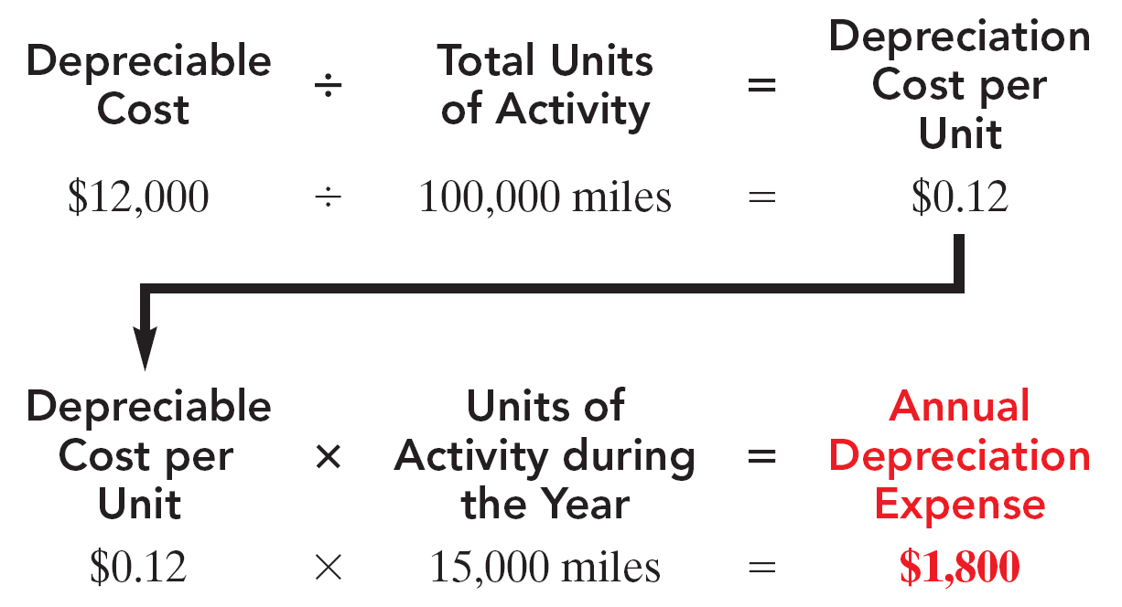
Depreciation
Units-of-Activity
Companies estimate total units of activity to calculate depreciation cost per unit.
Expense varies based on units of activity.
Depreciable cost is cost less residual value.
Illustration 9-10
SO 3 Compute periodic depreciation using different methods.

Slide 5
Depreciation
Illustration: (Units-of-Activity Method)
Illustration 9-11
2011
15,000
$ 0.12
$ 1,800
$ 1,800
$ 11,200
2012
30,000
0.12
3,600
5,400
7,600
2013
20,000
0.12
2,400
7,800
5,200
2014
25,000
0.12
3,000
10,800
2,200
2015
10,000
0.12
1,200
12,000
1,000
2011 Journal Entry
Depreciation expense 1,800
Accumulated depreciation 1,800
SO 3 Compute periodic depreciation using different methods.

Slide 6

Depreciation
Declining-Balance
Decreasing annual depreciation expense over the asset’s useful life.
Declining-balance rate is double the straight-line rate.
Rate applied to book value.
Illustration 9-12
SO 3 Compute periodic depreciation using different methods.

Slide 7
Depreciation
Illustration: (Declining-Balance Method)
Illustration 9-13
2011
13,000
40%
$ 5,200
$ 5,200
$ 7,800
2012
7,800
40
3,120
8,320
4,680
2013
4,680
40
1,872
10,192
2,808
2014
2,808
40
1,123
11,315
1,685
2015
1,685
40
685*
12,000
1,000
2011 Journal Entry
Depreciation expense 5,200
Accumulated depreciation 5,200
* Computation of $674 ($1,685 x 40%) is adjusted to $685.

Slide 8
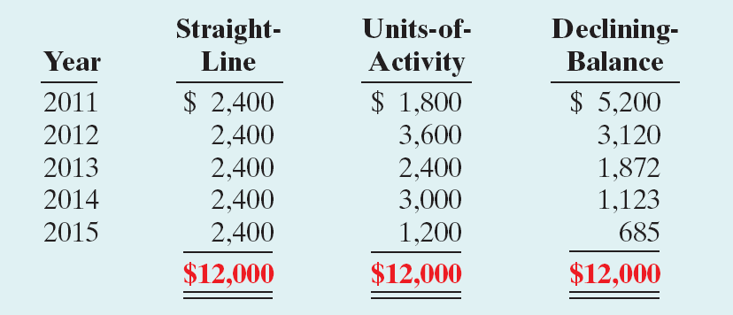
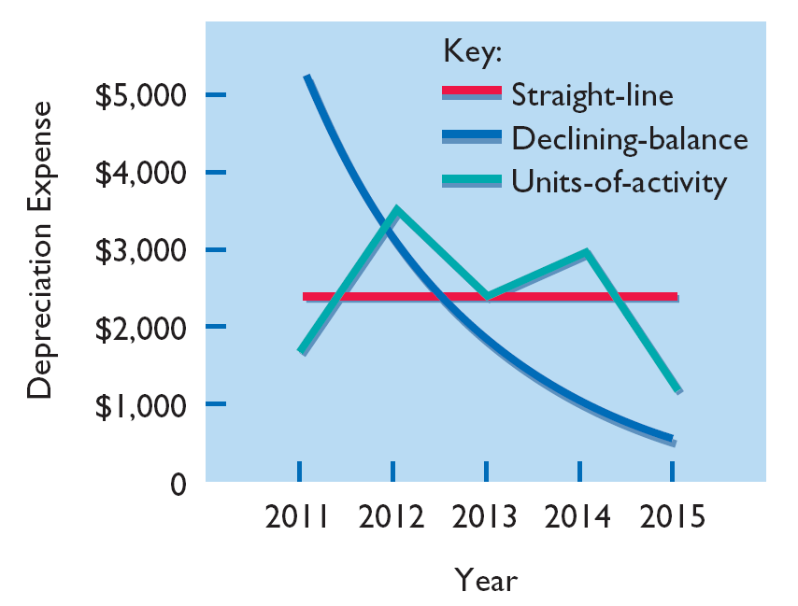
Depreciation
Comparison of Methods
Illustration 9-14
Illustration 9-15
SO 3 Compute periodic depreciation using different methods.

Slide 9
Depreciation
Review Question
Depreciation is a process of:
a. valuation.
b. cost allocation.
c. cash accumulation.
d. appraisal.
SO 3 Compute periodic depreciation using different methods.

