Slide 1
Single Degree of Freedom System Free Vibration
Mata Kuliah : Dinamika Struktur & Pengantar Rekayasa Kegempaan
Kode : CIV – 308
SKS : 3 SKS
Pertemuan - 2

Slide 2
TIU :
Mahasiswa dapat menjelaskan tentang teori dinamika struktur.
Mahasiswa dapat membuat model matematik dari masalah teknis yang ada serta mencari solusinya.
TIK :
Mahasiswa dapat memformulasikan persamaan gerak sistem struktur berderajat kebebasan tunggal yang bergetar bebas

Slide 3
Sub Pokok Bahasan :
Getaran Bebas SDoF Tak Teredam
Frekuensi dan Periode
Getaran Bebas SDoF Dengan Redaman

Slide 4
Undamped SDoF Free-Vibration
A structure is said to be undergoing free vibration when it is disturbed from its static equilibrium position and then allowed to vibrate without any external dynamic excitation.
The differential equation governing free vibration of the systems without damping (c = 0 & p(t) = 0) is :
This equation called second order homogeneous differential equation
u(t)
k
(1)
m

Slide 5
To find the solution of Eq. (1), assuming a trial solution given by :
Where A and B are constants depending on the initiation of the motion while ω is a quantity denoting a physical characteristic of the system.
(2.a)
(2.b)

Slide 6
The substitution eq.(2.a&b) into eq. (1) gives :
If eq.(3) is to be satisfied at any time, the factor in parentheses must be equal to zero, or :
ω_{n} is known as the natural circular frequency of the system (rad/s)
(3)
(4)

Slide 7
Since either eq.(2.a) or (2.b) is a solution of eq.(1), and since the differential equation is linear, the superposition of these two solution is also solution :
The expression for velocity, ú, is :
Constant A and B, will be determined based on initial condition (at t = 0) :
(5)
(6)

Slide 8
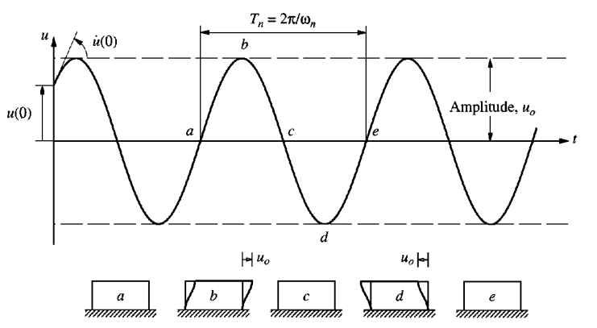
Subject to these initial conditions, the solution to the eq. (5) will be :
T1
(7)

Slide 9
Frequency and Period
The time required for the undamped system to complete one cycle of free vibration is the natural period of vibration, T_{n} (in second)
A system executes 1/T_{n} cycles in 1 sec. This natural cyclic frequency of vibration (in Hz) is denoted by :
(8)
(9)

Slide 10
Exercise
Determine natural frequency and natural period from each system below
W = 2,5 tons
k
EI ∞
E, I, L
W
40x40 cm²
3 m
k
(a)
(b)
E= 23.500 MPa

Slide 11
Assignment 1
If system (b) have initial condition
Determine the displacement at t = 2 sec
Plot a time history of displacement response of the system, for t = 0 s until t = 0,1 s.
W = 2,5 tons
Use Δt = 0,005 s.
T2
EI ∞
3 m
40x40 cm²
(b)
E= 23.500 MPa

Slide 12
Damped SDoF Free-Vibration
If damping is present in the system, the differential equation governing free vibration of the systems is :
The trial solution to satisfy Eq. (14) is
Subtitute Eq. (11) to Eq. (10) yield the characteristic eq. :
(10)
(11)
u(t)
(12)
c
m
k

Slide 13
The roots of the quadratic Eq. (12) are :
Thus the general solution of Eq. (10) is :
Three distinct cases may occur depends on the sign under the radical in Eq. (13)
(13)
(14)

Slide 14
1. Critically Damped System
For critical damping :
The expression under the radical in Eq. (13) is equal to zero, and the roots are equal, they are :
The general solution of Eq. (14) is :
(15)
(16)
(17)

Slide 15
1. Critically Damped System
Constant A and B, will be determined based on initial condition (at t = 0) :
Substitute the initial condition, yield :
(18)

Slide 16
2. Overdamped System
In an overdamped system, the damping coefficient is greater that the value for critical damping (c > c_{cr})
EoM of an overdamped system due to initial condition is :
Where :
ξ is the damping ratio (%)
T3
(19)

Slide 17
3. Underdamped System
When the value of the damping coefficient is less than the critical value (c < c_{cr}), the roots of the characteristic eq. (12) are complex conjugates, so that :
Regarding the Euler’s equations which relate exponential and trigonometric functions :

Slide 18
3. Underdamped System
The substitution of the roots p₁ and p₂ into Eq. (14) together with the use of Euler equation, gives :
Where
Using initial condition,
(20)
T4
(21)

Slide 19
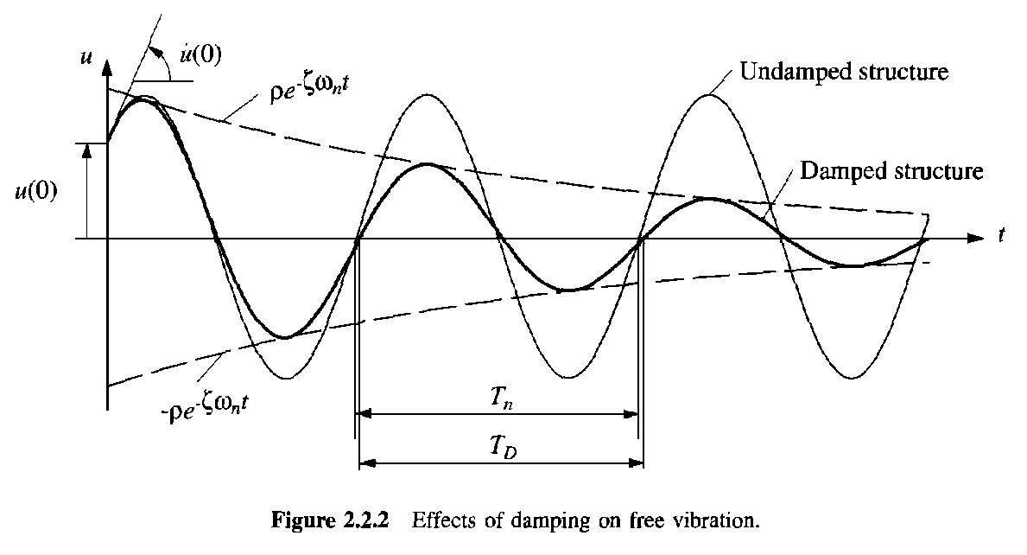
Many types of structures, such as buildings, bridges, dams, nuclear power plants, offshore structures, etc., all fall into underdamped system (c < c_{cr}), because typically their damping ratio is less than 0,10.

Slide 20
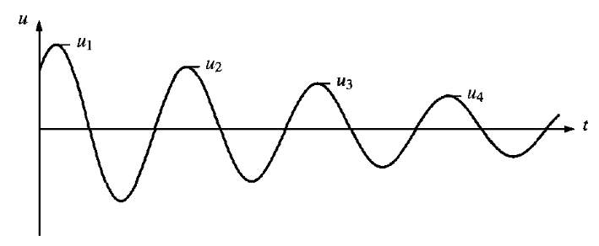
Logarithmic Decrement
The ratio u_{i}/u_{i+1} of successive peaks (maxima) is :
The natural logarithm of this ratio, called the logarithmic decrement,
If ζ is small, this gives an approximate equation : δ ≈ 2πζ
(22)
(23)

Slide 21
Over j cycles the motion decreases from u₁ to u_{j+1}. This ratio is given by :
Therefore,
(24)
(25)

Slide 22
Exercise
A one-story building is idealized as a rigid girder supported by weightless columns. In order to evaluate the dynamic properties of this structure, a free-vibration test is made, in which the roof system (rigid girder) is displaced laterally by a hydraulic jack and then suddenly released.
During the jacking operation, it is observed that a force of 10 kg is required to displace the girder 0.508 cm.
After the instantaneous release of this initial displacement, the maximum displacement on the first return swing is only 0.406 cm and the period of this displacement cycle is T = 1.40 sec.
Weight, W = mg
c
k/2
k/2
Find :
W
f and ω
δ, ξ, c, ω_{D}
u₆

Slide 23
Assignment 2
If system in the figure have initial condition
Plot a time history of displacement response of the system, for t = 0 s until t = 0.2 s, if :
ξ = 5%
ξ = 100%
ξ = 125%
W = 2,5 tons
T1
EI ∞
40x40 cm²
3 m
Use Δt = 0,005 s.
(b)
E= 23.500 MPa

