Slide 1
Introduction to Earthquake Engineering
Mata Kuliah : Dinamika Struktur & Pengantar Rekayasa Kegempaan
Kode : CIV – 308
SKS : 3 SKS
Pertemuan – 9

Slide 2
TIU :
Mahasiswa dapat menjelaskan fenomena-fenomena dinamik secara fisik.
TIK :
Mahasiswa dapat menjelaskan tentang teori kegempaan, terjadinya gempa, pengukuran gelombang gempa

Slide 3
Sub Pokok Bahasan :
Gelombang Gempa
Karakteristik pergerakan Tanah
Ukuran/Intensitas Gempa
Pencatatan Gempa
Persamaan Gerak

Slide 4
Written records of earthquakes in China date as far back as 3000 years, nearly 1600 years in Japan, and 350 years in United States.
Compared with the millions of years over which earthquakes have been occuring, humankind’s experience with earthquakes is very brief
Earthquakes will occur near densely populated urban areas and subject their inhabitans and the infrastructure they depend on to strong shaking.
Others will occur in remote, undeveloped areas where damage will be negligible.
It is impossible to prevent earthquake from occuring, but it is possible to mitigate the effects of strong earthquake shaking; to reduce loss of life, injuries & damage

Slide 5
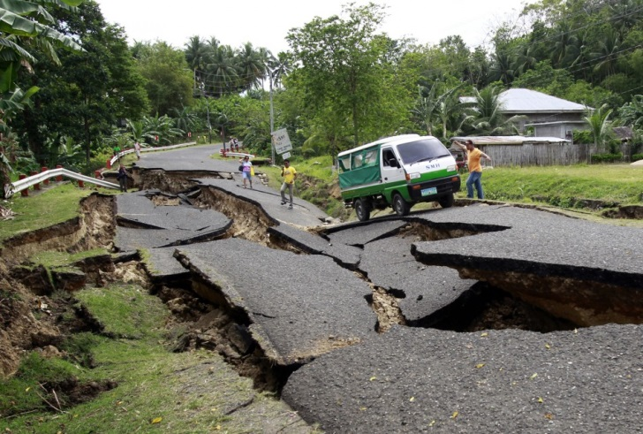
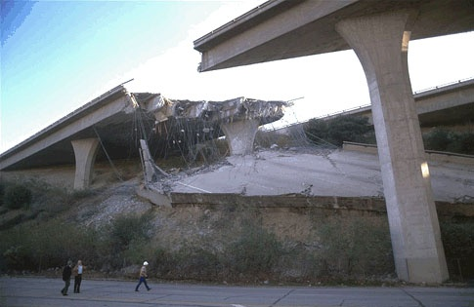
Seismic Hazard
Ground Shaking
Structural Hazards
Liquefaction
Landslides
Retaining Structure Failures
Tsunami

Slide 6
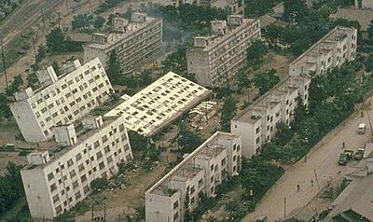
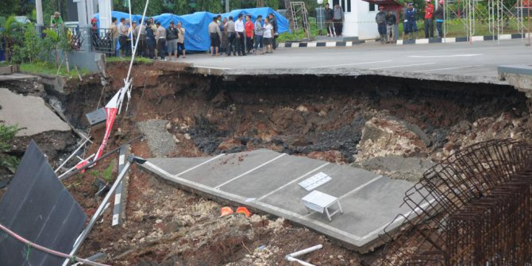
Seismic Hazard
Ground Shaking
Structural Hazards
Liquefaction
Landslides
Retaining Structure Failures
Tsunami

Slide 7
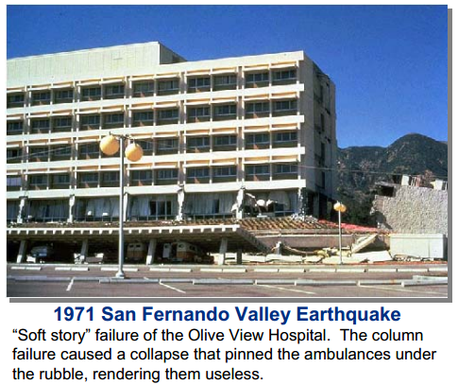
Historical Earthquake
Damage to the Olive View Hospital was particularly disturbing because the structure was relatively new and was designed according to the “modern” code at the time.
The building was a complete loss and had to be demolished. Note that the ambulance canopy in the foreground is a separate structure, and was also a complete loss.
Also significant is the fact that the ambulances were trapped in the collapsed canopy and were not available for use.

Slide 8
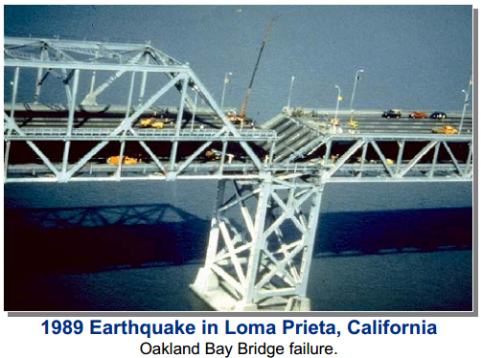
Historical Earthquake
Losses of transportation structures are very dramatic and can be among the most costly in terms of loss of life and property and indirect effects.
This bridge was out of service for several weeks after the earthquake requiring major rerouting of traffic.
The collapse of the Oakland Cyprus Street Viaduct (not shown) was responsible for the loss of 42 lives.
There were similar but less catastrophic failures of sections of
the Embarcadero Freeway in San Francisco.
The Loma Prieta earthquake killed more than 60 people, injured 3,700, and left 12,000 homeless.

Slide 9
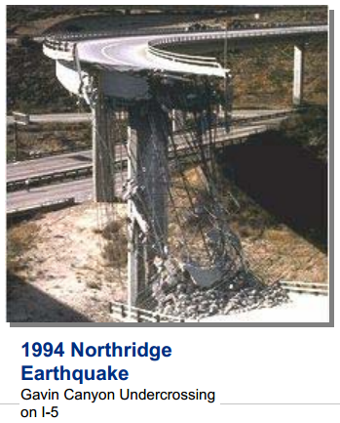
Historical Earthquake
The Northridge earthquake, like the 1971 San Fernando Valley earthquake, was a
“wakeup” call to engineers and ultimately resulted in significant changes to building
codes.
Much of the current emphasis on performance-based engineering is due to
the greater than expected damage that occurred as a result of the Northridge earthquake.

Slide 10
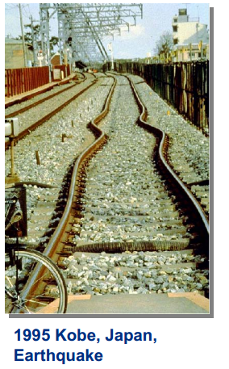
Historical Earthquake
The Kobe earthquake killed more than 5,000 people and injured 26,000 others.
More than 56,000 buildings were destroyed. Losses were estimated at more than
$2 billion.
This is more than 10 times the dollar loss for the Northridge earthquake which occurred exactly one year earlier in southern California. This slide was selected to emphasize the point that loss to nonbuilding structures and lifelines can have a significant effect on society.
Further, it should be noted that a considerable
amount of business and industrial activities that moved from the area after the earthquake never returned.

Slide 11
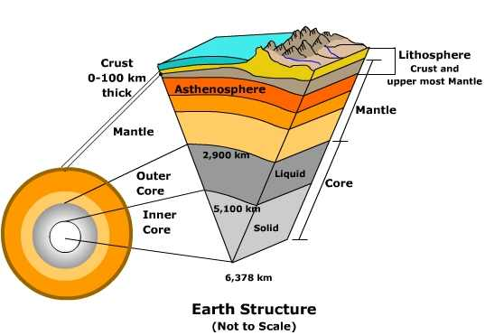
Seismology & Earthquake
The term seismology comes from Greek, seismos (earthquake) and logos (science)

Slide 12
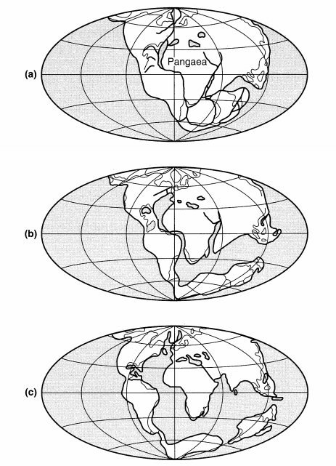
Continental Drift Theory
Proposed by Wagener (1915).
Wagener believed that the earth had only one continent called Pangaea 200 million years ago
Pangaea broke into pieces that slowly drifted into the present configuration of the continent

Slide 13
Plate Tectonic Theory
The basic hypothesis of plate tectonics is that the earth’s surface consists of a number of large, intact blocks called plates, and that these plates move with respect to each other.
The earth’s crust is divided into six continental-sized plates (African, American, Antarctic, Australia-Indian, Eurasian and Pacific) and about 14 of sub-continental size (caribbean, Philippine, etc.)
The relative deformation between plates occurs only in narrow zones near their boundaries.
This deformation can occur slowly and continuously (aseismic deformation) or can occur spasmodically in the form of earthquakes (seismic deformation)

Slide 14
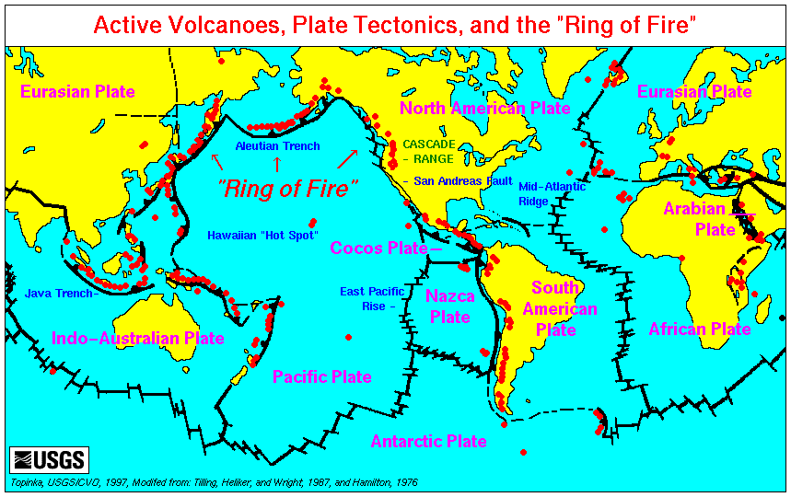

Slide 15
Seismic Waves (Body Waves)
P Wave (primary waves)
Its motion is the same as that of a sound wave, in that, as it spreads out, it alternately pushes (compresses) and pulls (dilates) the rock
Able to travel through both solid rock, such as granite mountains, and liquid material, such as volcanic magma or the water of the oceans.
S Wave (secondary waves)
It shears the rocks sideways at right angles to the direction of travel
At the ground surface S waves can produce both vertical and horizontal motions.
Cannot propagate in the liquid parts of the Earth, such as the oceans and their amplitude is significantly reduced in liquefied soil.

Slide 16
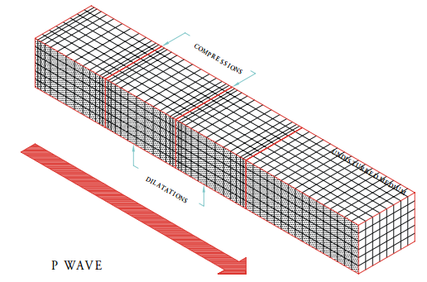
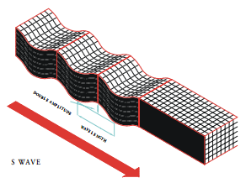
Seismic Waves (Body Waves)

Slide 17
Seismic Waves (Body Waves)
The actual speed of P and S seismic waves depends on the density and elastic properties of the rocks and soil through which they pass.
In most earthquakes, the P waves are felt first
The effect is similar to a sonic boom that bumps and rattles windows.
Some seconds later the S waves arrive with their significant component of side-to-side motion, so that the ground shaking is both vertical and horizontal.
This S wave motion is most effective in damaging structures.

Slide 18
Seismic Waves (Surface Waves)
Love Wave
Its motion is essentially the same as that of S waves that have no vertical displacement; it moves the ground side to side in a horizontal plane parallel to the Earth’s surface, but at right angles to the direction of Propagation
Rayleigh Wave
Like rolling ocean waves, the pieces of rock disturbed by a Rayleigh wave move both vertically and horizontally in a vertical plane pointed in the direction in which the waves are travelling.

Slide 19
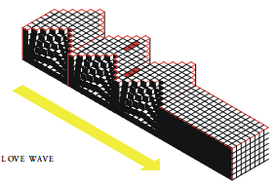
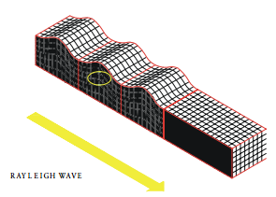
https://www.youtube.com/watch?v=gFU3_mZdGfY

Slide 20
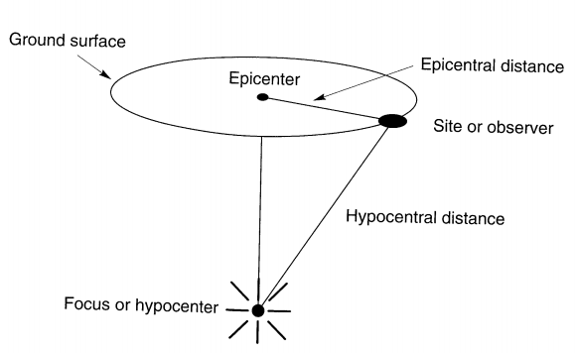
Geometric Notation

Slide 21
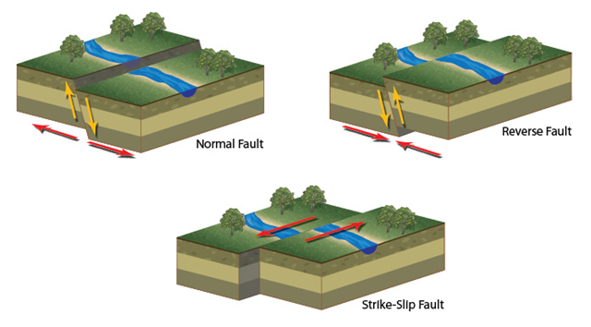
Types of Fault

Slide 22
Size of Earthquake
The oldest measure of earthquake is the earthquake intensity
The intensity is a qualitative description of the effects of the earthquake at a particular location, as evidenced by observed damage and human reactions at that location
The Rossi-Forel (RF) scale of intensity, describing intensities with values ranging from I to X, was developed in the 1880s
RF scale replaced by Modified Mercalli Intensity (MMI) scale, which originally developed by the Italian seismologist Mercalli and modified in 1931 to better represent conditions in California

Slide 23
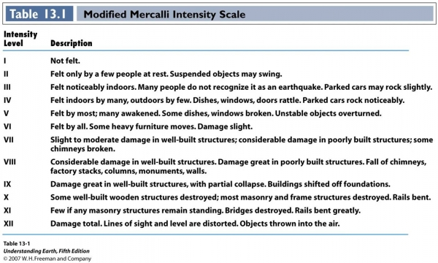

Slide 24
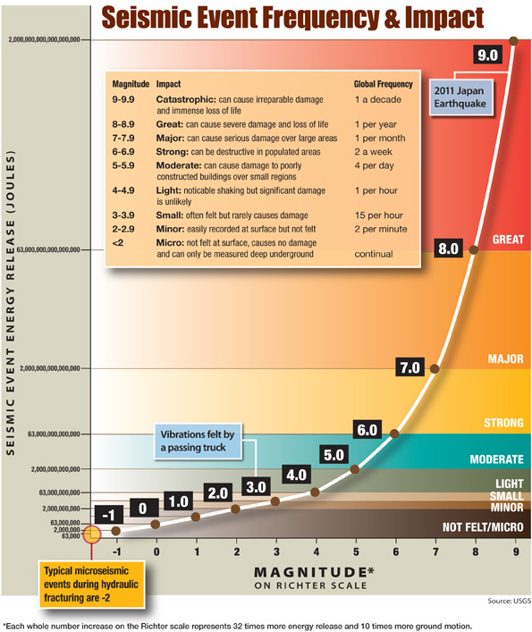
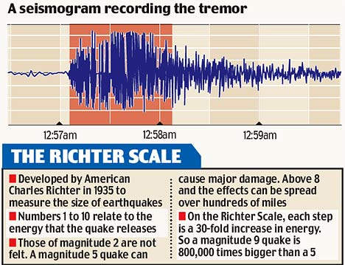
The Richter Scale

Slide 25
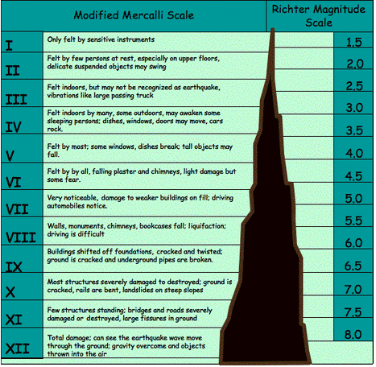

Slide 26
The first accurate measurements of destructive ground motions were made during the 1933 Long Beach, California Earthquake
Strong ground motions are usually measured by accelerographs and expressed in the form of accelerograms
The basic element of an accelerograph is a transducer element, which in its simplest form is an SDF mass-spring-damper system
Transducer element is characterized by its natural frequency f_{n} and viscous damping ratio ξ, typically f_{n} = 25 Hz dan ξ = 60% for modern analog accelerographs; and f_{n} = 50 Hz , ξ = 70% in modern digital accelerographs.

Slide 27
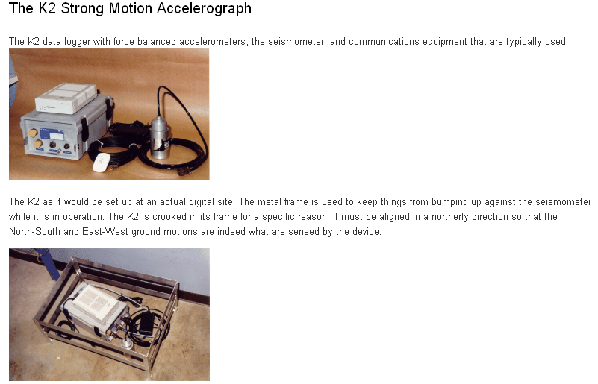
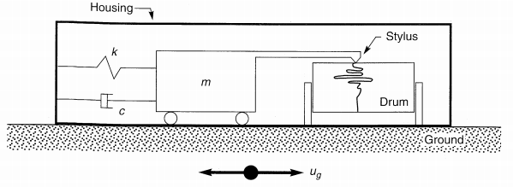

Slide 28
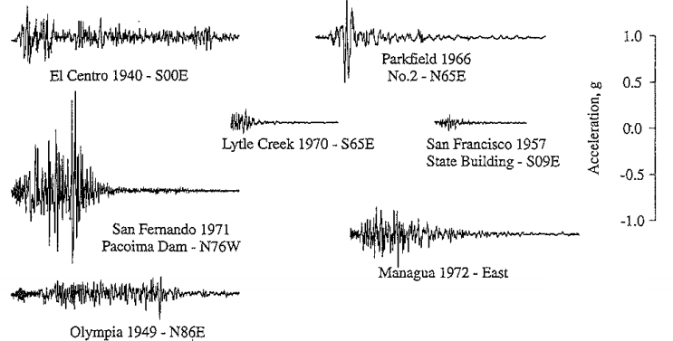
Ground Motion Record
https://www.youtube.com/watch?v=o_ulu-N-7KU

Slide 29
Tugas :
Buat 5 – 6 kelompok, desainlah sebuah poster dengan tema Bencana Gempa Bumi di Indonesia
Poster dibuat ukuran A2 portrait, desain header poster disepakati bersama (seragam)
Isi poster adalah minimal 1000 kata, dilengkapi gambar high res minimal 4 dengan ukuran proporsional
Poster dibingkai kaca warna hitam
Dikumpulkan 1 minggu ke depan.

Slide 30
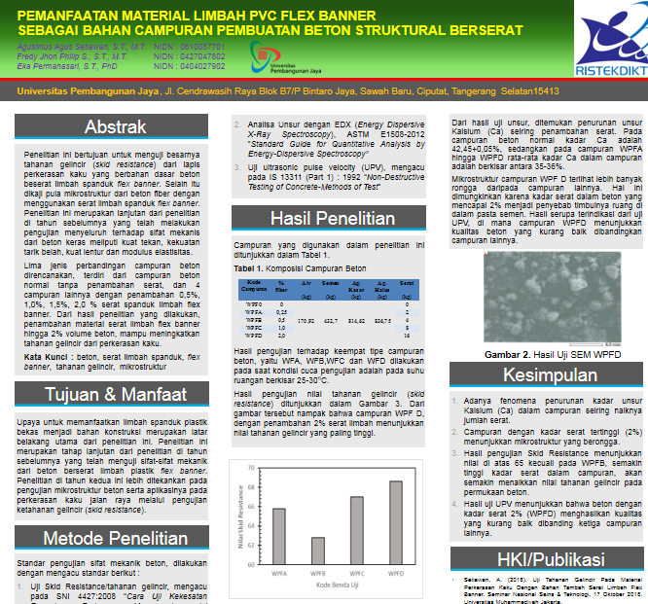

Slide 31
Equation of Motion
Differential equation governs the motion of a linear SDoF system subjected to ground acceleration is :
Dividing this equation by m gives :
The deformation response of the system depends only on the natural frequency ω_{n} or natural period T_{n} of the system and its damping ratio, ξ.
(1)
(2)

Slide 32
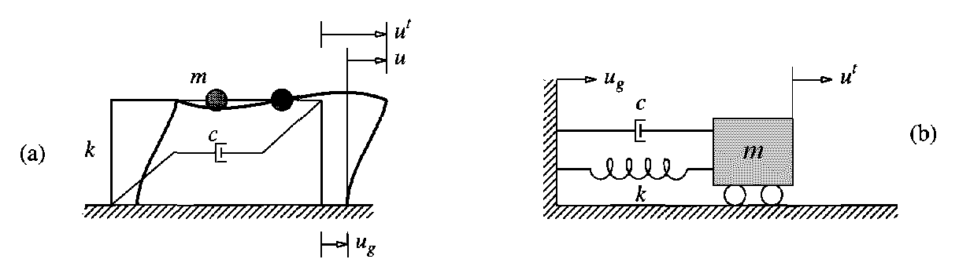
Response Quantities
The greatest interest in structural engineering is the deformation of the system, or displacement u(t) of the mass relative to the moving ground, to which the internal forces are linearly related.
These internal forces are bending moments and shears in the beams and columns, or the spring force in the system below

Slide 33
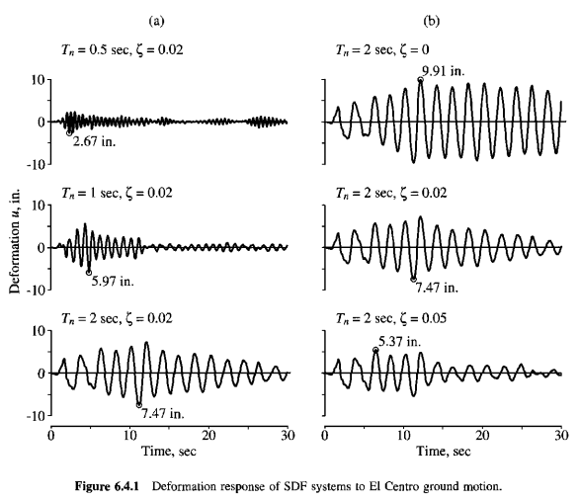
Response History
For a given ground motion, the deformation response u(t) of an SDF system depends only on the natural vibration period of the system and its damping ratio, ξ.

Slide 34
Once the deformation response history u(t) has been evaluated by dynamic analysis of the structure, the internal forces can be determined by static analysis of the structure at each time instant.
Method to implement such analysis is based on the concept of the equivalent static force f_{s} :
Where k is the lateral stiffness of the frame. Expressing k in terms of the mass, m gives :
Where : , is called pseudo-acceleration response
(3)
(4)

Slide 35
