Slide 1
Discrete Mathematics
Lecture 10:
Finding the Shortest Route
Using
Dijkstra’s Algorithm
By:
Nur Uddin, Ph.D

Slide 2
Shortest Route Problem
Find the shortest route from A to
5
B
D
2
6
11
F
C
2
10
4
3
8
3
A
7
5
E
G

Slide 3
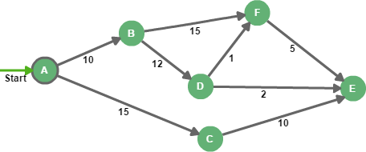

Slide 4
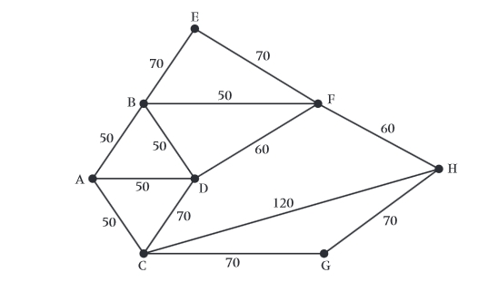

Slide 5
