Slide 1
Selamat Datang di “Programming Essentials in Python”
Instruktur:
Hendi Hermawan, S.T., M.T.I.
hendiananta@gmail.com / 085710098205

Slide 2
Profil Hendi Hermawan, S.T., M.T.I.
hendiananta@gmail.com / 085710098205
Dosen:
  Teknik Informatika, UMB, 2004-2010
  Multimedia, STDI Interstudi, 2010-2014
  Teknik Informatika, STTI NIIT I-Tech, 2005-2014
  Teknik Informatika, Univ. Pembangunan Jaya, 2014-skg
Instruktur Cisco Academy Indonesia
Founder depokhosting.com

Slide 3
Boolean values, Conditional execution, loop, lists and list processing, logical and bitwise operators
Modul 3

Slide 4
In this module, you will learn about:
Boolean values;
If-elif-else instructions;
The while and for loops;
Flow control;
Logical and bitwise operations;
Lists and arrays.

Slide 5
Boolean Values
Python supports the usual logical conditions from mathematics:
Equals: a == b
Not Equals: a != b
Less than: a < b
Less than or equal to: a <= b
Greater than: a > b
Greater than or equal to: a >= b

Slide 6
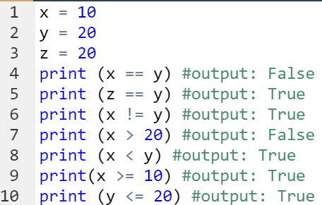

Boolean Values
Example:
Output:

Slide 7
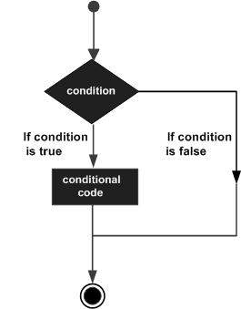
If-elif-else instructions
Decision-making is the anticipation of conditions occurring during the execution of a program and specified actions taken according to the conditions.
Decision structures evaluate multiple expressions, which produce TRUE or FALSE as the outcome.
You need to determine which action to take and which statements to execute if the outcome is TRUE or FALSE otherwise.

Slide 8

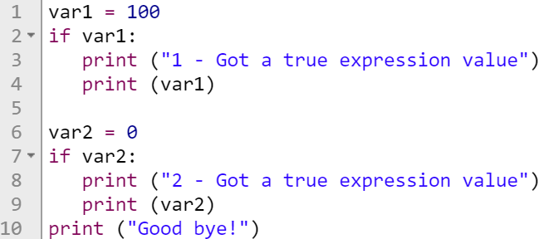

If-elif-else instructions
If Statement, sintax:
Example: Output:
If the boolean expression evaluates to TRUE,
then the block of statement(s) inside the if statement is executed.

Slide 9
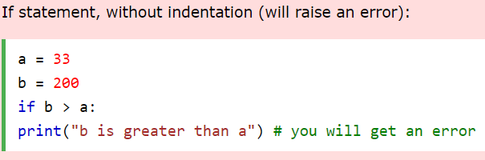
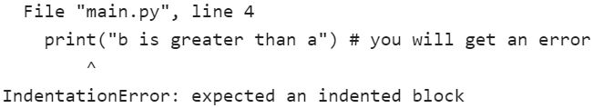
Indentation
Python relies on indentation, using whitespace, to define scope in the code. Other programming languages often use curly-brackets for this purpose.
Example:
Output:

Slide 10
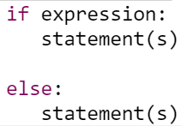
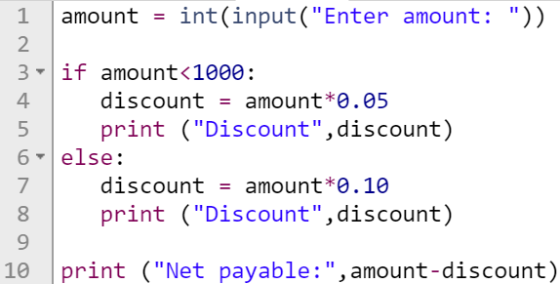

If-elif-else instructions
If-else Statement, sintax:
Example: Output:

Slide 11
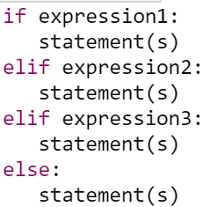
If-elif-else instructions
If-elif-else statement, sintax:

Slide 12
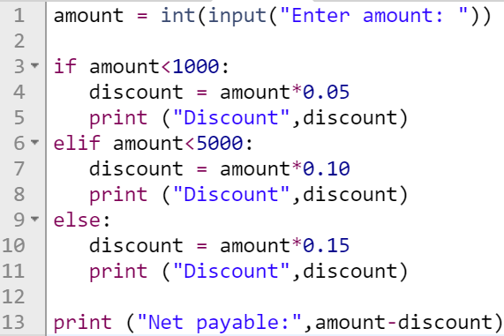



If-elif-else instructions
If-elif-else statement, example: Output:

Slide 13
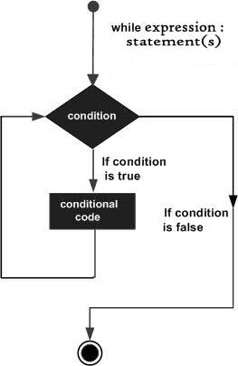

While Loops
Sintax:
A while loop statement repeatedly executes a target statement as long as a given condition is true.
When the condition becomes false, program control passes to the line immediately following the loop.

Slide 14
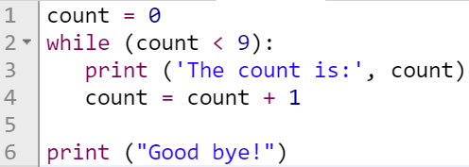
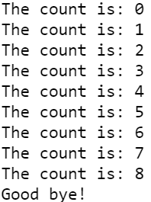
While Loops
Example: Output:
Infinite Loop
, example:

Slide 15

While Loops
Infinite Loop
A loop becomes infinite loop if a condition never becomes FALSE.
This results in a loop that never ends.
An infinite loop might be useful in client/server programming where the server needs to run continuously so that client programs can communicate with it as and when required.
Example:

Slide 16
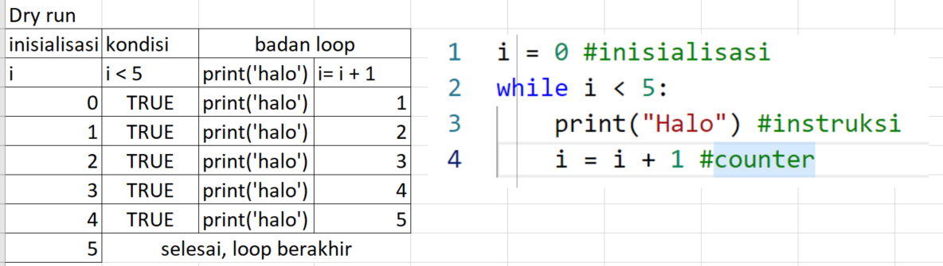
While Loops

Slide 17

For Loop
Sintax:
The for statement has the ability to iterate over the items of any sequence, such as a list or a string.
If a sequence contains an expression list, it is evaluated first.
Then, the first item in the sequence is assigned to the iterating variable iterating_var.
Next, the statements block is executed.
Each item in the list is assigned to iterating_var, and the statement(s) block is executed until the entire sequence is exhausted.

Slide 18
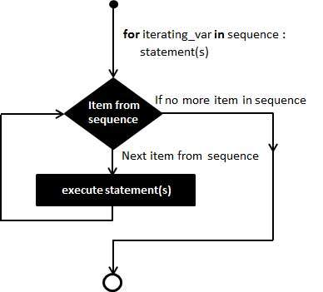
For Loop
Flowchart

Slide 19
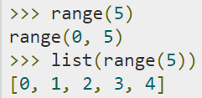
The range() function
The built-in function range() is the right function to iterate over a sequence of numbers.
It generates an iterator of arithmetic progressions.
Example:
range() generates an iterator to progress integers starting with 0 upto n-1.
To obtain a list object of the sequence, it is typecasted to list().
Now this list can be iterated using the for statement.

Slide 20



For Loop
Example: Output:
Example: Output:
Example: Output:
The range() function defaults to increment the sequence by 1,
however it is possible to specify the increment value
by adding a third parameter: range(2, 30, 3):

Slide 21
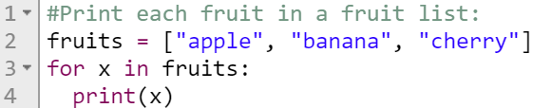

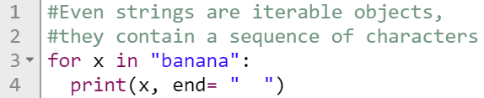
For Loop
Example: Output:
Example: Output:

Slide 22
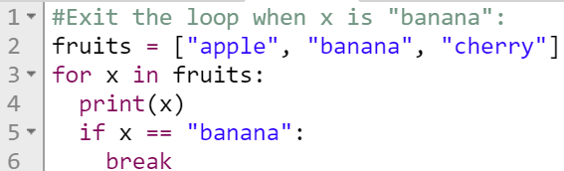

The break statement
With the break statement we can stop the loop before it has looped through all the items
Example: Output:

Slide 23
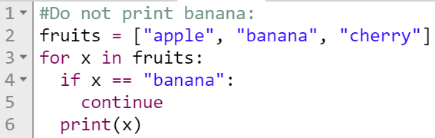

The continue statement
With the continue statement we can stop the current iteration of the loop, and continue with the next
Example: Output:

Slide 24
Using else Statement with Loops
If the else statement is used with a for loop, the else statement is executed when the loop has exhausted iterating the list.
If the else statement is used with a while loop, the else statement is executed when the condition becomes false.

Slide 25
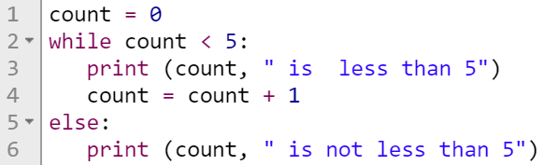
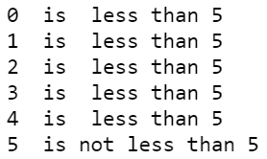
Using else Statement with Loops
While loop, example: output:

Slide 26
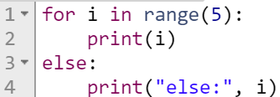
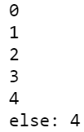
Using else Statement with Loops
For loop, example:
Output:

Slide 27
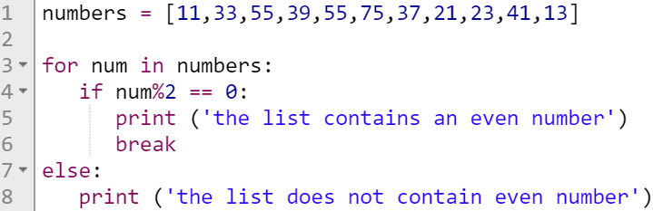
Using else Statement with Loops
For loop, example:
Output:

Slide 28
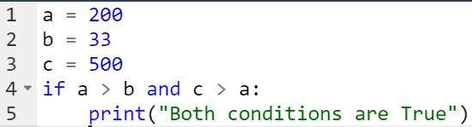
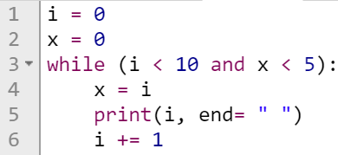
Logical expressions - and
If statement, example: output:
while statement, example: output:

Slide 29
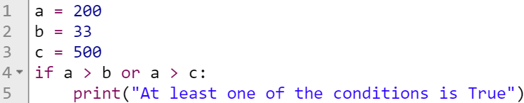
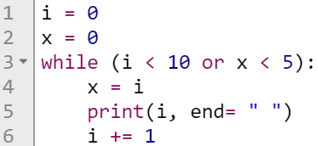
Logical expressions - or
If statement, example: output:
while statement, example: output:

Slide 30
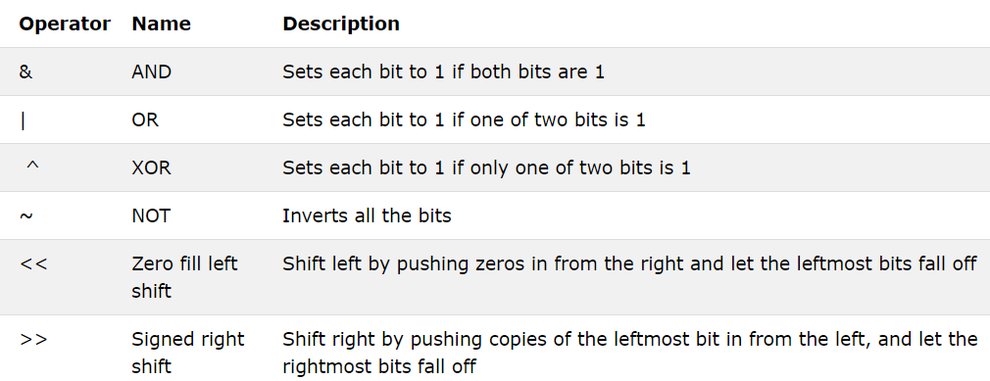
Bitwise Operators

Slide 31
Bitwise Operators
You can use bitwise operators to manipulate single bits of data. The following sample data:
  x = 15, which is 0000 1111 in binary,
  y = 16, which is 0001 0000 in binary.
will be used to illustrate the meaning of bitwise operators in Python. Analyze the examples below:
  & does a bitwise and, e.g., x & y = 0, which is 0000 0000 in binary,
  | does a bitwise or, e.g., x | y = 31, which is 0001 1111 in binary,
  ˜ does a bitwise not, e.g., ˜ x = 240, which is 1111 0000 in binary,
  ^ does a bitwise xor, e.g., x ^ y = 31, which is 0001 1111 in binary,
  >> does a bitwise right shift, e.g., y >> 1 = 8, which is 0000 1000 in binary,
  << does a bitwise left shift, e.g., y << 3 = , which is 1000 0000 in binary,

Slide 32
Python Collections (Arrays)
There are four collection data types in the Python programming language:
  List is a collection which is ordered and changeable. Allows duplicate members.
  Tuple is a collection which is ordered and unchangeable. Allows duplicate members.
  Set is a collection which is unordered and unindexed. No duplicate members.
  Dictionary is a collection which is unordered, changeable and indexed. No duplicate members.

Slide 33
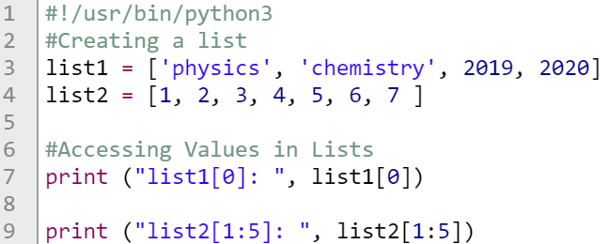

List
A list is a collection which is ordered and changeable. In Python lists are written with square brackets, example:
Output:

Slide 34
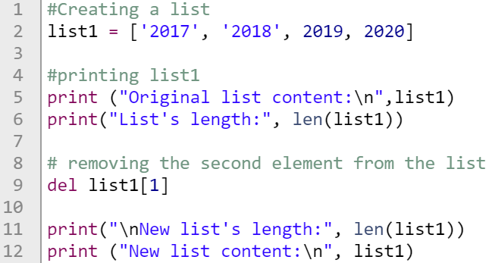
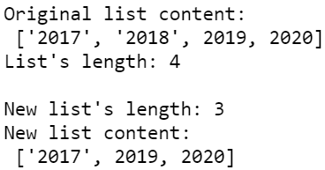
List – remove element
Any of the list's elements may be removed at any time - this is done with an instruction named del (delete)
Example: Output:

Slide 35


List – Negative indices are legal
An element with an index equal to -1 is the last one in the list.
Similarly, the element with an index equal to -2 is the one before last in the list.
Example:
Output:

Slide 36


List – Add Items
To add an item to the end of the list, use the append() method.
Example: output:
To add an item at the specified index, use the insert() method.
Example: output:

Slide 37


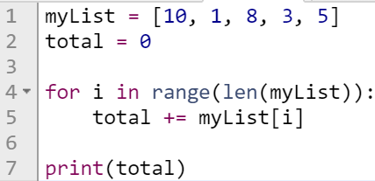
List – Loop Through a List
You can loop through the list items by using a for loop
Example: output:
Example: output:

Slide 38
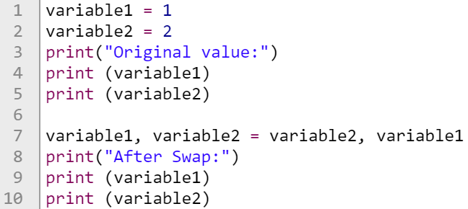
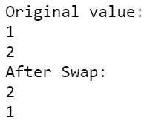
Swap the values of two variables?
Example: output:

Slide 39
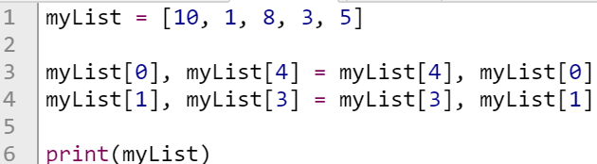

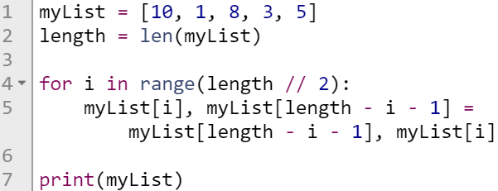

List – Swap the values
Example: output:
Example: Output:

Slide 40
List – The Bubble Sort
Now that you can effectively juggle the elements of lists, it's time to learn how to sort them
Let's say that a list can be sorted in two ways:
  increasing (or more precisely - non-decreasing) - if in every pair of adjacent elements, the former element is not greater than the latter;
  decreasing (or more precisely - non-increasing) - if in every pair of adjacent elements, the former element is not less than the latter.
In the following sections, we'll sort the list in increasing order, so that the numbers will be ordered from the smallest to the largest.

Slide 41
List – The Bubble Sort
Here's the list:
Now look at the second and the third elements. They're in the wrong positions. We have to swap them:
We go further, and look at the third and the fourth elements. Again, this is not what it's supposed to be like. We have to swap them:
Now we check the fourth and the fifth elements. Yes, they too are in the wrong positions. Another swap occurs:

Slide 42
List – The Bubble Sort
Now we start with the second pass through the list. We look at the first and second elements - a swap is necessary:
Time for the second and third elements: we have to swap them too:
Now the third and fourth elements, and the second pass is finished, as 8 is already in place:

Slide 43
List – The Bubble Sort
We start the next pass immediately. Watch the first and the second elements carefully - another swap is needed:
Now 6 needs to go into place. We swap the second and the third elements:
The list is already sorted. We have nothing more to do. This is exactly what we want.
As you can see, the essence of this algorithm is simple: we compare the adjacent elements, and by swapping some of them, we achieve our goal.

Slide 44
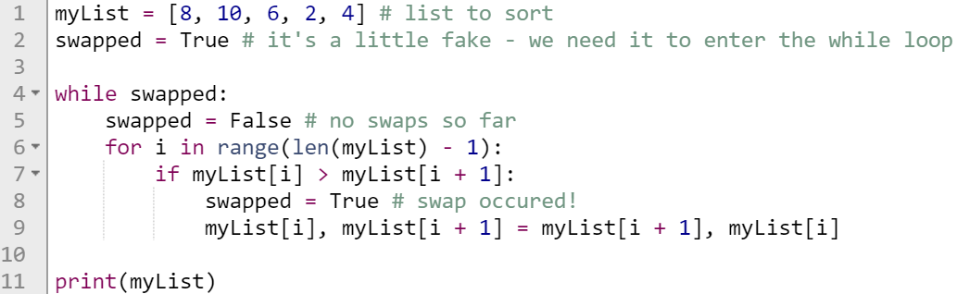

List – The Bubble Sort
Let's code in Python:
Output:

Slide 45
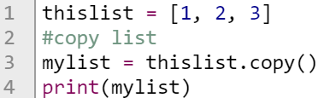

List – Copy a List
You cannot copy a list simply by typing list2 = list1, because: list2 will only be a reference to list1, and changes made in list1 will automatically also be made in list2.
There are ways to make a copy, one way is to use the built-in List method copy()
Example: output:

Slide 46

List – Copy a List
Powerful slices
A slice is an element of Python syntax that allows you to make a brand new copy of a list, or parts of a list.
It actually copies the list's contents, not the list's name.
A slice of this form makes a new (target) list, taking elements from the source list - the elements of the indices from start to end - 1.
Example:

Slide 47
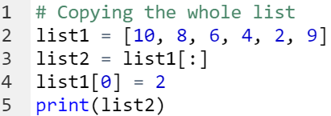

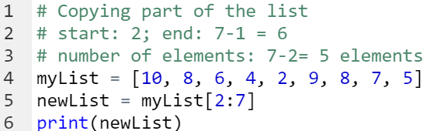

List – Copy a List
Example | Output

Slide 48
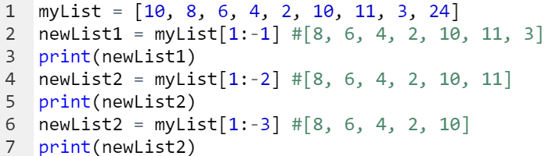

List – Copy a List
Example:
Output:

Slide 49
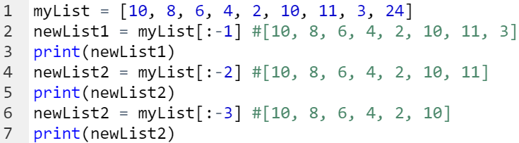

List – Copy a List
Example:
Output:

Slide 50


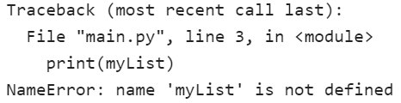
List – remove element
Example: Output:
Example: Output:

Slide 51
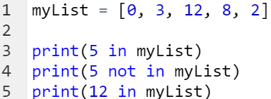

List – The in and not in operators
Example: Output:

