Slide 1
Module 6 Working with Files and Directories

Slide 2
Exam Objective 2.3 Using Directories and Listing Files
Objective Summary
Understanding Files and Directories including those that are hidden
Home Directory
Properly utilizing absolute and relative paths

Slide 3
Understanding Directories

Slide 4
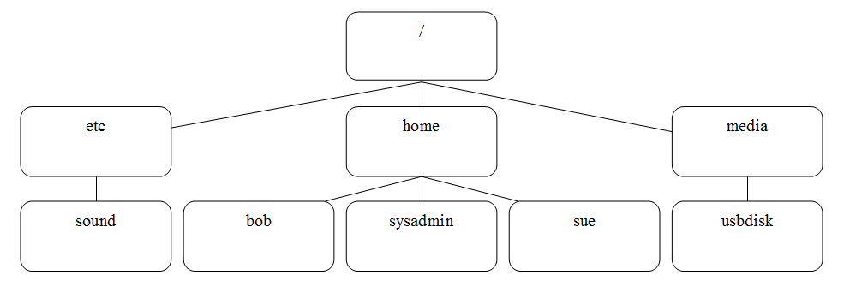
Files and Directories
File contain data (text, graphics, etc)
Directories store filenames
Top level directory: / (AKA, root directory)
Example directory structure:

Slide 5
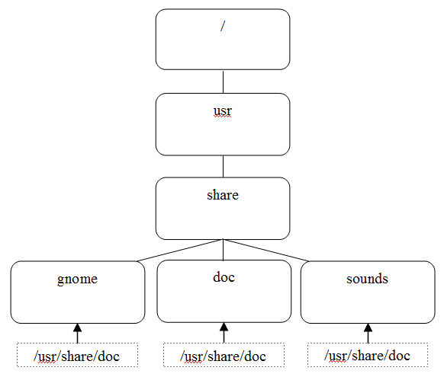
Directory path
Directions to a specific file or directory
Directions given from / directory are called “absolute” paths
Directions given from the current directory are called “relative” paths

Slide 6
The home directory
Each user has a home directory
Typically /home/bob for a user named bob
Place to store your own files
Normally users can’t access the home directory of other users
The ~ character symbolizes the home directory

Slide 7
The current directory
The directory that your shell is currently in
Can be displayed with the pwd command
Might also be displayed in your prompt

Slide 8
Changing directories
Use the cd command
With no arguments, takes you to your home directory
~bob would refer to bob’s home directory

Slide 9
Absolute vs relative pathnames
Absolute pathnames always provide directions from the root directory (/)
Relative pathnames always provide directions from the current directory.
To refer to one directory above current directory, use the .. characters
To refer to the current directory, use the . character

Slide 10
Manipulating Files

Slide 11
Exam Objective 2.4 Creating, Moving and Deleting Files
Objective Summary
Case sensitivity
Simply globbing and quoting

Slide 12
Listing files in a directory
List files with the ls command
Different file types may be highlighted by colored filenames:
plain file A file that isn't a special file type
directory A directory file (contains other files)
executable A file that can be run like a program
symbolic link A file that points to another file
Display of filenames in color is the result of the --color option

Slide 13
Common ls options
Many options to the ls command, including:
-a – display all files, including hidden files
-l – long display listing
-h – Give file sizes in human readable sizes
-R – Recursive listing
-S – Sort output based on file size
-t – Sort output based on modification time
-d – Don’t display directory contents

Slide 14
Copying files
The cp command copies files:
cp [source] [destination]
Use –v option to display copy process
Use –i to prompt overwrites
Use –n to avoid overwrites
Use –r to copy directory structures

Slide 15
Moving files
The mv command copies files:
mv [source] [destination]
The mv command also is used to rename files
Supported options that work the same as the cp command: -i, -n and –v

Slide 16
Creating files
Editors can be used to create files (discussed later in this course)
Use the touch command to create an empty file
The touch command also updates the modification timestamp of a file

Slide 17
Removing files
The rm command is used to delete files
File deletion is permanent!
Use -i to avoid accidental deletion when using globs
Delete directories with the –r option or rmdir if the directory is completely empty

Slide 18
Making directories
Use the mkdir command to create directories

