Slide 1
Module 11
Managing Packages and Processes

Slide 2
Exam Objective
4.3 Where Data is Stored
Objective Summary
  Understanding kernel and processes
  Logging utilities such as syslog, klog, and dmesg
  Information Storage Paths

Slide 3
Working with Package Management

Slide 4
Package Management
Package management is a system for installing, configuring, updating, querying and removing software from a Linux system.
Package management systems ensure that software functions by tracking prerequisites or dependencies between packages.
There are many different package management systems available, but two dominate the Linux landscape:
  Debian Package Management
  RPM Package Management

Slide 5
Debian Package Management
Used by the Debian distribution and its popular derivatives such as Ubuntu and Mint.
A software package is distributed as a ".deb" file, which contains the files and meta-information for the package.
The lowest level tool (back-end command) is dpkg
Command line front-end tools include:
  apt-get
  aptitude
GUI front-end tools include:
  synaptic
  software-center

Slide 6
Adding Packages (Debian)
To ensure your list of packages is current, first execute:
  sudo apt-cache update
To search for a package, you can use:
  sudo apt-cache search keyword
To install a package, run:
  sudo apt-get install package
Due to dependencies, if you want to install one package, you may have to install other packages, too.

Slide 7
Updating Packages (Debian)
If you want to update an individual package, then you perform the command that will install that package:
  sudo apt-get install package
If you want to update all packages, then you can execute:
  sudo apt-get upgrade
Users with a graphical login may notice update notifications from the update-manager

Slide 8
Removing Packages (Debian)
Due to dependencies between packages, if you want to remove one package of software, then you may end up having to remove other packages as well.
If you want to remove all files from a software package except the configuration files, then you can execute:
  sudo apt-get remove package
If you want to remove all files from a software package including the configuration files, then you can execute:
  sudo apt-get --purge remove package

Slide 9
Querying Packages (Debian)
To get a list of all installed packages:
  dpkg -l
To list all the files of a package:
  dpkg -L package
To query a package for information and its state:
  dpkg -s package
To determine if an file was provided by a package:
  dpkg -S /path/to/file

Slide 10
RPM-based Management

Slide 11
RPM Package Management
The Linux Standards Base, which is a Linux Foundation project, develops through consensus a set of standards that increase the compatibility between conforming Linux systems.
According to the Linux Standards Base, the standard package management system is RPM, or RPM Package Management, a recursive acronym.
RPM Package Management tracks dependencies between packages and was developed by Red Hat.
Distributions derived from Red Hat like (Centos and Fedora) and some of those that are not (SUSE, OpenSUSE and Mandriva) use RPM.

Slide 12
RPM Package Management
The low level, back-end tool for RPM Package Management is the rpm command.
Command line front-end tools include yum and up2date, which can perform automatic dependency resolution.
Graphical front-end tools such as yumex and gpk-application simplify the process of package management.
Commands that query the packages can be performed by any user.
Commands that install, update or remove system packages must be executed with root privileges.

Slide 13
Adding/Updating Packages (RPM)
To be able to find the package that you want to install:
  yum search keyword
To install a package and its dependencies:
  yum install package
To install an update for an individual package:
  yum update package
To update all packages run:
  yum update
If updates are available when a user performs a graphical login, then a message in the notification area may appear from gpk-update-viewer indicating that updates are available.

Slide 14
Removing Packages (RPM)
If you want to remove a package with the rpm command, then you may need to remove manually other packages, as well, due to the dependencies between packages.
To remove a package and the packages that depend on it:
  yum remove package

Slide 15
Querying Packages (RPM)
While it is possible to perform some queries with yum, the rpm command will work faster because it uses a local database instead of having to connect over the network to repositories of software.
To query to get a list of all installed packages:
  rpm -qa
To get the list of the files that are in a package:
  rpm -ql package
To query a package for its information or state:
  rpm -qi package
To determine if a file belongs to a package:
  rpm -qf /path/to/file

Slide 16
Understanding Processes

Slide 17
The Linux Kernel
When most people refer to Linux, they are actually referring to GNU/Linux the operating system.
GNU (Gnu's Not Unix) provides the open source equivalents to most common Unix commands, like ls, cp or passwd.
Linux is the core of the operating system, the kernel, which manages every aspect of a running system.
Key functions of the Linux kernel include:
  managing booting the operating system, processes, memory, filesystem, networking and device drivers.
  accepting commands from the user and managing processes that carry out those commands by accessing various devices.

Slide 18
The /proc directory
The /proc directory contains a pseudo-filesystem which contains several types of information:
  directories that have names matching the PID of processes on the system which contain numerous files with information about the process.
  files like cmdline, meminfo and modules which contain information about the system.
  files in /proc/sys that are writable by the root user and can immediately change the way that the kernel operates.
    to make kernel changes permanent, add entries to the /etc/sysctl.conf file.

Slide 19
Process Hierarchy
After the kernel finishes loading, it starts the first process (typically /sbin/init) and assigns it the PID of 1.
Each additional process that gets started is assigned a PID in sequential order.
As /sbin/init starts up other processes (or other processes start up processe) they are considered parent processes and
The processes that were started by the parent processes are called child processes.

Slide 20
Process Hierarchy
When the system has been running long enough, it may eventually reach the maximum PID value, which can be viewed and configured through /proc/sys/kernel/pid_max.
Once the largest PID is used, the system will "roll over" and resume by assigning PID values that are available at the bottom of the range.

Slide 21
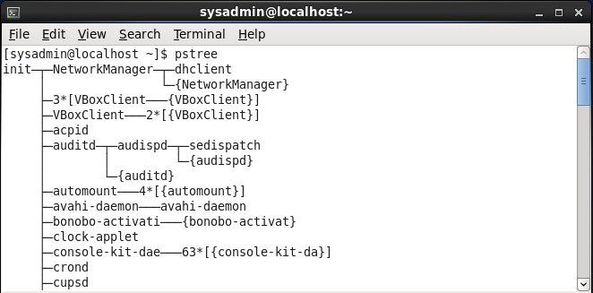
Viewing the Process Hierarchy
The pstree command can show the process hierarchy with “text art”:

Slide 22
An Example of Process Hierarchy
If you were to look at the parent-child relationships involved in executing the pstree command, it would look something like this:
init
login
bash
pstree

Slide 23
The Process (ps) Command
By default, the process (ps) command will only show the processes running in the current shell.
The ps --forest option will display lines to indicate parent and child relationships, similar to the pstree command.
The ps command accepts three kinds of options:
  Traditional Unix options given with a single dash
  BSD Unix options given without any dash
  GNU long options given with two dashes

Slide 24
Viewing All Processes
To view all processes execute ps aux or ps -ef.
Since hundreds of processes are normally present, piping the output to grep can be useful to find the information about a particular process:
    $ ps -ef | grep firefox
    sysadmin 4048 2380 10 16:37 pts/0 00:00:01 /usr/lib/firefox/firefox
    sysadmin 4096 2380 0 16:38 pts/0 00:00:00 grep firefox

Slide 25
Monitoring the system

Slide 26
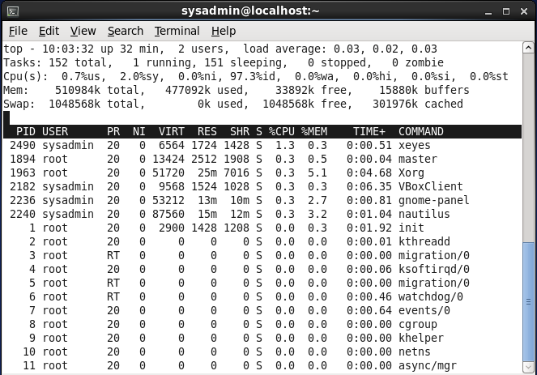
The top Command
The top command is very useful for real-time monitoring of processes, system load, CPU usage and memory usage.
By default, top sorts processes from the by % CPU

Slide 27
Controlling top
Key | Meaning
h | Help
l | Toggle load statistics
t | Toggle time statistics
m | Toggle memory usage statistics
< | Move the sorted field to the left
> | Move the sorted field to the right
F | Choose sorted field
R | Toggle sort direction
P | Sort by % CPU
M | Sort by % memory used
k | Kill a process (or send it a signal)
r | Renice priority of a process

Slide 28
Load Averages
Similar to the output of the uptime command, the first line of output from the top command shows the current time, the amount of time the system has been running and three averages of the load on the system.
The one, five and fifteen minute load averages give the administrator an idea of the current load and how it has been trending over recent time.

Slide 29
Load Averages
The number shown for the load averages is proportional to the number of CPU cores in the system:
  A load average of zero is no load.
  A load average equal to the number of CPU cores indicates a fully loaded system.
  A number higher than the total CPU cores indicates a system which is over-loaded.

Slide 30
The free Command
The free command is used to show memory usage statistics.
Using free with the -s option allows you to specify the number of seconds between updates

Slide 31
The free Command
By default the free command will show values in bytes, but using the -m or -g option will show megabytes or gigabytes:
$ free
total used free shared buffers cached
Mem: 510984 495280 15704 0 60436 258988
-/+ buffers/cache: 175856 335128
Swap: 1048568 0 1048568

Slide 32
Working with log files

Slide 33
Log Files
The output produced by the kernel and system processes is normally sent to log files.
Some processes, like the Apache web server, will perform logging independently.
The kernel and most background processes rely on separate logging processes to log their activity.
Commonly the syslogd and klogd are used to log system and kernel activity, respectively.
Other logging daemons include the rsyslogd used by Centos and Red Hat and systemd-journald used by Fedora.

Slide 34
/var/log Files
File | Contents
boot.log | Messages generated as services are started during the system boot.
cron | Messages generated by the crond daemon for jobs to be executed on a recurring basis.
dmesg | Kernel messages generated during system boot up.
maillog | Messages produced by the mail daemon for e-mail messages sent or received
messages / syslog | Messages from the kernel and other processes that don't belong in other log files.
secure | Messages from processes that require authorization or authentication.
Xorg.0.log | Messages from the X windows (GUI) server.

Slide 35
Log File Rotation
Log files are rotated to make them easier to analyze and prevent them from becoming too large (filling up the filesystem).
Example: the logging daemon would stop writing to /var/log/messages, rename that file /var/log/messages-20131103 (20131103 = current date) and then begin writing to /var/log/messages again.
After a certain number of rotations, typically four, the oldest log file is deleted as a new one is created.

Slide 36
Viewing Log Files
Most log files will require root privileges in order to access their contents.
Although most log files contain text and can be viewed with any command that displays text date, some contain binary data.
By using the file command, you can check to see if the contents of a file are text
    $ sudo file /var/log/messages
    /var/log/messages: ASCII English text, with very long lines
    $ sudo file /var/log/btmp
    /var/log/btmp: data

Slide 37
Working with dmesg

Slide 38
The dmesg Command
The kernel ring buffer is memory used to hold messages generated by the kernel.
The /var/log/dmesg file is used by some distributions to hold kernel messages that were generated during start up.
Kernel messages, mixed in with other messages, are found in the /var/log/messages or /var/log/syslog file.
The /etc/syslog.conf or /etc/rsyslog.conf file may be used to configure logging of kernel messages to a separate file.
Using the dmesg command to view the contents of the kernel ring buffer can be very helpful for troubleshooting hardware or other kernel-related issues.

Slide 39
dmesg Options
Option | Meaning
-c | Clear the ring buffer after printing
-r | Print the raw message buffer
-s SIZE | Use a buffer of size SIZE to query the kernel ring buffer
-n LEVEL | Set the level to LEVEL at which logging is done to the console. Using -n 1 prevents all messages except panic messages from printing to the console

