Slide 1
Analisis Proses Bisnis #5
Process Management & Knowledge Work

Slide 2
Knowledge Workers

Slide 3




Knowledge Worker
Knowledge workers are the key to innovation and growth in today’s organization.
  (T.H. Davenport, 2009).
They invent products and services, design marketing programs, and create strategies.

Slide 4

Knowledge
Workers
knowledge workers primary tasks involve the manipulation of knowledge and information.
knowledge used to differentiate physical goods and to diversify them into product-related services.

Slide 5
Knowledge Workers and The Organization’s Growth Prospects
Knowledge workers in management roles come up with new strategies.
Knowledge workers in R&D and engineering create new products.
Knowledge workers in marketing package up products and services in ways that appeal to customers.
Without knowledge workers, there would be no new products and services, and no growth

Slide 6
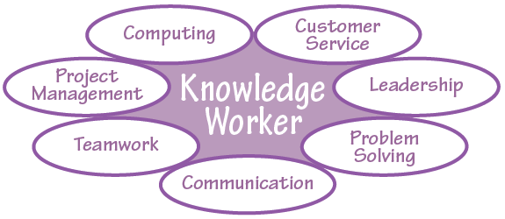

Slide 7
“Improving knowledge worker performance is the most important economic issue of the age”
(Drucker, 1968)

Slide 8
Improving Knowledge Work Through Process Management

Slide 9

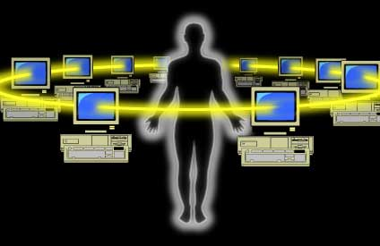

How to improve
Way of improving any form of work is to treat it as a process.

Slide 10


How to improve
To treat something as a process is to impose a formal structure on it;
  to identify its beginning, end, and intermediate steps, to clarify who the customer is for it,
  to measure it,
  to take stock of how well it is currently being performed,
  and ultimately to improve it.

Slide 11
How to improve
Knowledge workers often have the power to resist being told what to do, and process analysis is usually a sophisticated approach to having someone else tell you how to do your job.
It is not easy to view knowledge work in terms of processes, because much of it involves thinking, and it is often collaborative and iterative, which makes it difficult to structure.
But a Process Management for Knowledge Work orientation can make knowledge work more productive as well as “enabling and empowering” if managed correctly, i.e., with extensive participation.

Slide 12
“a process can be viewed as art rather than science”
(Hall and Johnson, 2009)
Whether this is true, of course, varies by the process involved, by the way a process is implemented and managed, and by the particular individuals involved.

Slide 13
Processes and Knowledge Work Segments
Four Approaches to Knowledge Work

Slide 14

Transaction Workers
Lebih mudah di-strukturisasi ke proses, karena pekerjaannya berulang-ulang (repeatable).
Para pekerja ini perlu memahami aliran pekerjaan mereka dan pengetahuan yang dibutuhkan untuk menjalankannya, tetapi mereka jarang memiliki waktu untuk membaca panduan.
Untuk itu biasanya digunakan aplikasi berbasis komputer, biasanya memerlukan alur kerja terstruktur.

Slide 15

Integration Workers
Pekerja jenis ini sangat mungkin untuk mengartikulasikan proses yang harus disertai dengan bentuk dokumennya, dan pekerja biasanya memiliki cukup waktu untuk mempelajari dokumen proses tersebut.
Prakteknya tiap industri memiliki proses sendiri yang berbeda-beda di banyak industri.
  Contohnya:
  Teknisi Medis, biasanya mengikuti prosedur pada protokol kesehatan dalam melakukan administrasi pekerjaannya.
  Salespeople, mengikuti “standard operating procedures” dalam bekerja melayani pelanggan dan melakukan penjualan

Slide 16

Expert Workers
Pekerja jenis ini memiliki otonomi dan kebijakan tersendiri dalam pekerjaannya (sehingga sulit untuk dikelola prosesnya).
Salah suatu cara untuk membuat pekerjaannya tersetruktur adalah dengan menanamkan proses kerjanya ke dalam komputer, hal ini merupakan suatu tantangan dalam melakukan penataan kerja expert.
Untuk melakukan peningkatan kerja expert, harus disediakan template, contoh output dan panduan tingkat tinggi

Slide 17

Collaboration Workers
Model pekerja yang paling sulit untuk kelola prosesnya.
Memiliki banyak model iterasi/urutan kerja berulang.
Pola kerja kolaborasi-nya susah untuk dipahami.
Setiap hari struktur kerjanya berbeda.
Memiliki kekuatan dan hak independen untuk menolak.
Menetapkan dan mengukur output (spt: menetapkan dan menargetkan orientasi pelanggan, dan tingkat urgensi) adalah suatu intervensi yang paling tepat diberikan daripada memberikan flowchart proses.
Mediasi yang paling tepat adalah dengan cara terstruktur menggunakan komputer

Slide 18
Measurements

Slide 19
Productivity
In the industrial age, this was a relatively easy task; an individual worker’s performance could be assessed through outputs, visible inputs, including hours worked or apparent effort expended.
Output measures over input measures → Productivity.
Productivity-oriented approaches convert the value of outputs to currency.

Slide 20
Creativity & Innovation
What is the formula for assessing the creativity and innovation of an idea?
managers of knowledge workers have traditionally fallen back on measuring visible inputs, e.g., hours worked.
However, the increasing movement of knowledge work out of the office and into homes, airplanes, and client sites makes it difficult to use hours worked as a measure, and that criterion never had much to do with the quality of knowledge produced.

Slide 21
Quality
Quality is perhaps the greatest problem in measuring knowledge work.
  Why is one research paper, one advertising slogan, or one new chemical compound better than another?
Subjective method is one of the method that makes the quality of knowledge work possible to measure.
Subjective Method with peer evaluation; it involves determining who is a relevant peer group for the particular work involved, and asking them what they think of it

Slide 22
Quality
There does not seem to be a universal measure for the quality or quantity of knowledge work outputs.
What matters is high-quality outputs per unit of time and cost, and the specific outputs vary widely across knowledge worker types
The appropriate output (and sometimes input) measures for knowledge work will vary by the industry, process, and job.
It is important to determine what measures make sense for the particular type of work being addressed

Slide 23
THAT’S ALL
See You Next Session

