Slide 1
Designing User Interfaces
Systems Analysis and Design

Slide 2
Major Topics
User interfaces
Dialogue guidelines
Feedback
Help
Ecommerce dialogue
Data mining
Ergonomics

Slide 3
The User Interface
The user interface is the system that helps users communicate with the computer system and/or the application system

Slide 4
User Interface Design Objectives
To design a better user interface, use the following objectives:
Match the user interface to the task.
Make the user interface efficient.
Provide appropriate feedback to users.
Generate usable queries.
Improve productivity of knowledge workers.

Slide 5
Components of the User Interface
The user interface has two main components:
Presentation language, which is the computer-to-human part of the transaction.
Action language that characterizes the human-to-computer portion.

Slide 6
Types of User Interfaces
There are several types of user interfaces:
Natural-language interfaces.
Question-and-answer interfaces.
A menu interface.
Form-fill interfaces.
Command-language interfaces.
Graphical User Interfaces (GUIs).

Slide 7
Natural-Language Interfaces
Natural-language interfaces permit users to interact with the computer in their everyday or "natural" language.

Slide 8
Question-and-Answer Interfaces
The computer displays a question for the user on the screen.
The user enters an answer via the keyboard or a mouse click.
The computer acts on that input information in a preprogrammed manner.
New users may find the question-and-answer interface most comfortable.

Slide 9
A Menu Interface
A menu interface, that provides the user with an onscreen list of available selections.
A nested menu is a menu that can be reached through another menu.

Slide 10
Advantages of Nested Menus
The advantages of nested menus are:
Less cluttered screen.
Eliminate menu options which do not interest a user.
Allow users to move quickly through the program.

Slide 11
Graphical User Interface (GUI) Menus
GUI menus guidelines:
The main menu is always on the screen.
The main menu uses single words.
The main menu should have secondary menus grouped into similar features.

Slide 12
Graphical User Interface (GUI) Menus
GUI menus guidelines (continued):
The secondary drop-down menus often consist of more than one word.
Secondary options perform actions or display additional menu options.
Menu items in grey are unavailable for the current activity.

Slide 13
Form-Fill Interfaces
Form-fill interfaces are onscreen forms displaying fields containing data items or parameters that need to be communicated to the user.
Form-fill interfaces may be implemented using the Web.

Slide 14
Advantages and Disadvantages of Web Forms
Advantages of using a Web-based form are:
User enters the data.
Data may be entered 24 hours a day, globally.
Disadvantages of a Web-based form are:
The experienced user may become impatient with input/output forms.

Slide 15
Command-Language Interfaces
Allow the user to control the application with a series of keystrokes, commands, phrases, or some sequence of these.
Require memorization of syntax rules.
May be an obstacle for inexperienced users.

Slide 16
Graphical User Interfaces (GUIs)
Allow direct manipulation of the graphical representation on the screen.
Can be accomplished with keyboard input, joystick, or mouse.
Requires more system sophistication than other interfaces.

Slide 17
Voice or Speech Recognition
Voice or speech recognition systems are developing rapidly
There are two different types of voice recognition:
Continuous speech systems, allowing for dictation.
Speaker independence, so people can enter commands or words at a given workstation.

Slide 18
Evaluating User Interfaces
The five useful standards in evaluating the interfaces are:
The training period for users should be acceptably short.
Users early in their training should be able to enter commands without thinking about them, or referring to a help menu or manual.

Slide 19
Evaluating User Interfaces
The five useful standards in evaluating the interfaces are (continued):
The interface should be seamless so that errors are few, and those that do occur are not occurring because of poor design.
Time necessary for users and the system to bounce back from errors should be short.
Infrequent users should be able to relearn the system quickly.

Slide 20
Dialog
Dialog is the communication between a person and the computer
Three key points to be considered are:
Meaningful communication.
Minimal user action.
Standard operation and consistency.

Slide 21
Communication
Communication means that the user understands the information that is being presented
Users with less skill require a greater amount of communication
Provide easy to use help screens
Often these contain hyperlinks to other related help topics

Slide 22
Minimal User Action
Minimal user action is achieved by:
Entering codes instead of code meanings.
Enter only data that are not stored on files.
Not requiring users to enter editing characters.
Supplying default values on entry screens.
Providing inquiry, change, or delete programs with short entry fields.

Slide 23
Minimal User Action
Minimal user action is achieved by:
Providing keystrokes for selecting menu options that are normally selected using a mouse
Selecting codes from a pull-down menu on a GUI screen

Slide 24
Standard Operation
Standard operation is achieved by:
Keeping header and footer information in the same locations for all screens.
Using the same keystrokes to exit a program.
Using the same keystroke to cancel a transaction.
Using a standard key for obtaining help.

Slide 25
Standard Operation
Standard operation is achieved by (continued):
Standardized use of icons when using graphical user interface screens.
Consistent use of terminology within a screen or Web site.
Providing a consistent way to navigate through the dialog.
Consistent font alignment, size, and color on a Web page.

Slide 26
Tab Control Dialogue Boxes
Tab control dialog boxes are a feature of GUI design.
They should have logically grouped functions on each tab.
Each tab dialog box should have OK, Cancel or Apply, and perhaps Help buttons.

Slide 27
Feedback
All systems require feedback in order to monitor and change behavior by:
Comparing current behavior with predetermined goals.
Giving back information describing the gap between actual and intended performance.

Slide 28
Types of Feedback
Feedback to the user is necessary in seven distinct situations:
The computer has accepted the input.
The input is in the correct form.
The input is not in the correct form.
There will be a delay in processing.
The request has been completed.
The computer cannot complete the request.
More detailed feedback is available.

Slide 29
Program Help
Program help comes in a variety of ways:
Pressing a function key, such as F1.
A GUI pull-down menu.
Context-sensitive help, specific for the operation being performed.
Iconic help, obtained when a cursor is left over an icon for a few seconds.

Slide 30
Program Help
Program help comes in a variety of ways (continued):
Wizards, which provide a series of questions and answers when trying to perform an operation
Telephone help desks provided by the software manufacturer
Software forums on nation wide bulletin boards

Slide 31
Ecommerce Dialog
Extra considerations are needed when developing ecommerce Web sites.
Feedback needs to be solicited from customers, using either of two methods:
Launch the user’s email program.
Create a blank feedback template with a submit button labeled “feedback”.

Slide 32
Intuitive Navigation for Ecommerce Sites
Intuitive navigation should be designed for:
Creating a rollover menu.
Building a collection of hierarchical links.
Placing a site map on the home page and emphasizing the link to it from every page on the site.
Placing a navigational bar on every inside page that repeats the categories used on the entry screen.

Slide 33
Types of Queries
The six different types of queries are :
Obtain specified data for a particular entity.
Find a group of entities that have certain characteristics.
Find attributes for an entity for certain characteristics.
Display all the attributes for a certain entity.

Slide 34
Types of Queries
The different types of queries are (continued):
Find all entities with a certain characteristic.
List attributes for all entities for certain characteristics.

Slide 35
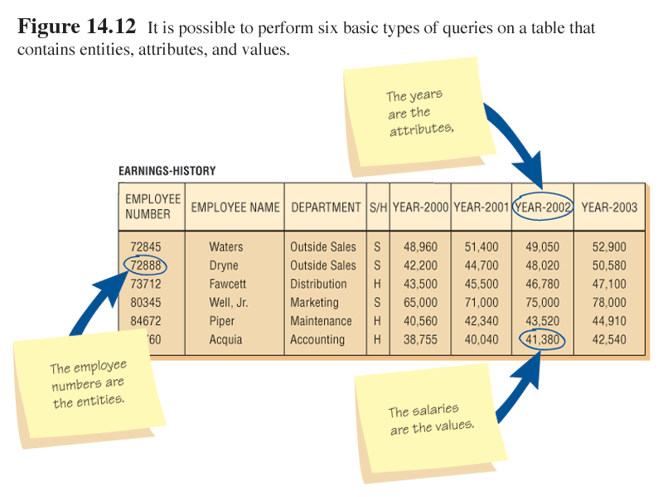
Entities, Attributes, and Values

Slide 36
Query Notation
V is value, E is entity, A is attributes, variables in parentheses are given:
Query type 1: V <--- (E,A)
Query type 2: E <--- (V,A)
Query type 3: A <--- (V,E)
Query type 4: V <--- (E, all A)
Query type 5: E <--- (V, all A)
Query type 6: A <--- (V, all E)

Slide 37
Methods for Implementing Queries
There are two methods for implementing database queries:
Query By Example (QBE), which allows users to select fields and specify conditions using a grid.
Structured Query Language (SQL), which uses a series of keywords and commands to select the rows and columns that should be displayed.

Slide 38
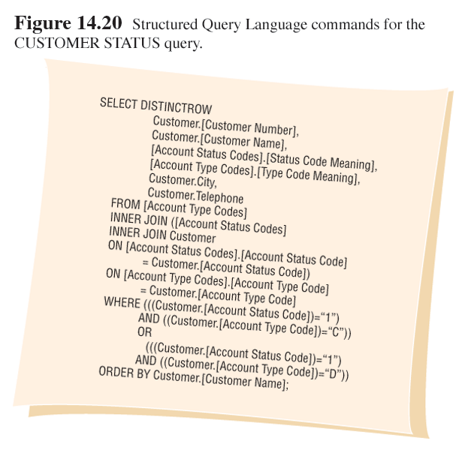
SQL Example

Slide 39
Parameter Queries
A parameter query allows users to enter a value to select records without changing the query syntax.

Slide 40
Web Searches
Web searches uses search engines to answer a query.
Guidelines for searching the Web are:
Decide whether to search or surf the Web.
Think of the key terms before searching.
Construct the search questions logically, with attention to the use of AND and OR search logic.

Slide 41
Web Searches
Guidelines for searching the Web are (continued):
Use a metasearch engine that saves your searches
Use a search engine that informs you of changes in the Web sites you select
Look for new search engines periodically

Slide 42
Data Mining
Data mining is gathering a large amount of information about a person and their habits and using that information as a predictor of future behavior.
It must be carefully and ethically used to avoid infringing on an individual’s privacy.

Slide 43
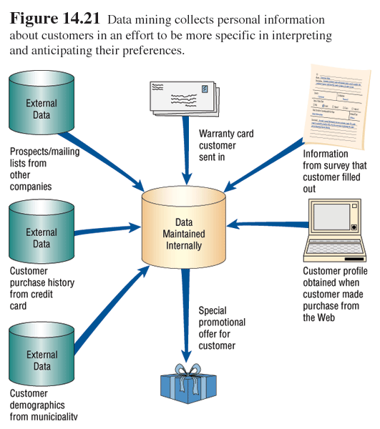
Data Mining

