Slide 1


INFORMATION TECHNOLOGY PROJECT AND CHANGE MANAGEMENT
Information System Department
Universitas Pembangunan Jaya

Slide 2

General Information
Course :
  Information Technology Project and Change Management
Main References:
  Marchewka, J., (2006), Information Technology Project Management : Providing Measurable Organizational Value, 3rd Edition, Wiley, New Jersey.
Schedule :
  Thursday
Lecturer :
  Suhendro

Slide 3
Course Objectives
This course follows the generic IT project methodology that related to PMBOK (Project Management Body of Knowledge), and its implications on organizational change management.
This course presents the area of IT Project Management Virtually all IT business processes involve IT Project Management.

Slide 4
Course Objectives
The focus of the course will be to develop in the student some of the skills of IT Project Management and to give the student a practical application of those skills.
After the completion of this course, the students should :
  Understand the generic of IT project management framework
  Understand the organizational change as the implications of IT project.
  Be able to develop a detail project plan.

Slide 5
Topic and Schedule (Regulair)
Week 01 : IT Project, Organizational Change, and Project Team
Week 02 : Business Case and Project Charter
Week 03 : Scope Management Plan and WBS
Week 04 : Project Schedule and Budget
Week 05 : Project Risk Management
Week 06 : Project Communication and Quality Management
Week 07 : Managing Procurement and Outsourcing
Week 08 : MID SEMESTER TEST
Week 09 : Project Implementation Plan and Closure
Week 10 : Project Leadership and Ethics
Week 11 : Managing Change, Resistance, and Conflict
Week 12 : Practice Session / Project Assigmenment
Week 13 : Practice Session / Project Assigmenment
Week 14 : Practice Session / Project Assigmenment
Week 15 : Practice Session / Project Assigmenment
Week 16 : FINAL SEMESTER TEST

Slide 6
Grading System
Mid semester test : 30 %
Final semester test : 30 %
Assignment : 25 %
Attendances (Minimal 75%) : 15 %

Slide 7

The Software Crisis
If builders built buildings the way programmers wrote programs, then the first woodpecker that came along would destroy civilization.
-Gerald Weinberg-

Slide 8
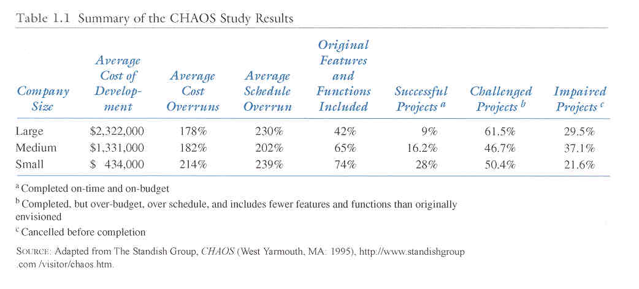
Why Projects Fail – CHAOS STUDY

Slide 9
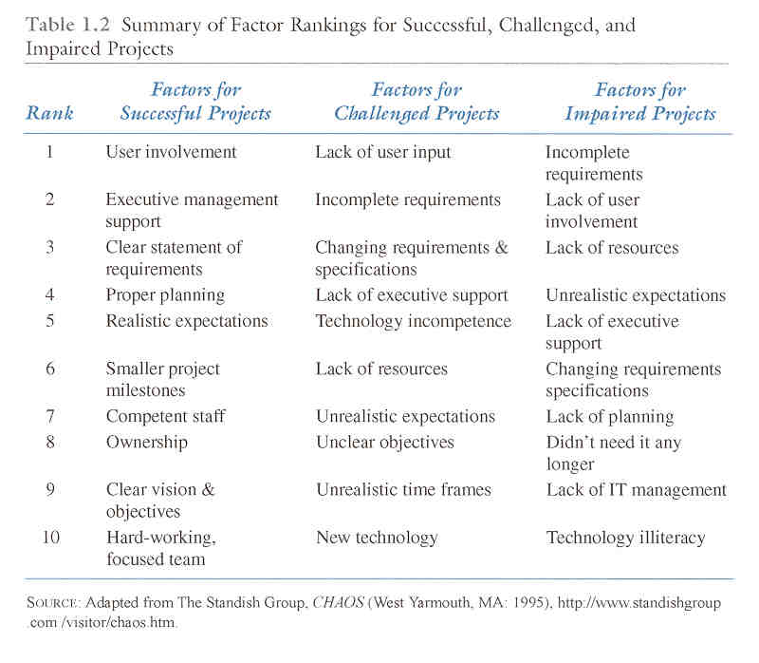
Chaos Study

Slide 10
Improving the likelihood of success
Socio-technical Approach
Project Management Approach
  processes and infrastructure
  resources
  expectations
  competition
  efficiency and effectiveness
Knowledge Management Approach
  lessons learned
  best practices

Slide 11
The context of project management
Project Definitions:
  A project is a temporary endeavor undertaken to accomplish a unique purpose (product, service or result ).
  Project management is the application of knowledge, skills, tools, and techniques to project activities in order to meet or exceed stakeholder needs and expectations from a project
That a product be quantifiable and either and end item in itself or part of something bigger
That the project result in the capability of performing a service
There is a result

Slide 12
Definition of a Project
Example 1: Manufacturing Cell Phone Cases
Scenario: a cell phone company is interested in manufacturing a special cell phone case for their newest model. This cell phone case is part of promotion to sell the phone that begin 4 months from today. Only 1200 of these special cases will manufactured for distribution during the promotion. After the promotion, no further cases will be manufactured or distributed

Slide 13
Definition of a Project
Example 1: Manufacturing Cell Phone Cases
Scenario: a cell phone company is interested in manufacturing a special cell phone case for their newest model. This cell phone case is part of promotion to sell the phone that begin 4 months from today. Only 1200 of these special cases will manufactured for distribution during the promotion. After the promotion, no further cases will be manufactured or distributed
Is it temporary?
Is it unique?
Will the end reach project objectives?

Slide 14

Definition of a Project
Example 1: Manufacturing Cell Phone Cases
Scenario: a cell phone company is interested in manufacturing a special cell phone case for their newest model. This cell phone case is part of promotion to sell the phone that begin 4 months from today. Only 1200 of these special cases will manufactured for distribution during the promotion. After the promotion, no further cases will be manufactured or distributed
Is it temporary?
Is it unique?
Will the end reach project objectives?

Slide 15
Definition of a Project
Example 1: Manufacturing Cell Phone Cases
Scenario: a cell phone company is interested in manufacturing a special cell phone case for their newest model. This cell phone case is part of promotion to sell the phone that begin 4 months from today. Only 1200 of these special cases will manufactured for distribution during the promotion. After the promotion, no further cases will be manufactured or distributed
Is it temporary?
Is it unique?
Will the end reach project objectives?

Slide 16
Definition of a Project
Example 1: Manufacturing Cell Phone Cases
Scenario: a cell phone company is interested in manufacturing a special cell phone case for their newest model. This cell phone case is part of promotion to sell the phone that begin 4 months from today. Only 1200 of these special cases will manufactured for distribution during the promotion. After the promotion, no further cases will be manufactured or distributed
Is it temporary?
Is it unique?
Will the end reach project objectives?

Slide 17
Definition of a Project
Example 1: Manufacturing Cell Phone Cases
Scenario: a cell phone company is interested in manufacturing a special cell phone case for their newest model. This cell phone case is part of promotion to sell the phone that begin 4 months from today. Only 1200 of these special cases will manufactured for distribution during the promotion. After the promotion, no further cases will be manufactured or distributed
APPROVED
Is it temporary?
Is it unique?
Will the end reach project objectives?

Slide 18
Definition of a Project
Example 2: Adding Cell Phone Cases to Assembly Line
Scenario: the cell phone company has so much success with their promotional cell phone cases, that customer demand has convinced them to integrated this case as part of their regular product offering. It will now be manufactured along with the other 5 cases that are offered. The cases will be manufactured until customer demand for the phone drops
Is it temporary? X
Is it unique?
Will the end reach project objectives?

Slide 19
Definition of a Project
Example 2: Adding Cell Phone Cases to Assembly Line
Scenario: the cell phone company has so much success with their promotional cell phone cases, that customer demand has convinced them to integrated this case as part of their regular product offering. It will now be manufactured along with the other 5 cases that are offered. The cases will be manufactured until customer demand for the phone drops
Is it temporary? X
Is it unique? X
Will the end reach project objectives?

Slide 20
Definition of a Project
Example 2: Adding Cell Phone Cases to Assembly Line
Scenario: the cell phone company has so much success with their promotional cell phone cases, that customer demand has convinced them to integrated this case as part of their regular product offering. It will now be manufactured along with the other 5 cases that are offered. The cases will be manufactured until customer demand for the phone drops
DENIED
Is it temporary? X
Is it unique? X
Will the end reach project objectives? X

Slide 21
Simple Answers to Simple Questions
Why do I need project management?
Why do projects need planning?
If I only have a small project, do I really need to bother with all of that?
What is a successful project?

Slide 22
The context of project management
Project Attributes:
Time Frame
Purpose
Ownership
Resources (Time, money, people, resources)
Roles
Risks & Assumptions
Interdependent tasks
Organizational change
Operating Environment

Slide 23
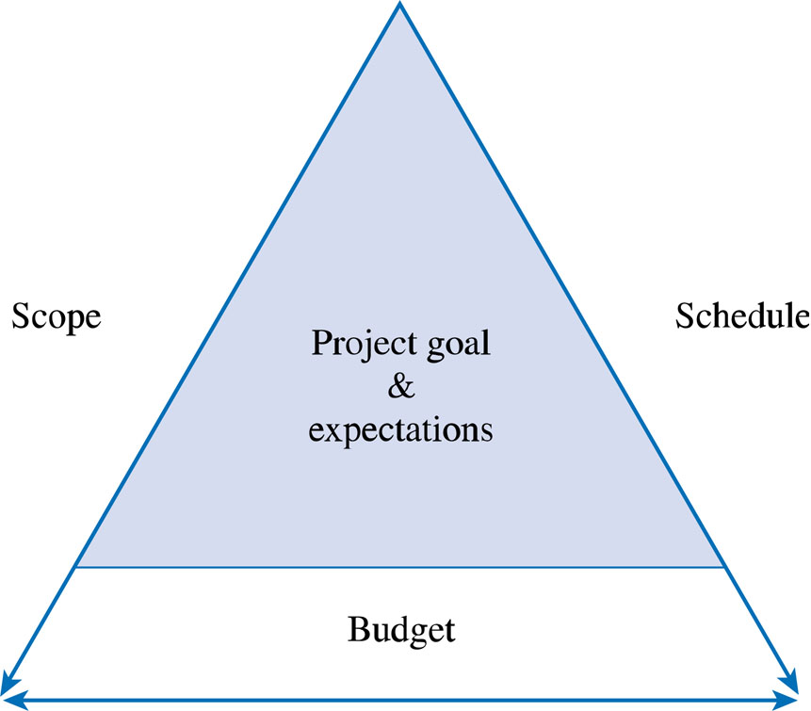
The Triple Constraint

Slide 24
Project Management (PMBOK) Knowledge Areas
Project integration management
Project scope management
Project time management
Project cost management
Project quality management

Slide 25
Project Management Knowledge Areas
Project human resource management
Project communication management
Project risk management
Project procurement management

Slide 26
KARENA ADANYA TEKNOLOGI
BARU DI ORGANISASI MAKA …
• Proses kerja berubah.
• Jumlah karyawan berubah.
• Struktur organisasi berubah.
• Kompetensi yang dibutuhkan berubah.
• Strategi bisnis berubah.
KETAKUTAN DAN RESISTENSI
KARYAWAN

Slide 27
JIKA KARYAWAN TAKUT DAN
RESISTEN MAKA …
• Reaksi ringan : cuek dan apatis.
• Reaksi menengah : mogok kerja.
• Reaksi berat : sabotase sistem.
PERLU MANAJEMEN PERUBAHAN
YANG TEPAT SUPAYA INI
TIDAK TERJADI

Slide 28
Business Risks
People:
Lack of Ownership
Under utilization
Confusion, low morale etc
Technical
Implementation:

Slide 29
Business Risks
Technical Implementation:
Lack of delivery
Frustration
Desired functionality not realized
People:

Slide 30

Change Management
Where should the change management effort focus?

Slide 31
Future
State
Organizational Transformation
Current
State
Individual Transformation

Slide 32

THANK YOU
FOR YOUR ATTENTION!

