Slide 1
Reference Groups and Word-Of-Mouth
Chapter 9

Slide 2
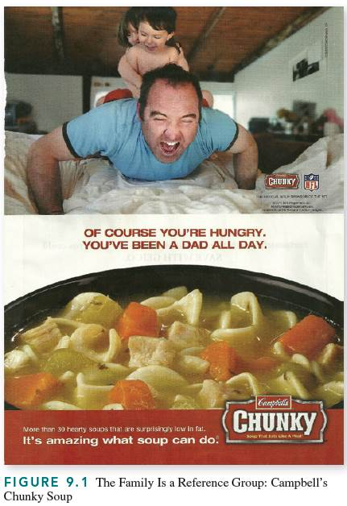
Family = Most Important Reference Group
Notes:
The most important reference group is the family because it provides children with the skills, knowledge, attitudes, and experiences necessary to function as consumers, a process called consumer socialization.

Slide 3
Source Credibility
A source’s persuasive impact, stemming from its perceived expertise, trustworthiness, and believability.

Slide 4
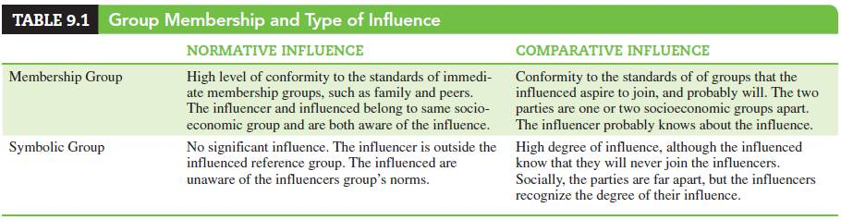
Reference Group Influence
Normative influence
Comparative influence
Notes:
Reference groups serve as comparative and normative frames of reference for a person’s values and behaviors. Normative influence consists of learning and adopting a group’s norms, values, and behaviors. The most pertinent normative influence comes from groups to which people
naturally belong, such as family, peers, and other members of one’s community. Comparative influence arises when people compare themselves to others whom they respect and admire, and then adopt some of those people’s values or imitate their behaviors.
A group to which a person belongs to, or realistically can join, is called a membership group. A symbolic group is a group to which an individual is unlikely to belong, but whose values and behaviors that person adopts.

Slide 5
Consumption-Related Reference Groups
Friendship groups
Shopping groups
Virtual communities
Advocacy groups
Notes:
The consumption-related groups that influence consumers’ attitudes and behavior include friendship groups, shopping groups, virtual communities, and advocacy groups.
Friends fulfill a wide range of needs: They provide companionship, security, and opportunities to discuss problems that an individual may be reluctant to discuss with family members. They may be a credible source of information about purchases.
People may shop together just to enjoy shopping or to reduce their perceived risk; that is, they may bring someone along whose expertise regarding a particular product category will reduce their chances of making incorrect purchases. Referral programs are an important element of shopping groups. Another example of a shopping group is the shared experience of waiting in line. Retail experts say that by standing in a crowd, shoppers see themselves as making the right buying decision—a concept known as “social proof.”
Many websites encourage consumers to leave comments and have others respond to them. Most young adults have extensive “buddy lists” and regularly communicate with people whom they have met online but never in person. The fact that people can share their interests, hobbies, and opinions with thousands of peers online has benefited marketers.
The objective of consumption-focused advocacy groups is to assist consumers in making consumption decisions and support their rights. There are two types of advocacy groups: entities organized to correct a specific consumer abuse and then disband, and groups whose purpose is to address broader,
more pervasive problem areas and operate over an extended period of time.

Slide 6
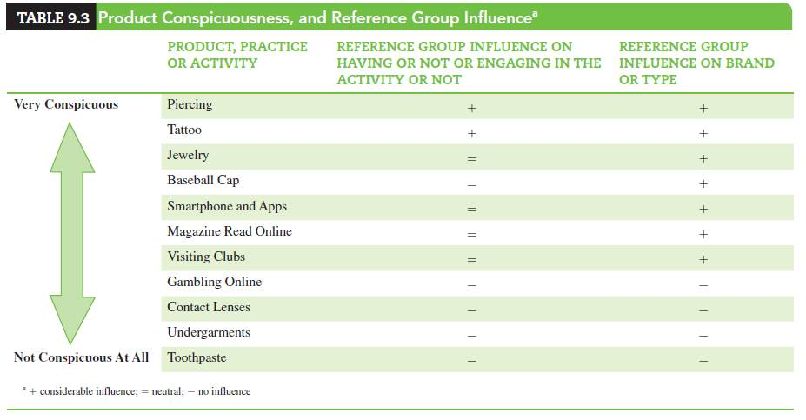
Factors Affecting Reference Group Influence
Group power and expertise
Relevant information and experiences
Product conspicuousness
Notes:
Different reference groups may influence the beliefs, attitudes, and behaviors of individuals at different times or under different circumstances. Consumers who are primarily concerned with approval from others usually adopt the same products and brands as those group members who have status. When consumers are preoccupied with the power that a person or group can exert over them, they often adopt products that conform to the norms of that person or group in order to be complimented on their choices. However, unlike reference groups that are not power based, “power groups” may bring about behaviors, but not changes in attitudes.
Individuals who have firsthand experience with a product or service, or can easily obtain detailed information about it, are less likely to be influenced by the advice or example of others. In contrast, persons who have little or no experience with a product or service, and do not trust advertising messages, are more likely to seek out the advice or example of others.
The degree of reference group influence on purchase decisions varies according to product conspicuousness. Products that are especially conspicuous
and status revealing are most likely to be purchased with an eye to the reactions of relevant others.

Slide 7
Conveying Company Credibility
Past performance
Good Reputation
Product Quality
Good Service
Image and attractiveness of spokespersons
Reputation of retailers that carry offerings
Media where they advertise
Institutional advertising
Notes:
Consumers recognize that the intentions of commercial sources (e.g., manufacturers, service companies, financial institutions, retailers) are clearly profit and view them as less credible than informal reference groups. Companies can convey their credibility through solid past performance, good reputation, product quality, and good service. Their perceived credibility is also a function of the image and attractiveness of their spokespersons, the reputation of the retailers that carry their offerings, and the media where they advertise.
Marketers also use institutional advertising, which consists of promoting a company’s image without referring to any of its specific offerings.

Slide 8
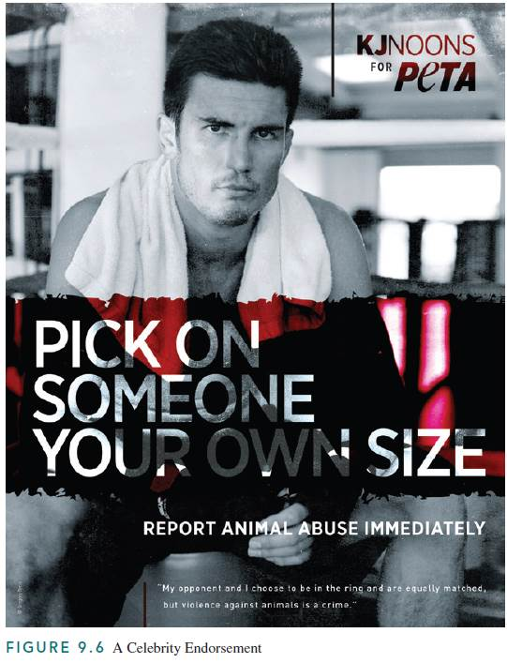
Celebrity Uses in Advertisements
Celebrity testimonials
Celebrity endorsements
Celebrity actors
Celebrity spokespersons
Notes:
Celebrities, particularly movie stars, TV personalities, popular entertainers, and sports icons, are a symbolic reference group because they are liked, admired, and often have a high degree of perceived credibility. The “pitchman” (or woman) who appears in a promotional message has enormous influence on the credibility of the message. Credibility is the most important thing the celebrity offers – the audience’s perception of both the celebrity’s expertise (how much the celebrity knows about the product area) and trustworthiness (how honest the celebrity is about what he or she says about the product).
Marketers employ celebrities in promotion in the following ways:
1. Celebrity testimonial—Based on personal usage, the celebrity attests to the product’s quality.
2. Celebrity endorsement—Celebrities appear on behalf of products, with which they may or may not have direct experience or familiarity, for extended periods. Figure 9.6 features “K.J.” Noons—a kickboxing and martial arts champion—as a spokesperson for a not-for-profit organization named People for the Ethical Treatment of Animals (PETA). “K.J.” is a tough fighter and he states that while he and his opponents in the ring are equally matched, animals often need protection from violence and abuse by bigger and stronger humans.
3. Celebrity actor—The celebrity plays a part in a commercial for the product.
4. Celebrity spokesperson—The celebrity represents the brand or company over an extended period.

Slide 9
Other Sources Credibility
Salesperson credibility
Vendor credibility
Message credibility (previous experience)
Medium credibility
How does time affect the influence of source credibility on message persuasiveness?
Notes:
Salespeople who engender confidence and who give the impression of honesty and integrity are most persuasive. A salesperson who “looks you in the eye” often is perceived as more honest than one who evades direct eye contact. For many products, a sales representative who dresses well and drives an expensive, late-model car may have more credibility than one without such outward signs of success. For other products, a salesperson may achieve more credibility by dressing in the role of an expert.
The reputation of the retailer who sells the product has a major influence on message credibility. Products sold by well-known, quality stores carry the added endorsement (and implicit guarantee) of the store itself.
The consumer’s previous experience with the product or vendor has a major impact on the credibility of the message. Fulfilled product expectations increase the credibility accorded to future messages by the same advertiser; unfulfilled product claims or disappointing product experiences reduce
the credibility of future messages. Thus, the key basis for message credibility is the ability of the product, service, or brand to deliver consistent quality, value, and satisfaction to consumers.
The reputation of the medium that carries the advertisement also enhances the credibility of the message. Most consumers believe that a respectable medium would only advertise products that it “knows” to be of good quality. Because specialization in an area implies knowledge and expertise,
consumers regard advertising they see in special-interest magazines and websites as more credible than ads in general-interest sources.
When information is transferred from the short-term memory to the cerebral cortex (where long-term memory is located), over time, it is separated from the context in which it was learned. One’s disassociation of the message from its source over time, and remembering only the message content but not its source, is called the sleeper effect. Thus, though a high-credibility source is initially more influential than a low-credibility source, studies
show that both positive and negative credibility effects tend to disappear after six weeks or so. Furthermore, the theory of differential decay suggests that the memory of a negative cue (e.g., a low credibility source) simply decays faster than the message itself, leaving behind the primary message
content.

Slide 10
E-WOM
Factors affecting engagement
Social networks
Brand communities
Blogs and microblogs
Notes:
Three dimensions underly consumers’ engagement in e-wom: 1. Tie strength—the degree of intimacy and frequency of contacts between the information seeker and the source. 2. Similarity among the group’s members in terms of demographics and lifestyles. 3. Source credibility—the information seeker’s perceptions of the source’s expertise.
Negative reviews of hedonic (i.e., products used mainly for pleasure) products where considered less useful/attributed to the reviewer; negative reviews for utilitarian products were attributed to the product. Involved consumers transfer and receive more rational product information than information appealing to emotions.
Online, social networks are virtual communities where people share information about themselves with others, generally with similar interests, with whom they have established relationships that, for the most part, exist only in cyberspace. The major social networks are Facebook, YouTube, Twitter, and MySpace.
A brand community is a specialized, nongeographically bound community formed on the basis of attachment to a product or brand.
A blog is a discussion or informational site published on the Internet and consists of discrete entries (“posts”). A microblog has less content than the traditional blog and allow users to exchange small elements of content, such as short sentences, individual images, and video links, mostly via Twitter. Twitter is an online social networking service and microblogging service that enables its users to send and read text-based messages of up to 140 characters, known as “tweets.”

Slide 11
Stimulating Word of Mouth
Viral marketing
Motivations for passing along emails
Buzz agents
Discussion Question:
Why do consumer share negative rumors about companies and their products/services?
Notes:
Marketers long ago realized the power of word-of-mouth communications between consumers, which it is almost always more effective than promotional messages paid for by advertisers, and they often encourage it in ads.
Viral marketing (viral advertising) is a marketing technique that uses pre-existing social networks and other technologies to produce increases in brand awareness or to achieve other marketing objectives through encouraging individuals to pass along messages.
Investigation of the motivations for passing along emails found that:1. People were receptive only to emails from people they knew. The kind of emails they received included jokes, virus alerts, inspirational stories, requests to vote on certain issues, video clips, and links to other websites.
2. The main reasons for not forwarding emails were outdated, dull, and inappropriate contents. About one-third of the forwarded emails included personalized notes from the forwarders, and most of the senders did not alter the emails’ original subject lines. 3. The key reasons for forwarding emails were enjoyment (e.g., fun, entertaining, exciting) and helping others (i.e., let others know that the senders care about them). The forwarders also
reported that they only passed along contents that they believed the receivers would find interesting.
Many firms enlist typical consumers to serve as their buzz agents—consumers who promote products clandestinely and generally receive free product samples but not monetary payments.
Consumers share negative experiences with others much more readily than positive ones. Consumers attend to negative information because it is less common than positive information and to protect themselves. Online media made it easier for consumers to spread negative word-of-mouth. One study discovered that some consumers who posted unfavorable information wanted to vent negative feelings or warn others. Others sought exposure, self-enhancement, social benefits, and even economic rewards.

Slide 12
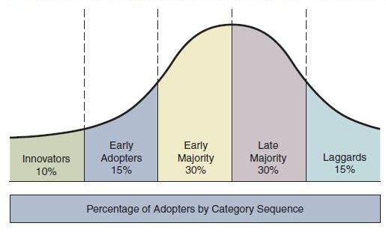
Adopter Categories
Innovators
Early Adopters
Early Majority
Late Majority
Laggards
Notes:
The concept of adopter categories is a classification that depicts where consumers stand in relation to other consumers in terms of the first time they purchase an innovation (e.g., a new product or model).
Sociologically, the model assumes that all members of a given society would, eventually, adopt the innovation. Thus, the number of people belonging to each category was calculated in a manner resembling a statistical normal distribution: innovators— the first 2.5% to adopt; early adopters—the next 13.5%; early majority—the next 34%; late majority—the following 34%; and the laggards—the last 15%.

Slide 13


Slide 14
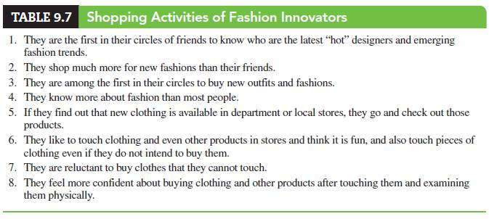
Innovators
Notes:
The innovators are the earliest consumers to buy new products. They are prepared to take the risk that the product will not work well, become unavailable, or be quickly replaced by an improved model (i.e., they are broad categorizers). They are often willing to pay somewhat higher prices for
newly introduced products, because they enjoy being the first to own gadgets and show them off. The table shows the shopping activities of fashion innovators.

Slide 15
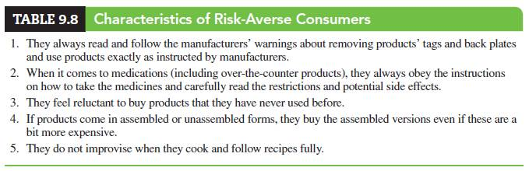
Adopter Categories – Non-Innovators
Early adopters
Early majority
Late majority
Laggards
Prospective adopters
Persistent non-adopters
Notes:
The early adopters are consumers who buy new products within a relatively short period following introduction, but not as early as the innovators. They are venturesome, likely to engage in word-of-mouth, and also likely to assist others who are considering adopting the new products.
The early majority consists of consumers who buy innovations after the early adopters have done so. This segment is larger than the preceding two groups combined. Risk aversion is defined as the reluctance to take risks and low tolerance of ambiguous situations, as illustrated by the consumption-related characteristics of risk-averse consumers in Table 9.8. Members of the early majority are somewhat risk averse, whereas the late majority and laggards are highly risk-averse consumers.
Members of the late majority are risk averse and slow to adopt innovation. They wait until most other consumers have adopted the new product before buying it.
The laggards are the very last consumers to adopt innovations. By the time they get around to purchasing their first electronic readers, the innovators and early adopters are already switching to more advanced models with advanced features. Laggards are generally high-risk perceivers and the last
ones to recognize the value of innovative products.
Marketers often “write off” non-adopters, but not all non-adopters are the same, and understanding nonusers is important. For instance, one study found two distinct segments among non-adopters of Internet banking:
1. Prospective adopters, who could potentially become customers.
2. Persistent non-adopters, who are very unlikely to become customers.
The study suggested that online banks should identify prospective customers among nonusers rather than lump all nonusers into a single category

Slide 16
Class Assignment
  Find ads that encourage consumers to engage in word-of-mouth communications and present them in class.

