Slide 1
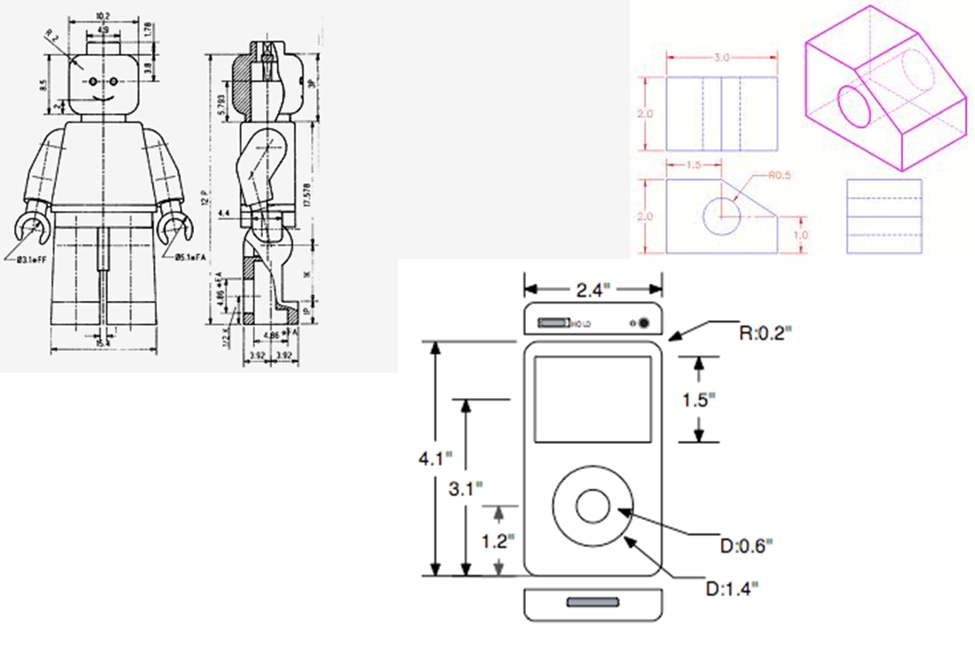
AFTER UTS : GAMBAR TAMPAK SEDERHANA

Slide 2
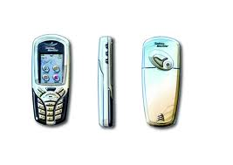
RENDERING SEDERHANA

Slide 3
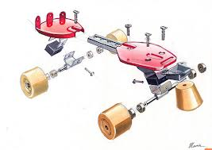
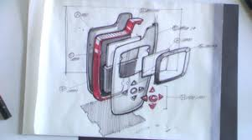
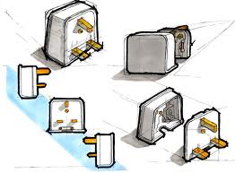
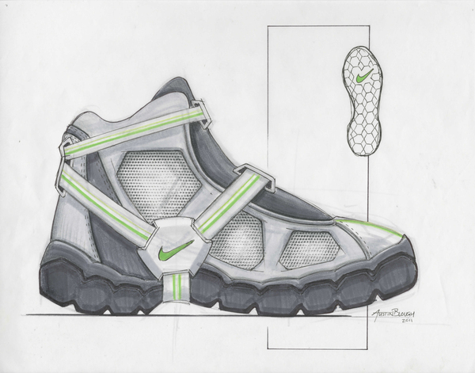
UAS EXPECTATIONS : GAMBAR TAMPAK + EXPLODED VIEW

