Slide 1
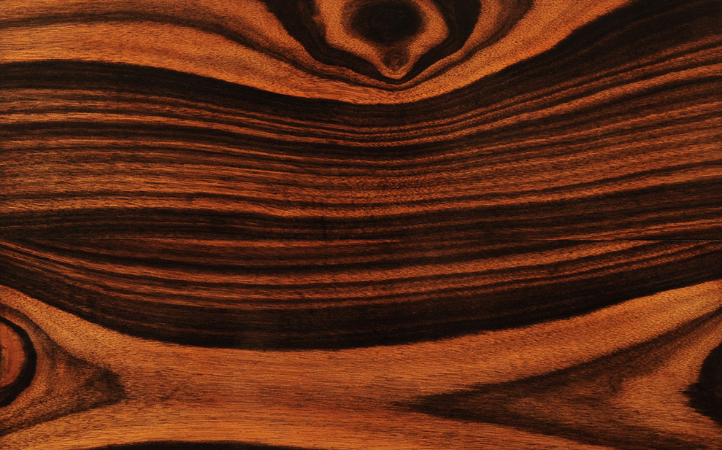
MATERIAL PRODUK
Dosen : I. Alif Siregar M.A

Slide 2
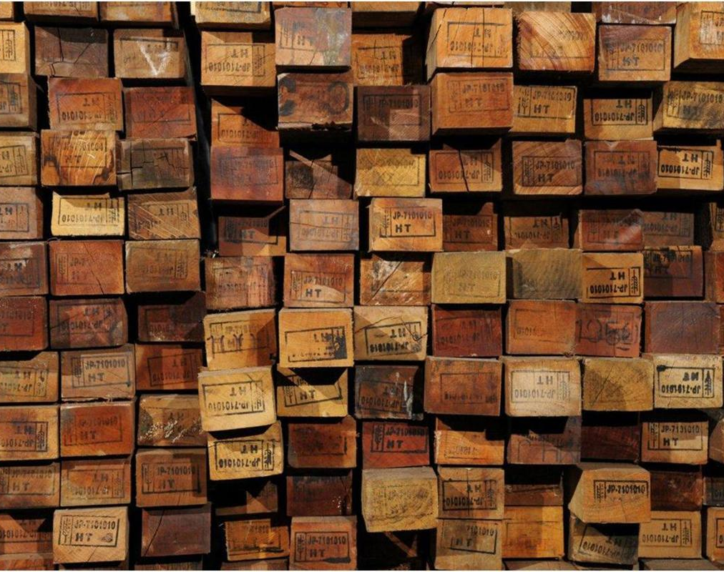
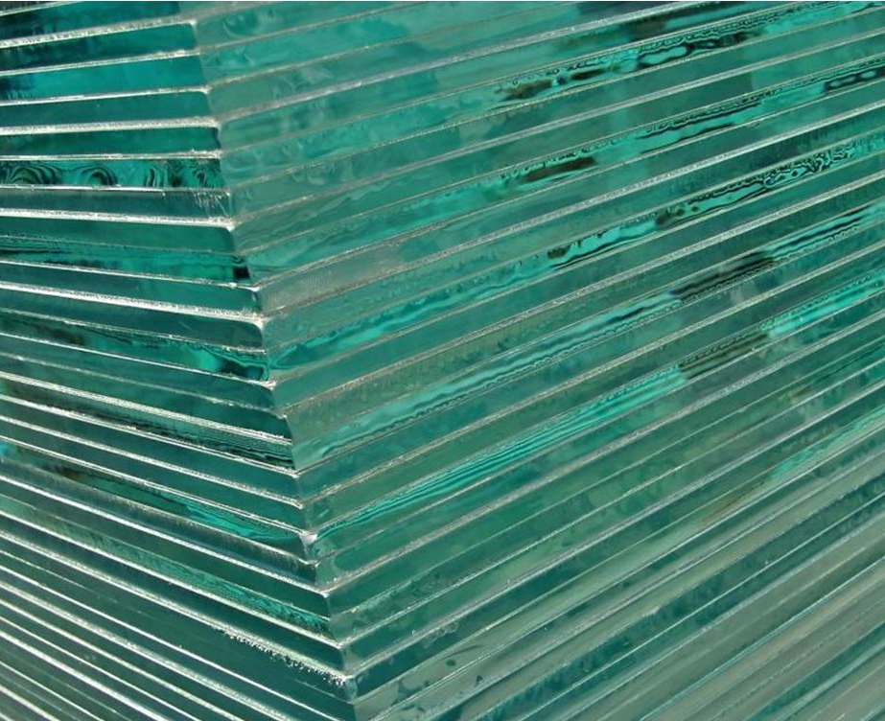
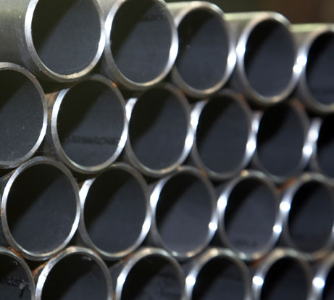
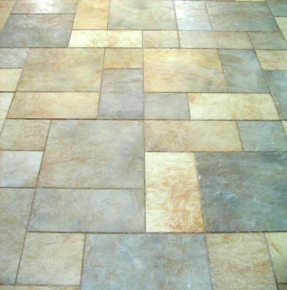
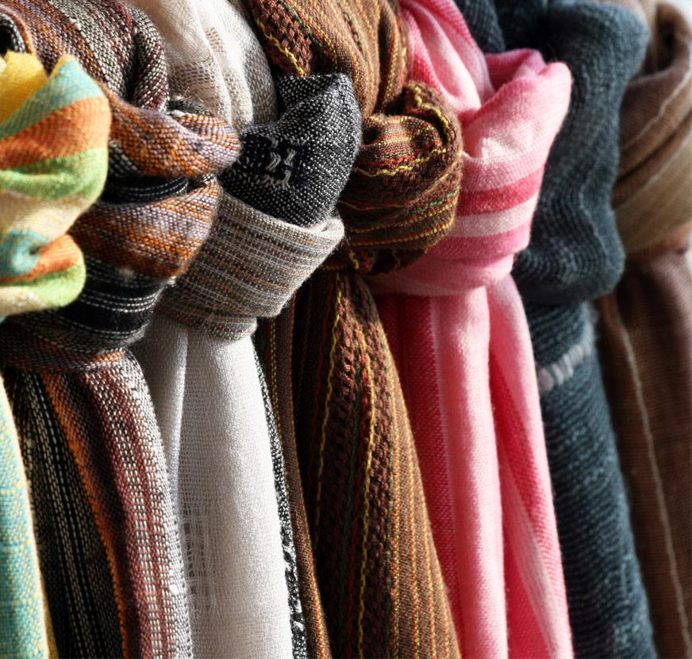
Woods Glass Metals
Ceramics Polymers Textiles

Slide 3
MATERIALS
Quality Visual identity Cost Suitability

Slide 4
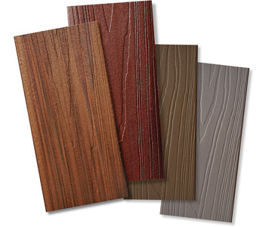
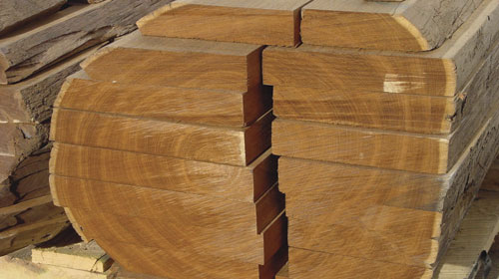
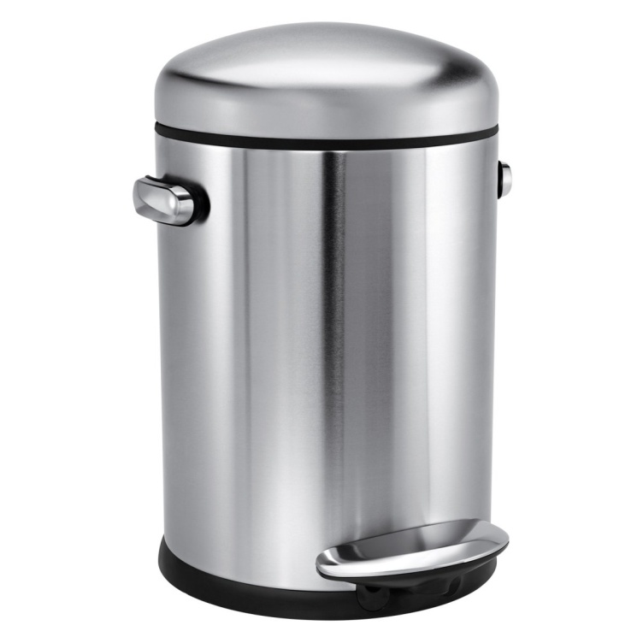
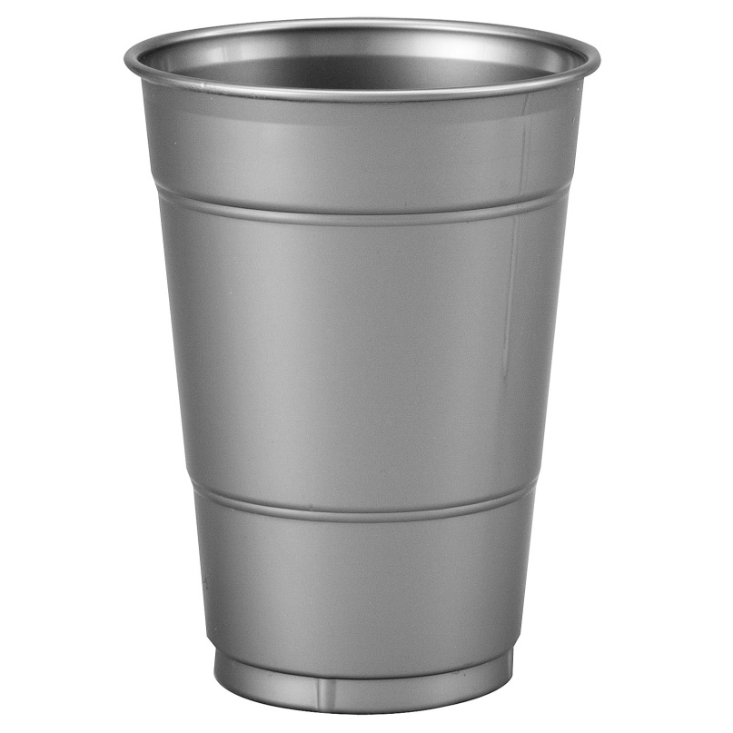
Cost
VS

Slide 5
Visual identity

Slide 6
Visual identity
Bang & Olufsen

Slide 7
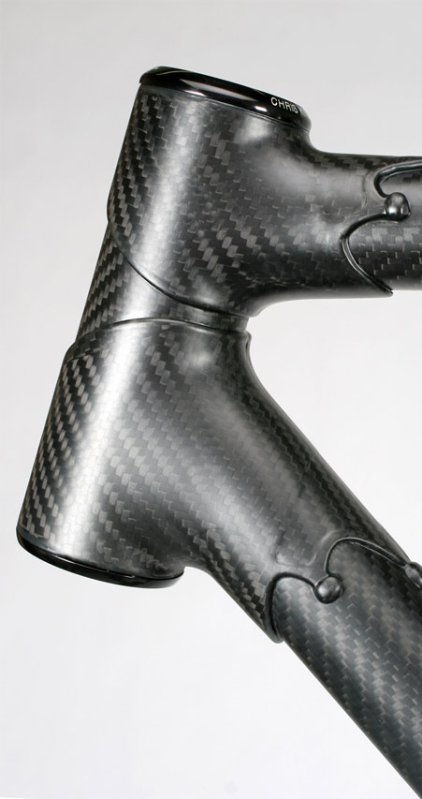
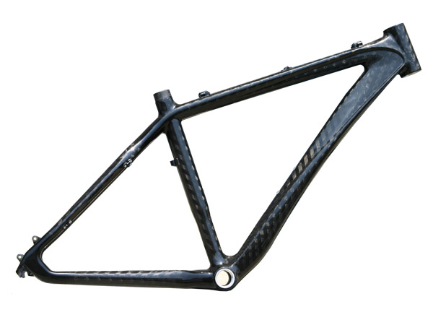
Quality

Slide 8
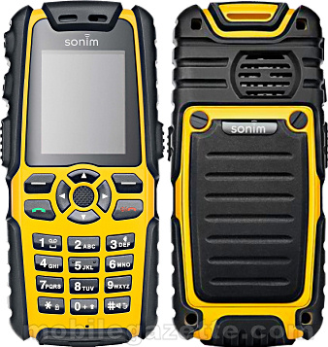
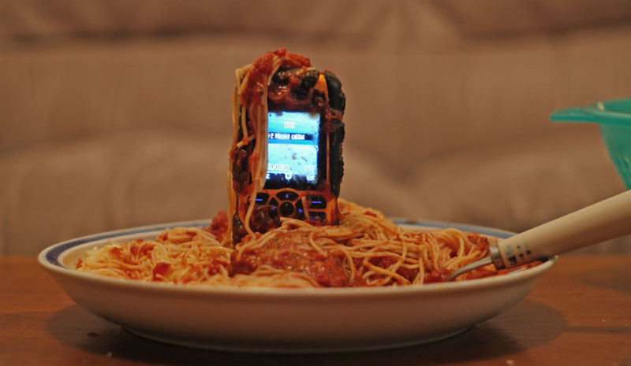
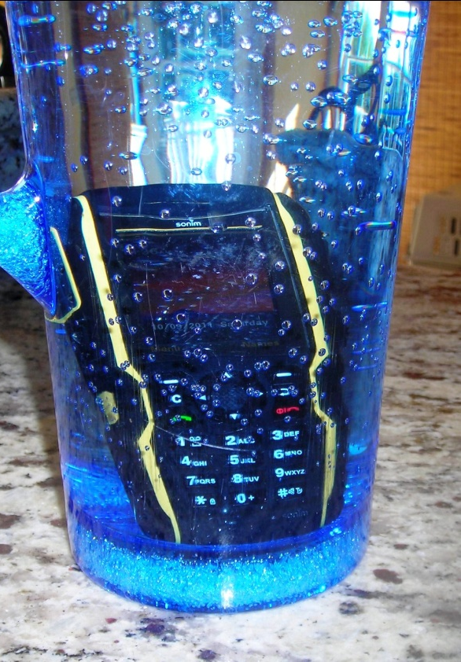
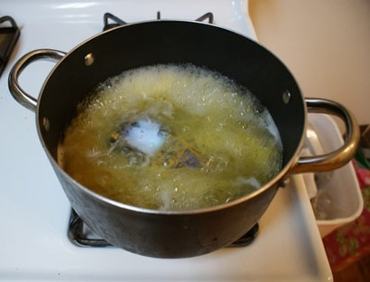
Quality

Slide 9
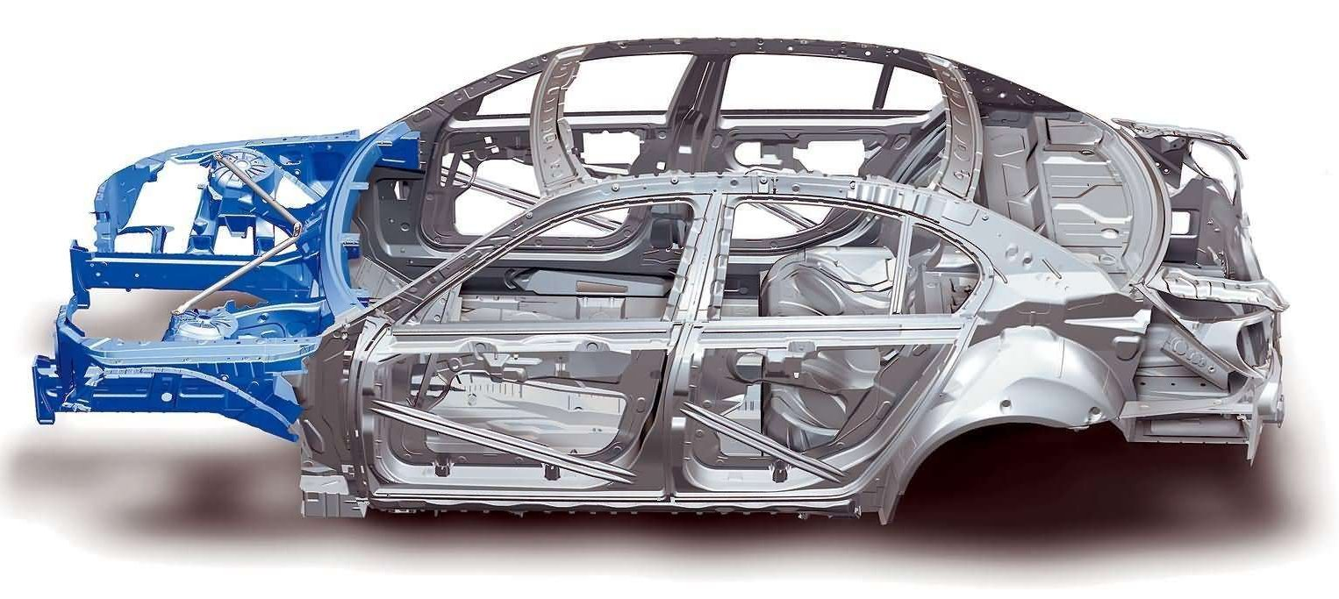
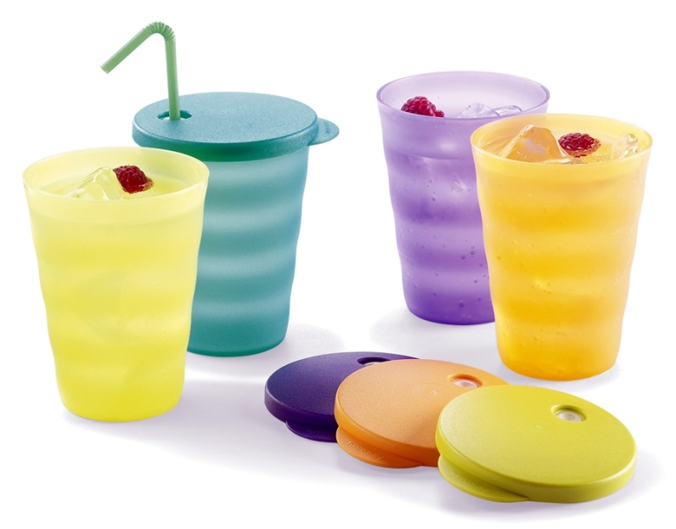
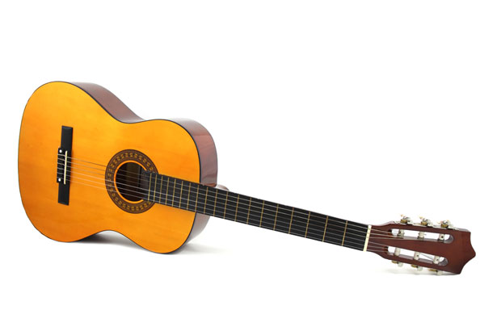
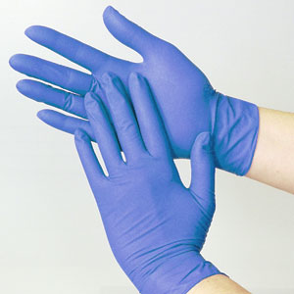
Suitability

Slide 10
Material termoplastik dengan output bentuk kompleks

Slide 11
5.1 A Classifi cation of
Processes
Based on groupings that are
familiar to engineers. The final
column shows a list of possible
attributes for a specific process.
Top, Classification of Shaping
Processes; center, Classification of
Joining Processes; bottom,
Classification of Surface Processes

Slide 12
Materials are the stuff of design, and throughout history have dictated its
opportunities and its limits. The ages in which man has lived are named for
the materials he used: stone, bronze, iron, plastics and – today – silicon. But
today is not the age of just one material; it is the age of an immense range
of materials and the combinations these allow. And people (your customers)
are more aware of issues related to material selection due to the emergence
of the idea of sustainability. There has never been an era in which the
evolution of materials was faster and the sweep of their properties more
varied. The menu of materials has expanded so rapidly that designers can
be forgiven for not knowing that half of them exist. Yet not-to-know is, for
the designer, to risk failure: innovative design, is enabled by the imaginative
exploitation of new or improved materials. There is no reason to expect that
the pace of material development will slow so things can only get worse (or
better!).

Slide 13
The Evolution of Engineering
Materials with Time
Relative importance in the Stone and Bronze
Age is based on assessments of archeologists;
that in 1960 on allocated teaching hours in
UK and US universities; that in 2020 on
prediction of material usage in automobiles
by manufacturers.

Slide 14
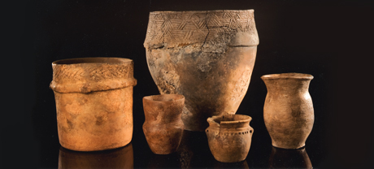
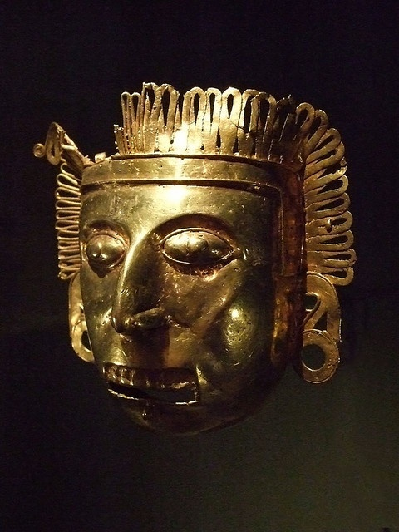
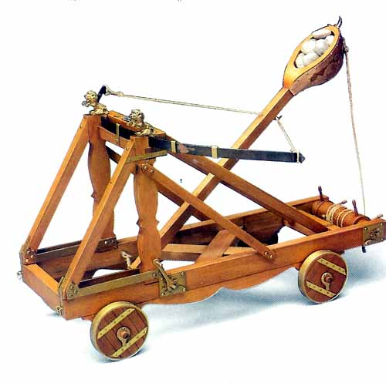
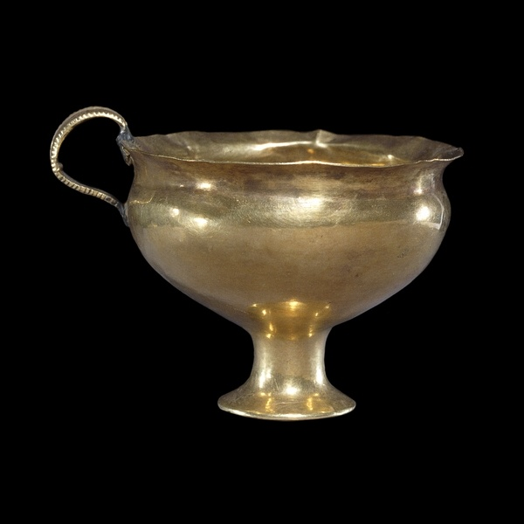
Pottery of dartmoor
Pectoral maskette gold Oaxaca Mexico Mixtec-Aztec Culture Late Postclassic Period 1350-1521 CE
The sword of Tiberius Roman,
around AD 15 From Mainz
Catapult
Gold goblet, Mycenaean Greek 1500 BC

Slide 15
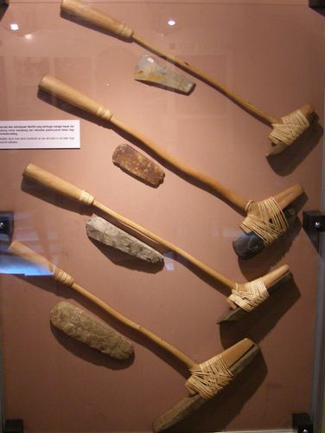
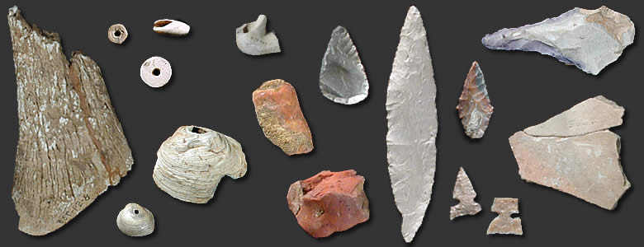
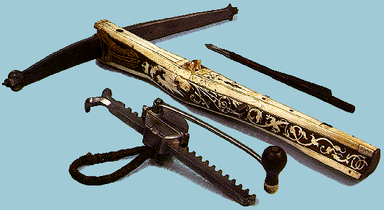
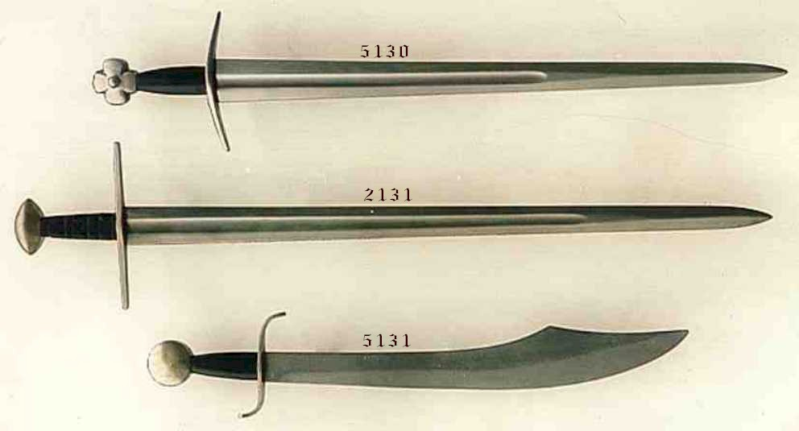
Stone age 4500 BC >
the Bronze Age, 3000 BC to 1000 BC, and the Iron Age, 1000 BC to 1620 AD

Slide 16
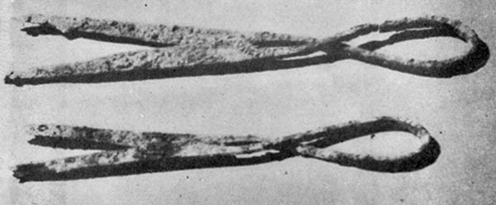
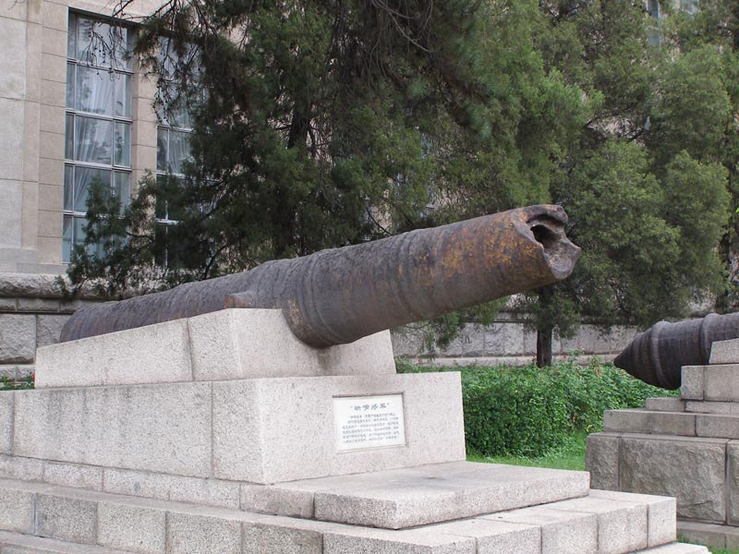
Cast iron (1620), development of steel (1850), light alloy (1940)
Engineering materials/metals (1960)

