Slide 1
Metal
Most of the elements in the periodic table are metals. Metals have “free” electrons
electrons that flow in an electric field, so they conduct electricity well, they refl ect light and viewed with the light behind them, they are completely opaque. The metals used in product design are, almost without exception, alloys. Steels (iron with carbon and a host of other alloying elements to make them harder, tougher, or more corrosion resistant) account for more than 90% of all the metals consumed in the world; aluminum comes next, followed by copper, nickel, zinc, titanium, magnesium and tungsten.

Slide 2
Compared to all other classes of material, metals are stiff, strong and tough, but they are
heavy. They have relatively high melting points, allowing some metal alloys to be used at
temperatures as high as 2200 c. Only one metal – gold – is chemically stable as a metal;
all the others will, given the chance, react with oxygen or sulfur to form compounds
that are more stable than the metal itself, making them vulnerable to corrosion. There
are numerous ways of preventing or slowing this to an acceptable level, but they require
maintenance. Metals are ductile, allowing them to be shaped by rolling, forging, drawing
and extrusion; they are easy to machine with precision; and they can be joined in many different
ways. This allows a fl exibility of design with metals that is only now being challenged
by polymers.
The development of metals and alloys continues. Superplastic alloys have the unique
property that, in sheet form, they can be vacuum or thermoformed like thermoplastics.
Shape-memory alloys have the capacity to remember their initial shape even when deformed
very heavily, so that they spring back like a rubber – they are used in thermostats,
and as the frames for eye glasses, brassieres and small actuators. Metal matrix composites
(such as aluminum with silicon carbide) extend the property range of metals, usually to
make them stiffer, lighter, and more tolerant of heat, but their cost limits their applications.
Techniques for foaming metals are emerging that have the potential to capture new
market. Nonetheless, the status of metals has been eroded during the past few decades by
other materials: polymers in small scale structures like household appliances, polymerbased
composites in cars, aircraft and boats; and ceramics in certain engine parts and
cutting blades. But as Guy Nordenson, of the engineering firm Arup, observes, “Materials
development and usage are historically cyclical. Work with metals is probably more out of
touch than it is behind.”
Primary production of metals is energy intensive. Many, among them aluminum, magnesium
and titanium, require at least twice as much energy per unit weight (or five times
more per unit volume) than commodity polymers. But metals can generally be recycled,
and the energy required to do so is much less than that required for primary production.
Some are toxic, particularly the heavy metals – lead, cadmium, mercury. Some, however,
are so inert that they can be implanted in the body: stainless steels, cobalt alloys and certain
alloys of titanium, for example.

Slide 3
Metals
Aluminum alloys
Copper alloys
Magnesium alloys
Nickel alloys
Steels – carbon
Steels – low alloy
Steels – stainless
Titanium alloys
Zinc alloys

Slide 4
Metal Manufacturing Process

Slide 5
Metal Ingots

Slide 6
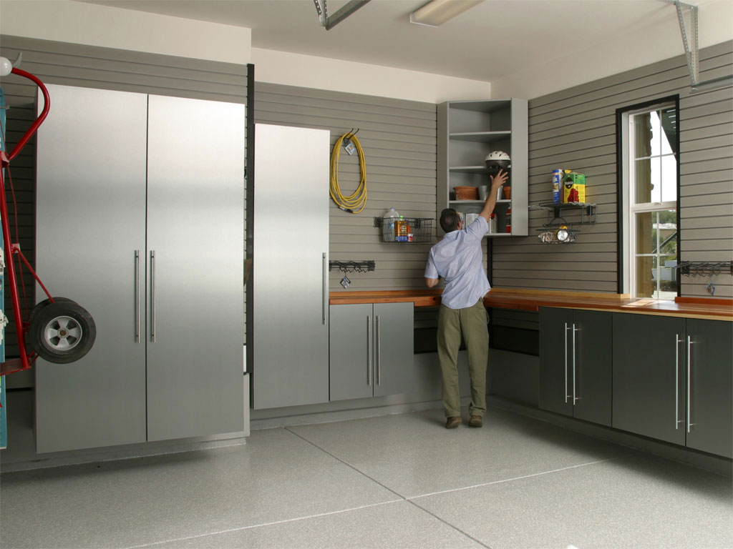
Aluminum alloys
Application : Aerospace engineering; automotive engineering; die cast chassis for household and electronic products; siding for buildings; foil for containers and packaging; beverage cans; electrical and thermal conductors.
Environment : Aluminum ore is abundant. It takes a lot of energy to extract aluminum, but it is easily recycled at low energy cost.

Slide 7
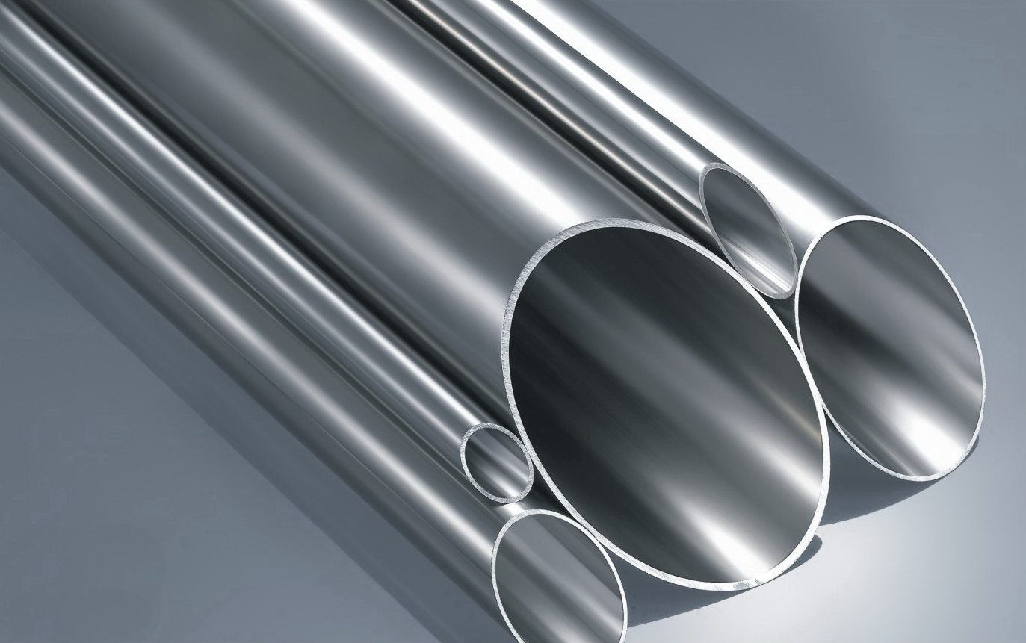
Carbon Steels
Application : Reinforcement of concrete, steel sections for construction, sheet for roofi ng, car body panels, cans and pressed sheet products give an idea of the scope. Medium carbon steels are the materials of general construction and engineering, axles and gears, bearings, cranks and shafts. High carbon steels are used for cutting tools, high performance bearings, cranks and shafts, springs, knives, ice axes and ice skates.
Environment : The production energy of steel is comparatively low – per unit weight, about a half that of polymers; per unit volume, though, twice as much. Carbon steels are easy to recycle, and the energy to do so is small.

Slide 8
Low Alloy Steels
Application : Springs, tools, ball bearings, rollers; crankshafts, gears, connecting rods.
Environment : Steels are not particularly energy intensive to make, and are easily and widely recycled.

Slide 9
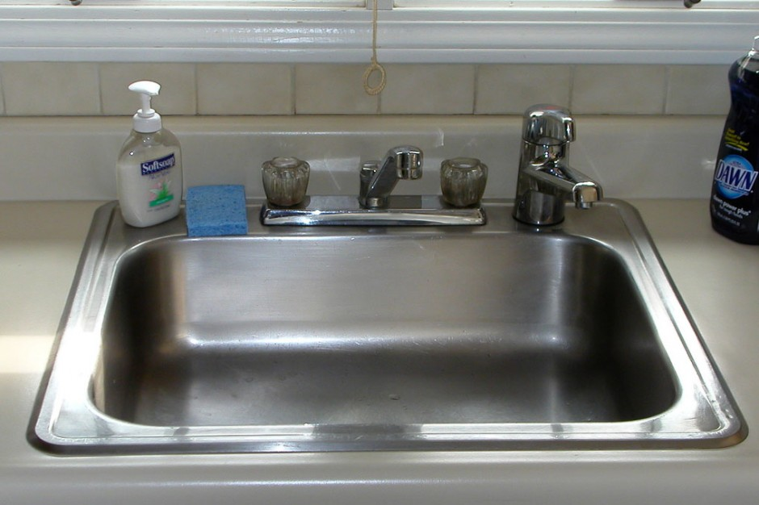
Stainless Steels
Application : Railway cars, trucks, trailers, food-processing equipment, sinks, stoves, cooking utensils, cutlery, fl atware, architectural metalwork, laundry equipment, chemicalprocessing equipment, jet-engine parts, surgical tools, furnace and boiler components, oil-burner parts, petroleum-processing equipment, dairy equipment, heat-treating equipment,
automotive trim.
Environment : Stainless steels are fda approved – indeed, they are so inert that they can be implanted in the body. All can be recycled.

Slide 10
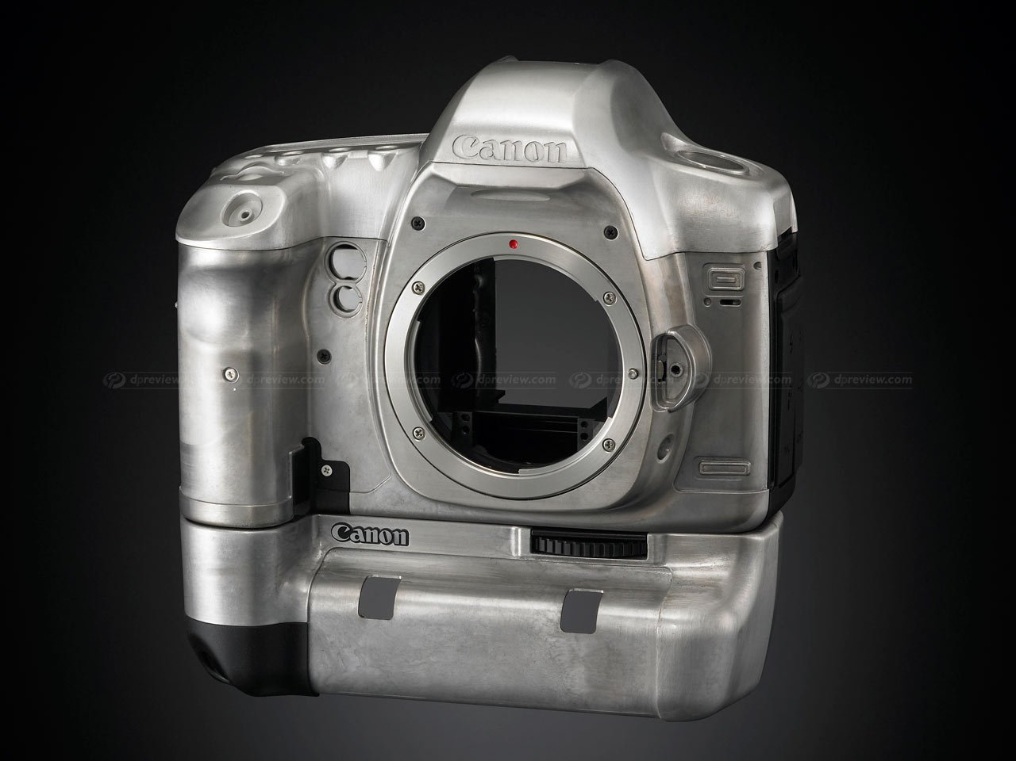
Magnesium Alloys
Application : Aerospace; automotive; sports goods; nuclear fuel cans; vibration damping and shielding of machine tools; engine case castings; automotive wheels; ladders; housings for electronic equipment, offi ce equipment, and lawnmowers.
Environment : Magnesium is the fi fth most abundant metal in the earth’s crust, and the third in its oceans – and it can be extracted economically from both (the Dead Sea, thick with dissolved salts – is the best source of all). But its extraction is very energy intensive, consuming three times more per unit weight than commodity polymers and nearly twice as much as aluminum. It can be recycled, and doing this uses barely one-fi fth as much energy.

Slide 11
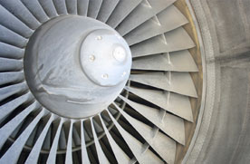
Titanium Alloys
Application : Aircraft turbine blades; general aerospace applications; chemical engineering; heat exchangers; bioengineering; medical; missile fuel tanks; heat exchangers, compressors, valve bodies, surgical implants, marine hardware, paper-pulp equipment, casings for mobile phones and portable computers.
Environment : Extracting titanium from its ores is very energy intensive. It can be recycled provided it is not contaminated with oxygen.

Slide 12
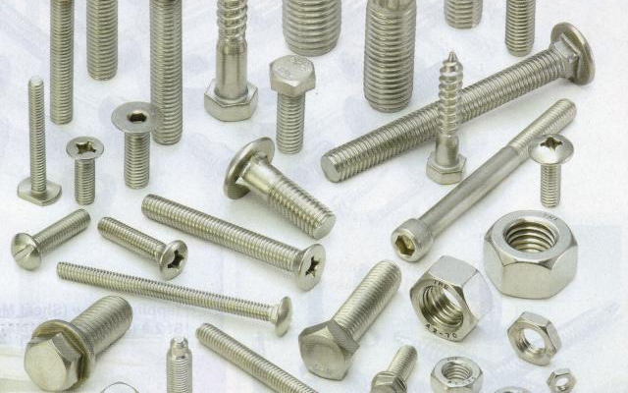
Nickel Alloys
Application : blades, disks, and combustion chambers in turbines and jet engines, rocket engines, bi-metallic strips, thermocouples, springs, food equipment, heating wires, electroplating for corrosion protection, coinage, and nickel-cadmium batteries.
Environment : About 10% of the population is sensitive to nickel, causing them to react even to the nickel in stainless steel watch straps. Compounds of nickel can be more toxic; nickel carbonyl, used in the extraction of nickel, is deadly.

Slide 13
Zinc Alloys
Application : Roofing, gutters, flashlight refl ectors, fruit jar caps, radio shielding, gaskets, photoengraving plates, handles, gears, automotive components, kitchen counter-tops, protective plating.
Environment : Zinc vapor is toxic if you inhale it you get the “spelter-shakes” but adequate protection is now universal. In all other ways zinc is a star: it is non-toxic, has low energy content and – in bulk can be recycled (not, of course, as plating).

Slide 14
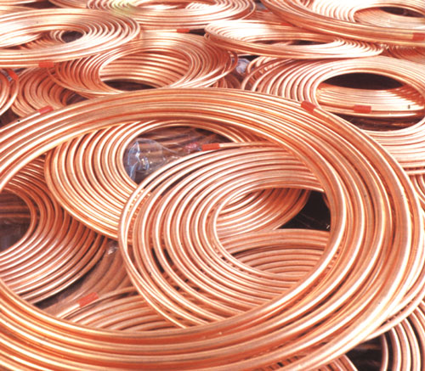
Copper
Application : Electrical conductors, heat exchangers, coinage, pans, kettles and boilers, plates for etching and engraving, roofi ng and architecture, cast sculptures, printing wires, heat pipes, fi laments and musical instruments.
Environment : Copper and its alloys are particularly easy to recycle in many countries the recycle fraction approaches 90%.

Slide 15
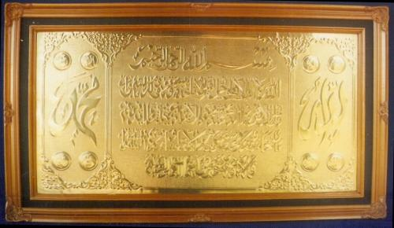
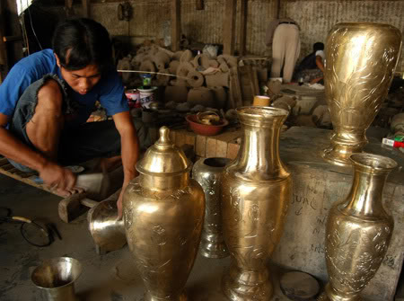
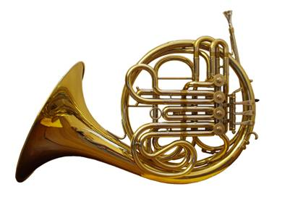
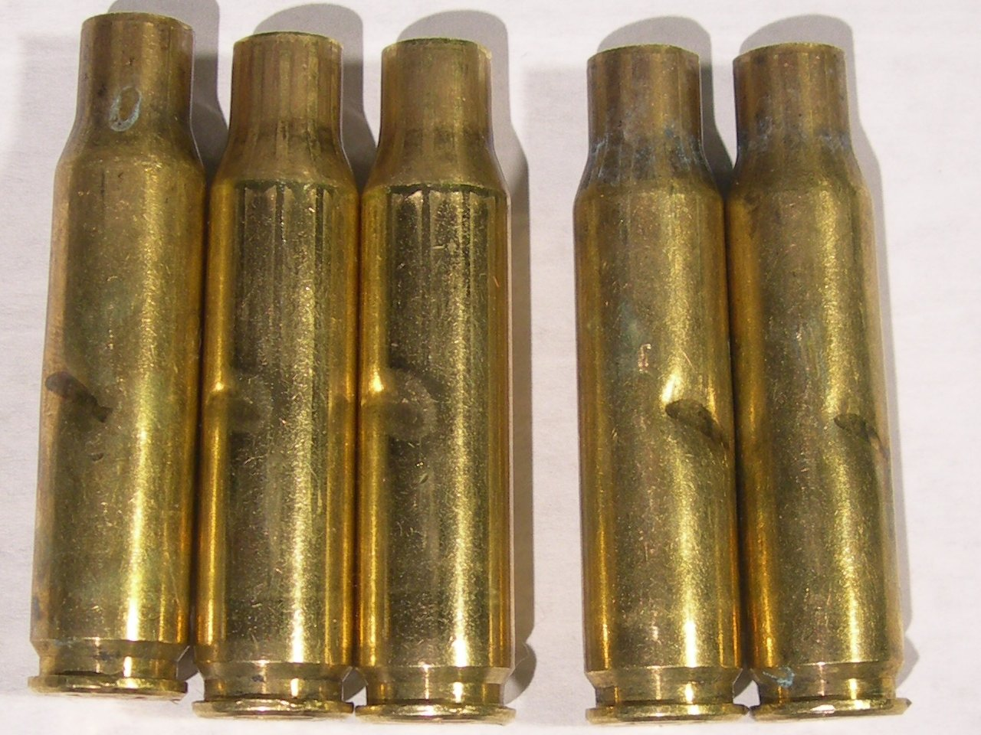
Brass

Slide 16
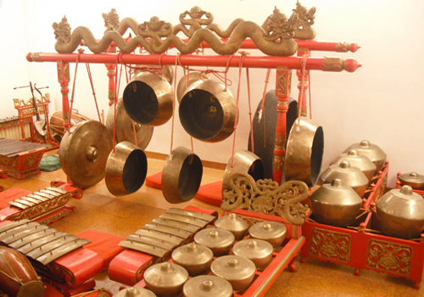
Bronze

