Slide 1
Polimer
Polimer didefinisikan sebagai substansi yang terdiri dari molekul-molekul yang menyertakan rangkaian satu atau lebih dari satu unit monomer. Manusia sudah berabad-abad menggunakan polimer dalam bentuk minyak, aspal, dan permen karet.
POLIMER
Bahan pembuatannya
Karakter bahannya
Natural polimer
Sintetik polimer
Termoplastik
Termoseting
Kayu, wool, kulit
Minyak bumi

Slide 2
Termoplastik polimer
Acrylonitrile-butadiene-styrene (abs)
Cellulose
Ionomers
Polyamide (Nylon, pa)
Polycarbonate (pc)
Polyetheretherkeytone (peek)
Polyethylene (pe)
Polymethylmethacrylate (pmma)
Polyoxymethylene (pom)
Polypropylene (pp)
Polystyrene (ps)
Polytetrafluoroethylene (ptfe)
Polyvinylchloride (tppvc)
Polyurethanes (tppu)
Polyesters (pet, pete, pbt)
Termoseting polimer
Epoxy
Phenolic
Polyester
Polyurethane (tspu)
Polyvinylchloride (tspvc)

Slide 3
Elastomer (polimer kenyal)
Acrylic elastomers
Butyl rubbers (nr)
Chlorinated elastomers (Neoprene)
Ethylene-propylene (epdm)
Ethylene-vinyl-acetate (eva)
Fluorocarbon elastomers (Viton)
Isoprene
Natural rubber
Nitrile (nbr, buna-n)
Polybutadiene elastomers
Polysulphide elastomers
Silicone
Styrene-butadiene (sbs)
Thermoplastic elastomers (tpe, tpo)
Polimer that are foamed
Phenolic
Polyethylene
Polypropylene
Polystyrene
Polyurethane

Slide 4
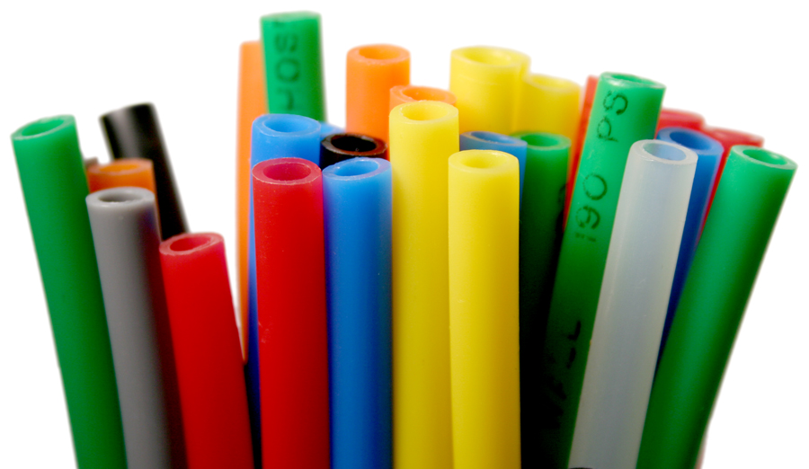
Polyethylene (PE)
Termoplastik
Function : Oil containers, street bollards, milk bottles, toys, beer crates, food packaging, shrink wrap, squeeze tubes, disposable clothing, plastic bags, Tupperware, chopping boards, paper coatings, cable insulation, artifi cial joints, and as fi bers low cost ropes and packing tape reinforcement.
Environmental aspect : non-toxic that it can be embedded in the human body (heart valves, hip-joint cups, artifi cial artery). pe, pp and pvc are made by processes that are relatively energy-effi cient, making them the least energy-intensive of commodity polymers.

Slide 5
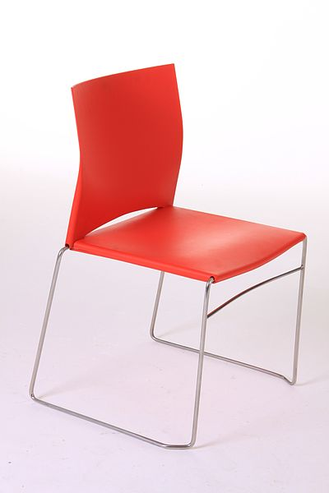
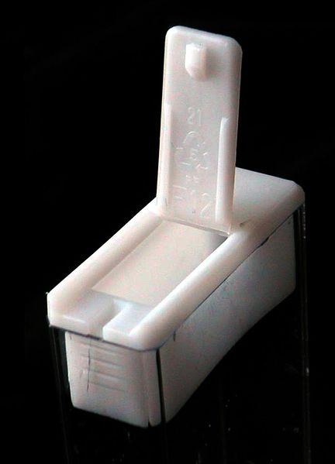
Polypropylene (PP)
Termoplastik
Application : Uses Ropes, general polymer engineering, automobile air ducting, parcel shelvingand air-cleaners, garden furniture, washing machine tanks, wet-cell battery cases, pipesand pipe fi ttings, beer bottle crates, chair shells, capacitor dielectrics, cable insulation,kitchen kettles, car bumpers, shatter proof glasses, crates, suitcases, artifi cial turf, thermal underwear.
Environment : pp is exceptionally inert and easy to recycle, and can be incinerated to
recover the energy it contains. pp, like pe and pvc, is made by processes that are relatively energy-effi cient.

Slide 6
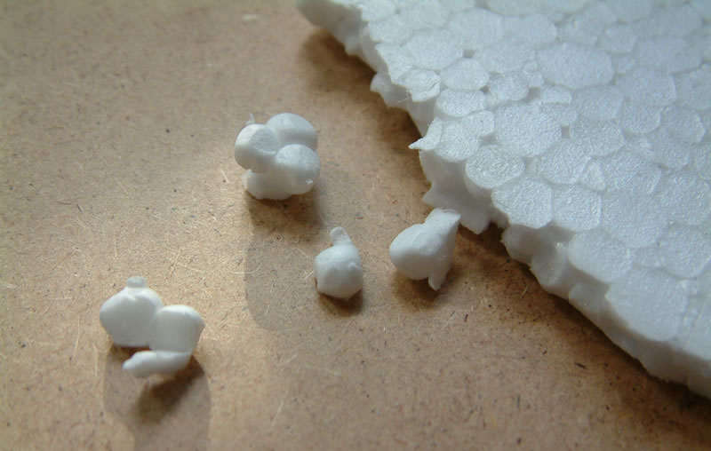
Polystyrene (PS)
Termoplastik
Application : Disposable cups; light fi ttings; toys; pens; models; in expanded form packaging, thermal insulation and ceiling tiles; tv cabinets; wall tiles; disposable dishes; furniture; molded parts and containers; cd covers, disposable glass, razors, hot drink cups.
Environment : ps can be recycled. The monomer, styrene, is irritating to the eyes and throat, but none survives in the polymer. flammability of ps foam, and the use of cfcs as blowing agents in the foaming process was, at one time, a cause for concern. New fl ame retardants allow ps foams to meet current fi re safety standards, and cfc blowing agents have been replaced by pentane, CO2 or hfcs which do not have a damaging effect on the ozone layer

Slide 7
Acrylonitrile-butadiene-styrene(ABS)
Termoplastik
Application : cases for computers and tvs, telephones, food mixers, vacuum cleaners,
baths, shower trays, pipes, luggage shells, rv parts, shower stalls, cassette holders, automotive parts, safety hard hats, Legos, computer mice, razors, handles, shavers, chairs. san: telephone cases, food processing bowls, medical syringes, mixing bowls, beakers, coffee filters, cassettes, industrial battery cases, toothbrushes, cosmetic packs, dinnerware, food containers. asa: appliance panels and knobs, toys, medical instruments, rear view mirrors, garden tables and chairs, hose fi ttings, garden tools, letter boxes, boat shells, windsurfing boards.
Environment : The acrylonitrile monomer is nasty stuff, almost as poisonous as
cyanide. Once polymerized with styrene it becomes harmless. Some grades of abs are fda
compliant and can be recycled.

Slide 8
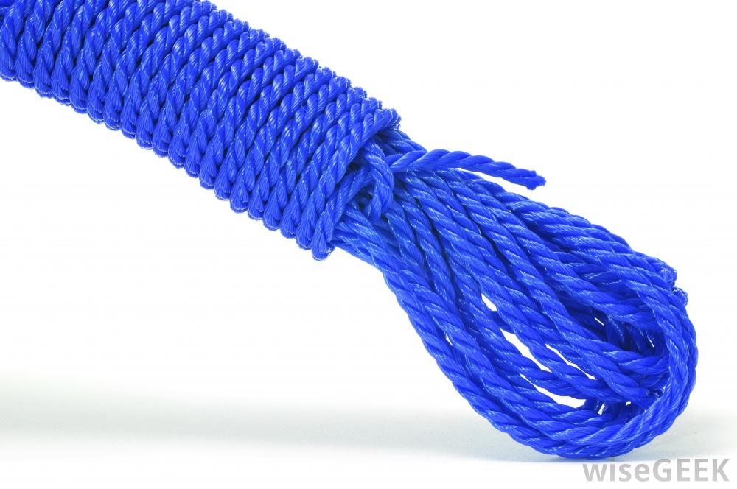
Polyamide (PA), Nylon
Termoplastik
Application : Light duty gears, bushings, sprockets and bearings; electrical equipment
housings, lenses, containers, tanks, tubing, furniture casters, plumbing connections,
bicycle wheel covers, ketchup bottles, chairs, toothbrush bristles, handles, bearings, food
packaging. Nylons are used as hot-melt adhesives for book bindings; as fibers ropes, fi shing
line, carpeting, car upholstery and stockings; as aramid fibers cables, ropes, protective
clothing, air filtration bags and electrical insulation.
Environment : Nylons have no known toxic effects, although they are not entirely inert
biologically. Nylons are oil-derivatives, but this will not disadvantage them in the near
future. With refi nements in polyolefi n catalysis, nylons face stiff competition from less
expensive polymers.

Slide 9
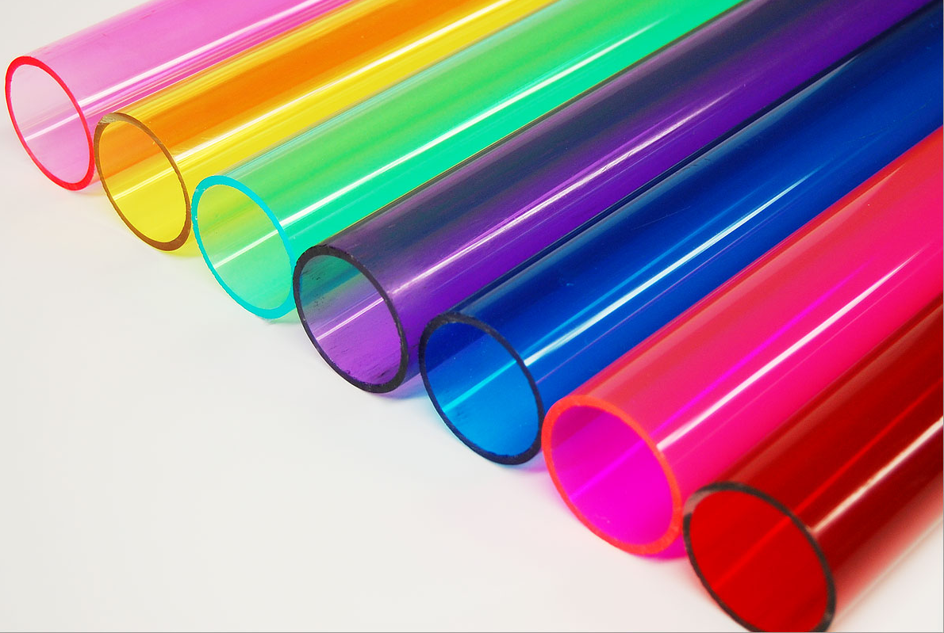
Polymethylmethacrylate (PMMA), Acrylic
Termoplastik
Application : Uses Lenses of all types; cockpit canopies and aircraft windows; signs; domesticbaths; packaging; containers; electrical components; drafting equipment; tool handles; safety spectacles; lighting, automotive tail lights, chairs, contact lenses, windows, advertising signs, static dissipation products; compact disks.
Environment : Acrylics are non-toxic and recyclable.

Slide 10
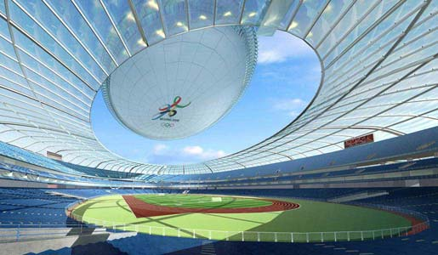
Polycarbonate (PC)
Termoplastik
Application : Compact disks, housings for hair dryers, toasters, printers and power tool
housings, refrigerator linings, mechanical gears, instrument panels, motorcycle helmets,
automotive bumpers and body parts, riot shields.
Environment : The processing of engineering thermoplastics requires a higher energy
input than that of commodity plastics, but otherwise there are no particular environmental penalties. pc can be recycled if unreinforced.

Slide 11
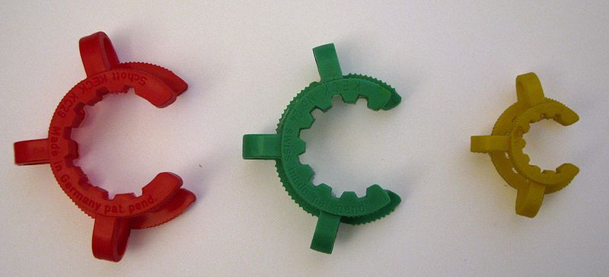
Polyoxymethylene (POM), Acetal
Termoplastik
Application : Automobile carburettors and door handles, videocassette parts, gears and bearings, tool handles, plumbing parts, clothing zips.
Environment : Acetal, like most thermoplastics, is an oil derivative, but this poses no immediate threat to its use.

Slide 12
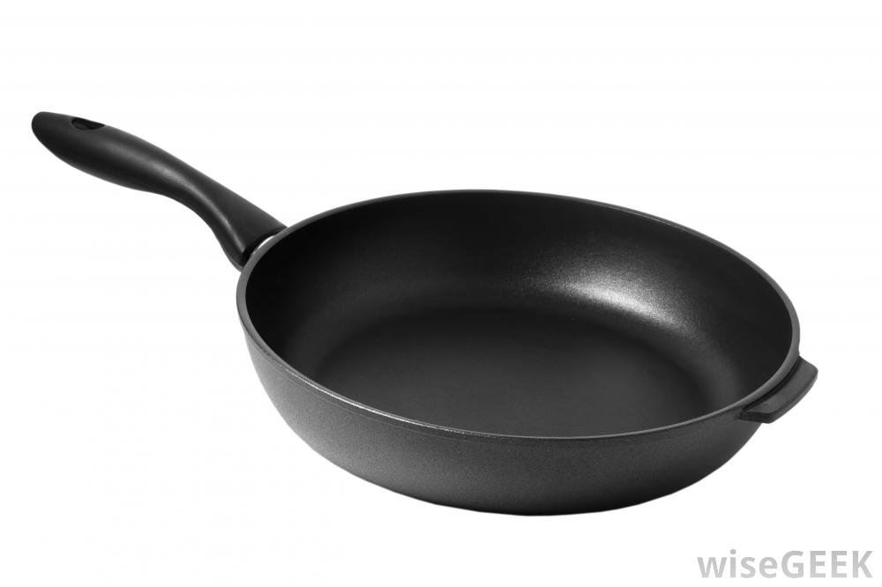
Polytetrafluoroethylene (PTFE)
Termoplastik
Application : Wire and cable covers; high-quality insulating tape; corrosion resistant lining for pipes and valves; protective coatings; seals and gaskets; low friction bearings and skis; translucent roofi ng and weather protection for other polymers (e.g. abs); non-stick cooking products; water repellent fabrics.
Environment : non-fl ammable and fda approved. Like all thermoplastics, simple ptfe can be recycled. But in making it into non-stick surfaces, or in transforming it into GoreTex, additives are made which prevent further recycling.

Slide 13
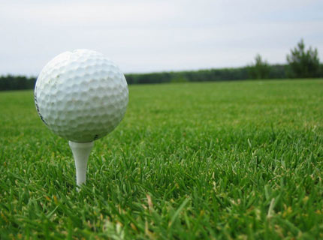
Ionomers
Termoplastik
Application : Food packaging, athletic soles with metal inserts, ski boots, ice skate shells,
wrestling mats, thermal pipe insulation, license plate holders, golf ball covers, automotive
bumpers, snack food packaging, blister packs, bottles.
Environment : Ionomers have properties that resemble thermosets yet they can be
recycled – an attractive combination.

Slide 14
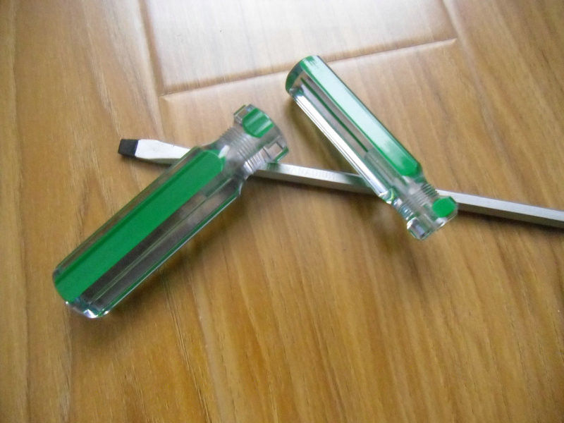
Celluloses (CA)
Termoplastik
Application : Film packaging, sunglasses, safety glasses, eye glass frames, laminated brochures, tool handles, hammer heads, electric screwdrivers, photographic film, typewriter keys, blister packaging, combs, hair decoration.
Environment : renewable material – forms one ingredient in cellulose-
based polymers. The processing, however, involves chemicals that create a problem
of disposal. Most cellulose-based polymers burn easily, requiring protection from naked
fl ame. Some are bio-degradable.

Slide 15
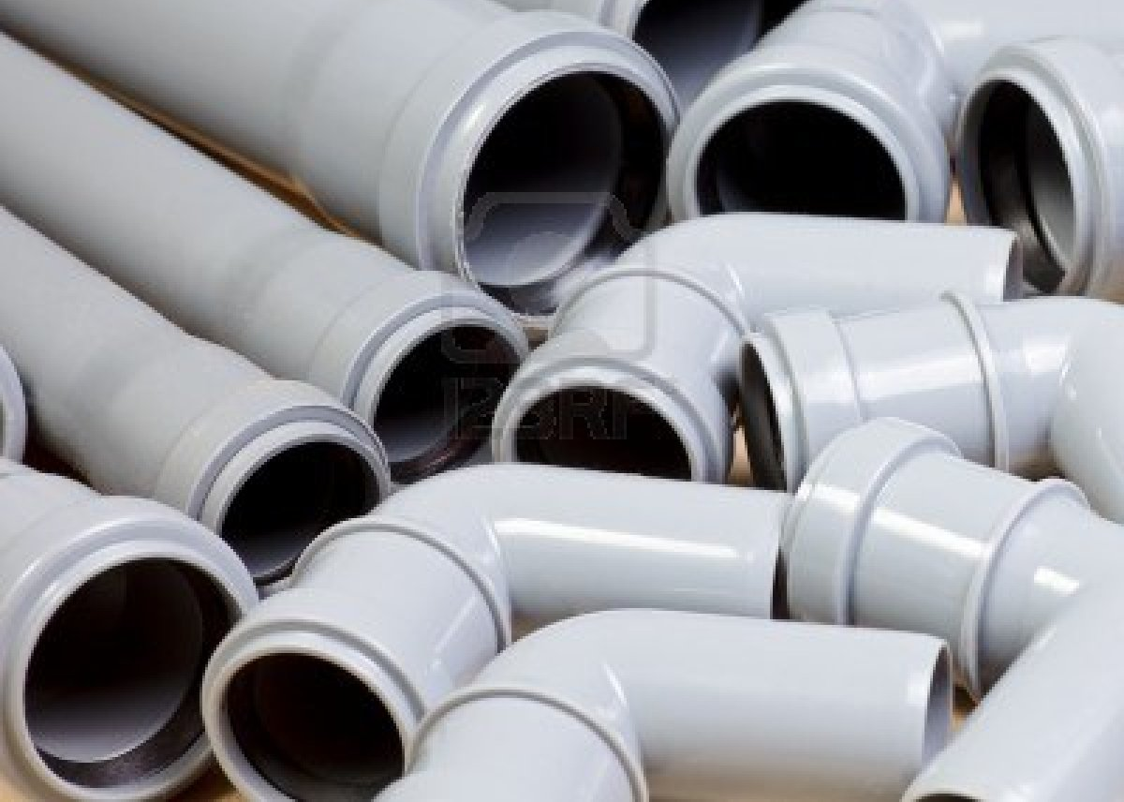
Polyvinylchloride (PVC)
thermoplastic, elastomeric and thermosetting
Application : pipes, fittings, profi les, road signs, cosmetic packaging, canoes, garden hoses, vinyl flooring, windows and cladding, vinyl records, dolls, medical tubes. elpvc:artificial leather, wire insulation, fi lm, sheet, fabric, car upholstery.
Environment : The polymer pvc has no known harmful effects. Disposal, however, can be a problem: thermal degradation releases chlorine, HCl and other toxic compounds, requiring special high temperature incineration for safety.

Slide 16
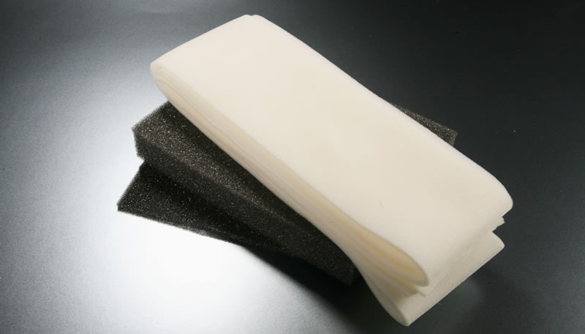
Polyurethane (PU)
Polimer that are foamed
Application : Cushioning and seating, packaging, running shoe soles, tires, wheels, fuel hoses, gears, bearings, wheels, car bumpers, adhesives, fabric-coatings for infl atables, transmission belts, diaphragms, coatings that are resistant to dry-cleaning, furniture, thermal insulation in refrigerators and freezers; as elastomers: truck wheels, shoe heals, bumpers, conveyor belts and metal forming dyes.
Environment : synthesized from diisocyanate and a polyester or polyether. The
diisocyanate is toxic, requiring precautions during production. pu itself is inert and nontoxic. The fl ammability of pu foam, and the use of cfcs as blowing agents in the foaming process were, at one time, a cause for concern. Thermoplastic pus can be recycled (thermosetting pus cannot), and when all useful lifeis over, incinerated to recover heat. Legislation for return of packaging and disposal problemsmay disadvantage pu.

Slide 17
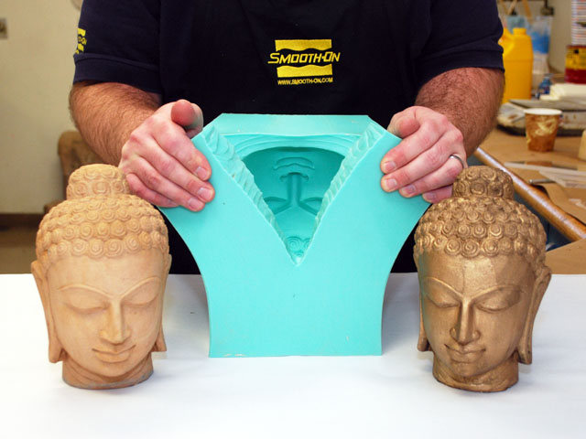
Silicones
Elastomers
Application : Wire and cable insulation, mold release agents, lens cleaning tissue coatings, seals, gaskets, adhesives, o-rings, insulation, encapsulation and potting of electronic circuitry, surgical and food processing equipment, baby bottle tips, breast implants, swimming caps and seals for swimming goggles.
Environment : Silicones are energy intensive – although they are not oil-derivatives. They cannot be recycled.

Slide 18
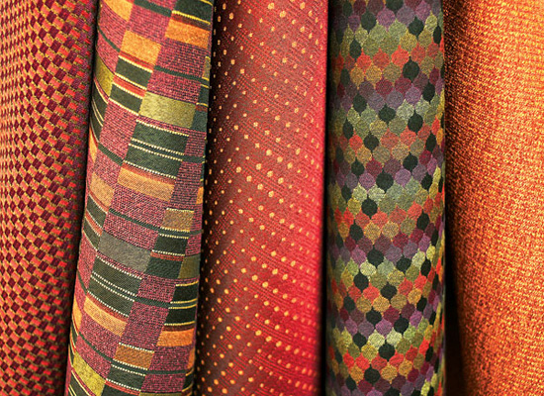
Polyesters (PET, PBT, PETg)
thermoplastic
Application : Decorative fi lm, metallized balloons, photography tape, videotape, carbonated drink containers, oven-proof cookware, windsurfing sails, credit cards, carpets, clothing,brushes, boats, fi shing rods, automobile body panels.
Environment : bottles take less energy to make than glass bottles of the same volume, and they are much lighter – saving fuel in delivery. Thick-walled bottles can be reused; thin-walled bottles can be recycled – and are, particularly in the us.

Slide 19
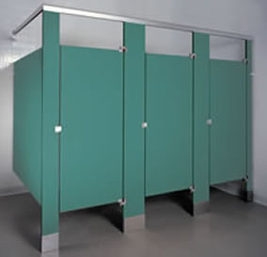
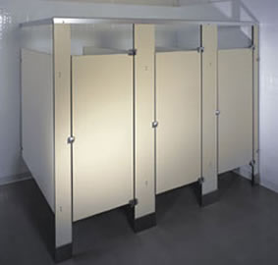
Phenolic
Polimer that are foamed (thermosetting)
Application : Switchboards, insulating washers, intricate punched parts (phenolic with paper laminate), gears, pinions, bearings, bushings (phenolic with cotton laminate), gaskets and seals (phenolic with glass), used to bond friction materials for automotive brake linings, beads, knife handles, paperweights, billiard balls, domestic plugs and switches, telephones, fuse box covers, distributor heads, saucepan handles and knobs, golf ball heads for typewriters, toilet seats. As a foam, phenolic resin is used in paneling for building work; its fi ne resistance is a particular attraction.
Environment : Phenolics, like all thermosets, cannot be recycled.

Slide 20
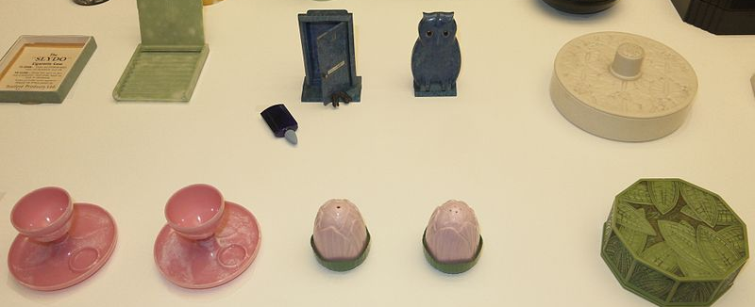
Urea-formaldehyde
Thermosetting
Application : decorative laminates, textiles, paper, foundry sand molds, wrinkle resistant fabrics, cotton blends, etc. It is also used to glue wood together. Urea formaldehyde was commonly used when producing electrical appliances casing (e.g. desk lamps)
Environment : Generally there are no observable health effects from formaldehyde when air concentrations are below 1.0 ppm. The onset of respiratory irritation and other health effects, and even increased cancer risk begins when air concentrations exceed 3.0-5.0 ppm. This triggers watery eyes, nose irritations, wheezing and coughing, fatigue, skin rash, severe allergic reactions, burning sensations in the eyes and throat, nausea, and difficulty in breathing in some humans (usually > 1.0 ppm).

Slide 21
They (thermoplastic) are all recycable

