Slide 1
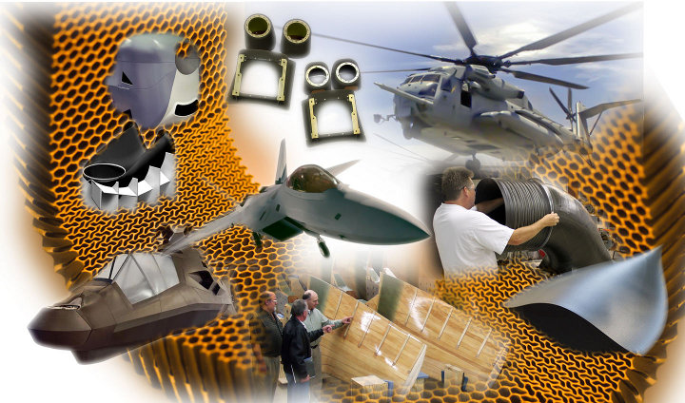
COMPOSITE MATERIALS

Slide 2
COMPOSITE MATERIALS
A composite material can be defined as a combination of a matrix and a reinforcement, which when combined gives properties superior to the properties of the individual components.
In the case of a composite, the reinforcement is the fibres and is used to fortify the matrix in terms of strength and stiffness.
The reinforcement fibres can be cut, aligned, placed in different ways to affect the properties of the resulting composite.
The matrix, normally a form of resin, keeps the reinforcement in the desired orientation. It protects the reinforcement from chemical and environmental attack, and it bonds the reinforcement so that applied loads can be effectively transferred.

Slide 3
Type of Composites
Carbon fibre-reinforced polymers (CFRP)
Glass fibre-reinforced polymers (GFRP)
Aramid products (e.g. Kevlar)
Bio-derived polymers (or biocomposites as they are sometimes referred)

Slide 4
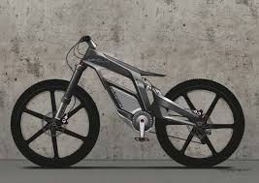
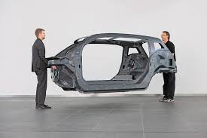
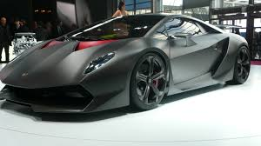
Type of Composites
Carbon fibre-reinforced polymers (CFRP)

Slide 5
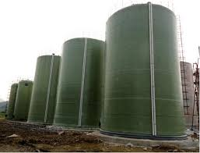
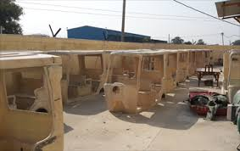
Type of Composites
Glass fibre-reinforced polymers (GFRP)

Slide 6
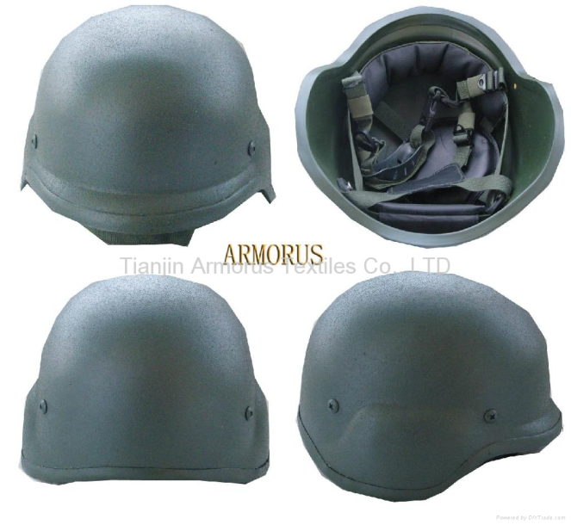
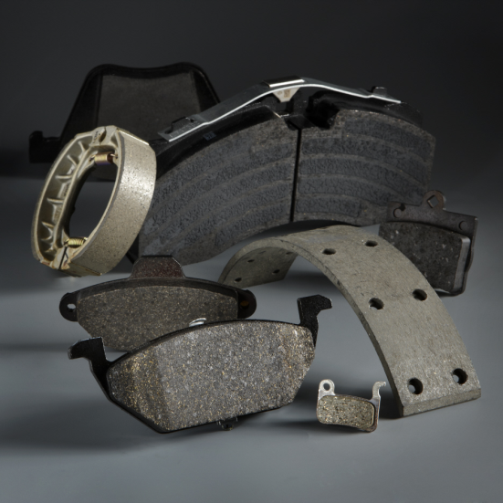
Type of Composites
Aramid products

Slide 7
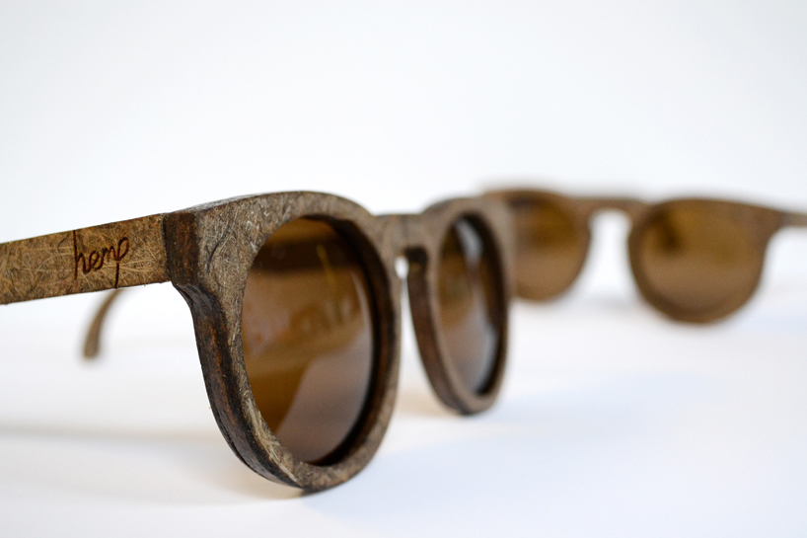
Type of Composites
Bio-derrived polymers

Slide 8
Why Use Composites?
The primary reason composite materials are chosen for components is because of weight saving for its relative stiffness and strength. For example, carbon-fibre reinforced composite can be five times stronger than 1020 grade steel while having only one fifth of the weight. Aluminium (6061 grade) is much nearer in weight to carbon-fibre composite, though still somewhat heavier, but the composite can have twice the modulus and up to seven times the strength.

Slide 9
Methods of composite manufacture
Wet Lay-Up
A mould in the shape of the final component is required. The reinforcement (as a woven fabric)is carefully laid into this mould and the matrix (resin) is poured on and spread, usually with the aid of a roller. This is then left to cure.
A gelcoat can be added to the mould before the reinforcement is placed into it depending on what surface finish is required (the top surface is the side which is face down in the mould). A release agent can also be applied to the mould to assist with removing the part after curing.

Slide 10
Filament Winding
This process is used for producing hollow tubes. The reinforcement (as strands) are taken through a resin bath, coating them with the matrix. The access resin is squeezed out by rollers and the reinforcement fibres are then wound onto a mandrel to form the round, hollow shape. The direction the fibres are wound contributes to the performance properties required of the finished part.

Slide 11
Compression Moulding
Compression moulding is normally used with pre-preg – reinforcement fibres already impregnated with resin. The pre-preg is placed in an open, heated female mould. The male mould is then placed down on to this with the combination of heat and pressure shaping and curing the component. Parts are then allowed to cool before removing from the mould.

Slide 12
Vacuum Bagging
This process can be used as an extension of the wet lay-up technique. The reinforcement (as woven fabric) is placed into a mould, which can be pre-coated with a release agent and/or gel coat. The resin is then rolled on top.
A plastic film is placed over this and is fully sealed at the edges. A vacuum then extracts the air from process helping to consolidate the part. It ensures that the resin is evenly spread.

Slide 13
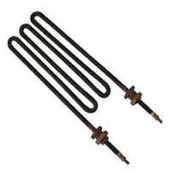
Alumina
Alumina (Al₂O₃) is to technical ceramics what mild steel is to metals – cheap, easy to
process, the work horse of the industry. It is the material of spark plugs and electrical
insulators. In single crystal form it is sapphire, used for watch faces and cockpit windows of high speed aircraft. More usually it is made by pressing and sintering powder, giving grades ranging from 80 to 99.9% alumina; the rest is porosity, glassy impurities or deliberately added components. Pure aluminas are white; impurities make them pink or green. The maximum operating temperature increases with increasing alumina content. Alumina has a low cost and a useful and broad set of properties: electrical insulation, high mechanical strength, good abrasion and temperature resistance up to 1650 c, excellent chemical stability and moderately high thermal conductivity, but it has limited thermal shock and impact resistance. Chromium oxide is added to improve abrasion resistance; sodium silicate, to improve processability but with some loss of electrical resistance. Competing materials are magnesia, silica and borosilicate glass.
Typical Uses Insulators, heating elements, micro-electronic substrates, radomes, bone replacement, tooth replacement, tank armour, spark plug insulators, dies for wire drawing, nozzles for welding and sandblasting.

Slide 14
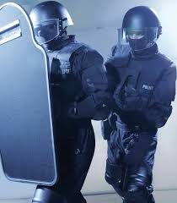
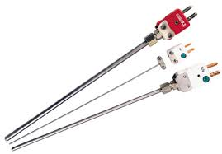
Boron Carbide
Boron carbide (B₄C) is nearly as hard as diamond and vastly less expensive (though still not cheap). Its very low density and high hardness make it attractive for the outer layer of bulletproof body armor and as an abrasive. Typical Uses Lightweight armor, bulletproof surfaces, abrasives, sandblasting nozzles, high temperature thermocouples.

Slide 15
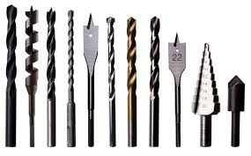
Tungsten Carbide
Tungsten carbide (WC) is most commonly used in the form of a “cemented” carbide, or cermet: a metal carbide held by a small amount (5–20%) of metallic binder, usually cobalt. Its exceptional hardness and stability make it an attractive material when wear resistance is essential. Its properties are governed by the type of carbide, grain size and shape and the proportion of carbide to metal. Cermets are expensive but, as cutting tools, they survive cutting speeds ten times those of the best tool steel. Shaping is usually done by pressing, sintering and then grinding; the tool bit is brazed to a shank or blade made from a cheaper steel. Tungsten carbide can be vapor-coated with Ti-nitride to improve wear resistance even further. Typical Uses Cutting tools, saw blades, dental drills, oil drilling bits, dies for wire drawing, knife edges.

Slide 16
Silicon Carbide
Silicon carbide (SiC, carborundum), made by fusing sand and coke at 2200 c, is the grit on high quality sandpaper. It is very hard and maintains its strength to high temperature, has good thermal shock resistance, excellent abrasion resistance and chemical stability, but, like all ceramics, it is brittle. Silicon carbide is a blue-black material. High strength SiC fibers such as Nicalon, made by cvd processes, are used as reinforcement in ceramic or metal matrix composites. Typical Uses Cutting tools, dies and molding materials, catalytic converters, engine components, mechanical seals, sliding bearings, wear protection sleeves, heat exchange tubes, furnace equipment, heating elements.

Slide 17
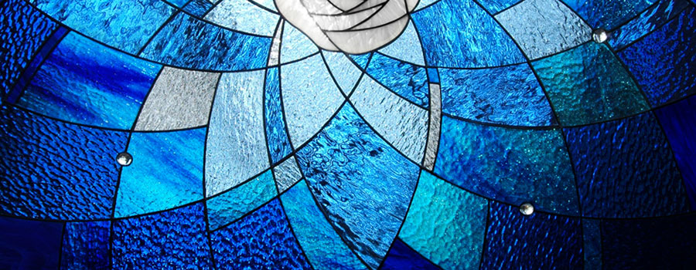
Glass

Slide 18
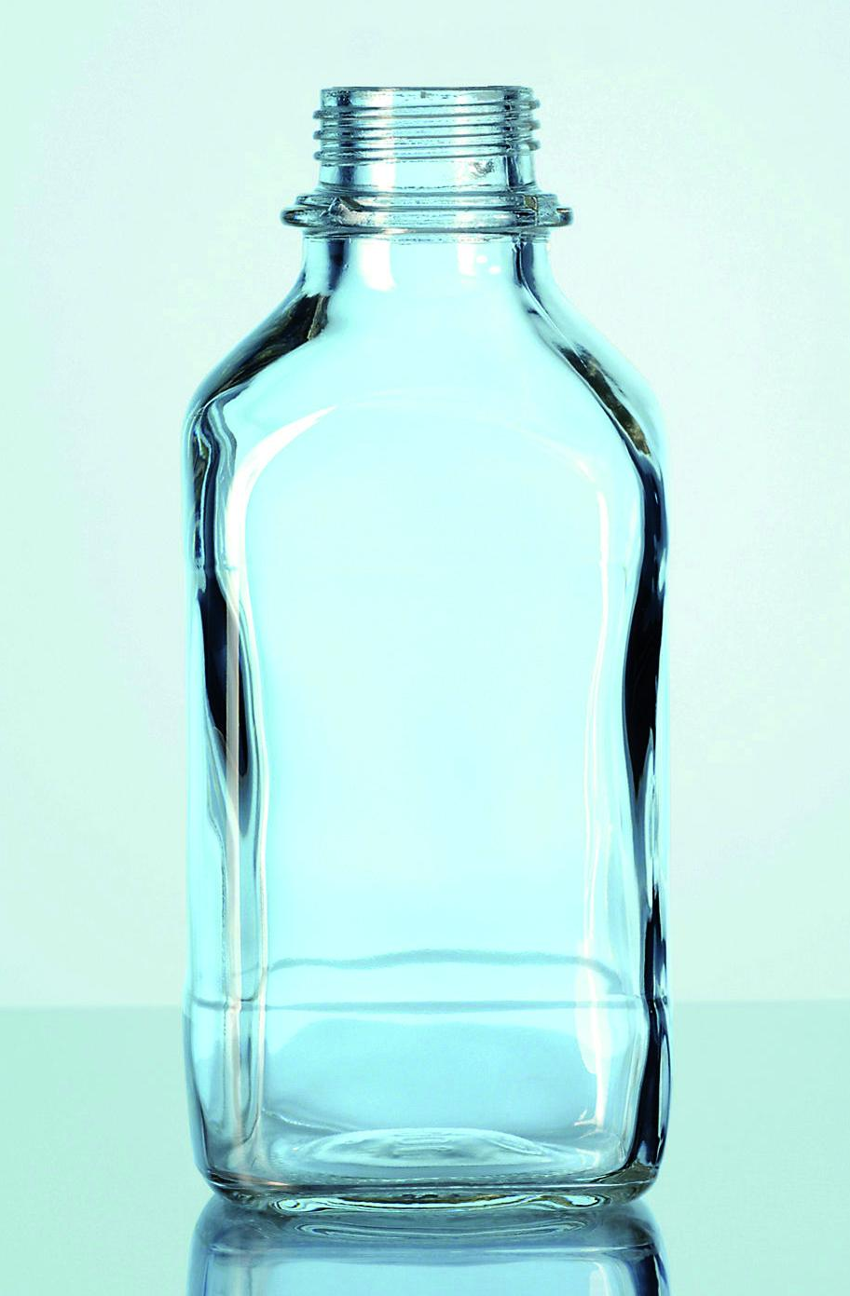
Soda-Lime Glass
Soda-lime is the glass of windows, bottles and light bulbs, used in vast quantities, the commonest of them all. The name suggests its composition: 13–17% NaO (the “soda”), 5–10% CaO (the “lime”) and 70–75% SiO₂ (the “glass”). It has a low melting point, is easy to blow and mold, and it is cheap. It is optically clear unless impure, when it is typically green or brown. Windows, today have to be fl at and that was not – until 1950 – easy to do; now the fl oat-glass process, solidifying glass on a bed of liquid tin, makes “plate” glass cheaply and quickly.
Typical Uses Windows, bottles, containers, tubing.
Notes:
Soda lime cairan kimia terdiri dari : Calcium hydroxide, Ca(OH)₂ (about 75%)
Water, H₂O (about 20%)
Sodium hydroxide, NaOH (about 3%)
Potassium hydroxide, KOH (about 1%).

Slide 19
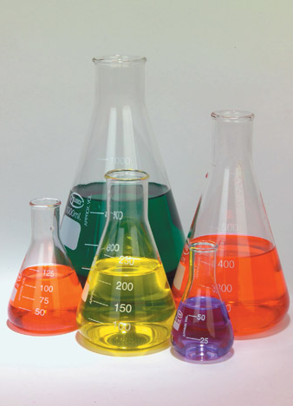
Borosilicate Glass
When most of the lime in soda lime glass is replaced by borax, B₂O₃, it becomes borosilicate glass (“Pyrex”). It has a higher melting point than soda lime glass and is harder to work; but it has a lower expansion coeffi cient and a high resistance to thermal shock, so its used for glass wear and laboratory equipment.
Typical Uses Laboratory glassware, ovenware, headlights, electrical insulators, metal/glass
seals, telescope mirrors, sights, gages, piping.
Notes:
Borax, also known as sodium borate, sodium tetraborate, or disodium tetraborate, is an important boron compound, a mineral, and a salt of boric acid. Powdered borax is white, consisting of soft colorless crystals that dissolve easily in water.

Slide 20
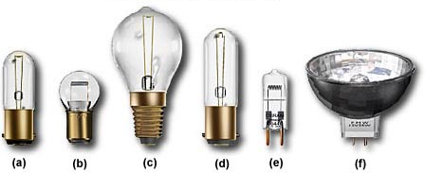
Silica Glass
Silica is a glass of great transparency. It is nearly pure SiO₂, it has an exceptionally high
melting point and is difficult to work, but, more than any other glass, it resists temperature and thermal shock.
Typical Uses Envelopes for high-temperature lamps.
Notes:
Gel silika adalah butiran seperti kaca dengan bentuk yang sangat berpori, silika dibuat secara sintetis dari natrium silikat. Walaupun namanya, gel silika padat. Gel silika adalah mineral alami yang dimurnikan dan diolah menjadi salah satu bentuk butiran atau manik-manik. Sebagai pengering, ia memiliki ukuran pori rata-rata 2,4 nanometer dan memiliki afinitas yang kuat untuk molekul air.

Slide 21
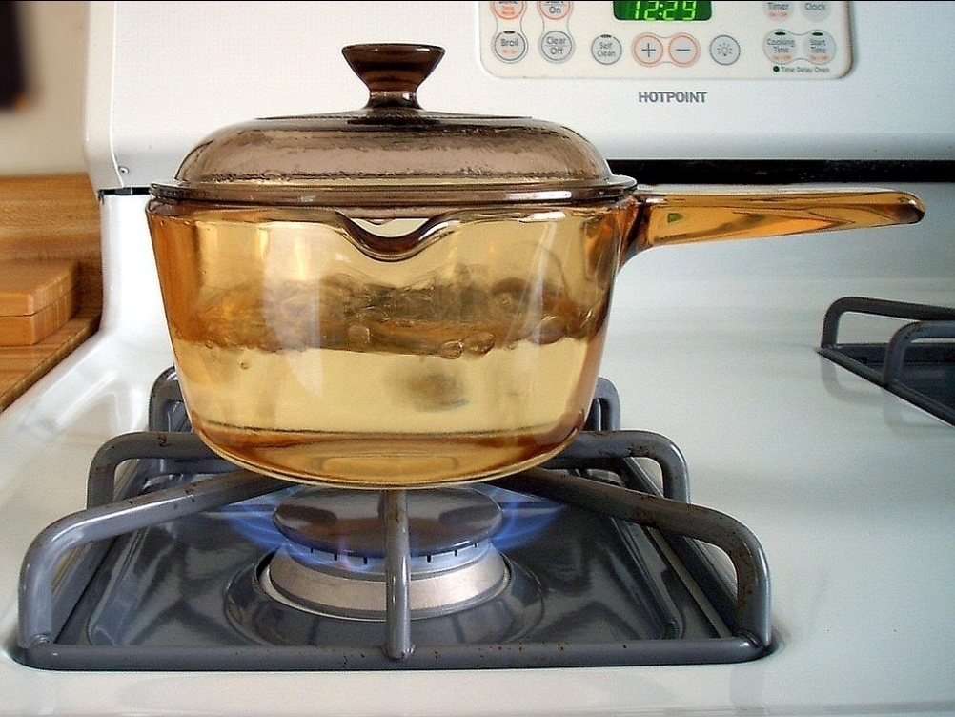
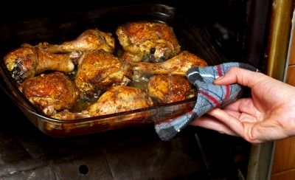
Glass Ceramic
Glass ceramics are glasses that, to a greater or lesser extent, have crystallized. They are
shaped while in the glassy state, using ordinary molding methods and then cooled in such a way that the additives they contain nucleate small crystals. It’s sold for cooking as Pyroceram and is used for high performance heat-resisting applications.
Typical Uses Cookware, stove surfaces, high performance heat-resisting applications

Slide 22
TRANSPARENT SOLAR CELL
In August 2014, researchers at Michigan State University have created a fully transparent solar concentrator, which could turn any window or sheet of glass (like your smartphone’s screen) into a photovoltaic solar cell.
The researchers — and Ubiquitous Energy — are confident that the technology can be scaled all the way from large industrial and commercial applications, down to consumer devices, while remaining affordable. So far, one of the larger barriers to large-scale adoption of solar power is the intrusive and ugly nature of solar panels — obviously, if we can produce large amounts of solar power from sheets of glass and plastic that look like normal sheets of glass and plastic, then that would be incredible.

