Slide 1
DESAIN PRODUK II

Slide 2
Penilaian
Absensi : 10 %
Tugas 1 : 10 %
Tugas 2 : 10 %
UTS : 30 %
UAS : 30 %

Slide 3
Persilangan antara : Art, Dunia Sosial, Science dan Industri
Prof. Imam Buchori

Slide 4
Marketing
Desain Produk
Manajemen
Engineering
Art

Slide 5
Definisi
A mechanism is a device designed to transform input forces and movement into a desired set of output forces and movement. Mechanisms generally consist of moving components such as gears and gear trains, belt and chain drives, cam and follower mechanisms, and linkages as well as friction devices such as brakes and clutches, and structural components such as the frame, fasteners, bearings, springs, lubricants and seals, as well as a variety of specialized machine elements such as splines, pins and keys.
(J. J. Uicker, G. R. Pennock, and J. E. Shigley, 2003, Theory of Machines and Mechanisms, Oxford University Press, New York)

Slide 6
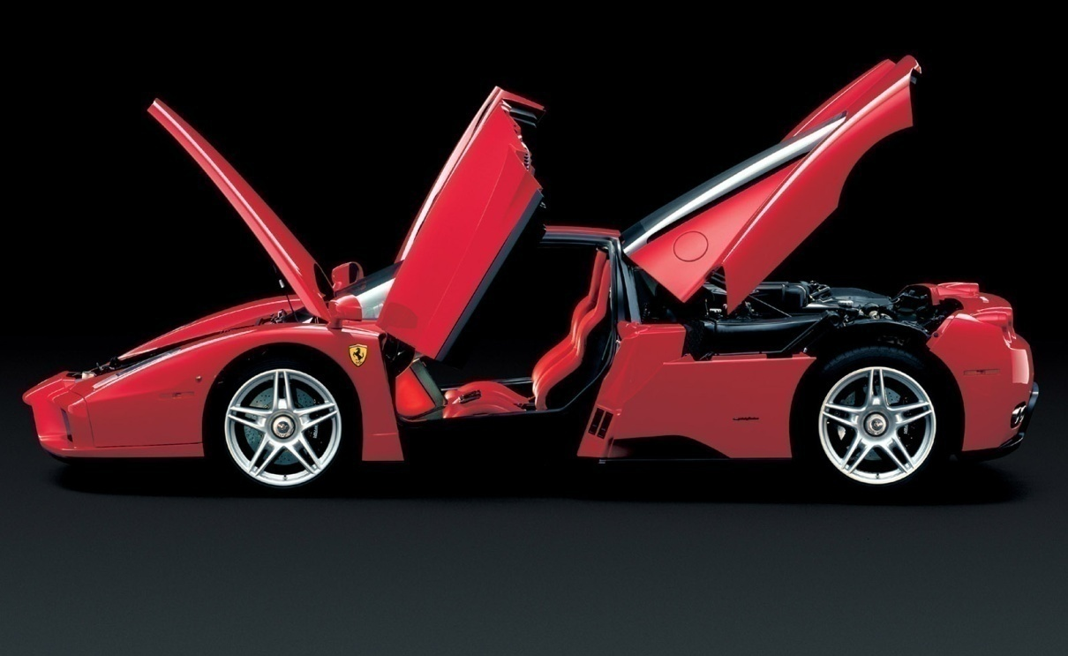
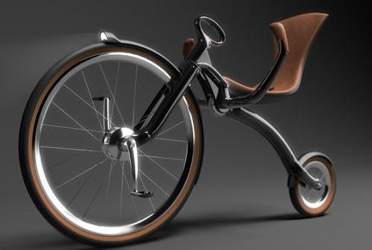
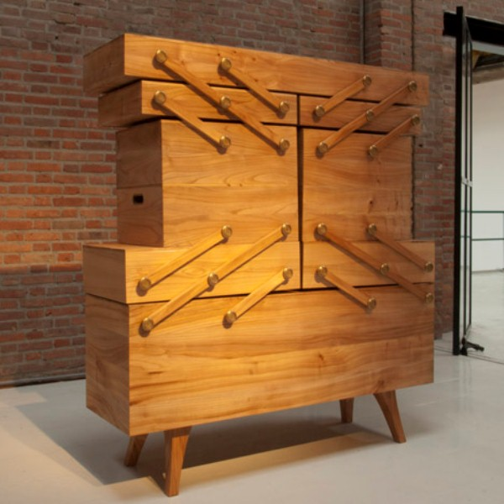
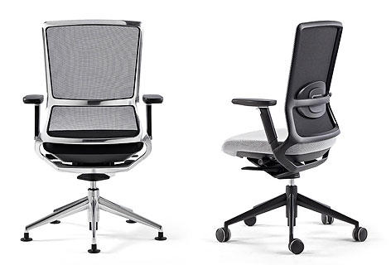
Most of product needs mechanism

Slide 7
Basic gerak mekanisme
Gerak berputar
Gerak Horizontal Vertikal
Gerak engsel bola

Slide 8
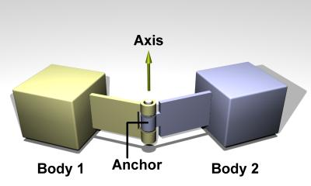
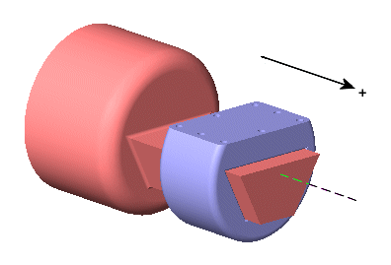
Tipe mekanisme
Kinematic pairs
1. Lower pair : is an ideal joint that constrains contact between a point, line or plane in the moving body to a corresponding point line or plane in the fixed body.
Hinged joint
prismatic joint
Notes:
menghubungkan bagian yang fixed dengan bagian yang bergerak

Slide 9
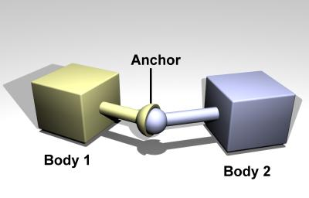
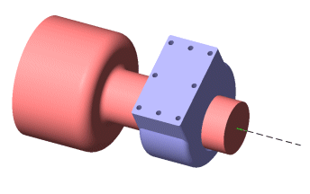
Spherical joint
Cylindrical joint

Slide 10
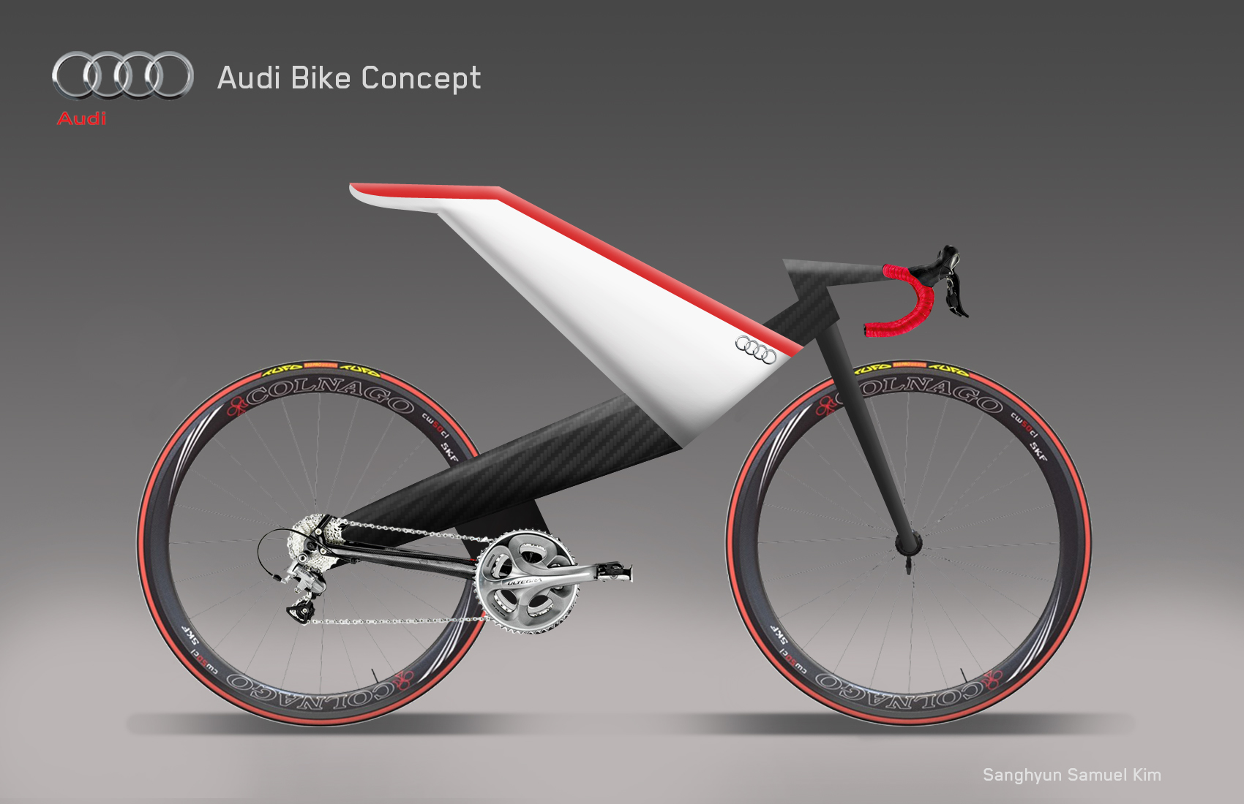
2. Wrapping pair : A wrapping pair is a constraint that comprises belts, chains, and such other devices

Slide 11
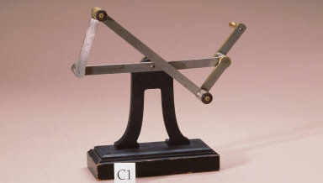
Planar mechanism
is a mechanical system that is constrained so the trajectories of points in all the bodies of the system lie on planes parallel to a ground plane.

Slide 12
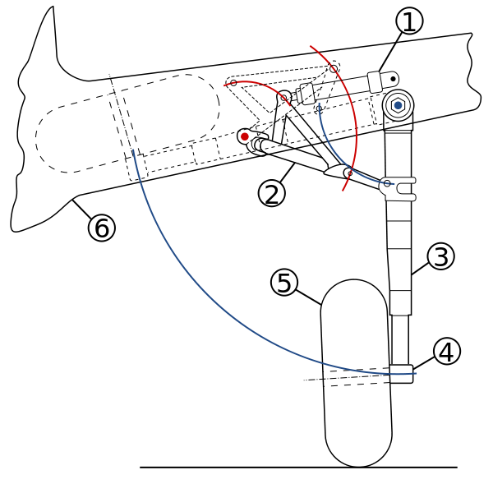

Slide 13
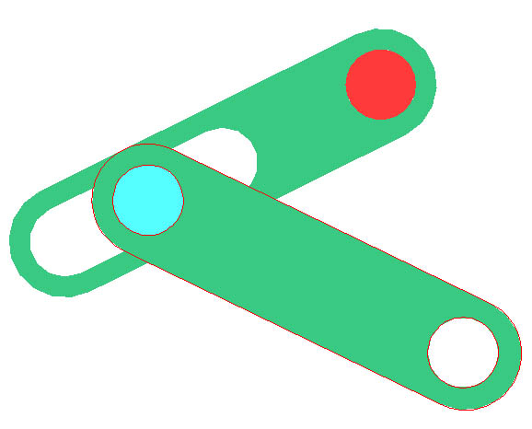
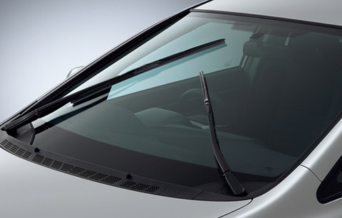

Slide 14
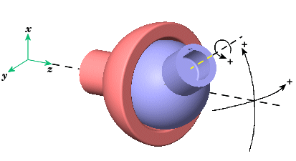
Spherical mechanism
is a mechanical system in which the bodies move in a way that the trajectories of points in the system lie on concentric spheres.

Slide 15
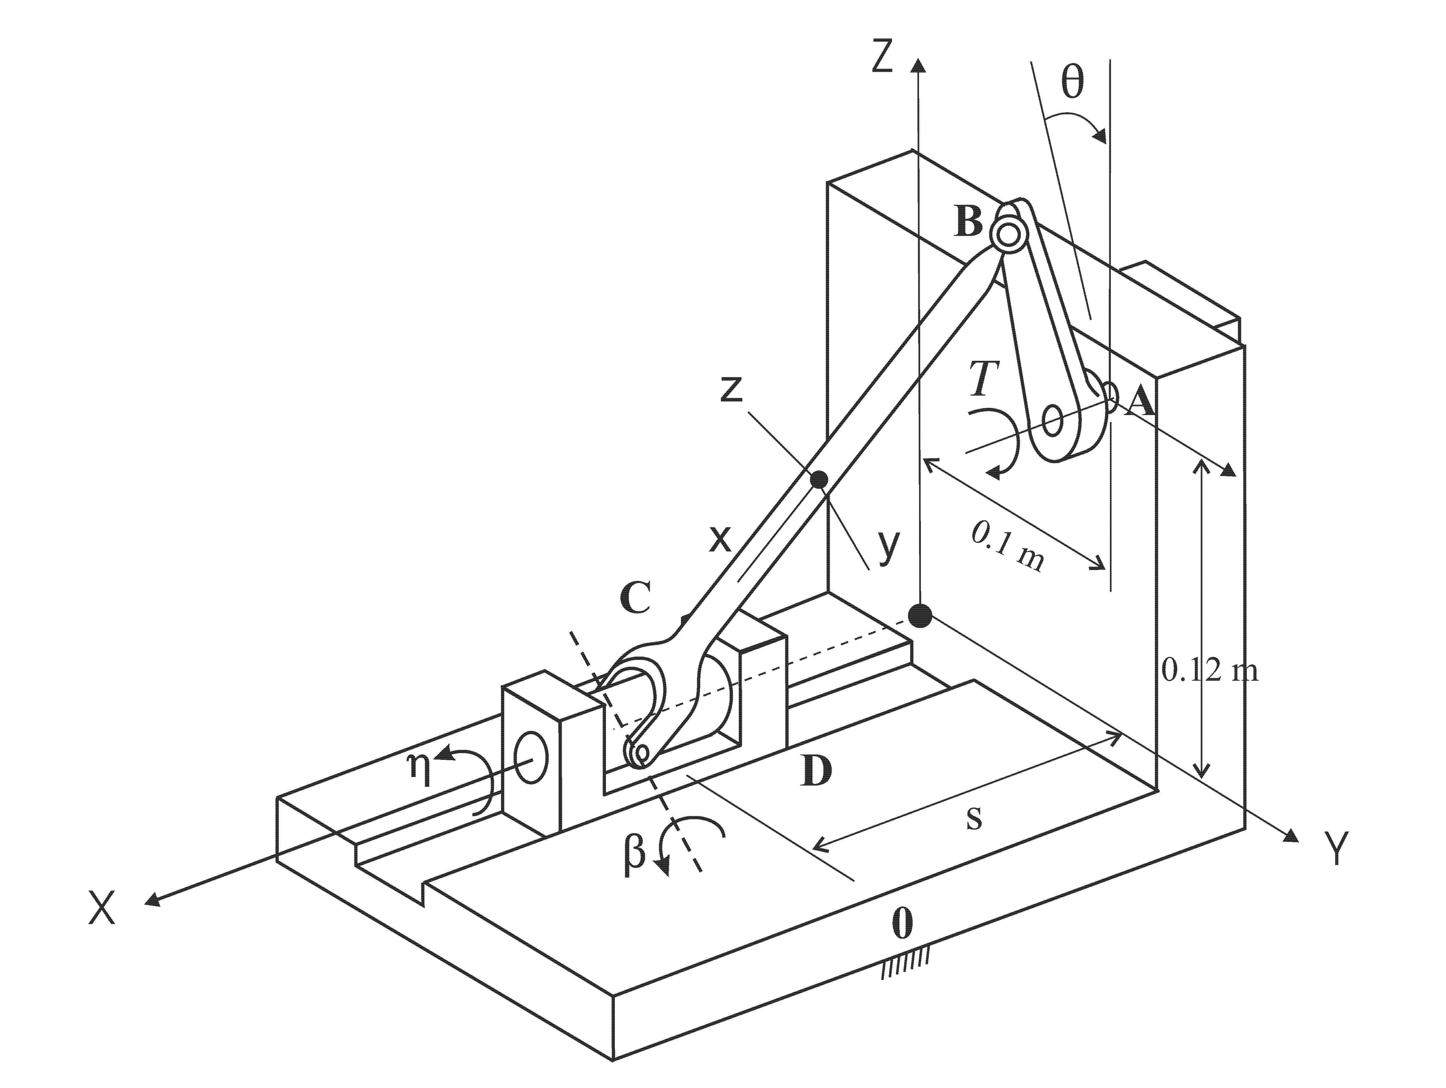
Spatial mechanism
is a mechanical system that has at least one body that moves in a way that its point trajectories are general space curves.

Slide 17
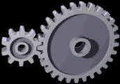
Gears and gear trains
The transmission of rotation between contacting toothed wheels
Notes:
Jelasin kalau gen igi kecil butuh daya tidak besar, gerigi kecil dengan gerigi besar jadinya lambat yang besar, latihan arah putar, membuat gerakan lambat dengan gerigi besar

Slide 18
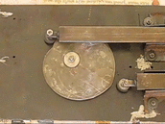
Cam and follower mechanisms
A cam and follower is formed by the direct contact of two specially shaped links. The driving link is called the cam and the link that is driven through the direct contact of their surfaces is called the follower. The shape of the contacting surfaces of the cam and follower determines the movement of the mechanism.

Slide 19
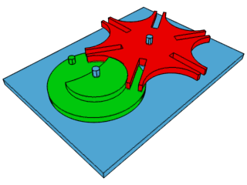
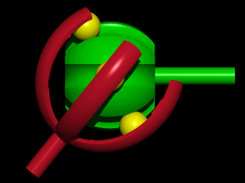

Slide 20
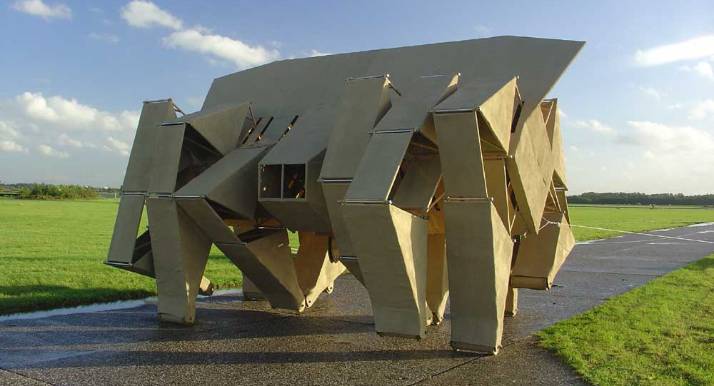
Linkages
A linkage is a collection of links connected by joints. Generally, the links are the structural elements and the joints allow movement.

Slide 21
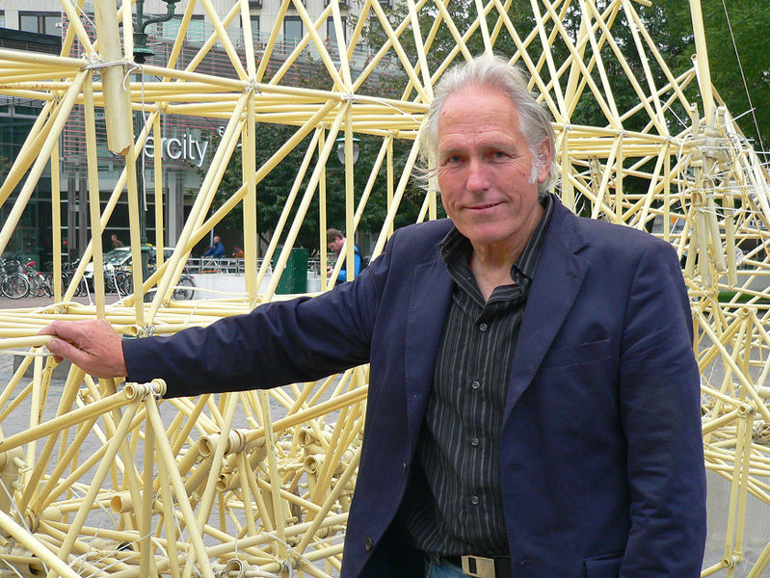
Theo Jansen (Kinetic Sculpture)
"The walls between art and engineering exist only in our minds." He strives to equip his creations with their own artificial intelligence so they can avoid obstacles by changing course when one is detected, such as the sea itself.

Slide 22
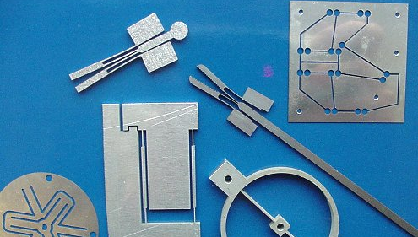
Flexure mechanisms
A flexure mechanism consisted of a series of rigid bodies connected by compliant elements (flexure bearings also known as flexure joints) that is designed to produce a geometrically well-defined motion upon application of a force.

Slide 23
Mechanism application
examples

Slide 24
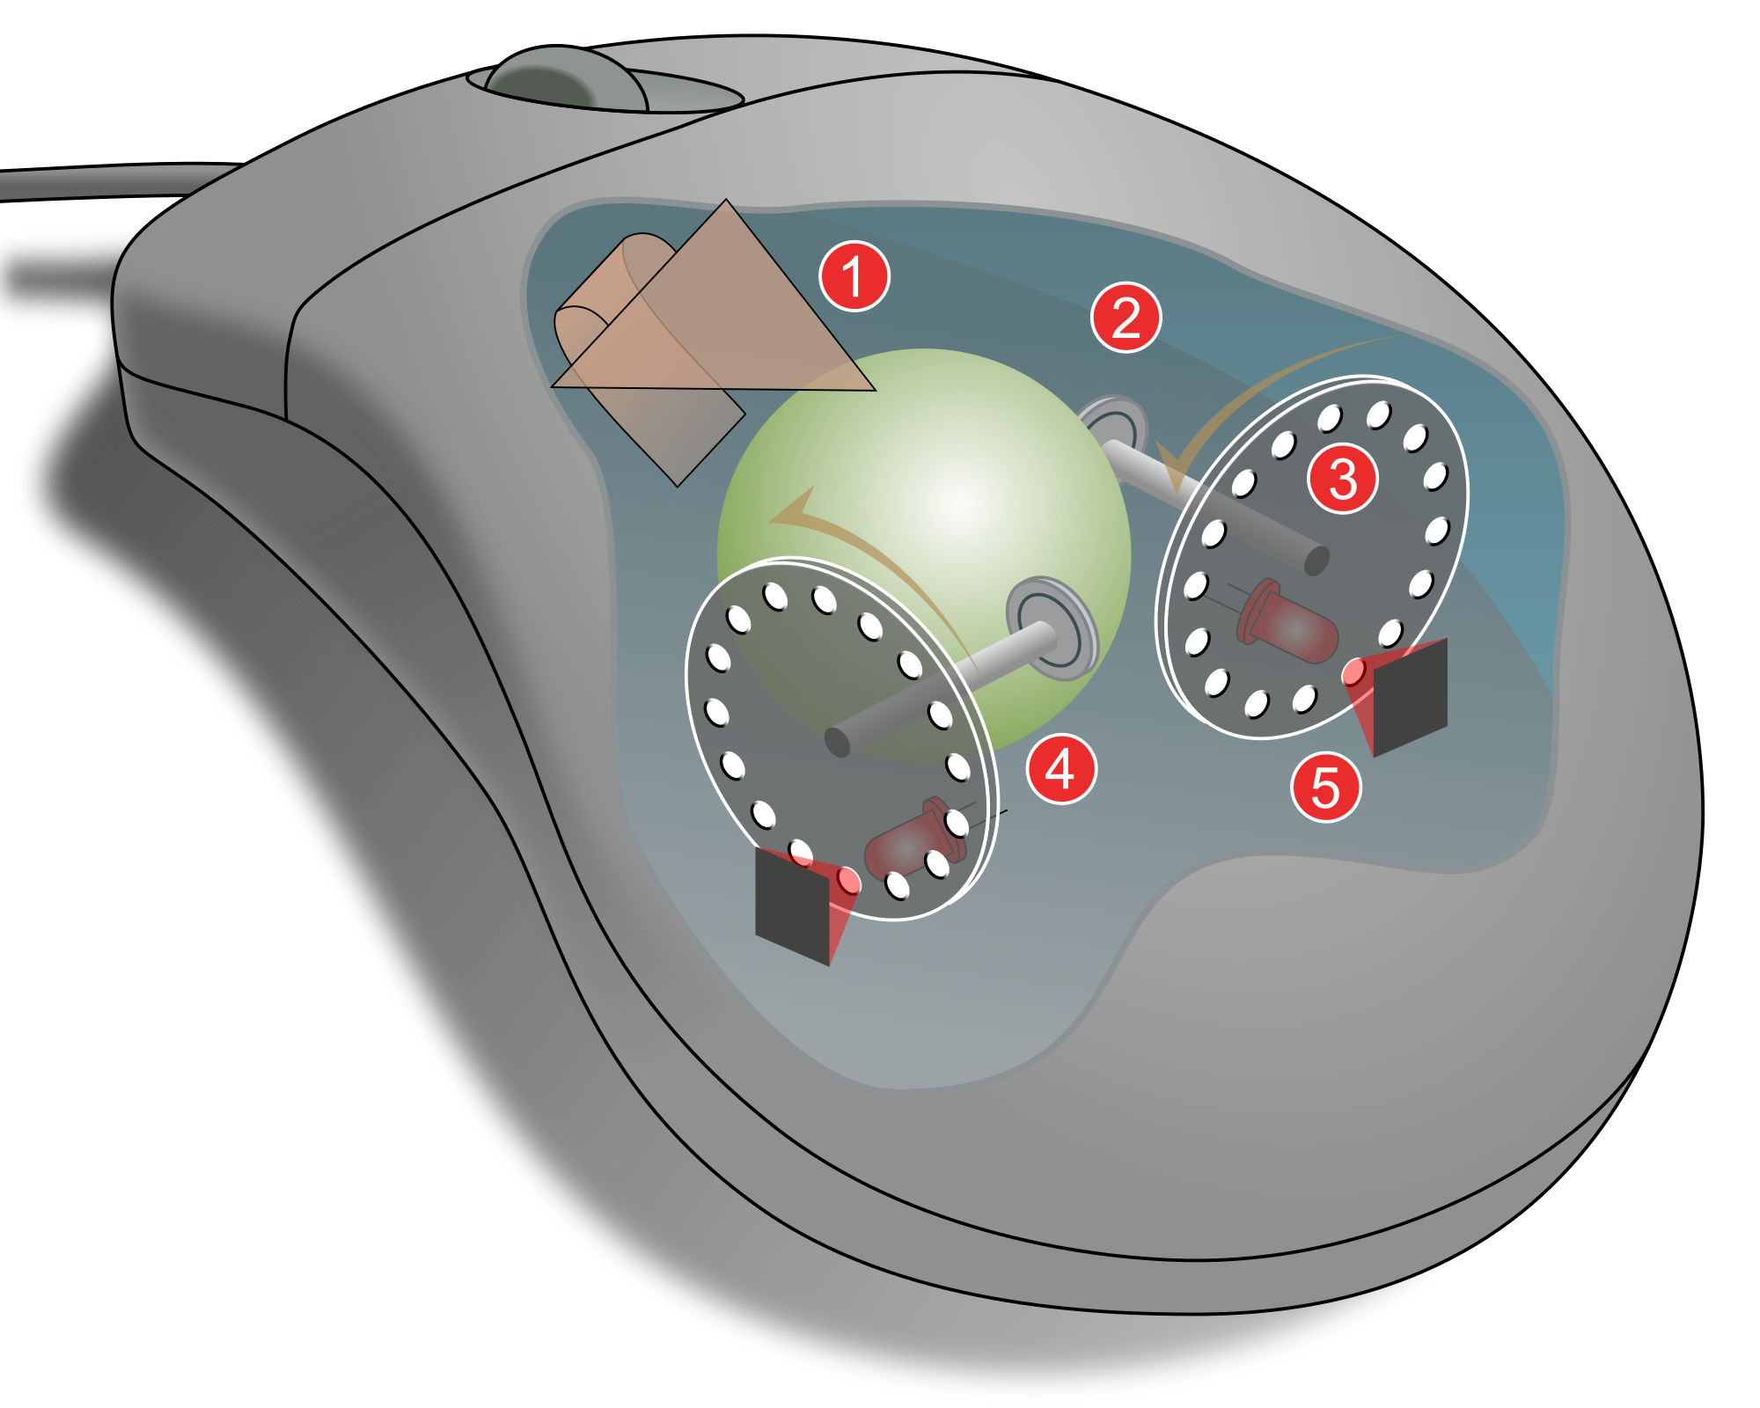

Slide 25
Tengah semester
Perkenalan produk fungsional dengan gerak mekanisme
Metodologi perencanaan produk dengan mekanisme gerak (pendekatan engineering)

Slide 26
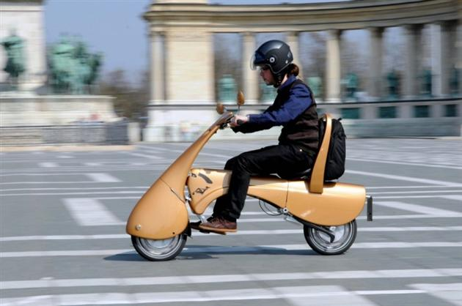
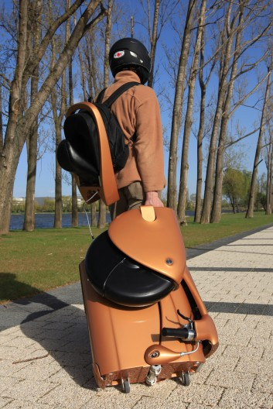
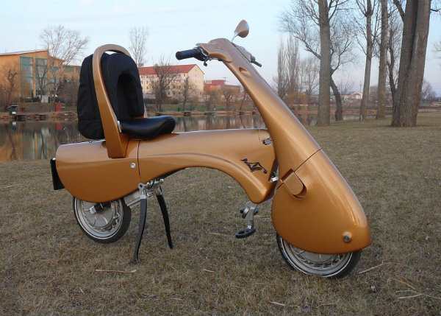
Tugas 3 : membuat produk multifungsi dengan mekanisme

Slide 27
Moveo – The Folding Electric Scooter That Helps You Say Bye-Bye To Pollution And Wasted Time Finding Parking Spaces

Slide 28
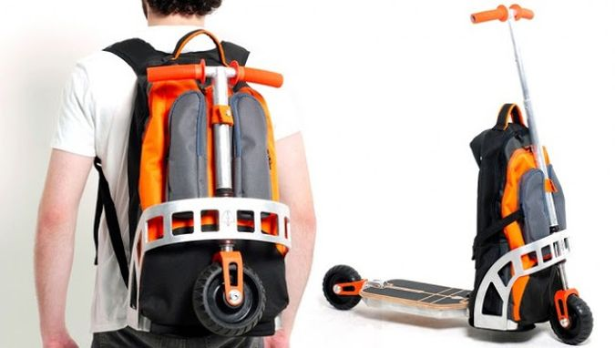
The Mountain monk and the Montague Paratrooper Folding Bike are great ways to transport a folding mountain bike as a backpack. If you’re looking for something similar but more adapted for the city use, the Scooter Backpack can provide you with easy individual transportation, while keeping the package light and small.
Designed by the Barasilian designer Gustavo Brenck, the Scooter Backpack combines a wearable backpack, a rolling luggage and a scooter in one cool backpack. The bag is made of strong polyester, features a padded laptop compartment, and the incorporated scooter allows you to quickly navigate the city. Mounting the scooter is as easy as unzipping the backpack, removing the scooter’s end and fasten the front and back wheels.

Slide 29
Multifungsi
mempermudah

Slide 30
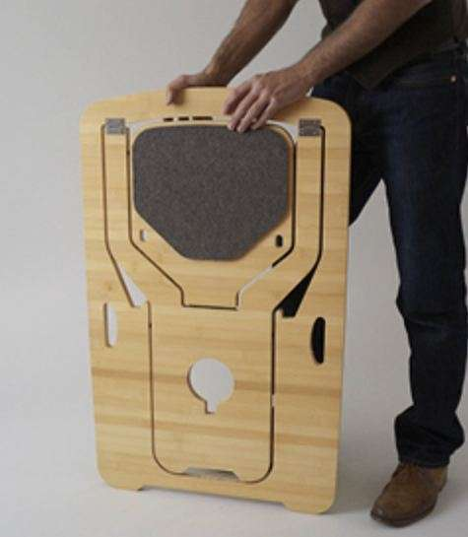
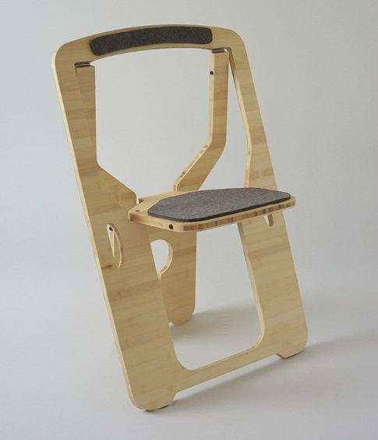

Slide 31
Teori kedekatan
Buku design method

Slide 33
Materi

Slide 34
Setiap produk didukung oleh aspek mekanisme
Definisi mekanisme ?
Mekanisme dalam produk
Lingkup desain produk , marketing, manajemen, termasuk dalam enjiniring
Mekanisme berfungsi sebagai
Bahas tentang alternatif mekanisme

Slide 35
Mekanisme pada mobil
furniture

Slide 36
Tugas
Alternatif mekanisme dalam bentuk sketsa
Alternatif mekanisme dalam bentuk gambar kerja
Alternatif mekanisme dalam bentuk prototip
Aplikasi alternatif mekanisme menjadi produk
Konsep produk (ikuti metodologi desain)
Prototiping produk akhir

Slide 37
UTS UAS
Alternatif mekanisme yang kemungkinan menunjang pembuatan produk akhir

Slide 38
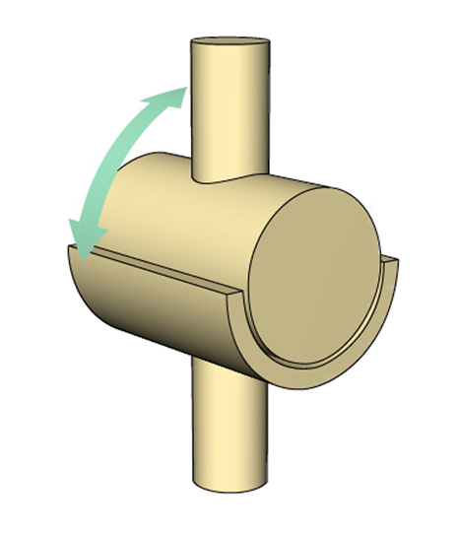
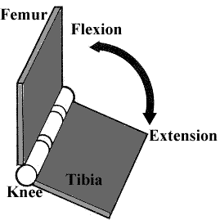
Kinematic pairs
Hinge Joint

Slide 39
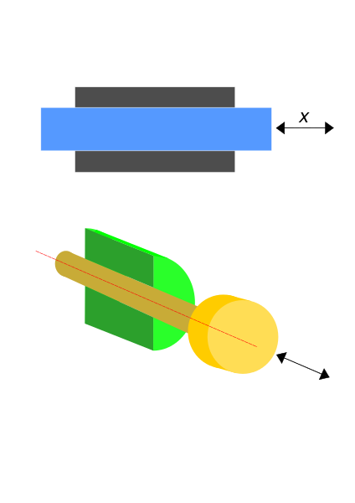
Prismatic Joint

Slide 40
cylindrical joint

Slide 41
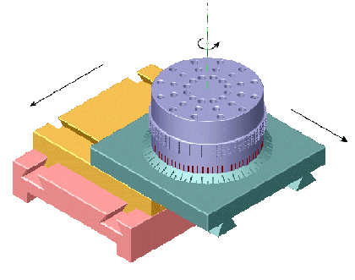
planar joint

Slide 42
Tugas 1 :
Buat dari karton, 10 alternatif gerak planar di board karton
Awal buat sketsa sebanyak-banyaknya
Buat 5 rekayasa pergerakan yang terinspirasi dari makhluk hidup (UTS)
part dari produk transportasi (UAS)

