Slide 1
Setiap unsur FISIK memiliki bahasa
1. WARNA

Slide 2
RED
Vitalitas
Atractive
Spirit
Happy, Fun.
Strong & Brave
Provokative
Aktive & Offensive
Energic & Dynamic
Exciting
Sexy and Gorgeous
Charming
HOT

Slide 3
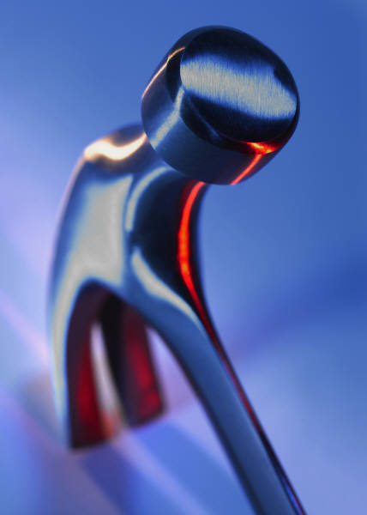
BLue
Stabil
Optimis
Calm
Prestige
clasic
Bonafide
Dependable
Have Credibility
COLD

Slide 4
OraNge
Warm
Fun
Friendly /Ramah
Couraging
Creative
Erotic
Happy
Warm

Slide 5
GreeN
Fresh Air
Renewed
Refreshing
Calm
Peace
Comfort / Nyaman
Fresh

Slide 6
YeLLow
Funny and Fun
Energic
Warm
Youthful
Full of Vitality as a Sun
Cheerful / Gembira, Riang
Eyecatching
Soft
Bright

Slide 7
WhiTe
Pure n Gentle
SteriL
Clean
Bright
Boring
Common / Biasa
Romantic
PuRe

Slide 8
Dark Brown
MascuLine
Earthy
Rich
Strong
Hard
Dependable
Protective
Save
Earthy

Slide 9
Light Brown
NaturaL
NetraL
Comfort
Earthy
Easy
Conservative
Common / Umum
Classic

Slide 10
BurGundy
Gorgeous
Aristocracy
Bergengsi
Expensive
Perfect
Classic
Elegance
Perfectionist

Slide 11
Deep PurpLe
Magical
SpirituaL
SensuaL
Artistic
Creative
Eksentric
Megah
MagicaL

Slide 12
PinK
Eyecatching
Exciting
Charming
Cute
Romance
Interest
Lovable
Energetic

Slide 13
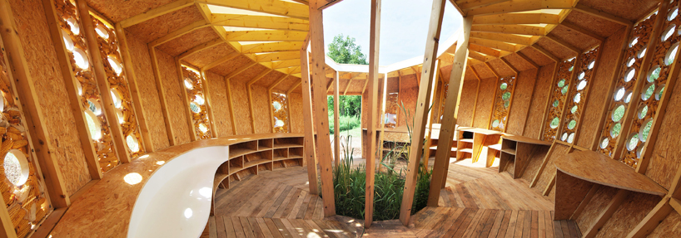
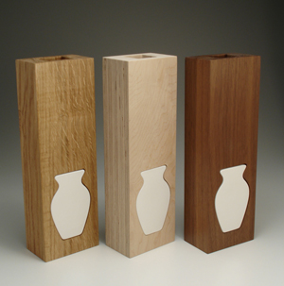
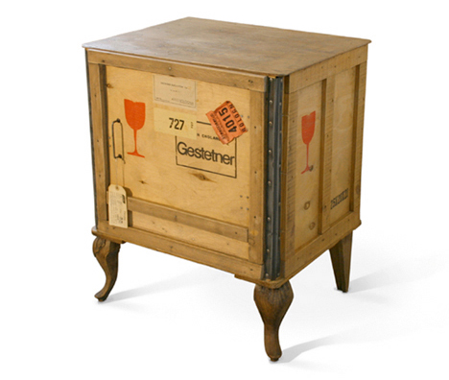
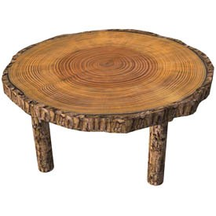
2. MATERIAL/BAHAN dan TEKSTUR

Slide 14
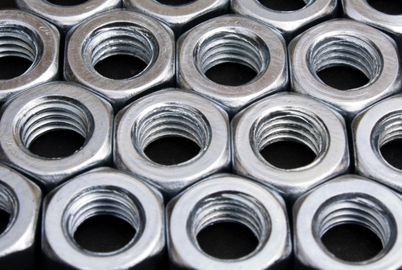
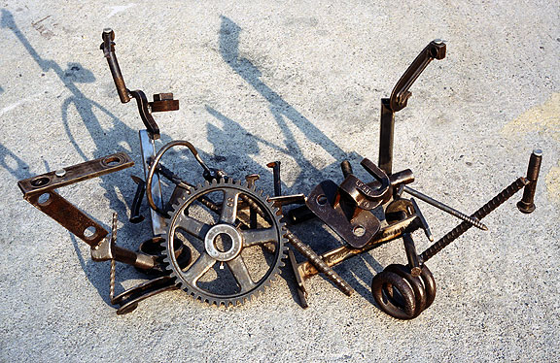
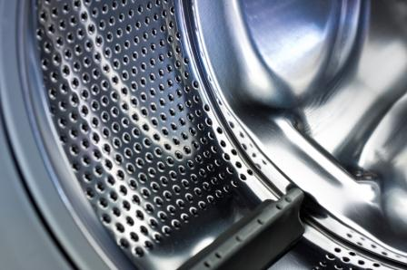

Slide 15
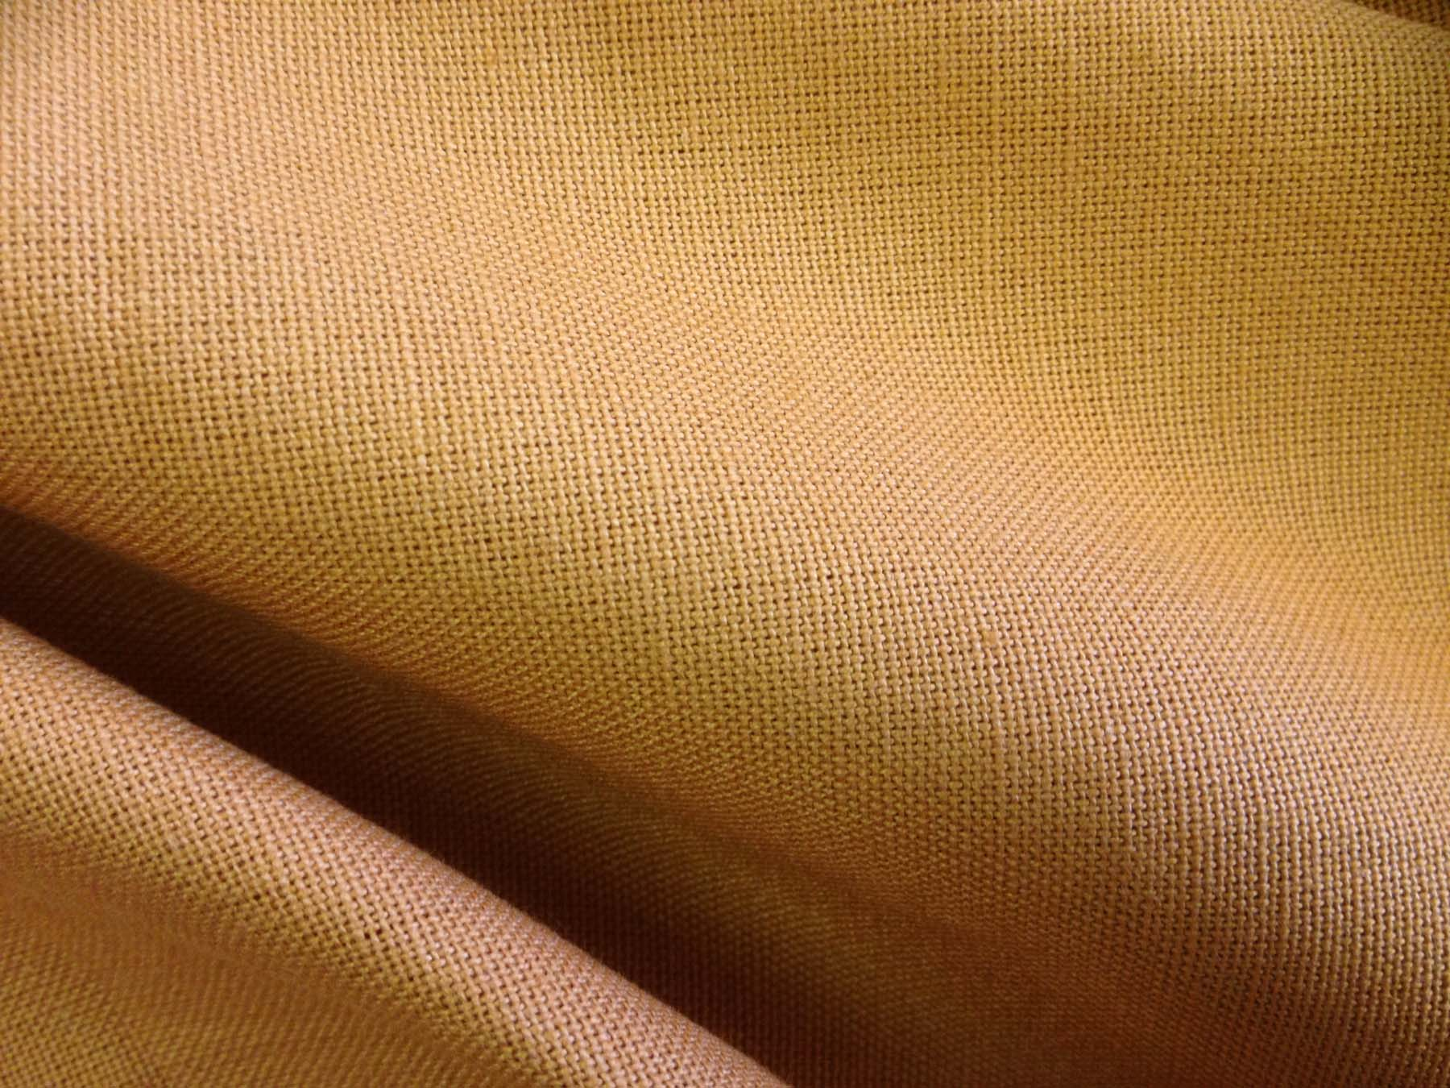
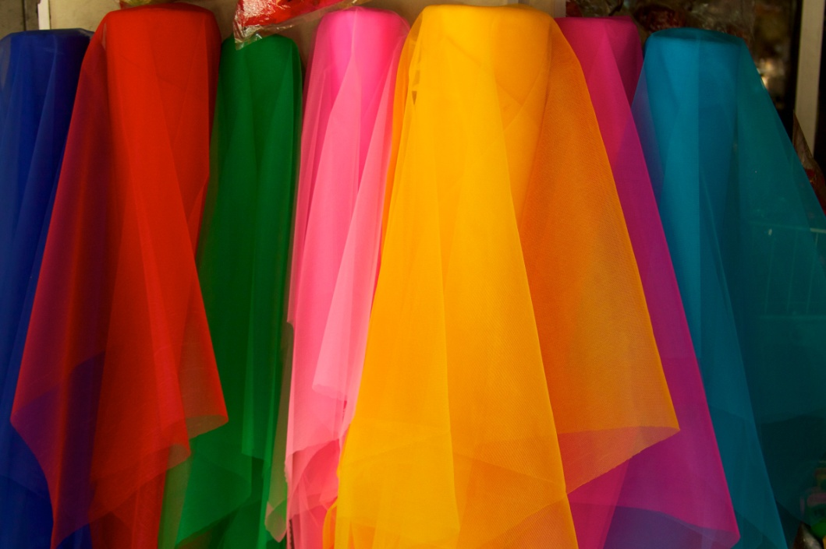
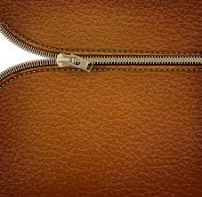
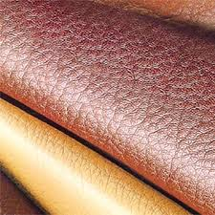

Slide 16
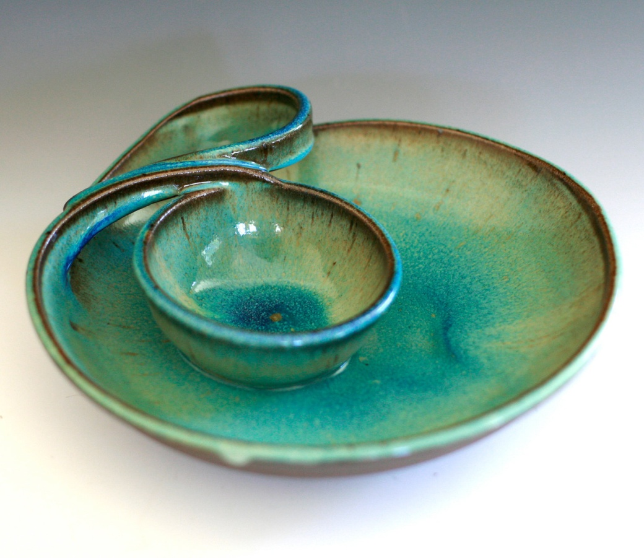
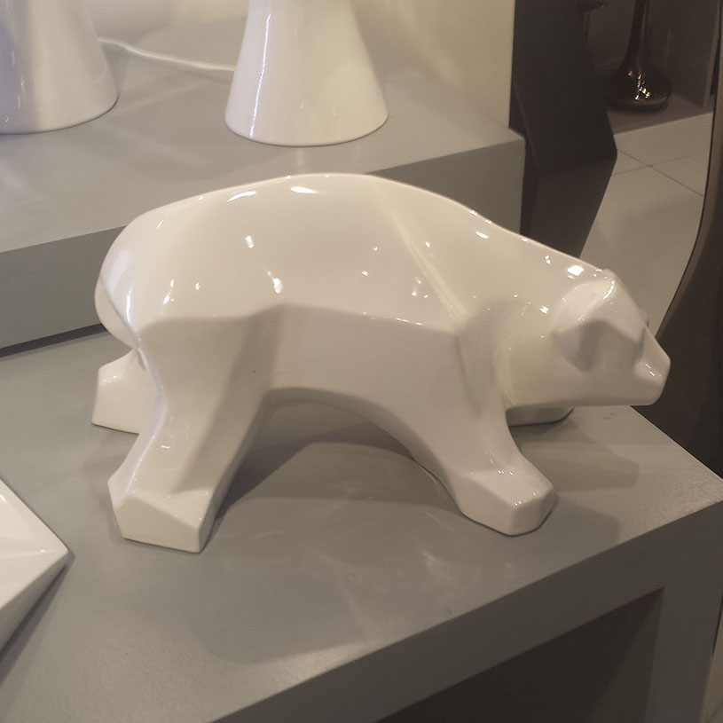
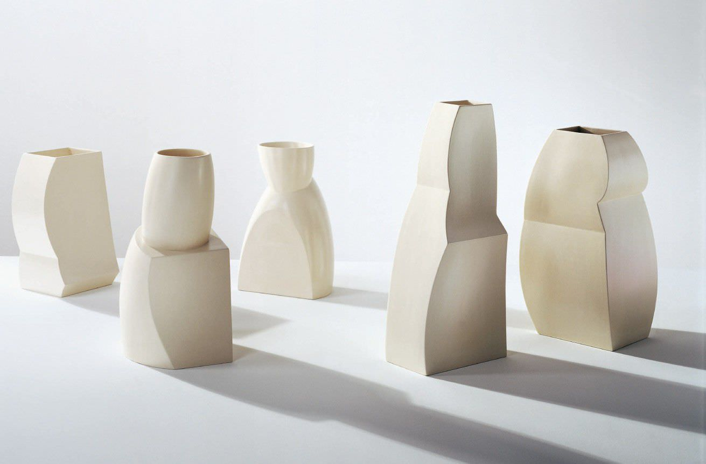

Slide 17
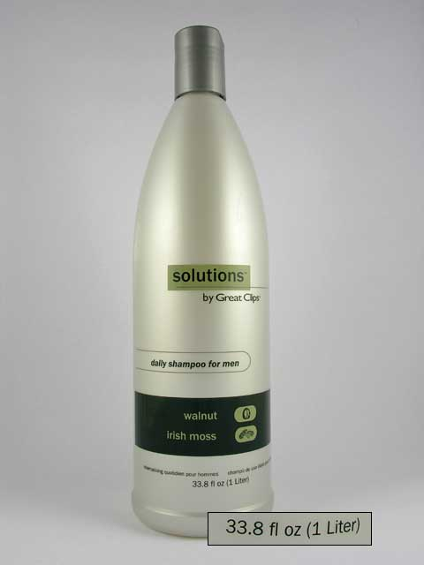
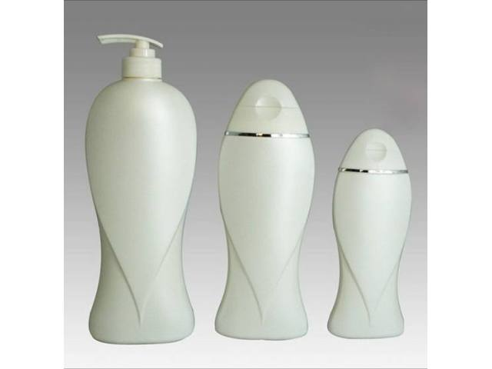
3. Wujud

Slide 18
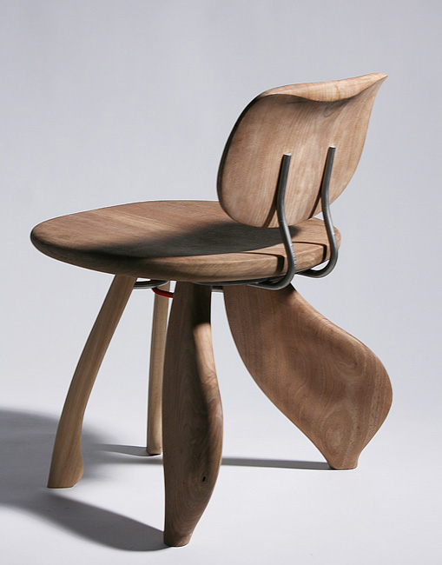
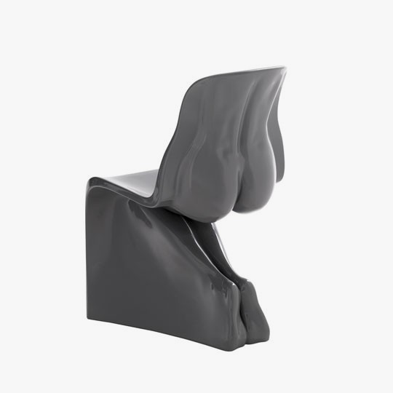

Slide 19
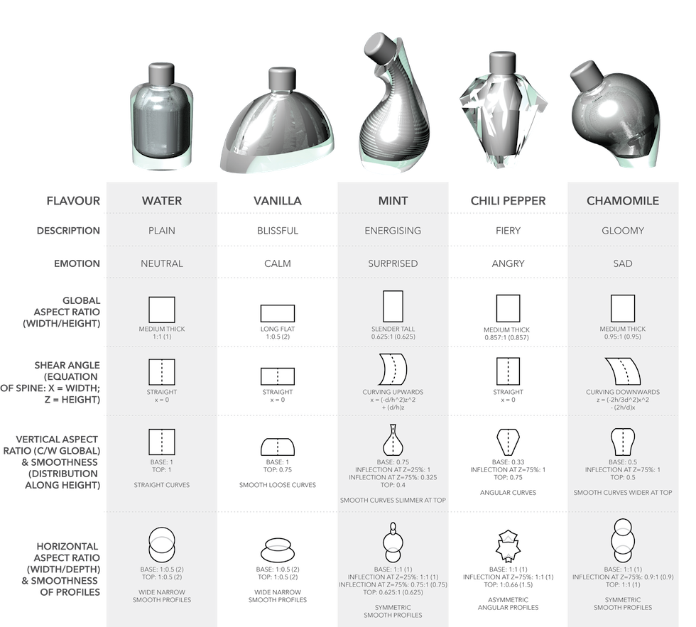
http://web.media.mit.edu/~pip/Flavourful_Forms/Flavourful_Forms.html

