Slide 1
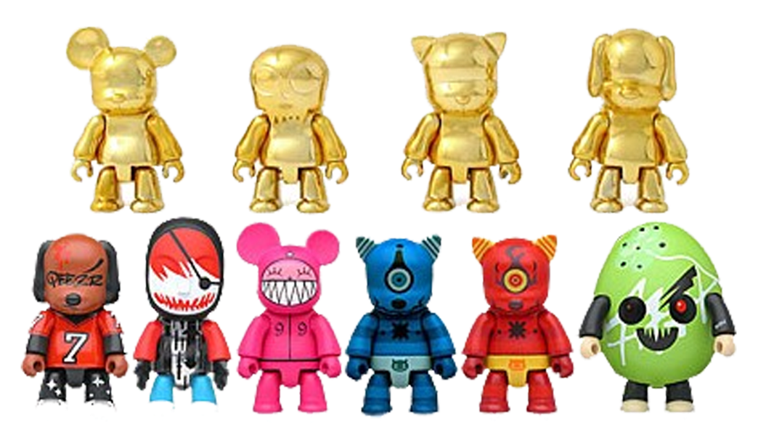
DESIGN YOUR OWN URBAN TOY
PROGRAM STUDI DESAIN PRODUK
Universitas Pembangunan Jaya
Dosen: I.A Siregar

Slide 2
MOOD BOARD
Collect at least 10 images (or more!) to create a mood board of things that you might want to incorporate into your own toy sketch.
Images can be taken from online, ripped from magazines, or even photographs of found objects (a pink plastic flamingo, a bottle of mustard). Feel free to appropriate from anything you find interesting!
There is no limit to the number of images you can collect, and the images don't have to make sense together (yet).

