Slide 1
ORGANIZE
Organize groups of 2 or more images that seem interesting together. Consider using juxtaposition when pairing images.
For example:
A cute kitten image with a crowbar.
Hillary Clinton in a pant suit with a mohawk.

Slide 2
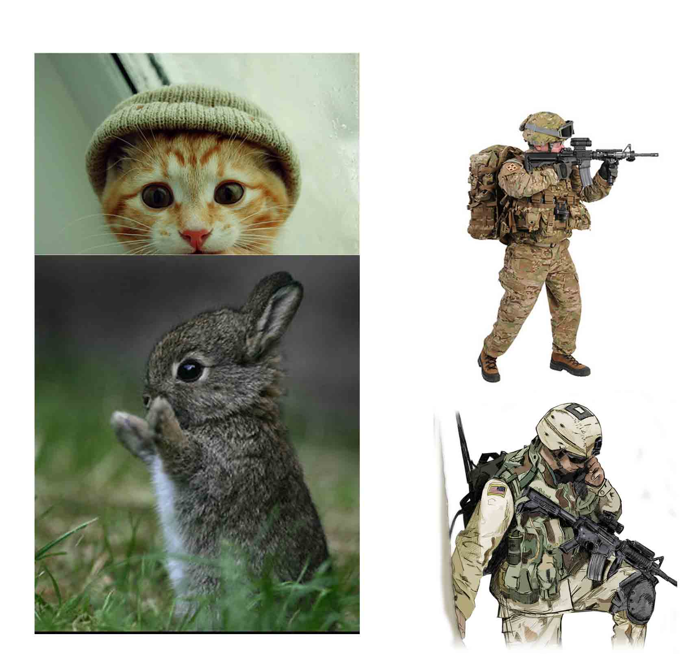

Slide 3
ROUGH SKETCH
Using the images you grouped from your mood board, create at least 3 initial sketches of your toy design.
It's not neccessary to draw the toy from more than one angle right now, and there is no need to get technical. These first sketches are just to convey the feeling and mood of your toy.
You can work with pencil and paper, pens, crayons, on the computer, collage, clay – whatever you like. Don’t forget accessories!

Slide 4
