Slide 1
ITERATE YOUR IDEA
Choose one of the sketches that you like best, and begin to iterate: draw it again and again, until you've come up with something that you really like.
This is still supposed to be only a rough sketch! It isn't necessary to produce finsihed art, and it's fine to stay in black and white — or use color. Whatever you prefer.

Slide 2
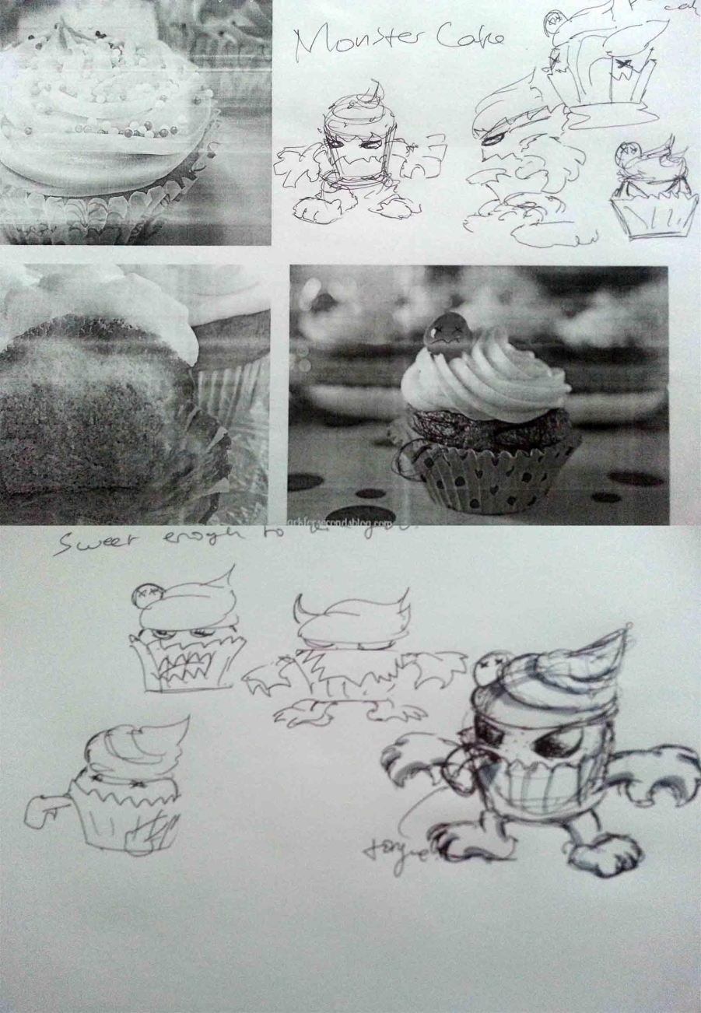
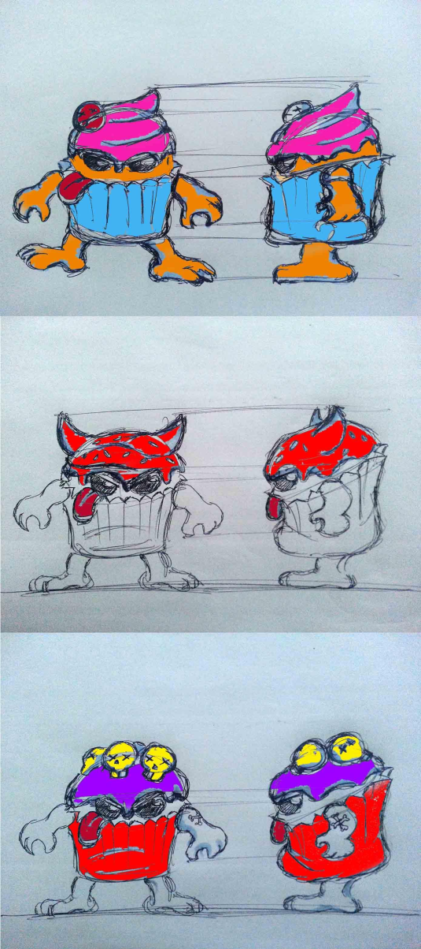

Slide 3
FINALIZE SKETCH
Choose one of your sketches and finalize it by creating a control drawing "presentation", with multiple angles, in black and white.
Draw your toy from all sides — top, bottom, left and right. Don't forget to do the same thing with accessories. Mark parts that will articulate, come on and off, or move.

