Slide 1
APRESIASI SENI
Ismail Alif Siregar M.A

Slide 2
PERKULIAHAN
Pembahasan 2 D
Pembahasan 3D
Final Project

Slide 3
APA HUBUNGANNYA SAMA GUE?

Slide 4
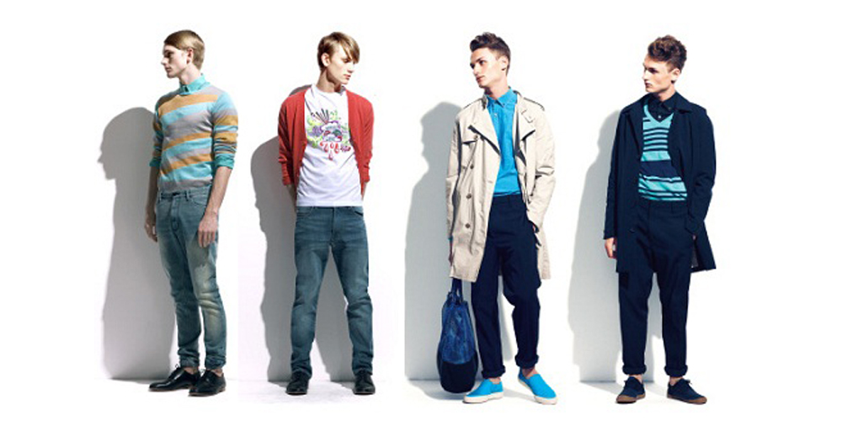
KITA DIKELILINGI SENI APLIKATIF

Slide 5
APLIKASI SENI PADA IT

Slide 6
SENI MEMBUAT KITA NYAMAN

Slide 7
The Attraction of Beauty
"what is beautiful is good" was first systematically studied by Dion, Berscheid, and Walster in 1972. The researchers asked both male and female college students to look at pictures of men and women who were either good-looking, average, or below-average. The students were then asked to give their impression of the individuals' personalities from the photos.
Students' responses to Dion and associates indicated that the good-looking photographed individuals were indeed seen as more attractive. In addition, beautiful people were judged by the students to have more socially desirable personalities. They were also assumed to have better jobs and be better relationship partners. Later meta-analysis by Feingold (1992) supports these findings as well. Across numerous studies, he found that good-looking people were seen as more sociable, dominant, sexually warm, mentally healthy, intelligent, and socially skilled.

