Slide 1
Why are we attracted to beautiful things?
‘We wear clothing and jewelry. We buy the biggest, most beautiful houses we can afford. We decorate our homes with furniture, rugs, prints, and gardens. We drive finely designed brightly colored automobiles, which we choose for their aesthetic appeal as much as their fuel efficiency. ‘ ‘ Geoffrey Miller in the Mating Mind

Slide 2
OMG WTFBBQARRGGHH SO COOL!!1!1!!

Slide 3
basic principles of beauty
APRECIATING ART IN LIFE

Slide 4
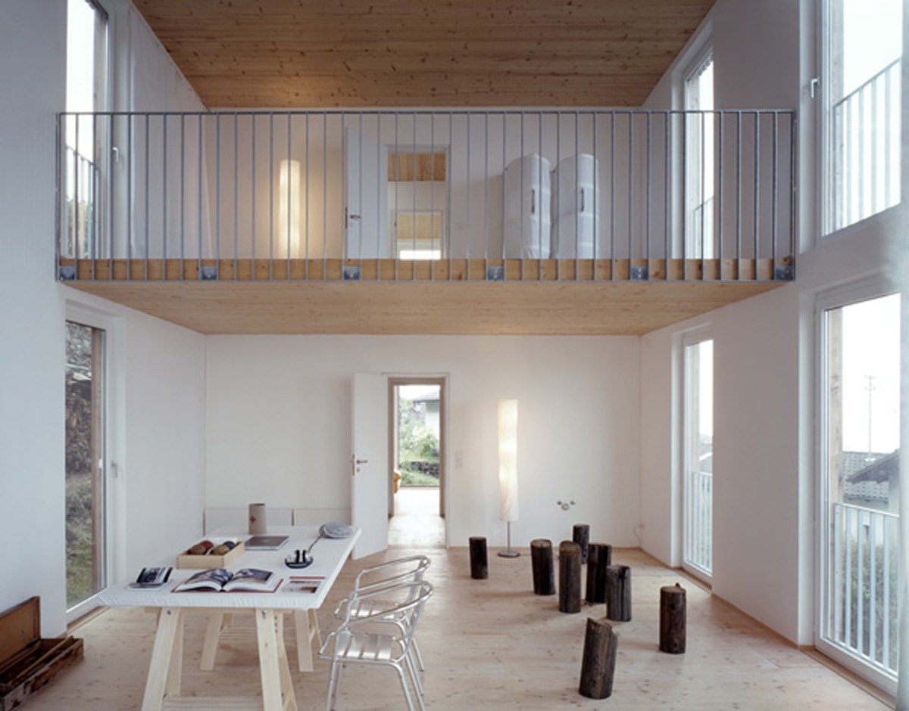
Simple objects are attractive
[High ceilings, simple geometric shapes]

Slide 5
[Clutter free desktops]

Slide 6
GOLDEN RATIO
Golden Ratio adalah sebuah perbandingan. Golden karena segala hal indah di alam semesta ini mengikuti perbandingan ini

Slide 7
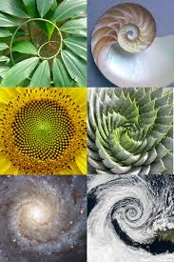
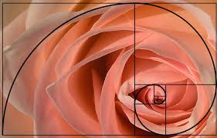
GOLDEN RATIO IN NATURE

Slide 8
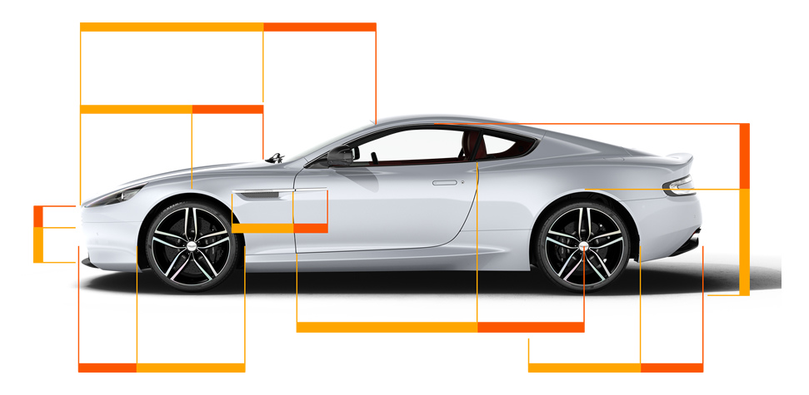
golden RATIO IN PRODUCTS

Slide 9
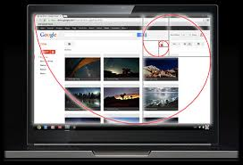
GOLDEN RATIO IN USER INTERFACE

Slide 10
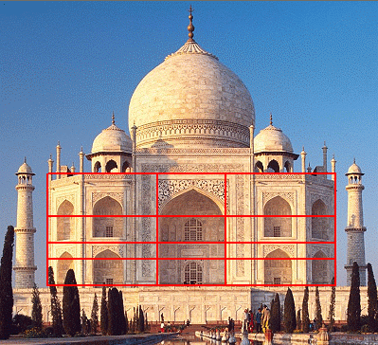
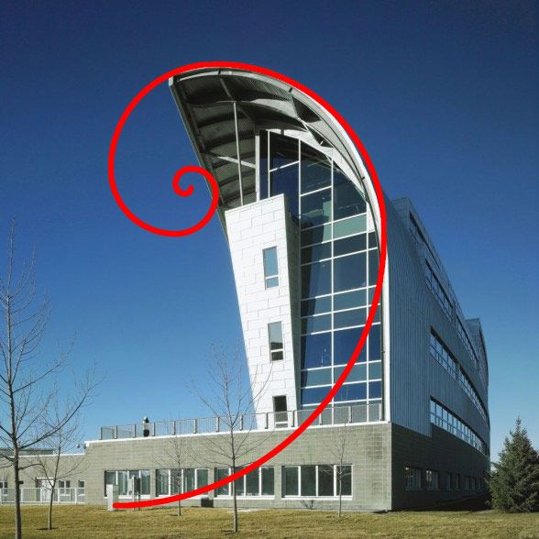
GOLDEN RATIO IN ARCHITECTURE

