Slide 1
center bias
center bias, where the subject of the picture is in the center of the frame

Slide 2
inward bias
Subject of the picture was intentionally off-center, participants had an aesthetic preference when the subject was looking inwards instead of outwards

Slide 3
TUGAS 1
INSTAGRAM 10 foto.
Mention @kuronoraito
Berikan deskripsi singkat tentang foto di caption,
5W 1H, What, Who, Where, When,Why + How

Slide 4
Geoffrey Miller, an evolutionary psychologist, studies why human beings are attracted to such things things. He states:
‘The mind makes very little sense as a Swiss army knife or a military command center. It makes more sense as an entertainment system designed to stimulate other brains. ‘

Slide 5
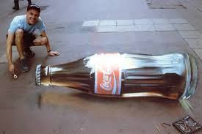
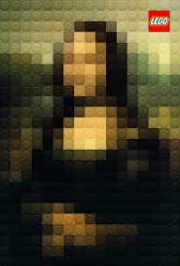
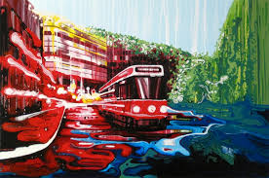
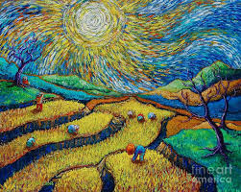
2D ART

Slide 6
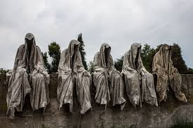
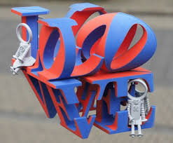
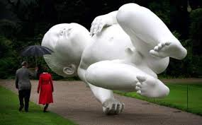
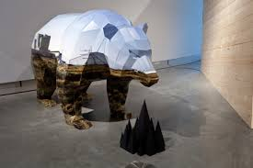
3D ART

Slide 7
The Arts Creative Cycle

