Slide 1
TYPES OF FASHION
APPAREL & ACCESSORIES

Slide 3
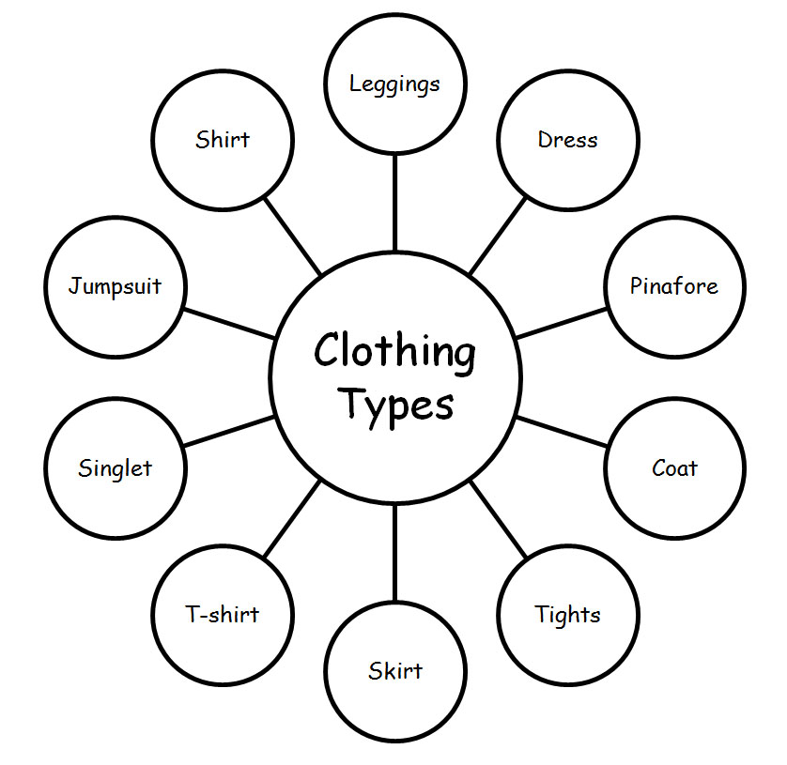
Fashion Apperal
Dress
Skirt
Pants
Trousers
Jacket
Cardigan
Gown
T-shirt

Slide 4
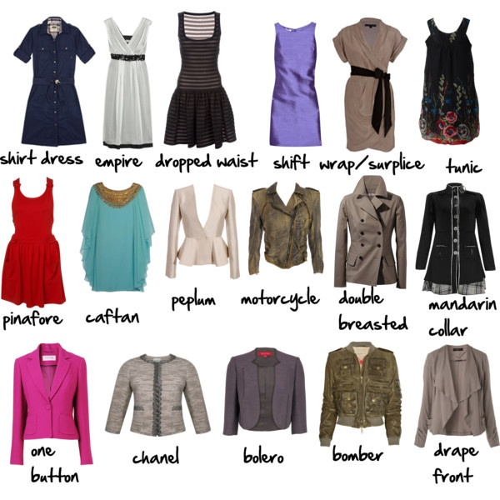
Types of Apparel / Clothing

Slide 5
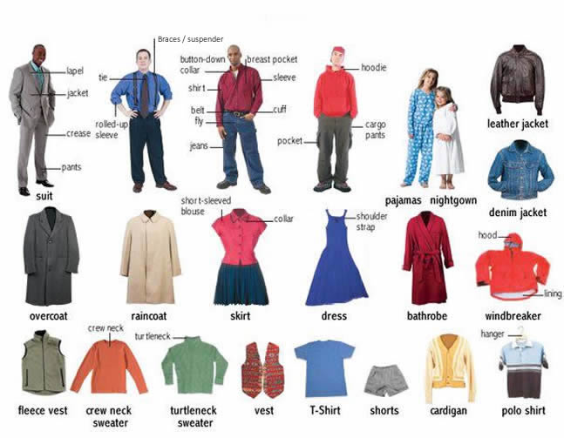

Slide 6
Types of Dresses

Slide 7
Types of Jacket

Slide 8
Types of Men’s Jacket

Slide 9
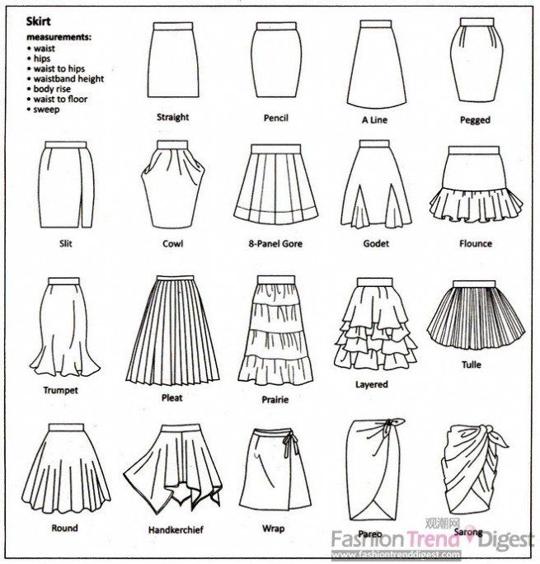
Skirt’s Shape

Slide 10
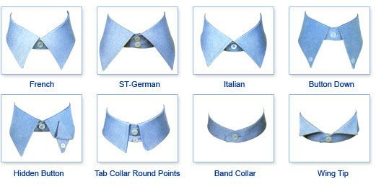
Tipe Kerah Baju

Slide 11
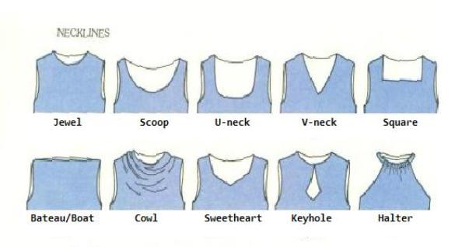
Dress Cutting

Slide 12
Fashion Accessories

Slide 13
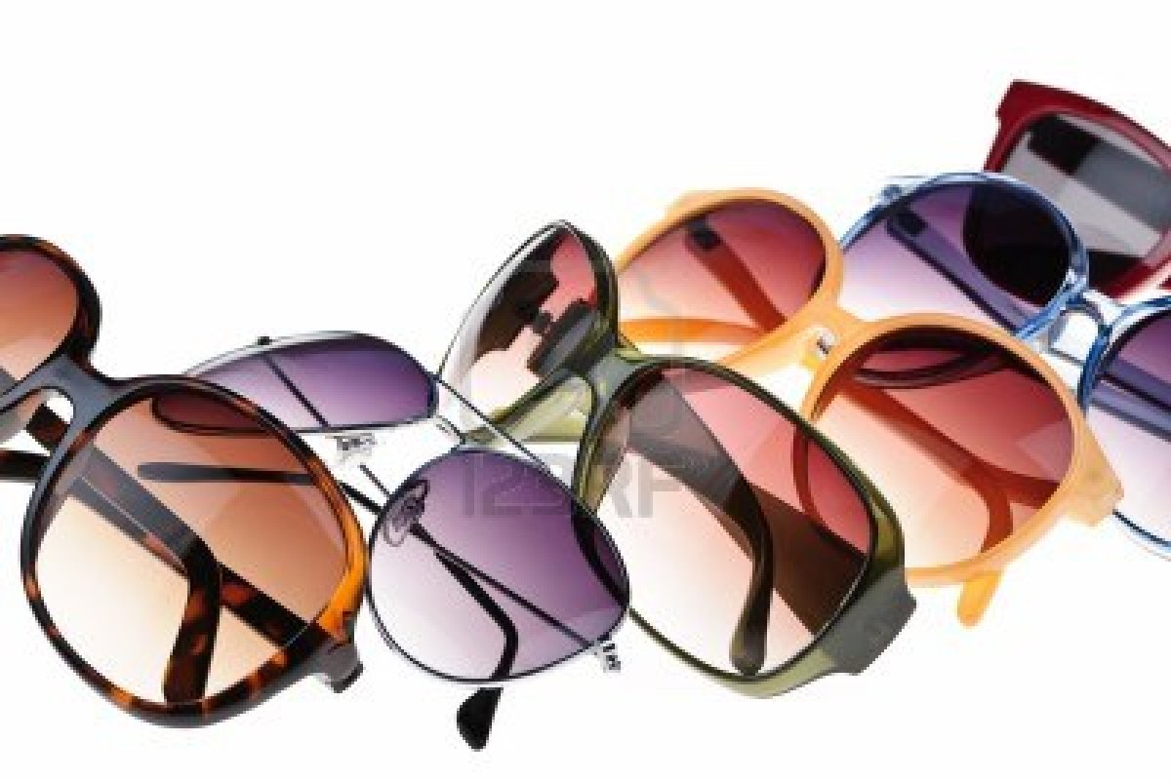
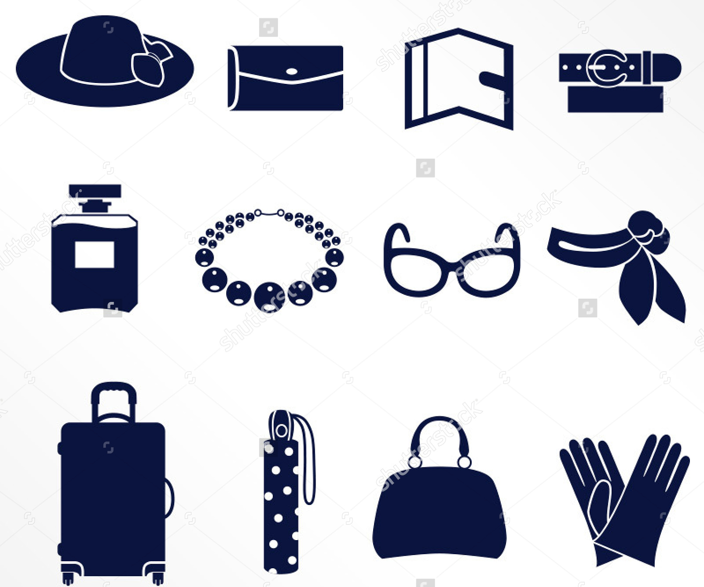

Slide 15
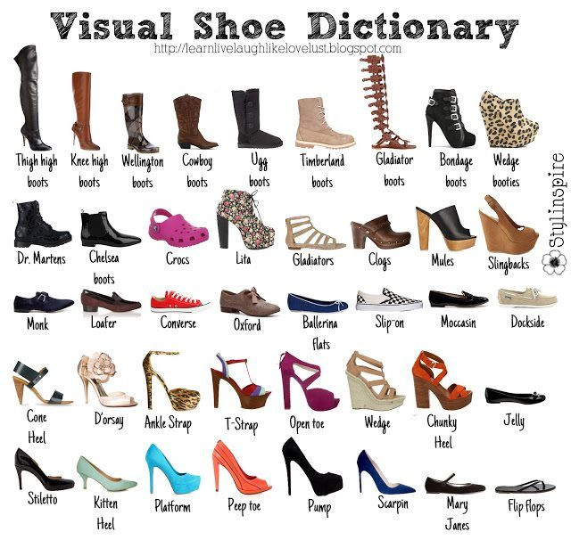

Slide 16
