Slide 1
CREATIVE MOOD BOARD [2]
Urban Fashion & Lifestyle Product

Slide 2
Mood Board Guidline
Be clear what you're trying to achieve
Choose a few high level directions
Collect any written inspiration
Add any visual elements that already exist
Collect inspiring design from around the web
Add some photography
Add colors and fonts
Add examples of motion and animation
Focus on composition, hierarchy and scale
Add some notes explaining your thinking

Slide 3
Collect inspiring design from around the web
Next it's time to start searching online. There are lots of fantastic sites where you can find great visual inspiration for free, like Dribbble, Behance and Designspiration.
The keyword you use to search can be literal words describing the topic of the moodboard (e.g. "bicycle") metaphors (e.g. "ribbon") or descriptive (e.g. "clean").

Slide 4
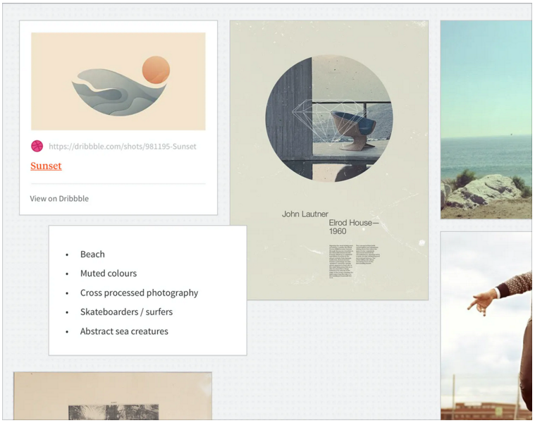
Drag in a new Note to keep track of your search terms.
Search the web for images which match your keywords.
When you find an image you like, drag it straight into Milanote (or paste the image URL into a Link card).

Slide 5
Add some photography
Websites like Pexels, iStockPhoto and the Creative Commons search are great places to find free photography.
You can also use the Image Search feature within Milanote to find great images for your moodboard. The photos you choose can start to define things like tone, cropping, lighting and color. You can also start to decide whether photography should contain people, who they should be and what emotions they should be expressing.

Slide 6
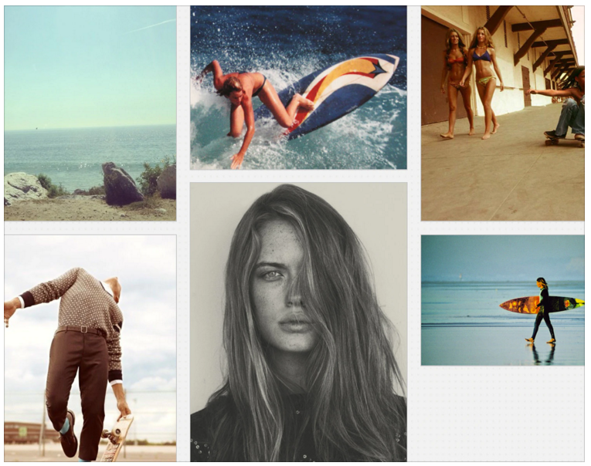
Drag in a new Note to keep track of your search terms.
Search the web for images which match your keywords.
When you find an image you like, drag it straight into Milanote (or paste the image URL into a Link card).

Slide 7
Add colors and fonts
Color palettes and fonts can be a great way to express a particular mood or personality. Tools like Kuler , an be a great starting point for finding colors that complement the brand you're working with. Another trick is to pick colors directly from the images and photos you've added to the board.

Slide 8
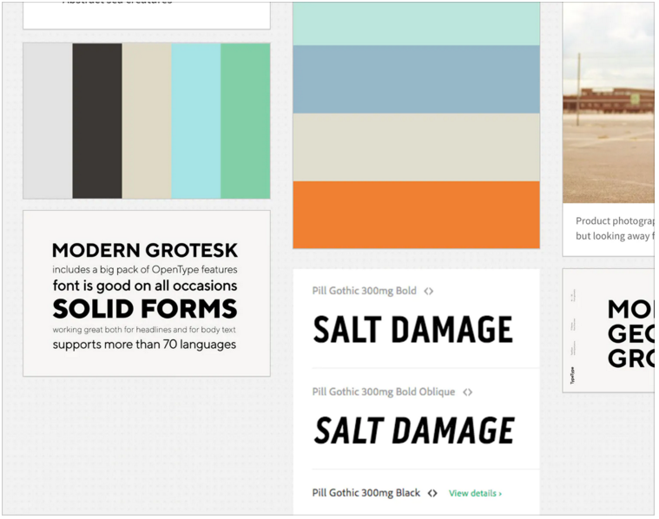
Take screenshots of the color palettes and fonts you find online, or dragFont Files that you've collected to add them to the Board.
Make sure you include different weights of the same font.
Drag your screenshots into Milanote to add them to the Board.

Slide 9
Add examples of motion and animation
The days of static moodboards are gone. With an online board it's possible to embed examples of how movement and animation could contribute to a piece of creative work. Grab some animated GIFs from Giphy, and video from YouTube to bring your board to life.

Slide 10
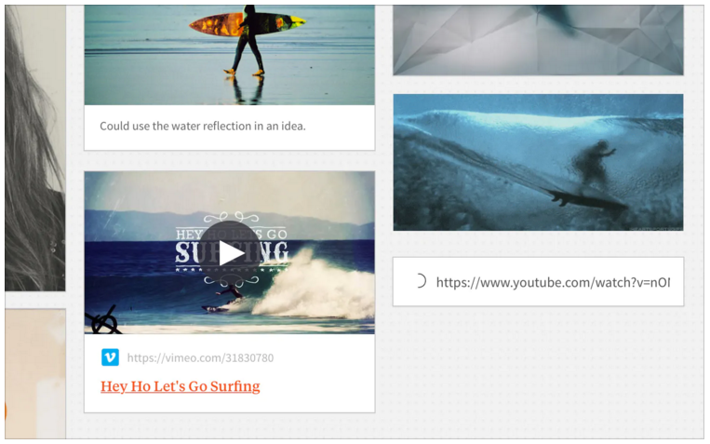
Drag animated GIFs straight from your desktop into your Board to upload them.
Select and image and use the Transparent option in the toolbar to toggle the background on and off.
Use a Link card to embed video from YouTube into your board.

Slide 11
Focus on composition, hierarchy and scale
Now that you've got the raw pieces, it's time to start arranging them into a final composition. Starting by scaling and placing the logo can be a good way to anchor your composition. Use the size of elements to indicate their importance, and put related elements side by side. This process can take a while, so just relax and enjoy it!

Slide 12
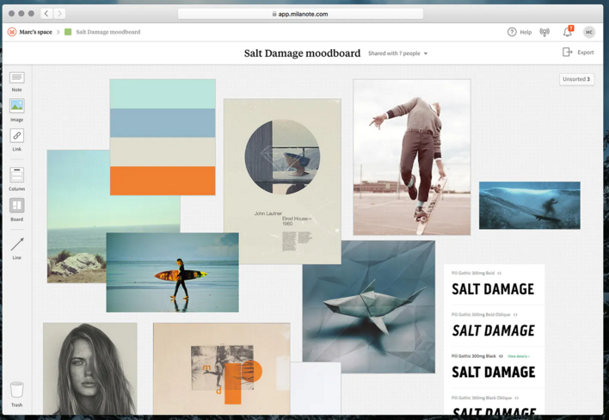
Drag any card to reposition it on the Board.
Click and drag on the canvas to create a rectangle which lets you select and move multiple cards at once.
Drag the bottom right corner of an Image to resize it.
Delete anything that doesn't fit by selecting it and hitting the delete key.

Slide 13
Add some notes explaining your thinking
Although a moodboard is a piece of visual communication, it's going to need some explanation before it will make sense to someone else. Adding short notes about why certain elements were chosen can really help communicate your ideas. Embedding these notes in a board keeps everything in context.

Slide 14
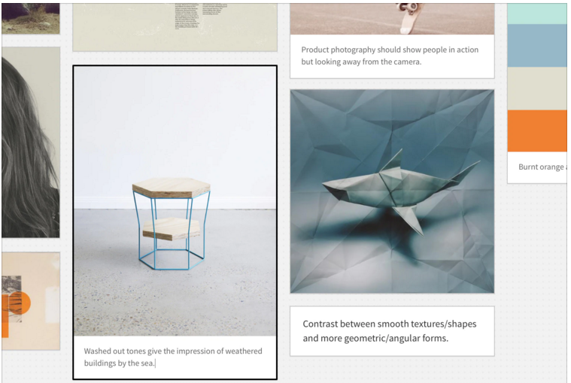
Select an image and choose Caption from the toolbar to add a description (or just start typing to add a caption automatically).
Choose Lock from the toolbar to force an image to stay behind everything else.
Drag in text notes to add extra explanation.

Slide 15
FASHION & LIFESTYLE PRODUCT MOOD BOARD by Donna Angelina
E. Detail Pattern ke-1 | I. Illustrasi hasil desain. |  |  |  |  | D. Gambar inspirasi untuk referensi dari sebuah baju / product lifestyle yang akan diangkat. | C. Gbr Inspirasi ke-1 (lifestyle product)
E. Detail Pattern ke-2
 |  |  |  |  |  |  | C. Gbr Inspirasi ke-2 (ambient of interior)
E. Detail Pattern ke-3
 | F. Color Tone yg direncanakan |  |  |  |  |  | C. Gbr Inspirasi ke-3 (nature/country/culture)
A. JUDUL / TEMA BESAR dari Perencanaan Design
 |  |  |  |  |  |  | C. Gbr Inspirasi ke-4 (mood expression)
G. Key fabrics Jenis bahan Jenis teksture | B. Trend Summary
 |  |  |  |  |  |  | C. Gbr Inspirasi ke-5 (produk/aksesoris pendukung)
 | H. Penjelasan dari: Color Palette Penjelasan Occasion

Slide 16
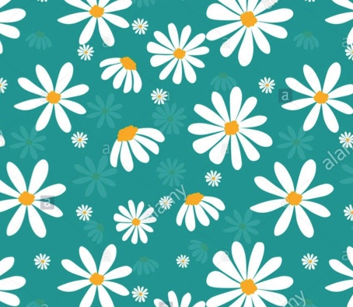
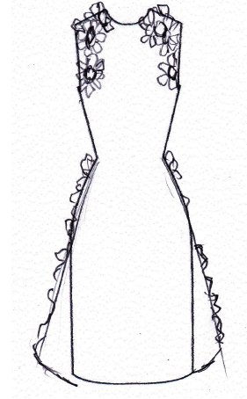
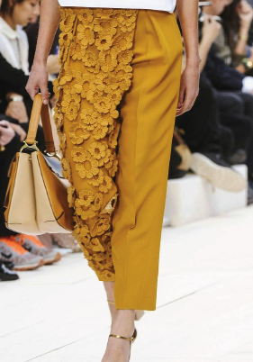
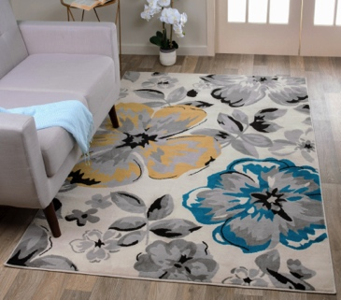

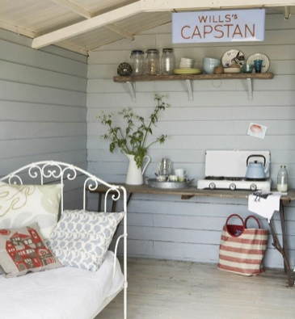

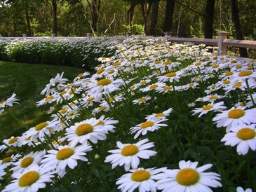
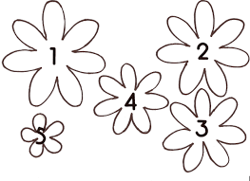
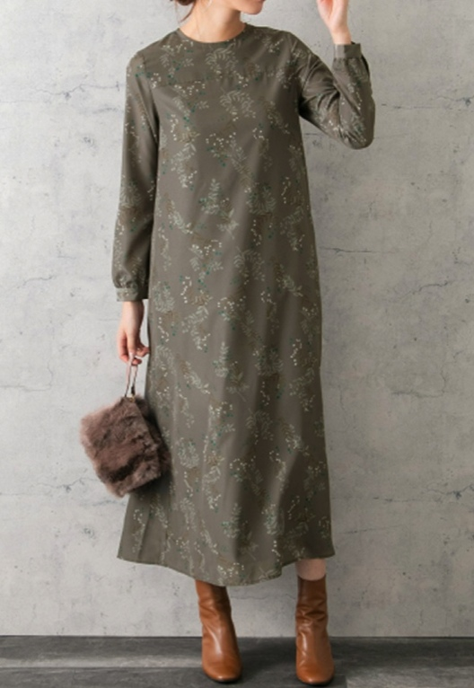
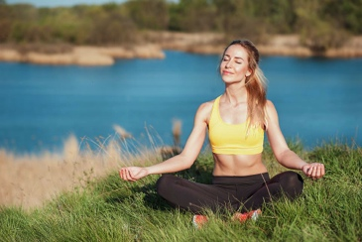
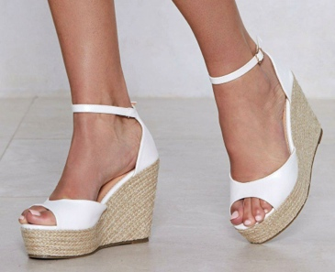
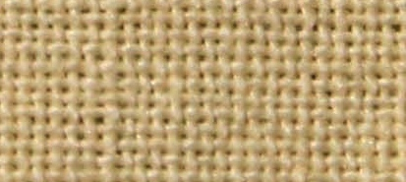
B L O O M
Fabric type: cotton.
Trend: xxxxxxxxxx…..
The color is representative of Earthy and Life.
Occasion: use at cocktail party at summer.

Slide 17
Reference
https://www.youtube.com/watch?v=QLTbT2bqsj0
https://milanote.com/guide/create-better-moodboards
https://www.canva.com/learn/make-a-mood-board/

