Slide 2
Importance of Heredity
A BRIEF INTRO TO GENETICS

Slide 3
Nature Nurture issues come back AGAIN!
Which is more important:
Nature: innate, biological, what you are “born with”
Nurture: environmental experiences that shape your brain (including in utero experiences)
Genetics vs experience
Do your genes guide your experience?
Can experience actually change your genes?
Which contributes more to who you are?

Slide 4
Quick review: What is your “Genetic Code”
Gene:
biological unit that directs cellular processes
Transmits inherited characteristics
Typically found in chromosomes
Chromosomes
In humans: each cell has 46 chromosomes arranged in 23 pairs
23rd pair = sex chromosomes
Each set of 46 chromosomes distinct from all others- even in identical twins!
Sperm, eggs carry only 23 chromosomes: if put together- get the 46!
Each chromosome carries unique set of information that makes you who you are

Slide 5
DNA: Watson and Crick (1953)
Deoxyribonucleic acid or DNA
Double stranded chain of chemical molecules
Forms a double helix
Forms rungs, like on a ladder (that’s the double helix!)
Each rung is composed of 2 of 4 bases:
Adenine: A
Thymine: T
Guanine: G
Cytosine: C
Order that they are put together is unique for every person
Genes influence most of our behavior
Not cause, but influence
Provide directions for making proteins
Proteins = catalyst for making body parts and enzymes
Enzymes = catalyst for modifying chemical reactions in body and particularly the brain!

Slide 6
Inheritance
Chromosomes are paired, so genes are also paired
Allow inherited traits
Genotype: actual inherited trait
Phenotype: expression of that trait
Dominant gene effects
One gene dominates the other
If you have that gene, it will be expressed
Recessive gene effects:
Takes two of the genes for effect to be expressed
OR is x-linked or sex linked
If only get that one, then it is expressed
Carried and passed on by the mother

Slide 7
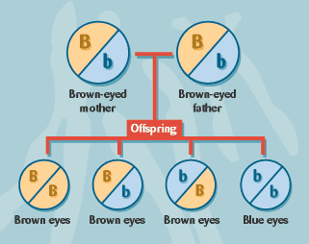
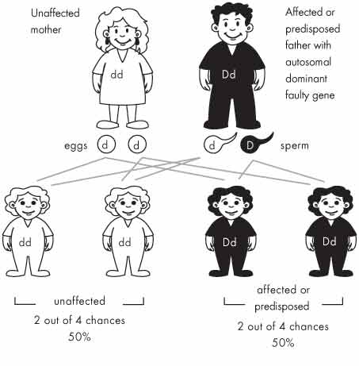
Examples of Inheritance
Recessive Gene Trait:
Autosomal dominant Gene

Slide 8
Blood type inheritance: Slightly different inheritance
If someone has blood type A, they must have at least one copy of the A allele, but they could have two copies. Their genotype is either AA or AO.
Similarly, someone who is blood type B could have a genotype of either BB or BO.
Blood type Possible genotypes
A AA or AO
B BB or BO
A blood test of either type AB or type O is more informative.
Someone with blood type AB must have both the A and B alleles. The genotype must be AB.
Someone with blood type O has neither the A nor the B allele. The genotype must be OO
Blood type Possible genotypes
AB AB
O OO
A AA or AO
B BB or BO
Question: Could a mother with “type A” blood and a father with “type B” blood produce a child with “Type O”? How?

Slide 9
Genes cause behavior? Well, maybe……..!
Animal breeding studies: can breed for several kinds of traits
Physical traits
Behavioral traits
But genetics not explain the WHOLE picture!
Not sure to what degree “behaviors” such as intelligence, mental illness, addiction are inherited or are environmentally elicited.

Slide 10
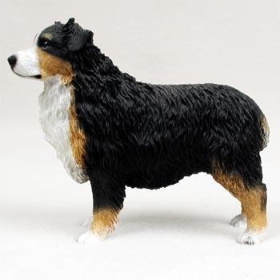
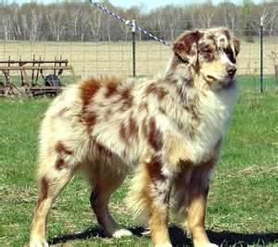
Genes cause behavior? Well, maybe……..!
Look at disorders in dogs: The Merle Coloring Gene
Merle = patterned coloring
Tricolored or bicolored: Dog is black/white or red/white or black/white/red
Merle pattern: diffuses these colors so is more spotted
To get a Merle pattern dog:
Breed a Merle to a Tri or Bicolored:
M m M MM Mm two bi colored
M MM Mm two merles

Slide 11
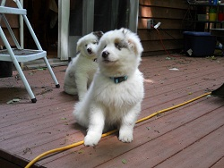
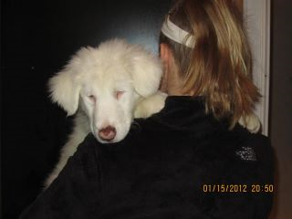
Genes cause behavior?
Now: What if breed two merle with a tri with a merle gene? Or two merles?
M m m m
m Mm mm m mm mm
m Mm mm m mm mm
Great, right? They are all merles (and I make lots of money)
But wait: mm produces:
Deafness
Underdeveloped eyes
Dogs are blind, deaf or both!
So, playing with color produces side effects!

Slide 12
Genes cause behavior? Well, maybe……..!
Human Genome Project also may help understand relation between behavior and genes
Goal: map the location of all genes on the human chromosomes and determine genetic codes: order of the bases on each gene
Only have approximately 20,000 functioning genes- about as many as a roundworm
97% of DNA does not encode proteins- appear to be ‘junk’
Genetic research investigates role of genes in behavior
Fragile X
Huntington’s disease
Bigger question: Is heredity a destiny or a predisposition?

Slide 13
Side trip to understand importance of inheritance
A BRIEF INTRO TO EVOLUTION

Slide 14
Our bodies change over time: Evidence for evolution
Charles Darwin (1809-1882): 1859 book: Origin of Species
argued species originated from other species and eventually become distinct from their ancestors
thus: many animals have common, but very distant, ancestors
Evidence from domesticated plants and animals
breeding programs; hybrid plants, purebred dogs, cats, etc.
Great similarity in body parts across animals: paws, arms, etc.
embryology: most embryos look HIGHLY similar
Fossil records:

Slide 15
Natural Selection: Darwin’s 5 major premises:
Members of particular species have characteristics that vary
Some of these variable characteristics are passed on from parents to siblings
Some of these variable characteristics aid survival
Species produce more offspring that survive to become adults
Characteristics that aid survival will become more common across generations, those that impede survival will die out.

Slide 16
Heritability
Heritability = percentage of variation in a characteristic that can be attributed to genetic factors
Identical twins versus fraternal twins
Intelligence about 50%
60-90% heritability for schizophrenia
40-50% for personality characteristics
90% for height
Appears about ½ of differences in behavioral characteristics are due to heritability
Rest must be due to environment
or interaction of genes and environment
Vulnerability: genes contribute to predispositon for disorder
Must exceed required threshold to elicit disorder
Diathesis stress model
Takes both genetic predisposition AND stress to elicit certain mental disorders such as schizophrenia

Slide 17
Most important take home lesson:
Our brain controls behavior AND
Behavior changes our brain
Two way street
Interactions
These interactions are explainable and able to be scientifically studied.
Genetic traits are important
We inherit dispositions, not inevitabilities.
Genes must interact with environment
Not what WILL happen, but what COULD happen
Takes an eliciting stimulus to turn on/off the gene

Slide 18
Practice Quiz Questions:
Who showed that nerves operate cannot operate like an electric wire because that would be too slow?
Hermann von Hemmholtz
Rene DesCartes
Wilhelm Wundt
Paul Broca

Slide 19
Practice Quiz Questions:
The idea that specific areas of the brain carry only one specific function is called__________.
localization and has shown to be incorrect.
localization and has shown to be correct.
specialization and has shown to be incorrect.
specialization and has shown to be correct.

Slide 20
Practice Quiz Questions:
A proposed mechanism for how things work is called a _______________.
Theory
Mechanism
Model
Predisposition

Slide 21
Practice Quiz Questions:
Extra Credit Question:
A person has a gene that is linked with a disease, but he or she does not have the disease. The book mentions several reasons why this could occur. Describe two of them.

