Slide 1
Dealing with Death and Bereavement
Week 7 Chapter 19 Life Span Development

Slide 2
Guideposts
How do attitudes and customs concerning death differ across cultures, and what are the implication of the “mortality revolution” in developed countries?
How do people deal with dying, and how do they grieve for a loss?
What special challenges are involved in surviving a spouse, a parent, or a child, and in mourning a miscarriage?
How are attitudes toward hastening death changing, and what concerns do such practices raise?
How can people overcome fear of dying and come to terms with death?

Slide 3
Seandainya kamu bisa MENENTUKAN SENDIRI,
Kapan kamu MEMILIH UNTUK meninggal dunia?
Mengapa?
Hypothetical Question

Slide 4
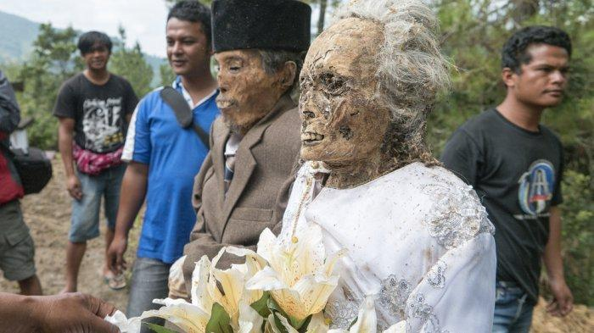
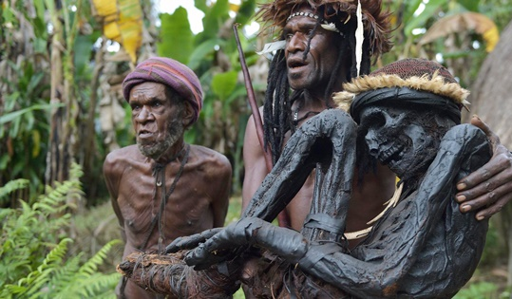
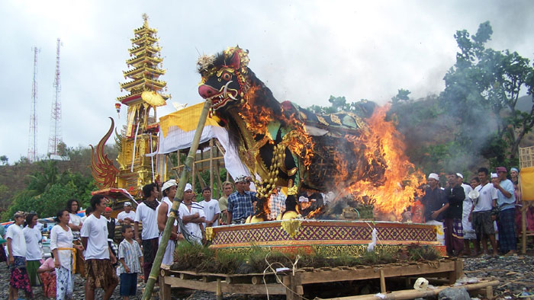
Guidepost 1: How do attitudes and customs concerning death differ across cultures, and what are the implication of the “mortality revolution” in developed countries?
Death = universal experience → yet culture-specific
The Cultural Context
The Mortality Revolution
Thanatology
Hospice Care
Palliative/Comfort Care

Slide 5
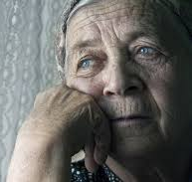
Guidepost 2: How do people deal with dying, and how do they grieve for a loss?
Physical and Cognitive Changes Preceding Death
Terminal Drop/Decline
Confronting One’s Own Death – Kubler-Ross
  Denial
  Anger
  Bargaining for Extra Time
  Depression
  Acceptance

Slide 6
Guidepost 2: How do people deal with dying, and how do they grieve for a loss? (cont.)
Patterns of Grieving
Grief
Bereavement
The Classic Grief Work Model
Shock and disbelief
Preoccupation with the memory of the dead person
Resolution

Slide 7
Guidepost 2: How do people deal with dying, and how do they grieve for a loss? (cont.)
Childhood and Adolescence
Irreversible
Universal
Inevitable
Non-functional
Adulthood
Integrity versus despair
Life review

Slide 8
Guidepost 3: What special challenges are involved in surviving a spouse, a parent, or a child, and in mourning a miscarriage?
Significant Losses
Surviving a Spouse
Losing a Parent in Adulthood
Losing a Child
Mourning a Miscarriage

Slide 9
Guidepost 4: How are attitudes toward hastening death changing, and what concerns do such practices raise?
Suicide
Hastening Death
Passive Euthanasia
Active Euthanasia
Advance Directive (Living Will)
Durable Power of Attorney
Assisted Suicide
Legalizing Physician Aid in Dying
End-of-Life Decisions and Cultural Attitude
End-of-Life Options and Diversity Concerns

Slide 10
World Mental Health Day 2019
Preventing Suicide

Slide 11
EUTHANASIA
PRO
KONTRA

Slide 12
Guidepost 5: How can people overcome fear of dying and come to terms with death?
Reviewing a Life
  Life Review

Slide 13
Hari ini adalah hari terakhirmu
TuliskanLAH
Pesanmu yang terakhir
Hypothetical Situation

Slide 14
Guideposts
How do attitudes and customs concerning death differ across cultures, and what are the implication of the “mortality revolution” in developed countries?
How do people deal with dying, and how do they grieve for a loss?
What special challenges are involved in surviving a spouse, a parent, or a child, and in mourning a miscarriage?
How are attitudes toward hastening death changing, and what concerns do such practices raise?
How can people overcome fear of dying and come to terms with death?

Slide 15
Chuck Palahniuk
We all die.
The goal isn’t to live forever,
the goal is to create something that will.

