Slide 1
Personality & Lifestyles
Aldiansyah Yulianto (Teknik Sipil)
Nisrina Imsaskia (Psikologi)
Riesta Vidya Putri P. (Psikologi)

Slide 2
Personality

Slide 3
Consumer Behaviour on the couch: Freudian Theory
Freudian Systems
id
Superego
Ego
Pleasure principle
Penyeimbang id
Penengah id dan superego
Maximise pleasure, avoid pain
Reality principle
hubungan antara simbolisme produk dan motivasi
produk mewakili tujuan konsumen, yg secara sosial tidak dapat diterima

Slide 4
Motivational research
alasan motivational research memiliki daya tarik yang besar untuk pasar:
motivational research cenderung lebih mural daripada data survey kuantitatif karena wawancara dan pengolahan data biaya relatif minim.
pengetahuan yang berasal dari penelitian motivasi mungkin dapat membantu mengembangkan komunikasi pemasaran yang menarik bagi kebutuhan yang mendalam.
beberapa temuan tampaknya intuitif masuk akal.

Slide 5
Ernest Dichter: Motif utama dalam konsumsi
motif | produk terkait
power-masculinity-virility | power; produk gala dan sarapan besar, kereta listrik, mobil balap masculinity-virility; kopi, pistol mainan, membeli perhiasan untuk wanita, mencukur dengan pisau cukur
security | es krim, laci penuh kemeja disetrika rapi, masakan rumah, perawatan rumah sakit
eroticism | permen, sarung tangan, pria menyalakan api pada rokok wanita
moral-purity-cleanliness | roti putih, kain katun, mandi, oatmeal
social acceptance | companionship; es krim, coffee love & affection; mania, madu dan gala acceptance; sabun, produce kecantikan
individuality | mobil asing, pipa rokok, vodka, perfume, pulpen
status | scotch: maag, serangan jantung, gangguan pencernaan; karpet
feminity | kue dan biscuit, boneka, teh, barang antik di rumah
reward | rokok, permen, alkohol, es krim, biskuit
mastery over environment | peralatan dapur, kapal, korek api, barang-barang olahraga
disalienation | dekorasi rumah, siaran radio pagi
magic mystery | sup, lukisan, vodka, membuka kado

Slide 6
Neo-freudian theories
Karen Horney
Carl Jung
Jung percaya bahwa orang dibentuk oleh pengalaman kumulatif dari generasi masa lalu.
Compliant
Detached
Aggressive
kenangan bersama
Archetypes

Slide 7
Trait Theory
Personality Traits
beberapa ciri khusus yang relevan dengan consumer behaviour:
inovatif
materialism
kesadaran diri
are you an ‘innie’ or an ‘outie’?
salah satu personality traits yang dapat diukur adalah kebutuhan untuk keunikan
4. kebutuhan kognisi
5. kehematan
inner-directed
outer-directed

Slide 8
Beberapa penelitian baru-baru ini meneliti perbedaan konsumsi antara individu;
idiocentrics & allocentrics. Perbedaan antara kedua jenis kepribadian ini, yaitu:
contentment
health consciousness
food preparation
workaholics
travel and entertainment

Slide 9
Problems with Trait Theory in Consumer Research
banyak skala yang tidak cukup valid atau terpercaya
tes kepribadian lebih sering dikembangkan untuk populasi tertentu
seringkali tes tidak diberikan pada kondisi yang sesuai
para peneliti sering membuat perubahan dalam instrumen untuk beradaptasi mereka untuk situasi mereka sendiri, dalam proses menghapus atau menambahkan item dan penggantian nama variable.
banyak skala sifat yang ditujukan untuk mengukur kecenderungan keseluruhan kotor; hasil ini kemudian digunakan untuk membuat prediksi tentang pembelian merek tertentu
dalam banyak kasus, beberapa skala diberikan tanpa dipikirkan terlebih dahulu tentang bagaimana langkah-langkah ini harus berkaitan dengan consumer behaviour

Slide 10
Brand Personality
Brand Equity
how do people think about brands?
beberapa dari advertiser melakukan riset konsumen yang luas untuk membantu mereka memahami bagaimana konsumen terhubung ke sebuah merek sebelum mereka menggelar kampanye.
dimensi kepribadian yang dapat digunakan untuk membandingkan karakteristik yang dirasakan merek dalam berbagai kategori produk;
old-fashioned, bermanfaat, tradisional
mengejutkan, intelligent, efisien
glamor, romantis, sexy
kasar, ketat, atletik

Slide 11
kreasi dan komunikasi dari kepribadian merek khusus adalah salah satu cara utama pemasar dapat membuat produk menonjol dari kompetisi dan menginspirasi years of loyalty animism
ada dua tipe animism:
level 1 orang percaya benda tersebut dimiliki oleh suatu jiwa makhluk
level 2 benda yang diberikan karakteristik manusia.

Slide 12
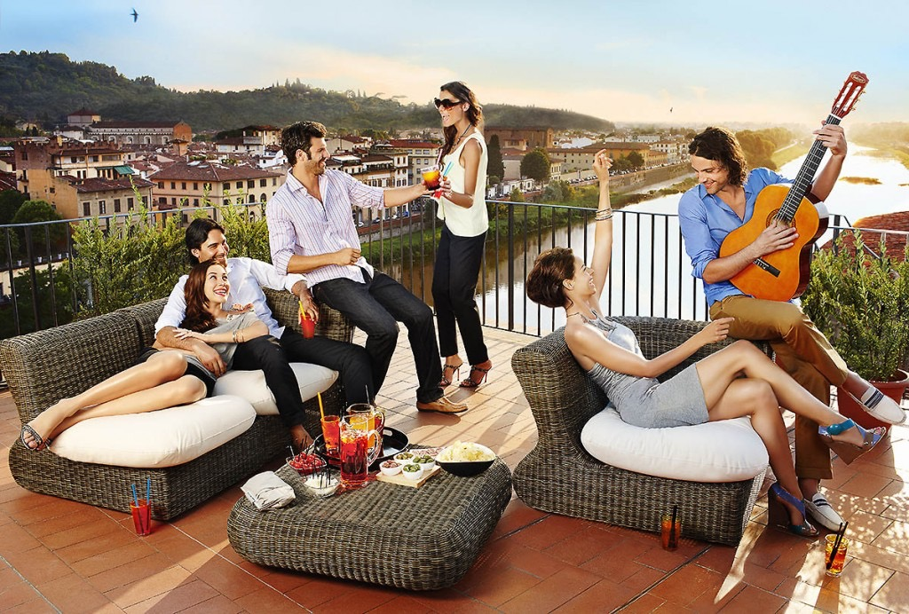
LIFESTYLES AND PSYCHOGRAPHICS

Slide 13
LIFESTYLE: WHO WE ARE WHAT WE DO
Lifestyle refers to a pattern of consumption reflecting a person’s choice how she (he) spends time and money. In an economic sense, her lifestyle represents the way she has elected to allocate income, both in terms of relative allocations to different products and servicess and to specific alternatives within these categories.

Slide 14
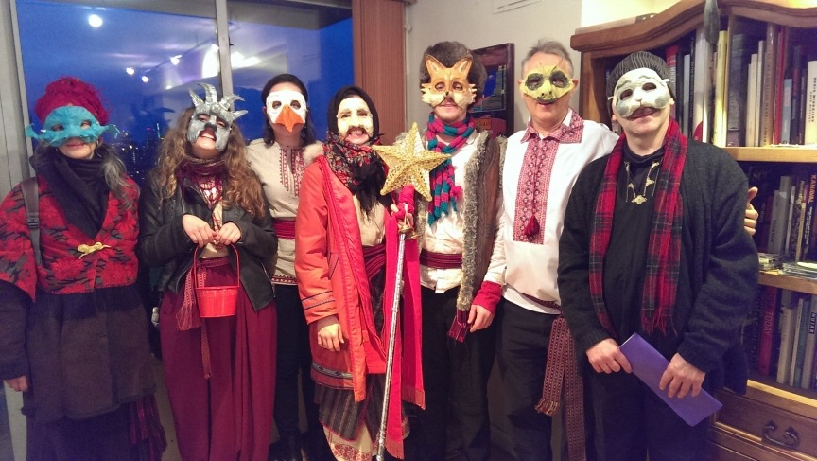
LIFESTYLE AS GROUP IDENTITIES
Economic approaches are useful for tracking changes in broad societal priorities, but they do not begin to embrace the symbolic nuances the separate lifestyle group. lifestyle is more than the allocation of discretionary income. it is the statement about who in in society and who one is not. Group identities, wether hobbyists, athletes or drug user, gel around forms of expressive symbolism. The self definitions of group members are derived from the common symbol system to which the group is dedicated.

Slide 15
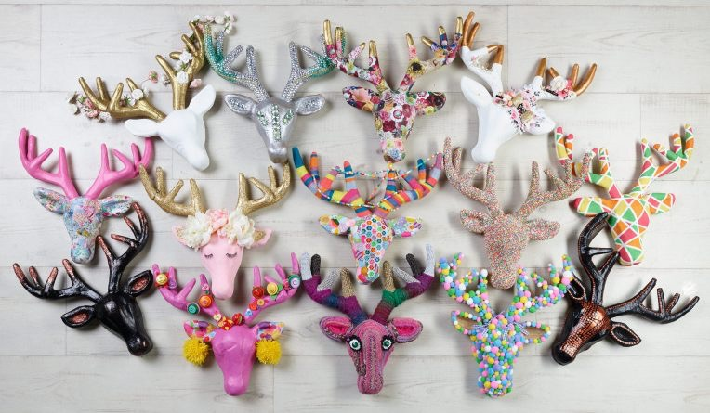
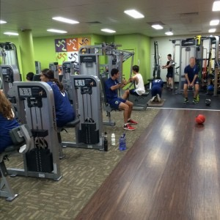
SMALL BUSINESS AS LIFESTYLE PROVIDER
CRAFT TRENDS
SPORTS LIFESTYLE

Slide 16
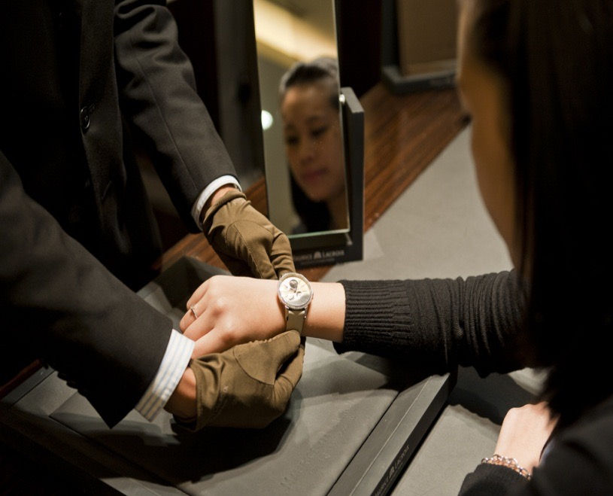
PRODUCTS ARE THE BUILDING BLOCKS OF LIFESTYLES
A goal of lifestyle marketting is to allow consumers to pursue their choosen ways to enjoy their lives and express their social identities, a key aspect of this strategy is to focus on product usage in desirable social settings.

Slide 17
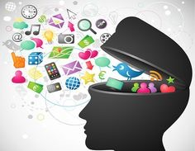
PSYCHOGRAPHICS
Psychographics is the study of personality, values, opinions, attitudes, interests, and lifestyles. Because this area of research focuses on interests, attitudes, and opinions, psychographic factors are also called IAO variables. Psychographic studies of individuals or communities can be valuable in the fields of marketing, demographics, opinion research, prediction, and social research in general

Slide 18
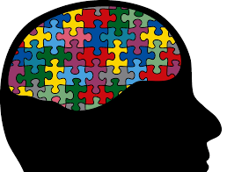
THE ROOTS OF PSYCHOGRAPHICS
Psychographics research was first developed in the 1960s and 1970s the short comings of two other types of consumer research: motivational research and quantitative survey research.

Slide 19
DOING PSYCHOGRAPHICS ANALYSIS
Psychographics studies can take several differents forms:
A lifestyle profile looks for items that differentiate between users and non-users of a product
A product-specific profile identifies a target group and then profiles these consumers on product-relevant dimensions
A general lifestyle segmentation places a large sample of respondents of homogenous groups based of similarities of their overall preferences
A product-specific segmentation tailors questions to a product category

Slide 20
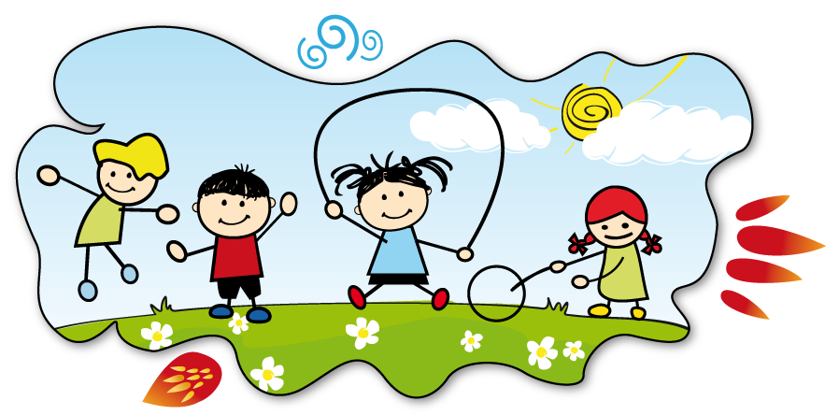
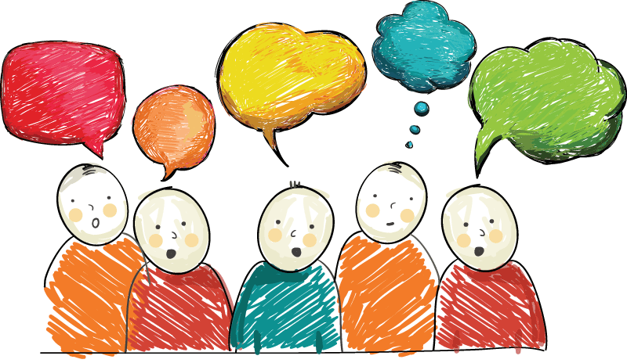
AI0S
ACTIVITIES
INTERESTS
OPINIONS

Slide 21
Uses of psychographic segmentation
TO DEFINE THE TARGET MARKET
TO CREATE A NEW VIEW OF THE MARKET
TO POSITION THE PRODUCT
TO BETTER COMMUNICATE PRODUCT ATTRIBUTES
TO DEVELOP OVERALL STRATEGY
TO MARKET SOCIAL AND POLITICAL ISSUES

Slide 22
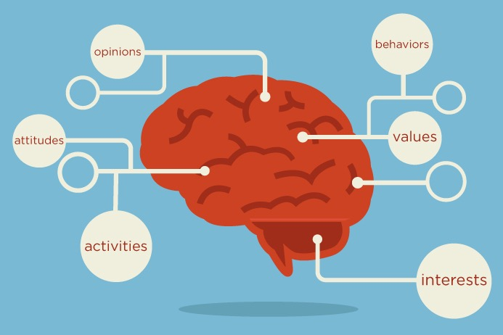
PSYCHOGRAPHIC SEGMENTATION TYPOLOGIES
Marketers are consultantly on the prowl for new insights that will allow them to identify and reach groups of consumers that are united by a common lifestyle. To meet this need, many research companies and advertising agencies have developed their own segmentation typologies.

Slide 23
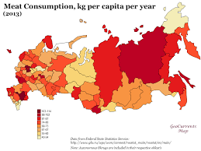
Regional Consumption Differences

Slide 24
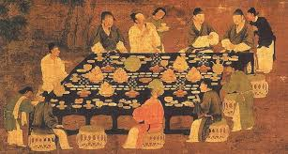
Food Cultures
A food culture is a pattern of food and beverage consumption that reflects the values of a social group.

Slide 25
Geodemography
Geodemography refers to analitycal techniques that combine data on consumer expenditures and other socioeconomic factors with geographic information about the areas in which people live, in order to identify consumers who share common consumption patterns.

Slide 26
Single-source Data
Several marketing research ventures now employ Single-source Data, in which information about a person’s actual purchasing history is combined with geodemographic data, thus allowing marketes to learn even more about the types of marketing strategies that motivate some people-but not others-to respond.

