Slide 1

Establishing Strategic Pay Plans
By:
Ester Aprilia Lalenoh
Manuel Bias Azhari
Riski Basith

Slide 2

List The basic factors determining pay rates
Employee compensation
Direct financial payment
Indirect financial payment

Slide 3


Aligning total rewards with strategy

Slide 4
Equity and its impact on pay rates
Equity theory of motivation
External equity
Procedural equity
Internal equity
Individual equity

Slide 5

Addresing equity issues

Slide 6
1. DAVID BACON ACT 1931
2. WALS HEALEY PUBLIC CONTRACT ACT 1936
3. THE VII OF THE 1964 CIVIL RIGHTS ACT
4. FAIR LABOR STANDARDS ACT 1938
5. EXEMPT/NONEXEMPT
6. 1961 EQUAL PAY ACT
7. 1974 EMPLOYEE RETIREMENT INCOME SECURITY ACT
Legal consideration in compensation

Slide 7
Other legislation affecting compensation
Union influences on compensation decision
GEOGRAPHY
Pay policies

Slide 8
Define and give an example of how to conduct a job evaluation
Job evaluation methods
Compensable factors
Prepraring for the job evaluation
Job evaluation methods
Ranking
Select and group jobs
Obtain job information
Select compensable factors
Rank job
Combine ratings

Slide 9

Job evaluation methods
Job classification
Job evaluation methods
Point methods
Computerized job evaluations

Slide 10

1. Choose Benchmark Jobs
2. Select Compensable Factors
3. Assign Weights to compensable factors
4. Convert percentages to points for each factor
5. Define each factor’s degrees
6. Determine for each factor its factor degrees’ point
7. Review job descriptions and job specifications
8. Evaluate the job
HOW TO CREATE A MARKET-COMPETITIVE PAY PLAN
16 Steps

Slide 11
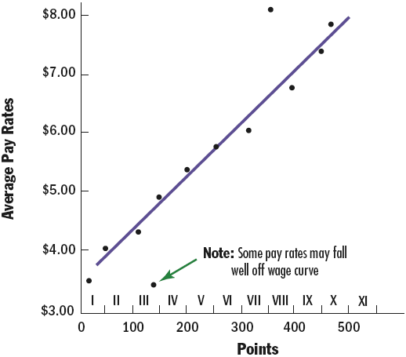

8.Evaluate the jobs
WHAT IS A MARKET-COMPETITIVE PAY PLAN?
Market-competitive pay system
WHAT ARE WAGE CURVES?

Slide 12

1. Choose Benchmark Jobs
2. Select Compensable Factors
3. Assign Weights to compensable factors
4. Convert percentages to points for each factor
5. Define each factor’s degrees
6. Determine for each factor its factor degrees’ point
7. Review job descriptions and job specifications
8. Evaluate the job
HOW TO CREATE A MARKET-COMPETITIVE PAY PLAN
9. Draw the current (internal) wage curve
10. Conduct a Market Analysis : Salary Survey
11. Draw the Market (Exsternal) Wage Curve
12. Compare and Adjust Current and Market Wage Rates for Jobs
13. Develop Pay Grades

Slide 13

13. Develop Pay Grades
Pay (or wage) Grade
Determining the number of pay grades

Slide 14
1. Choose Benchmark Jobs
2. Select Compensable Factors
3. Assign Weights to compensable factors
4. Convert percentages to points for each factor
5. Define each factor’s degrees
6. Determine for each factor its factor degrees’ point
7. Review job descriptions and job specifications
8. Evaluate the job
HOW TO CREATE A MARKET-COMPETITIVE PAY PLAN
9. Draw the current (internal) wage curve
10. Conduct a Market Analysis : Salary Survey
11. Draw the Market (Exsternal) Wage Curve
12. Compare and Adjust Current and Market Wage Rates for Jobs
13. Develop Pay Grades
14. Establish Rate Ranges

Slide 15
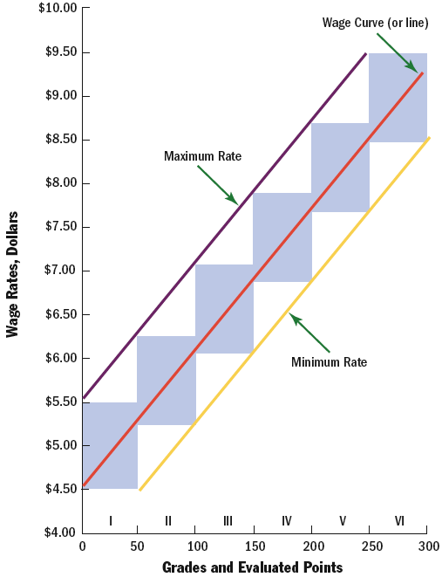
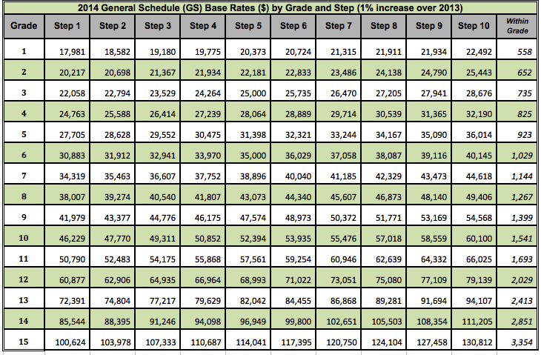
14. Establish Rate Ranges
Developing Rate Ranges

Slide 16
1. Choose Benchmark Jobs
2. Select Compensable Factors
3. Assign Weights to compensable factors
4. Convert percentages to points for each factor
5. Define each factor’s degrees
6. Determine for each factor its factor degrees’ point
7. Review job descriptions and job specifications
8. Evaluate the job
HOW TO CREATE A MARKET-COMPETITIVE PAY PLAN
9. Draw the current (internal) wage curve
10. Conduct a Market Analysis : Salary Survey
11. Draw the Market (Exsternal) Wage Curve
12. Compare and Adjust Current and Market Wage Rates for Jobs
13. Develop Pay Grades
14. Establish Rate Ranges
15. Address Remaining Jobs
16. Correct Outof-Line Rates

Slide 17

Pricing Managerial and Professional Jobs
Compensating Executives and Managers
Base Pay
Short-term incentives
Long-term incentives
Executive Benefits and perks
What Determines Executive Pay?
Job Complexity
Ability To Pay
Human Capital
Managerial Job Evaluation
Compensating Professional Employees

Slide 18
Explain the diffrence between competency-based and traditional pay plans !
CONTEMPORARY TOPICS IN COMPENSATION
Competency-Based Pay
WHAT IS COMPETENCY-BASED PAY?
WHY USE COMPETENCY-BASED PAY?
COMPETENCY-BASED PAY?
COMPETENCY-BASED PAY IN PRACTICE
GENERAL MILLS EXAMPLE
THO BOTTOM LINE ON COMPETENCY-BASED PAY

Slide 19
List and explain six important trends in compensation management!
Broadbanding
- PROS AND CONS
Actively Managing Compensation Allocations, and Talent Management
Comparable Worth
- THE PAY GAP

Slide 20
Board Oversigth of Executive Pay
Total Rewards and Tomorrow’s Pay Programs
Improving Productivity through HRIS

Slide 21
THANKYOU

