Slide 1

Employee Testing and Selection
CHAPTER 6
200
Dini Arifiani 2014021021
Erwin Winarjo 2014021002
Erwin.winarjo@student.upj.ac.id

Slide 2

201
Explain what is meant by reliability and validity.
Explain how you would go about validating test.
Cite and illustrate our testing guidelines.
Give examples of some of the ethical and legal considerations in testing
List eight test you could use for employee selection, and how you would use them.
Give two examples of work sample/simulation test.
Explain the key points to remember in conducting background investigations.

Slide 3


202
WHY CAREFUL SELECTION IS IMPORTANT ?
PERFORMANCE
LEGAL OBLIGATIONS
COST

Slide 4

Person and Job or Organization Fit
202

Slide 5
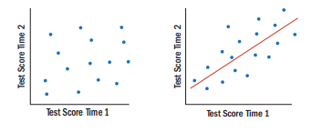
203
1. Explain what is mean by reliability and validity
Basic Testing Concepts
• Reliability

Slide 6

204-205
Validity
Test Validity
Criterion Validity
Content Validity
Construct Validity

Slide 7
206-207
2. Explain how you would go about validating a test
HOW TO VALIDATE A TEST
5 STEPS

Slide 8
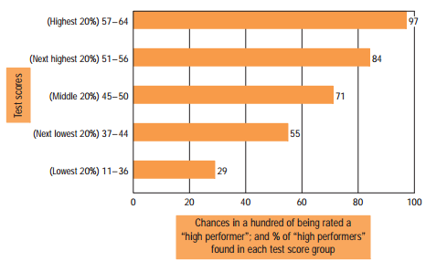
206-207
Step 1. Analyze the Job
Step 2. Choose The Test
Step 3. Administer The Test
Step 5. Cross-Validate and Revalidate
Step 4. Relate your test Scores and Criteria

Slide 9
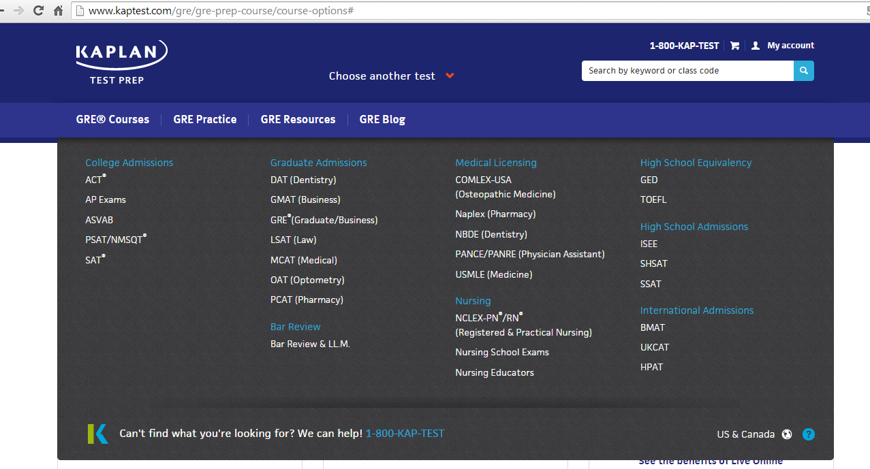
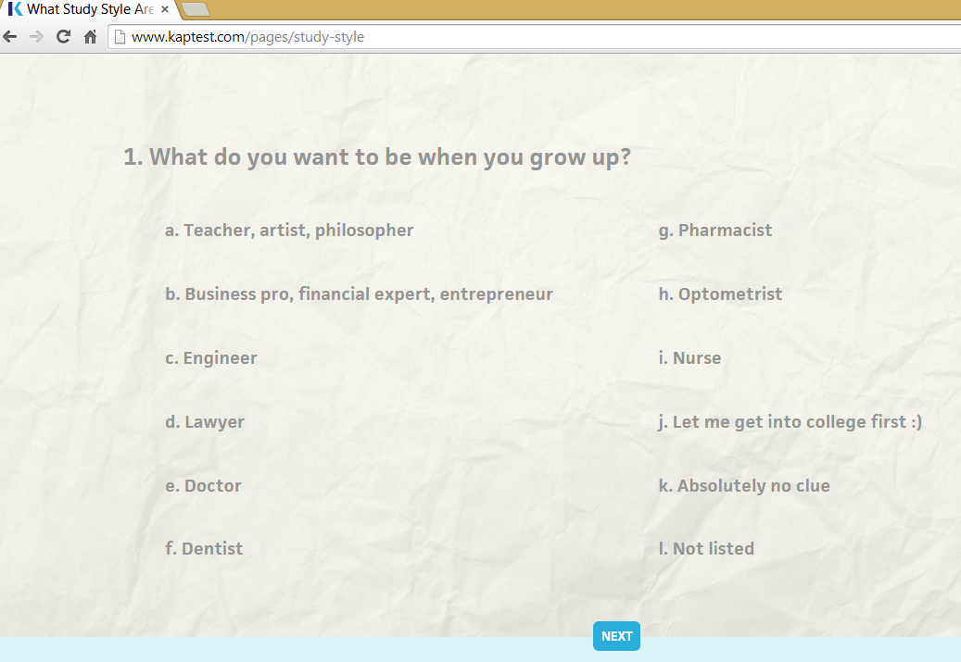
Example step 2 : Choose the test (GRE)

Slide 10
208-209
3. Cite and Ilustrate our Testing Guidelines
Who scores the test?
Bias
Validity Generalization
Utility Analysis

Slide 11
209-211
4. Give Example of some the Ethical and legal Considerations in testing.
Privacy Issues
Test Takers’ Individual Right and Test Security
OUTBACK STEAK HOUSE EXAMPLE
How Do Employers Use Test At Work?
CITY GARAGE EXAMPLE
Computerized and Online Testing

Slide 12
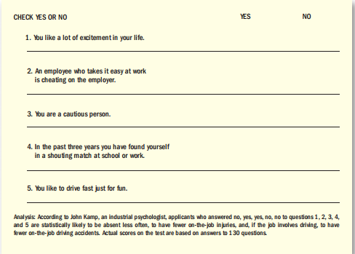
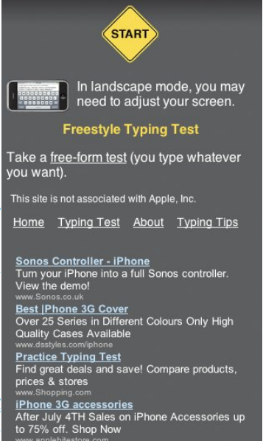

OUTBACK STEAK HOUSE EXAMPLE
210-212
Computerized and Online Testing

Slide 13
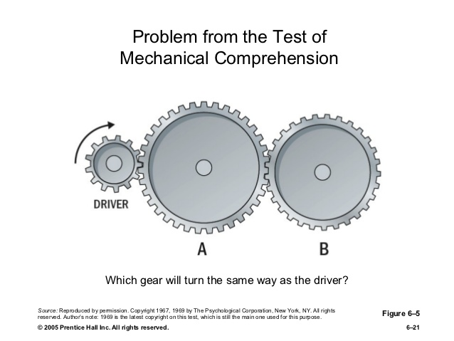

212-216
TYPE OF TESTS
Cognitive Abilities
Intelligence Test
Specific Cognitive Abilities
Motor and Physical Abilities
Personality and Interest or Achievement
Personality Test
Achievement Test

Slide 14
215
THE BIG FIVE
Agreeableness
Conscientiouness
Emotional Stability
Openness to Experience
Extraversion

Slide 15


215
DO PERSONALITY TEST PREDICT PERFORMANCE ?
INTEREST INVENTORIES

Slide 16
216
WORK SAMPLES AND SIMULATION
Situational Testing and Video-Based Situational Testing
Management Assessment Centers
Situational Judgment Test
Using Work Sampling for Employee Selection
Computerized Multimedia Candidate Assessment Tools
The Miniature Job Training and Evaluation Approach
Realistic Job Previews
HR in Practice: Testing Techniques for Managers
EFFECTIVENESS
HONDA EXAMPLE

Slide 17
BACKGROUND INVESTIGATIONS
AND OTHER SELECTION METHODS
220
Why Perform Background Investigations and Reference Checks?
Why Check?
EFFECTIVENESS

Slide 18


The Legal Dangers and How to Avoid Them
221-222

Slide 19
222-224
How to Check a Candidate’s Background
The Social Network: Checking Applicants’ Social Postings

Slide 20
MAKING THE BACKGROUND CHECK MORE VALUABLE
224
STATEMENT FOR APPLICANT TO SIGN EXPLICITLY AUTHORIZING A BACKGROUND CHECK
1.
RELY ON TELEPHONE REFRENCE & USE A FORM
2.
PERSISTENCE ANG ATTENTIVENESS TO POTENTIAL RED FLAGS IMPROVE RESULT
3.
COMPARE THE APPLICATION TO THE RESUME
4.
TRY YO ASK OPEN-ENDED QUESTION
5.
USE THE REFERENCE OFFERED BY THE APLICANT AS SOURCE FOR OTHER REFRENCE
6.

Slide 21
Using Preemployment Information Services
225
DISCLOSURE AND AUTHORIZATION
CERTIFICATION
1.
2.
PROVIDING COPIES OF REPORTS
NOTICE AFTER ADVERSE ACTION
3.
4.

Slide 22
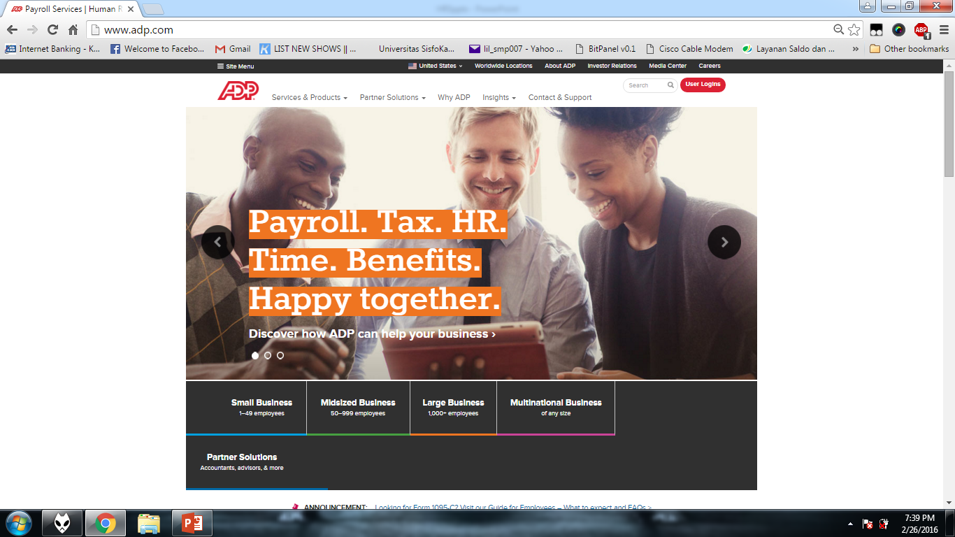


Slide 23
The Polygraph and Honesty Testing
225
WHO CAN USE THE POLYGRAPH?
Four Standards
SUFFERED AN ECONOMIC LOSS OR INJURY
REASONABLE SUSPICION
HAD ACCESS TO THE PROPERTY
RECEIVE THE DETAILS BEFORE TEST

Slide 24

226
Ask blunt questions
Listen, rather than talk
Do a credit check
Check all employment and personal references
Use paper-and-pencil honesty test and psychological test
Test for drugs
Establish a search-and-seizure policy and conduct searchs
HONESTY TEST
CHECKING FOR HONESTY

Slide 25


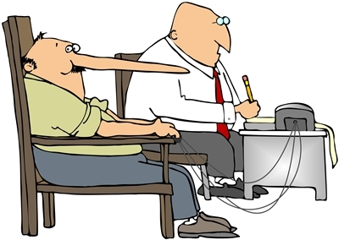
227
Graphology
Human Lie Detector

Slide 26


Physical Exams
227

Slide 27
Substance Abuse Screening
228
SOME PRACTICAL CONSIDERATIONS
LEGAL ISSUES
WHAT DO IF AN EMPLOYEE TESTS POSITIVE

Slide 28


229
Complying with Imigration Law
PROOF OF ELIGIBILITY
AVOIDING DISCRIMINATION

Slide 29
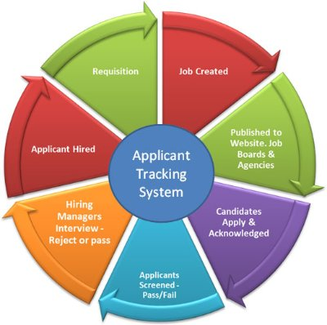
Improving Productivity Through HRIS
230

Slide 30


