Slide 1


Slide 2

 “The most important part of a player’s body is about his shoulders.”
– Ty Cobb
 “What you are thinking, what shape your mind is in, is what makes the biggest
difference of all.”
-Bobby Jones
 “Mental toughness is not being affected by anything but what’s going on in the game or competition no matter what coaches, other players, or refs are doing. It’s being able to block out what’s not important.”
-Jenny Brenden

Slide 3
Definition of Mental Toughness
 Mental toughness is having developed psychological edge that enables you to be more
consistent, determined, focused, confiden t, and in control under pressure.
 It can make the difference between a victory and defeat.

Slide 4

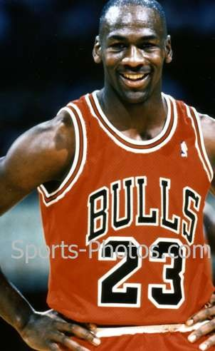
Example
Michael Jordan was cut from his high school basketball team, but he did not give up there. He stayed focused and determined and worked hard to improve. And he became one of the best basketball players there ever was. His story represents mental toughness because he could have given up when he was cut from the high school team, but he stayed strong and achieved his dream of being a great basketball player.

Slide 5
Law of Dominant Thought
 What is running through the athletes mind.
 Negative, positive or neutral thoughts.
 It is important to control your thoughts because your actions tend to follow your thoughts.
 Example:
 If a basketball player is thinking, “don’t miss
this free throw,” their dominant thought is
“don’t miss” and they are more likely to miss the free throw.

Slide 6
Distractions
 Our minds are always running.
 “task conscious”
 Focusing on the present
 Need to block out distractions because may cause stress and frustration.
 Our minds our like a television…
 The wrong channel could pop up at the wrong time, but it you don’t like what your seeing then change the channel.

Slide 7
Distraction Technique
 Athletes need to control his or her mind.
 technique:
 Pick a word that calms you down and relaxes you when times get hard or you notice that you are getting frustrated.
 This technique will help you stay engaged at all times.

Slide 8
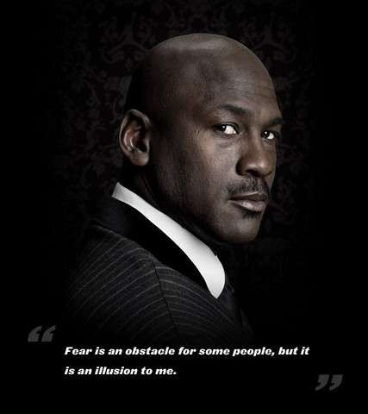
“Fear is an obstacle for some people, but it is an illusion to me.”
Fear
Fear can hold back any athlete from success. It can make you tense up and inhibit you from playing to your full potential.

Slide 9
Fear of Failure
 Some athletes get nervous that they will look stupid if they fail.
 According to research, humans are the only species that get in the way of our own growth.
 “Failure is the best teacher in the world… you get to learn from what happens to you- both good and bad- in a real-life situation.”
-Greg Maddux

Slide 10

Pressure
“Under pressure, people can perform fifteen percent better of fifteen percent
worse.”
-Schott Hamilton

Slide 11
Under Pressure
 Can cause athletes to become tense and not play his or her game.
 If you are mentally tough, pressure will not change the way you play the game.
 Athletes let the pressure get to them when they don’t know what they are doing.
 “The only pressure that I’m under is the
pressure I put on myself.”
-Mark Messier

Slide 12

7 Characteristics of Mental Toughness

Slide 13
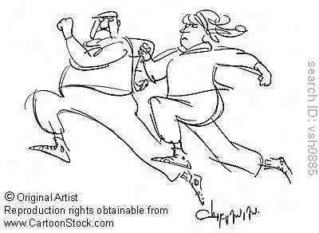
Competitive
Being competitive is always finding way to win and doing whatever it
takes, They make the best of the obstacles thrown at them and push themselves that much more.

Slide 14

Confidence
Athletes need to have a positive can-do attitude. Players need to believe they are the best so others will respect them as well.

Slide 15
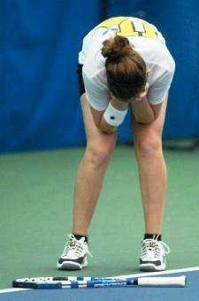
Control
Athletes need to make sure that they control their emotions because humans are very emotional in everything we do. You need to make sure you control yourself especially under pressure.

Slide 16

Commitment
All athletes need to be 100 percent committed to their sport and getting better.
They need to keep their eyes on the prize and stay away from any distractions.

Slide 17
Composure
 Keep your cool when the heat is on.
 Athletes can’t afford to freak out when
times get hard.
 They need to be able to deal with the pressure and keep fighting.

Slide 18
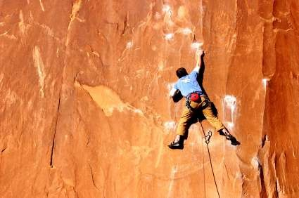
Courage
Every athlete needs to be strong enough that they can take risks. The only way they will continue to get better is if they challenge themselves.

Slide 19
Consistency
 All athletes need to be consistent because they need to push themselves every single game or match that they play.
 To get the respect they need to prove to people that they are good and consistent.

Slide 20
The End!
Hope you learned a little about Mental Toughness and thank you for watching!

